Slide 1


Slide 2

WARM UP

Slide 3

Work in pairs
Do you like history?
List down some people from the history that you know and admire

Slide 4

.Period 70:
Unit 7: MOVIES
Lesson 3.1 – NEW WORDS + LISTENING

Slide 5
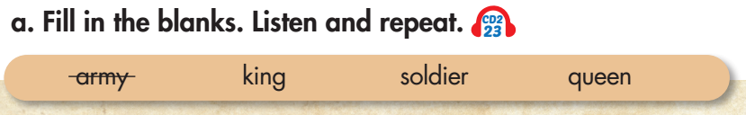
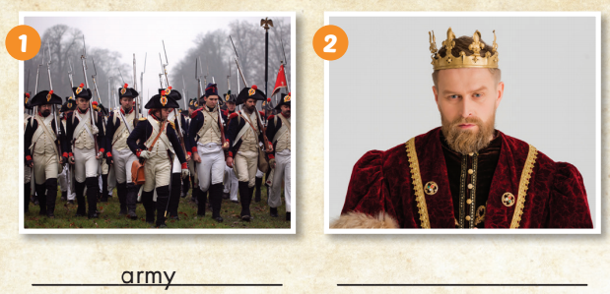
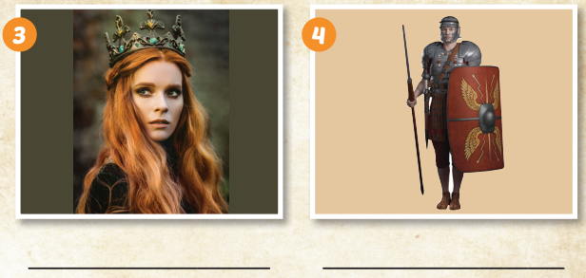

King
Queen
soldier

Slide 6
Listen and repeat.
Army (n) /ˈɑːrmi/ quân đội
King (n) /kɪŋ/ nhà vua
Queen (n) /kwiːn/ nữ hoàng, hoàng hậu
Soldier (n) /ˈsoʊldʒə/ binh lính

Slide 7
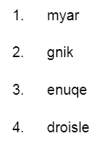
Rearrange the letters to make a correct word.
Army
King
Queen
Soldier

Slide 8
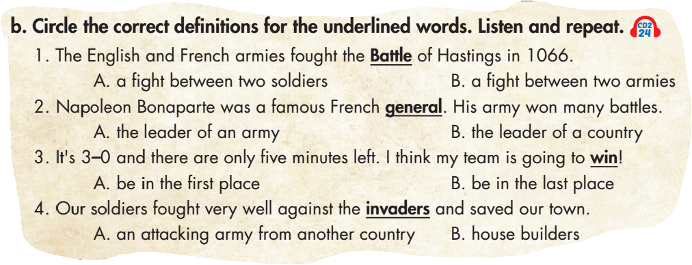

Slide 9
Listen and repeat.
battle (n) /ˈˈbætl/ trận chiến
general (n) /ˈdʒenrəl/ vị tướng
win (v) /wɪn/ chiến thắng
invaders (n) /ɪnˈveɪdərz/ kẻ xâm lược

Slide 10

The Bạch Đằng River is a famous Battle.

Slide 11

Listening

Slide 12
Do you often watch movie?
2. Do you watch a movie about history?

Slide 13
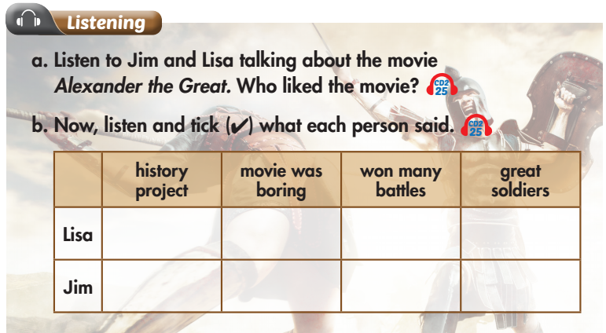

Slide 14
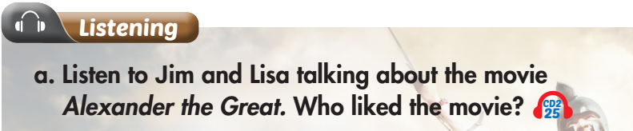
Underline the key words to know what we are going to do?

Slide 15
While-Listening
Listen. What is your answer?
Jim
Lisa
Jim: Yeah, I did. I thought Alexander was cool but the movie was too long. I thought it was boring.
Lisa: I thought it was great. He was a great king. And, I didn't know he won so many battles. I thought it was really interesting.

Slide 16
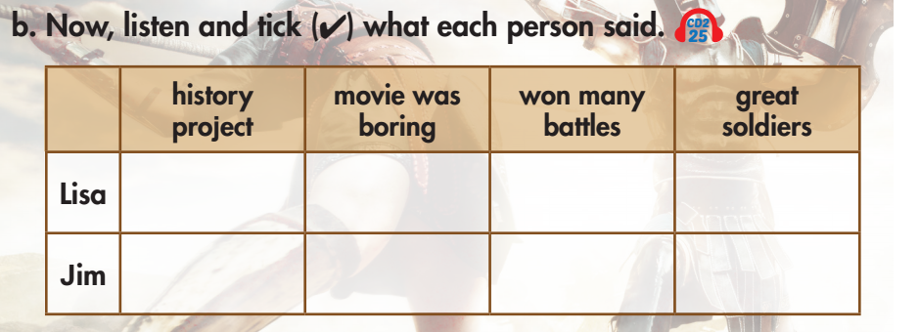
Pre-Listening
b. Underline the key words. What are we going to do?

Slide 17
While-Listening
Now listen and stick.  FIRST TIME

Slide 19
While-Listening
Let’s check.  SECOND TIME
Jim: I'm good, thanks, Lisa. How about you?
Lisa: I'm great. Hey, did you watch the movie for our history project?

Slide 20
While-Listening
Let’s check.  SECOND TIME
Jim: Yeah, I did. I thought Alexander was cool but the
movie was too long. I thought it was boring.

Slide 21
While-Listening
Let’s check.  SECOND TIME
Lisa: I thought it was great. He was a great king. And, I didn't know he won so many battles. I thought it was really interesting.

Slide 22
While-Listening
Let’s check.  SECOND TIME
Lisa: And his soldiers were great. They were so good at fighting.

Slide 23
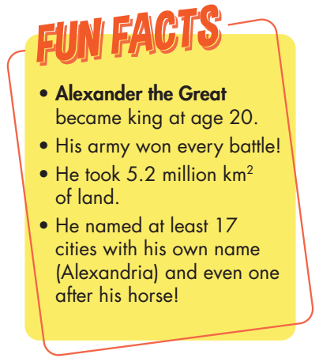

Slide 24
Practice the conversation with your friend
Lisa: Hi, Jim, how are you?
Jim: I'm good, thanks, Lisa. How about you?
Lisa: I'm great. Hey, did you watch the movie for our history project?
Jim: Yeah, I did. I thought Alexander was cool but the movie was too long. I thought it was boring.
Lisa: I thought it was great. He was a great king. And, I didn't know he won so many battles. I thought it was really interesting.
Jim: Yeah, Alexander was really clever. He always knew how to win.
Lisa: And his soldiers were great. They were so good at fighting.
Jim: Yeah, they were a big help!
Narrator: Now, listen again and check.

Slide 25
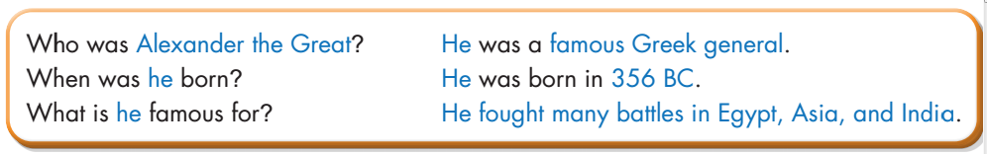
☞ Practice with your friends

Slide 26
Lesson 3
Today’s lesson
Listening:
Listen to people talking about movies and identify main idea and specific information.
Vocabularies
army
king
soldier
queen
Battle
general
win
invader
Practice:
Talking about a person from history.
Asking and answering questions about a famous person from history.

Slide 27
Lesson 3
Homework
Learn by hearts vocabularies and make sentences using them.
Do the exercises on page 42 WB
Do the exercises in Tiếng Anh 6 i-Learn Smart World Notebook on page 45
Prepare the next lesson (page 61 SB)
Play the consolidation games in Tiếng Anh 6 i-Learn Smart World DHA App on www.eduhome.com.vn

Slide 28

Enjoy your day!

