Slide 1


Slide 2
MATCHING
Army (n) : - Vua
Soldier (n): - Nữ hoàng
King (n) : - Kẻ xâm lược
Battle (n): - Quân đội
General (n): - Chiến thắng
Queen (n) : - Binh lính
Invaders (n): - Vị tướng
Win – won (v) : - Trận chiến

Slide 3

.Period 71:
Unit 7: MOVIES
Lesson 3.2
READING – SPEAKING - WRITING

Slide 4
1. NEW WORDS:
Được sinh ra
- Was born (v) :
- Become – became (v):
Trở thành
- Attack - ( ed) (v):
Tấn công
- Come - came (v):
Đến
- Ride – rode (v):
Cưỡi , đi (xe đạp)
- Century (n):
Thế kỷ
- Female (n):
Nữ
-Make – made :
Làm

Slide 5
READING
Read Phuong's movie review and fill in blanks.
soldiers king general Battle army invaders Người Anh Hùng Áo Vải: The story of Quang Trung
Phương Lê, March 20
I watched an animated movie about Quang Trung. It was really cool! Quang Trung was a famous Vietnamese king. He was born in 1753. He was a great (1) general. In 1785, he and his soldiers fought against an (2) ________from the south. He won many battles and became (3) ________in 1788. The next year, (4) ________attacked again. Two armies came from the north and Quang Trung went with his (5) ________to meet them. He rode on an elephant and won the great (6) ________of Ngọc Hồi - Đống Đa in 1789. Người Anh Hùng Áo Vải was a very interesting movie about Vietnamese history, and the animation was great.
army
king
invaders
soldiers
Battle

Slide 6
READING
I watched an animated movie about Quang Trung. It was really cool! Quang Trung was a famous Vietnamese king. He was born in 1753. He was a great (1) general. In 1785, he and his soldiers fought against an (2) army from the south. He won many battles and became (3) king in 1788. The next year, (4) invaders attacked again. Two armies came from the north and Quang Trung went with his (5) soldiers to meet them. He rode on an elephant and won the great (6) battle of Ngọc Hồi - Đống Đa in 1789. Người Anh Hùng Áo Vải was a very interesting movie about Vietnamese history, and the animation was great.
b. Read and write “True” or “False”.
1. ___Quang Trung was born in 1788.
2. ___His army fought against an army from the south in 1789.
3. ___He fought invaders from the north before he became king
4. ___He won a great battle on the back of an elephant.
F
F
F
T

Slide 7
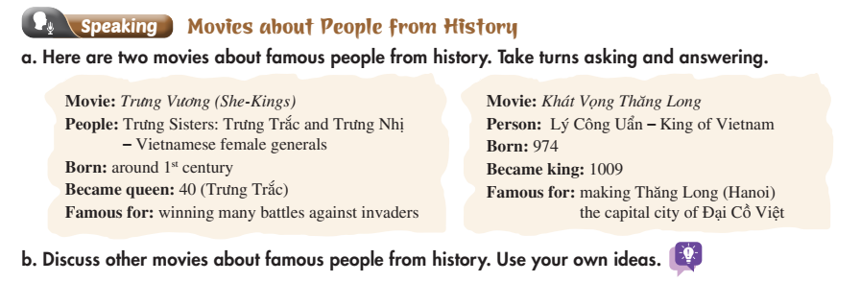
Lesson 3

Slide 8
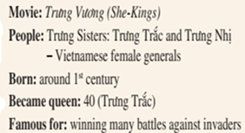
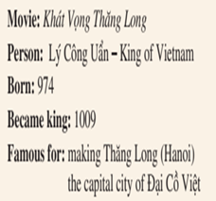
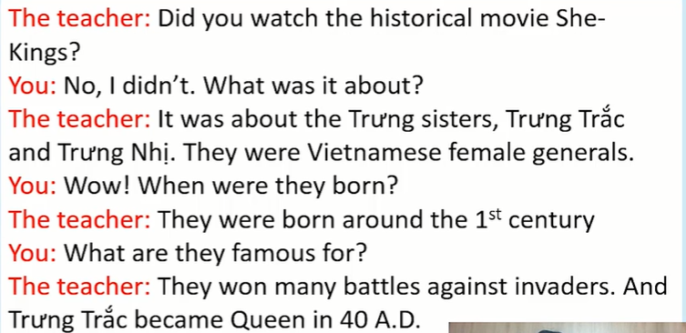

Lesson 3
It was about Trưng Sisters: Trưng Trắc
and Trưng Nhị - Vietnamese female generals.
What were they famous for?

Slide 10
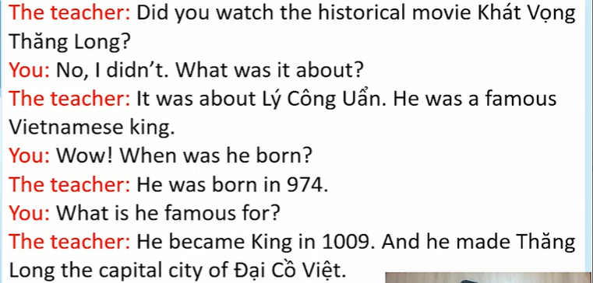

Slide 11
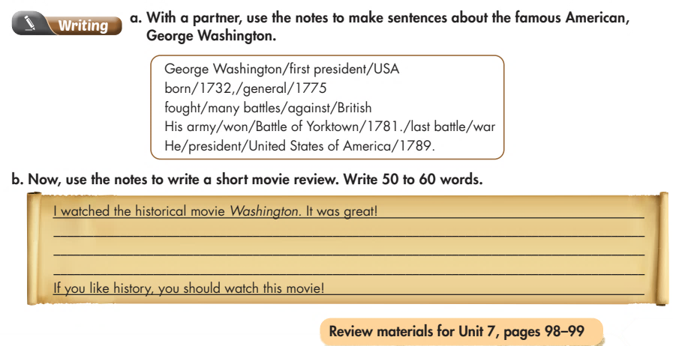
Lesson 3

Slide 12
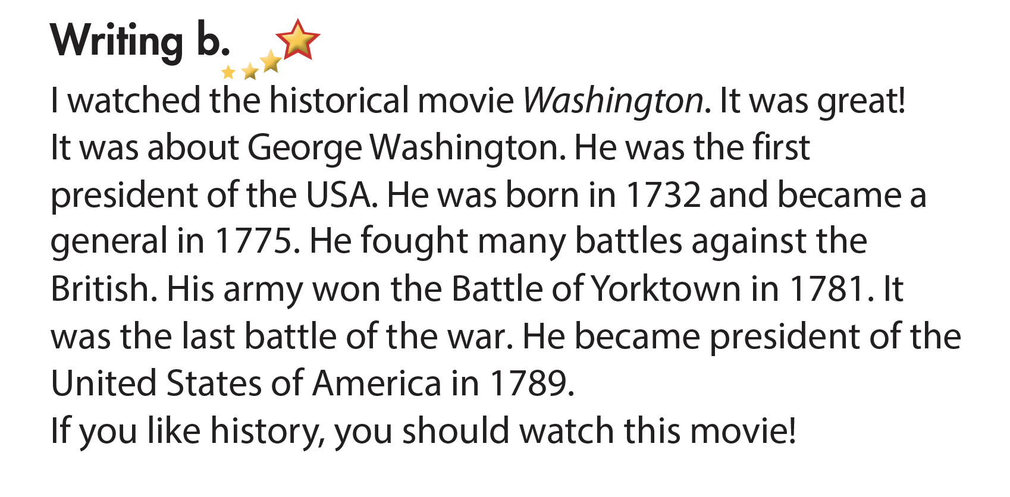
Lesson 3

Slide 13

HOMEWORK
- Practice asking and answering movies about famous people from history.
- Write a short movie review (b) - page 61 in the notebook.
- New lesson: Review

Slide 14


