Slide 1
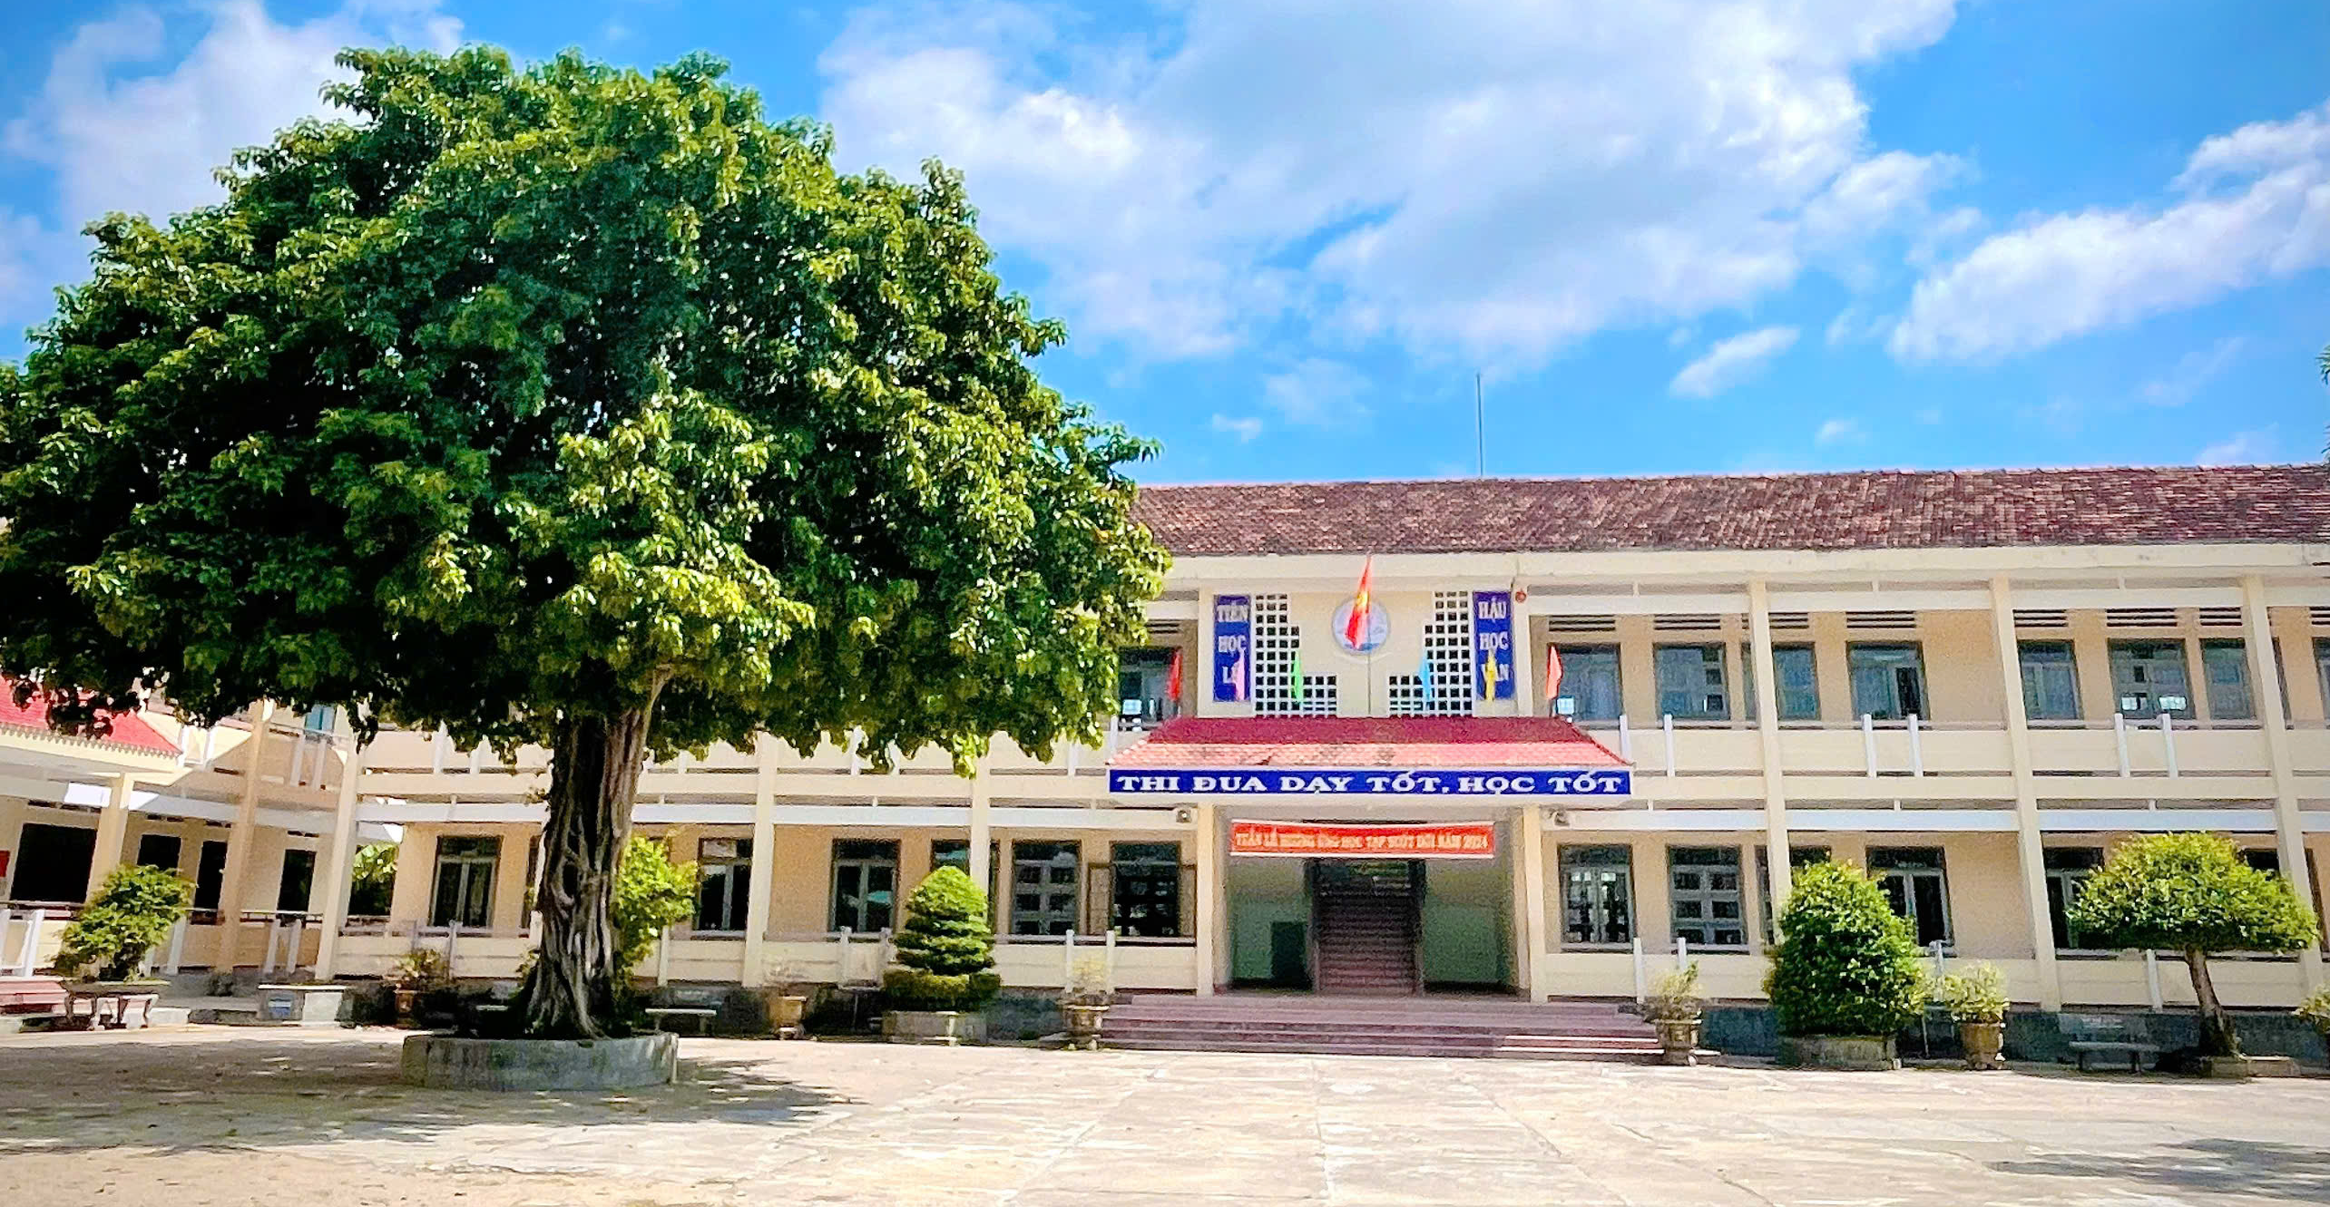
Binh Hoa Secondary School
Good morning Everybody
WELCOME TO OUR CLASS
Bùi Thị Minh Thảo

Slide 2
TOURISM
Lesson 1
NEW WORDS & READING

Slide 3
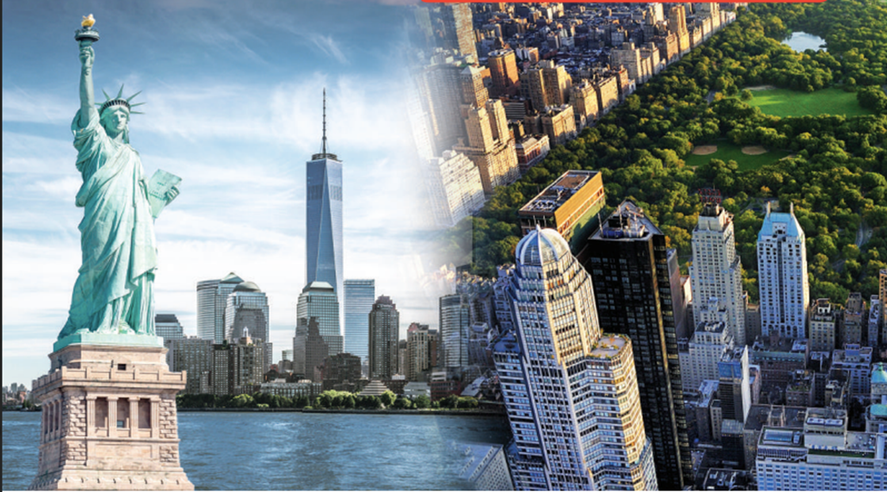
Monday, November 25th, 2024
Unit 4: TOURISM
Lesson 1: NEW WORDS AND READING
Work in pairs. Look at the pictures
1. What famous city can you see?
I see New York city.
2. Where would you most like to travel in the world?
I want to travel in the United States.
3. What would you like to see there?
I want to see the Statue of Liberty.

Slide 4
Monday, November 25th, 2024
Unit 4: TOURISM
Lesson 1: NEW WORDS AND READING
Work in pairs. Look at the pictures
1. What famous city can you see?
I see New York city.
2. Where would you most like to travel in the world?
I want to travel in the United States.
3. What would you like to see there?
I want to see the Statue of Liberty.

Slide 6
Monday, November 25th, 2024
Unit 4: TOURISM
Lesson 1: NEW WORDS AND READING
Let’s Talk! Work in pairs. Look at the pictures
1. I see New York city.
2. I want to travel in the United States.
3. I want to see the Statue of Liberty.
New words

Slide 7
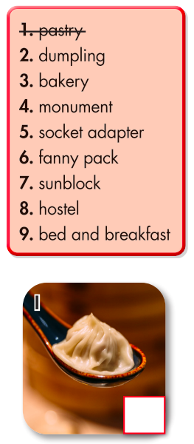
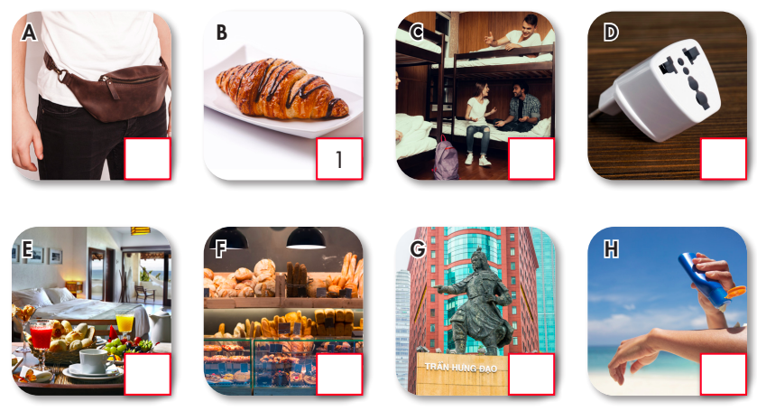
Monday, November 25th, 2024
Unit 4: TOURISM
Lesson 1: NEW WORDS AND READING
New words
a. Number the pictures. Listen and repeat.

Slide 8
Monday, November 25th, 2024
Unit 4: TOURISM
Lesson 1: NEW WORDS AND READING
New words
a. Number the pictures. Listen and repeat.
6
8
5
9
3
4
7
2

Slide 9
Monday, November 25th, 2024
Unit 4: TOURISM
Lesson 1: NEW WORDS AND READING
New words
a. Number the pictures. Listen and repeat.
bakery (n) /ˈbeɪkəri/ tiệm bánh
bed and breakfast (n phr) /ˌbed ən ˈbrekfəst/ nhà trọ, khách sạn kèm bữa sáng
dumpling (n) /ˈdʌmplɪŋ/ sủi cảo, há cảo
fanny pack(n phr) /ˈfæni ˌpæk/ túi bao tử
hostel (n) /ˈhɑːstl/ nhà trọ, nhà nghỉ giá rẻ
monument (n) /ˈmɑːnjəmənt/ tượng đài
pastry(n) /ˈpeɪstri/ bánh ngọt, bánh bột nhào
socket adapter (n phr) /ˈsɑːkɪt əˈdæptər/ bộ chuyển đổi ổ cắm điện
sunblock (n) /ˈsʌnblɑːk/ kem chống nắng
Notes:
GV click vào từng cụm nghe âm thanh

Slide 10
Monday, November 25th, 2024
Unit 4: TOURISM
Lesson 1: NEW WORDS AND READING
New words
a. Number the pictures. Listen and repeat.
1. B 2. L 3. F 4. G 5. D 7. H 8. C 9. E
bakery (n) tiệm bánh
bed and breakfast (n phr) nhà trọ, khách sạn kèm bữa sáng
dumpling (n) sủi cảo, há cảo
fanny pack (n phr) túi bao tử
hostel (n) nhà trọ, nhà nghỉ giá rẻ
monument (n) tượng đài
pastry (n) bánh ngọt, bánh bột nhào
socket adapter (n phr) bộ chuyển đổi ổ cắm điện
sunblock (n) kem chống nắng
Notes:
GV click vào từng cụm nghe âm thanh

Slide 11
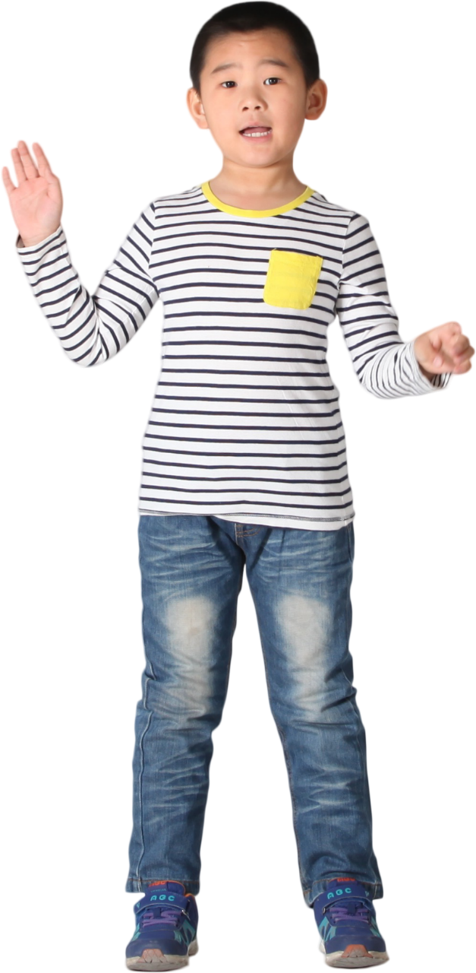
Monday, November 25th, 2024
Unit 4: TOURISM
Lesson 1: NEW WORDS AND READING
New words
b. In pairs: Write the new words in the table and add more words you know. Use the new words to talk about your past vacations.
hostel
bed and breakfast
hotel
- pastry
- dumpling
- cake
- bakery
- monument
- museum
- socket adapter
- fanny pack
- sunblock
- phone charger

Slide 12
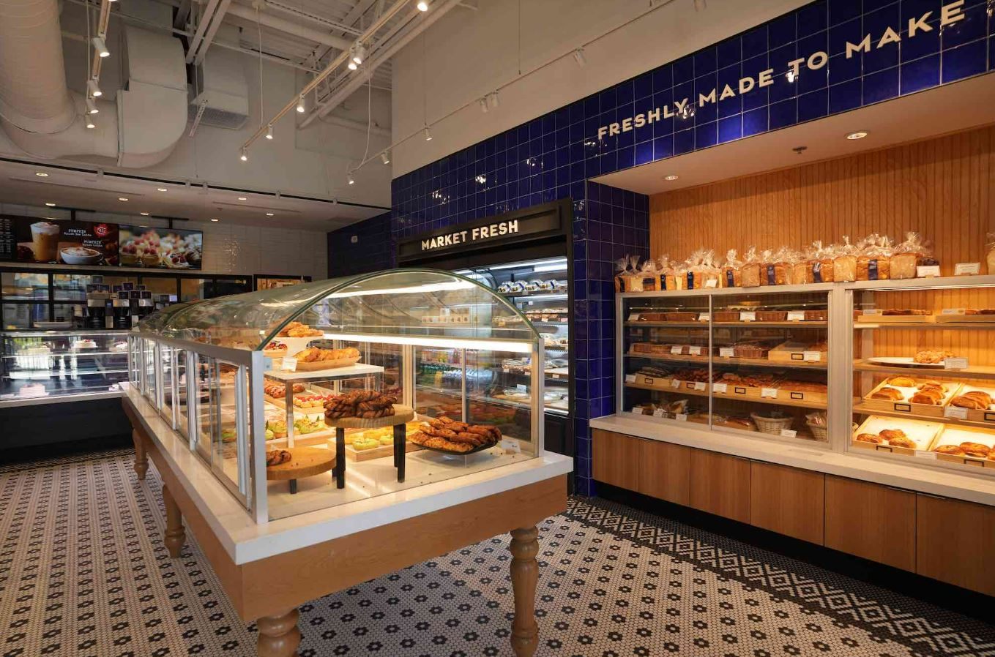
Monday, November 25th, 2024
Unit 4: TOURISM
Lesson 1: NEW WORDS AND READING
New words
b. In pairs: Talk about your past vacations.
hostel
bed and breakfast
hotel
- pastry
- dumpling
- cake
- bakery
- monument
- museum
- socket adapter
- fanny pack
- sunblock
- phone charger
1. I went to the bakery to buy some bread.

Slide 13
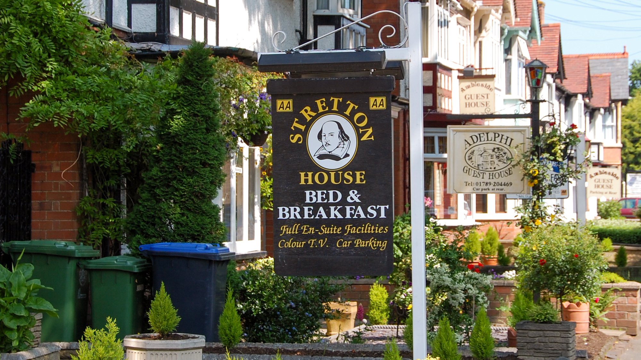
Monday, November 25th, 2024
Unit 4: TOURISM
Lesson 1: NEW WORDS AND READING
New words
b. In pairs: Talk about your past vacations.
hostel
bed and breakfast
hotel
- pastry
- dumpling
- cake
- bakery
- monument
- museum
- socket adapter
- fanny pack
- sunblock
- phone charger
2. At the bed and breakfast, I tried a homemade cake.

Slide 14
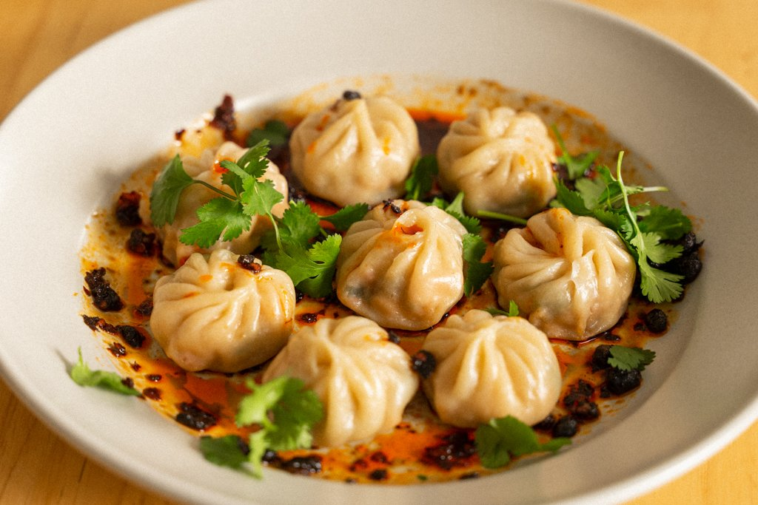
Monday, November 25th, 2024
Unit 4: TOURISM
Lesson 1: NEW WORDS AND READING
New words
b. In pairs: Talk about your past vacations.
hostel
bed and breakfast
hotel
- pastry
- dumpling
- cake
- bakery
- monument
- museum
- socket adapter
- fanny pack
- sunblock
- phone charger
3. My favorite meal was a dumpling I had at lunch.

Slide 15
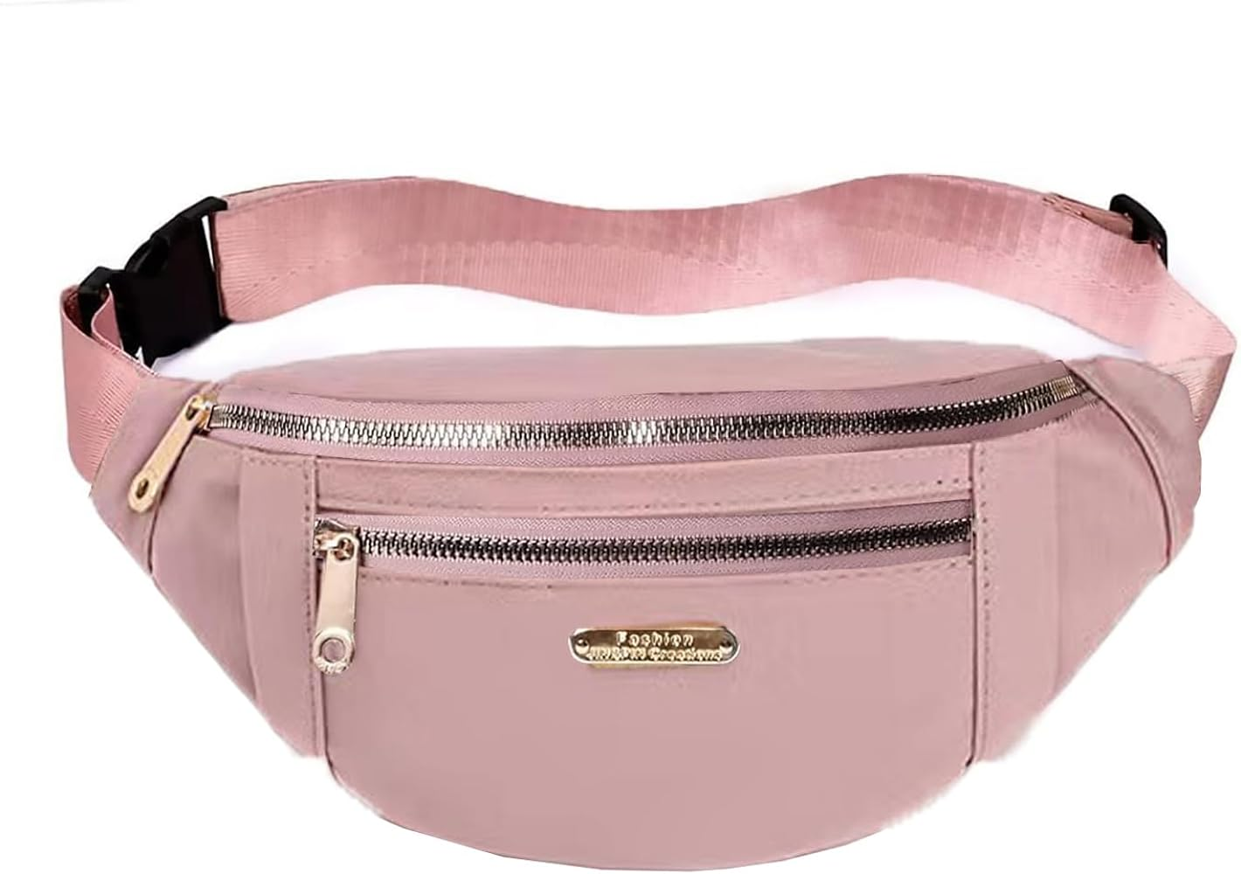
Monday, November 25th, 2024
Unit 4: TOURISM
Lesson 1: NEW WORDS AND READING
New words
b. In pairs: Talk about your past vacations.
hostel
bed and breakfast
hotel
- pastry
- dumpling
- cake
- bakery
- monument
- museum
- socket adapter
- fanny pack
- sunblock
- phone charger
4. I carried my phone charger in my fanny pack.

Slide 16
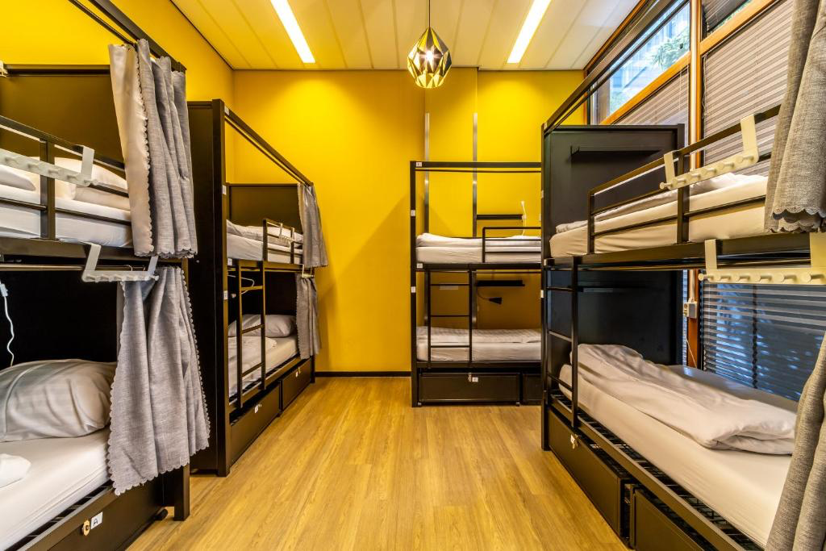
Monday, November 25th, 2024
Unit 4: TOURISM
Lesson 1: NEW WORDS AND READING
New words
b. In pairs: Talk about your past vacations.
hostel
bed and breakfast
hotel
- pastry
- dumpling
- cake
- bakery
- monument
- museum
- socket adapter
- fanny pack
- sunblock
- phone charger
5. The hostel we stayed was built 5 years ago.

Slide 17
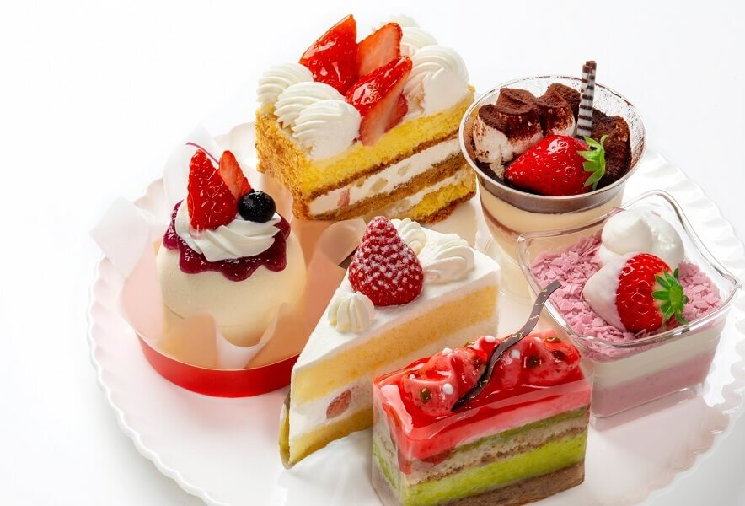
Monday, November 25th, 2024
Unit 4: TOURISM
Lesson 1: NEW WORDS AND READING
New words
b. In pairs: Talk about your past vacations.
hostel
bed and breakfast
hotel
- pastry
- dumpling
- cake
- bakery
- monument
- museum
- socket adapter
- fanny pack
- sunblock
- phone charger
6. I ate a lot of pastry after dinner.

Slide 18
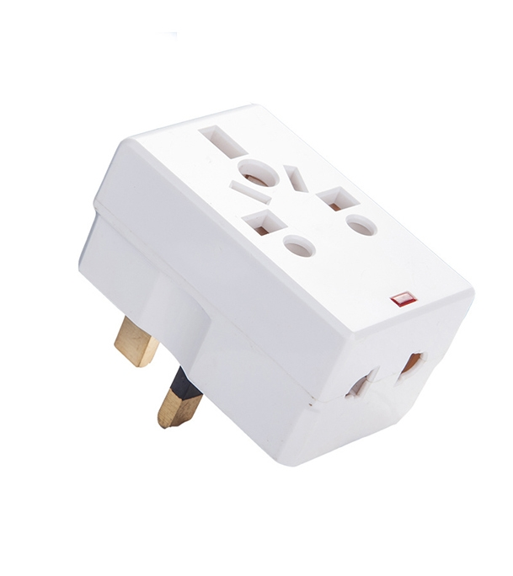
Monday, November 25th, 2024
Unit 4: TOURISM
Lesson 1: NEW WORDS AND READING
New words
b. In pairs: Talk about your past vacations.
hostel
bed and breakfast
hotel
- pastry
- dumpling
- cake
- bakery
- monument
- museum
- socket adapter
- fanny pack
- sunblock
- phone charger
7. I took a socket adapter to charge my devices.

Slide 19
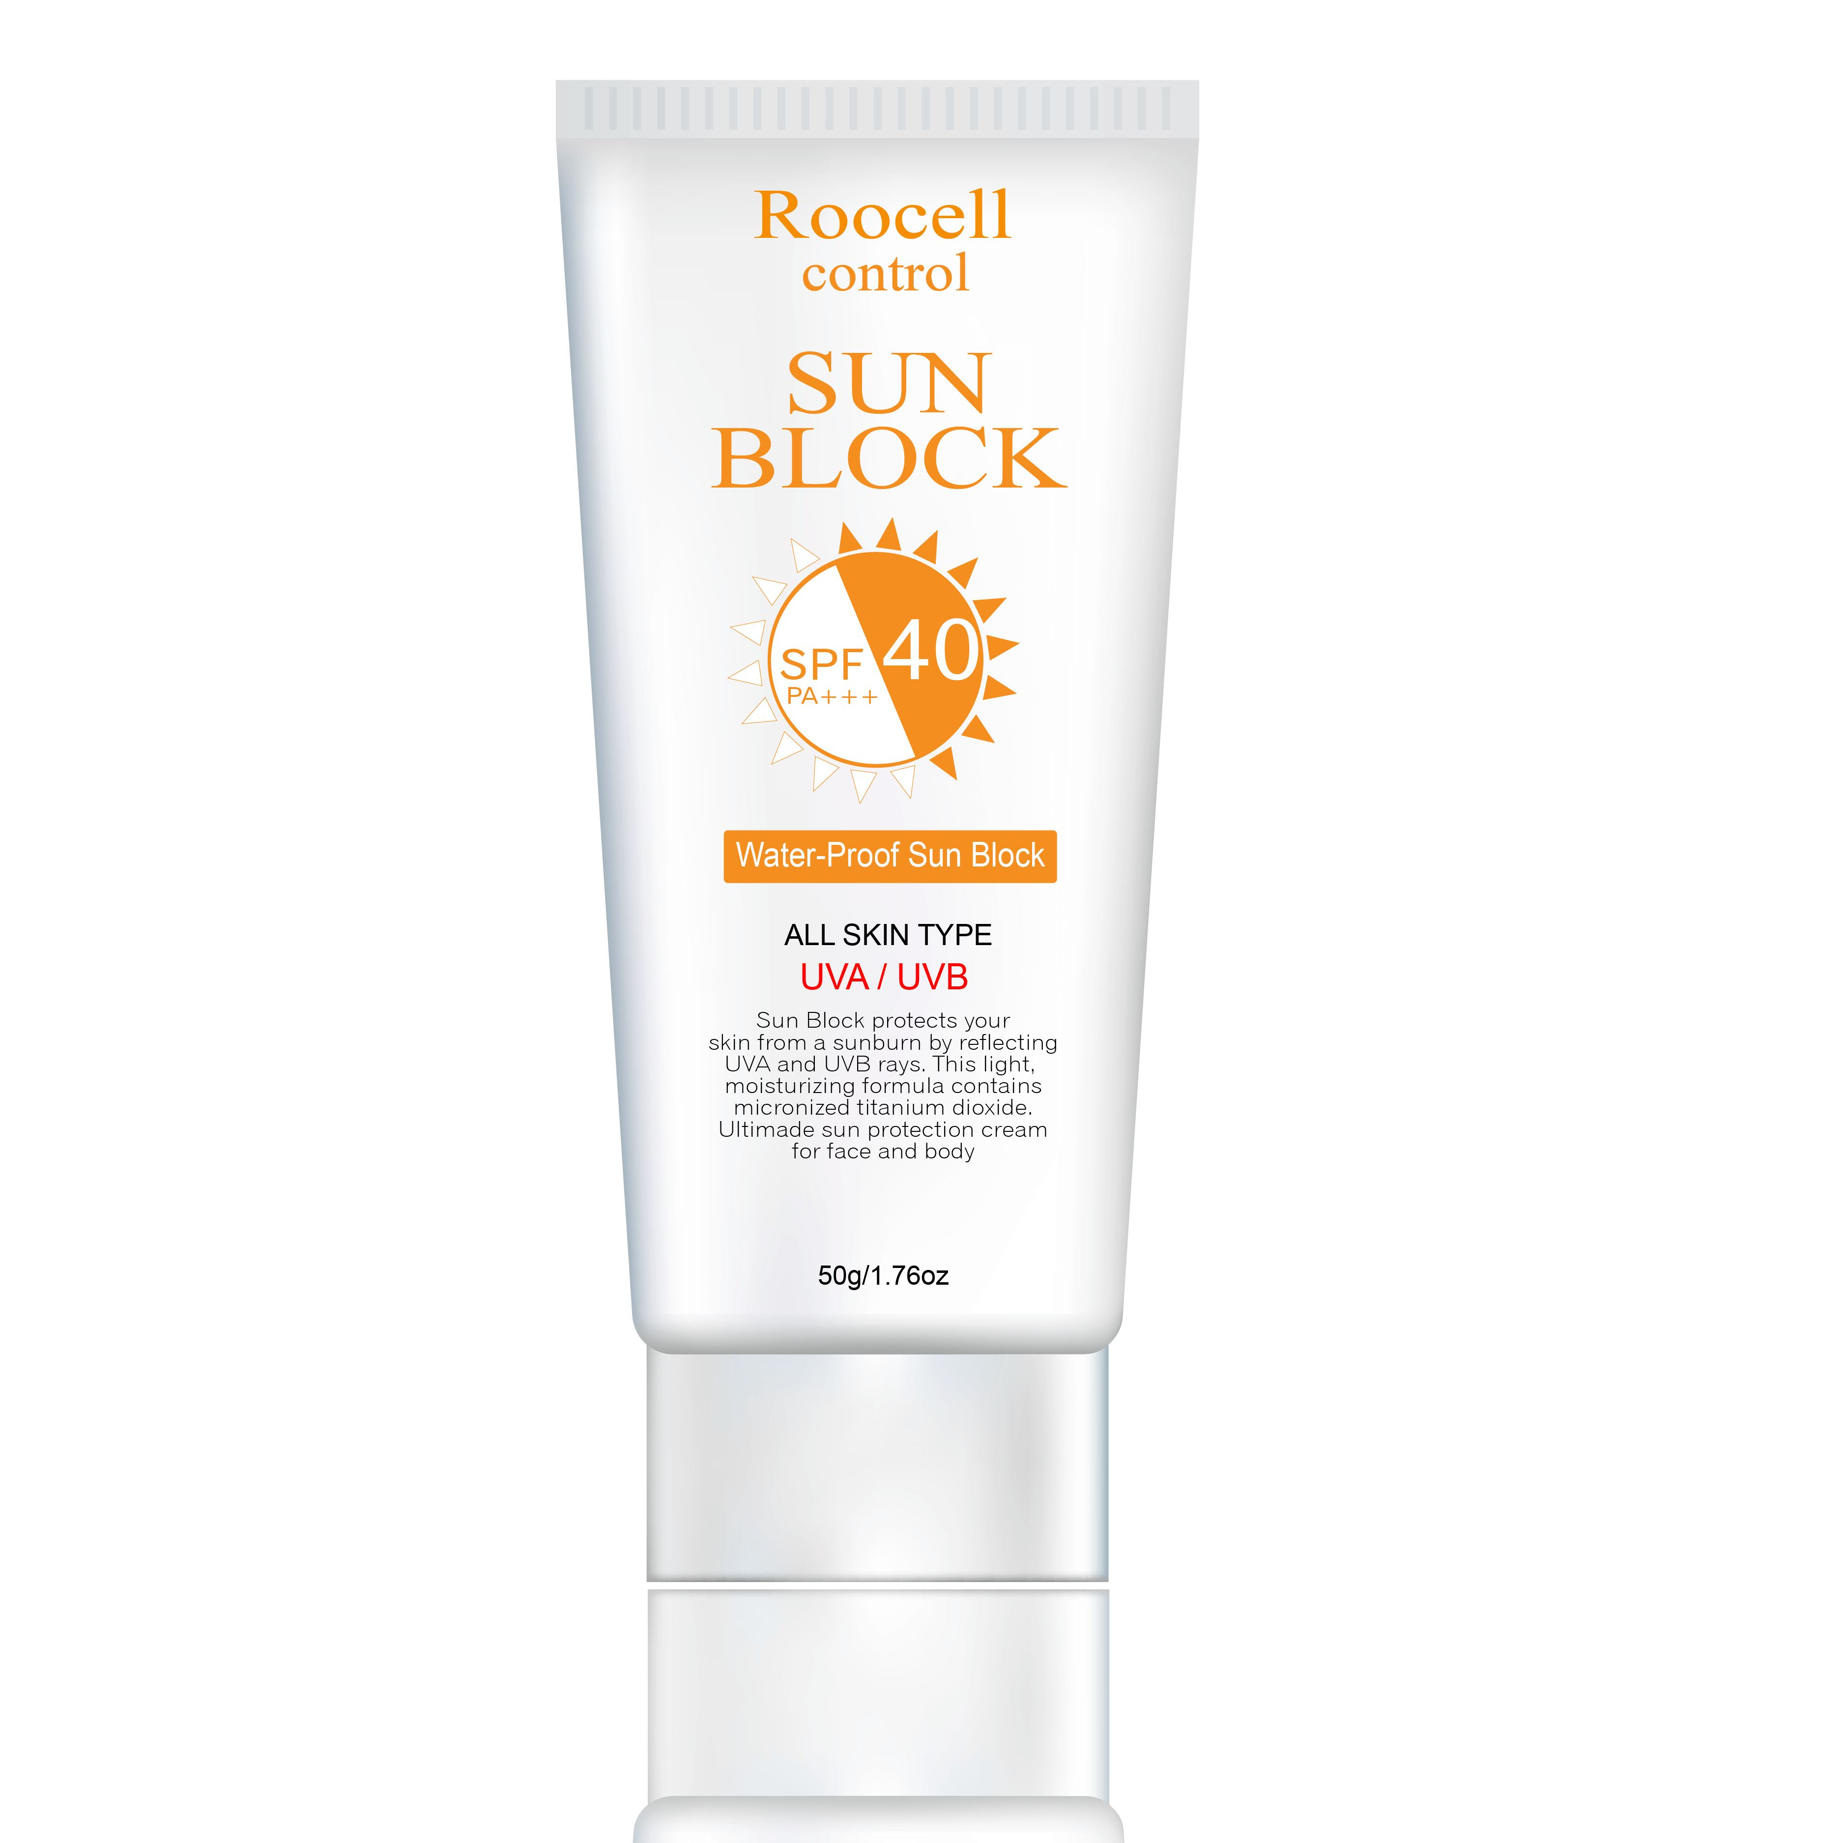
Monday, November 25th, 2024
Unit 4: TOURISM
Lesson 1: NEW WORDS AND READING
New words
b. In pairs: Talk about your past vacations.
hostel
bed and breakfast
hotel
- pastry
- dumpling
- cake
- bakery
- monument
- museum
- socket adapter
- fanny pack
- sunblock
- phone charger
8. I wore sunblock because it was sunny and hot

Slide 20
Monday, November 25th, 2024
Unit 4: TOURISM
Lesson 1: NEW WORDS AND READING
New words
b. In pairs: Talk about your past vacations.
hostel
bed and breakfast
hotel
- pastry
- dumpling
- cake
- bakery
- monument
- museum
- socket adapter
- fanny pack
- sunblock
- phone charger
1. I went to the bakery to buy some bread.
2. At the bed and breakfast, I tried a homemade cake.
3. My favorite meal was a dumpling I had at lunch.
4. I carried my phone charger in my fanny pack.
5. The hostel we stayed was built 5 years ago.
6. I ate a lot of pastry after dinner.
7. I took a socket adapter to charge my devices.
8. I wore sunblock because it was sunny and hot.

Slide 21
Monday, November 25th, 2024
Unit 4: TOURISM
Lesson 1: NEW WORDS AND READING
New words
a. Number the pictures. Listen and repeat.
1. B 2. L 3. F 4. G 5. D 7. H 8. C 9. E
b. In pairs: Talk about your past vacations.
1. I went to the bakery to buy some bread.
2. At the bed and breakfast, I tried a homemade cake.
3. My favorite meal was a dumpling I had at lunch.
4. I carried my phone charger in my fanny pack.
5. The hostel we stayed was built 5 years ago.
6. I ate a lot of pastry after dinner.
7. I took a socket adapter to charge my devices.
8. I wore sunblock because it was sunny and hot.
bakery (n) tiệm bánh
bed and breakfast (n phr) khách sạn kèm bữa sáng
dumpling (n) sủi cảo, há cảo
fanny pack (n phr) túi bao tử
hostel (n) nhà trọ, nhà nghỉ giá rẻ
monument (n) tượng đài
pastry (n) bánh ngọt, bánh bột nhào
socket adapter (n phr) bộ chuyển đổi ổ cắm điện
sunblock (n) kem chống nắng
Notes:
GV click vào từng cụm nghe âm thanh

Slide 22
Monday, November 25th, 2024
Unit 4: TOURISM
Lesson 1: NEW WORDS AND READING
Reading
Read the email and choose the best subject line.
1. Last week's trip 2. Our trip to Paris! 3. What did you learn?
To: janegrunt@abcmail.com
Subject: ________________
Hey Jane,
My family gave me some great suggestions for the trip to Paris you and I are taking next year, and I wanted to tell you about them. My dad suggested we travel in October or April. He said it was less crowded at those times. I think April will be the nicest because it will be sunny and warm. He also said we should visit the Eiffel Tower and the Louvre Museum. I thought that sounded pretty boring, so I asked my mom.
She suggested we visit Disneyland Paris. I think that sounds really fun. I love roller coasters. She also told me about some great places to eat such as Le Petit Paris Restaurant. It's expensive, but I heard it's amazing. She also suggested we go to a bakery and try some pastries. She said they were really tasty.
Finally, my brother gave me some really useful advice. He suggested we take a socket adapter. They have different sockets in France. He also suggested we take a fanny pack to keep our things safe. I think it might be a good idea to take both.
What do you think? Did you find out anything interesting?
Speak to you soon,
Sabrina

Slide 23
Monday, November 25th, 2024
Unit 4: TOURISM
Lesson 1: NEW WORDS AND READING
Reading
Read the email and choose the best subject line.
2. Our trip to Paris!
b. Now, read and write short answers.
When are they planning to travel to Paris?
2. What will the weather be like when Sabrina wants to go?
3. Which two places did Sabrina think were boring?
4. What restaurant did Sabrina's mom suggest?
5. What things did Sabrina's brother say they should take?
Next year
To: janegrunt@abcmail.com
Subject: Our trip to Paris!
Hey Jane, My family gave me some great suggestions for the trip to Paris you and I are taking next year, and I wanted to tell you about them.

Slide 24
Monday, November 25th, 2024
Unit 4: TOURISM
Lesson 1: NEW WORDS AND READING
Reading
Read the email and choose the best subject line.
2. Our trip to Paris!
b. Now, read and write short answers.
When are they planning to travel to Paris?
2. What will the weather be like when Sabrina wants to go?
3. Which two places did Sabrina think were boring?
4. What restaurant did Sabrina's mom suggest?
5. What things did Sabrina's brother say they should take?
Next year
Sunny and warm
My family gave me some great suggestions for the trip to Paris you and I are taking next year, and I wanted to tell you about them. My dad suggested we travel in October or April. He said it was less crowded at those times. I think April will be the nicest because it will be sunny and warm.

Slide 25
Monday, November 25th, 2024
Unit 4: TOURISM
Lesson 1: NEW WORDS AND READING
Reading
Read the email and choose the best subject line.
2. Our trip to Paris!
b. Now, read and write short answers.
When are they planning to travel to Paris?
2. What will the weather be like when Sabrina wants to go?
3. Which two places did Sabrina think were boring?
4. What restaurant did Sabrina's mom suggest?
5. What things did Sabrina's brother say they should take?
Next year
Sunny and warm
The Eiffel Tower and the Louvre Museum
He also said we should visit the Eiffel Tower and the Louvre Museum. I thought that sounded pretty boring, so I asked my mom.

Slide 26
Monday, November 25th, 2024
Unit 4: TOURISM
Lesson 1: NEW WORDS AND READING
Reading
Read the email and choose the best subject line.
2. Our trip to Paris!
She suggested we visit Disneyland Paris. I think that sounds really fun. I love roller coasters. She also told me about some great places to eat such as Le Petit Paris Restaurant.
b. Now, read and write short answers.
When are they planning to travel to Paris?
2. What will the weather be like when Sabrina wants to go?
3. Which two places did Sabrina think were boring?
4. What restaurant did Sabrina's mom suggest?
5. What things did Sabrina's brother say they should take?
Next year
Sunny and warm
The Eiffel Tower and the Louvre Museum
Le Petit Paris Restaurant

Slide 27
Monday, November 25th, 2024
Unit 4: TOURISM
Lesson 1: NEW WORDS AND READING
Reading
Read the email and choose the best subject line.
2. Our trip to Paris!
He suggested we take a socket adapter. They have different sockets in France. He also suggested we take a fanny pack to keep our things safe.
b. Now, read and write short answers.
When are they planning to travel to Paris?
2. What will the weather be like when Sabrina wants to go?
3. Which two places did Sabrina think were boring?
4. What restaurant did Sabrina's mom suggest?
5. What things did Sabrina's brother say they should take?
Next year
Sunny and warm
The Eiffel Tower and the Louvre Museum
Le Petit Paris Restaurant
A socket adapter and a fanny pack

Slide 28
Monday, November 25th, 2024
Unit 4: TOURISM
Lesson 1: NEW WORDS AND READING
Reading
a. Read the email and choose the best subject line.
2. Our trip to Paris!
b. Now, read and write short answers.
Next year
Sunny and warm
The Eiffel Tower and the Louvre Museum
Le Petit Paris Restaurant
A socket adapter and a fanny pack

Slide 29
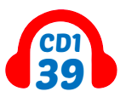
Monday, November 25th, 2024
Unit 4: TOURISM
Lesson 1: NEW WORDS AND READING
Reading
a. Read the email and choose the best subject line.
2. Our trip to Paris!
b. Now, read and write short answers.
Next year
Sunny and warm
The Eiffel Tower and the Louvre Museum
Le Petit Paris Restaurant
A socket adapter and a fanny pack
c. Listen and read

Slide 30
Monday, November 25th, 2024
Unit 4: TOURISM
Lesson 1: NEW WORDS AND READING
Reading
a. Read the email and choose the best subject line.
2. Our trip to Paris!
b. Now, read and write short answers.
Next year
Sunny and warm
The Eiffel Tower and the Louvre Museum
Le Petit Paris Restaurant
A socket adapter and a fanny pack
Which do you think is the best suggestion Sabrina got from her family?
The best suggestion she received from her family was to visit Disneyland Paris
Why?
Because that sounds really fun. Besides, Sabrina loves roller coasters.
What other travel tips do you think they should know about?
c. In pairs.

Slide 31
Monday, November 25th, 2024
Unit 4: TOURISM
Lesson 1: NEW WORDS AND READING
Reading
c. In pairs.
- Which do you think is the best suggestion Sabrina got from her family?
- Why?
- The best suggestion she received from her family was to visit Disneyland Paris
- Because that sounds really fun. Besides, Sabrina loves roller coasters.

Slide 32
Monday, November 25th, 2024
Unit 4: TOURISM
Lesson 1: NEW WORDS AND READING
New words
a. Number the pictures. Listen and repeat.
1. B 2. L 3. F 4. G 5. D 7. H 8. C 9. E
bakery (n) tiệm bánh
bed and breakfast (n phr) nhà trọ, khách sạn kèm bữa sáng
dumpling (n) sủi cảo, há cảo
fanny pack (n phr) túi bao tử
hostel (n) nhà trọ, nhà nghỉ giá rẻ
monument (n) tượng đài
pastry (n) bánh ngọt, bánh bột nhào
socket adapter (n phr) bộ chuyển đổi ổ cắm điện
sunblock (n) kem chống nắng
Notes:
GV click vào từng cụm nghe âm thanh

Slide 33
Monday, November 25th, 2024
Unit 4: TOURISM
Lesson 1: NEW WORDS AND READING
New words
a. Number the pictures.
1. B 2. L 3. F 4. G 5. D 7. H 8. C 9. E
b. In pairs.
bakery (n) tiệm bánh
bed and breakfast (n phr) khách sạn kèm bữa sáng
dumpling (n) sủi cảo, há cảo
fanny pack (n phr) túi bao tử
hostel (n) nhà trọ, nhà nghỉ giá rẻ
monument (n) tượng đài
pastry (n) bánh ngọt, bánh bột nhào
socket adapter (n phr) bộ chuyển đổi ổ cắm điện
sunblock (n) kem chống nắng
1. I went to the bakery to buy some bread.
2. At the bed and breakfast, I tried a homemade cake.
3. My favorite meal was a dumpling I had at lunch.
4. I carried my phone charger in my fanny pack.
5. The hostel we stayed was built 5 years ago.
6. I ate a lot of pastry after dinner.
7. I took a socket adapter to charge my devices.
8. I wore sunblock because it was sunny and hot.
Reading
b. Write short answers.
a. Read and choose the best subject line.
2. Our trip to Paris!
Next year
Sunny and warm
The Eiffel Tower and the Louvre Museum
Le Petit Paris Restaurant
A socket adapter and a fanny pack
Notes:
GV click vào từng cụm nghe âm thanh

Slide 34
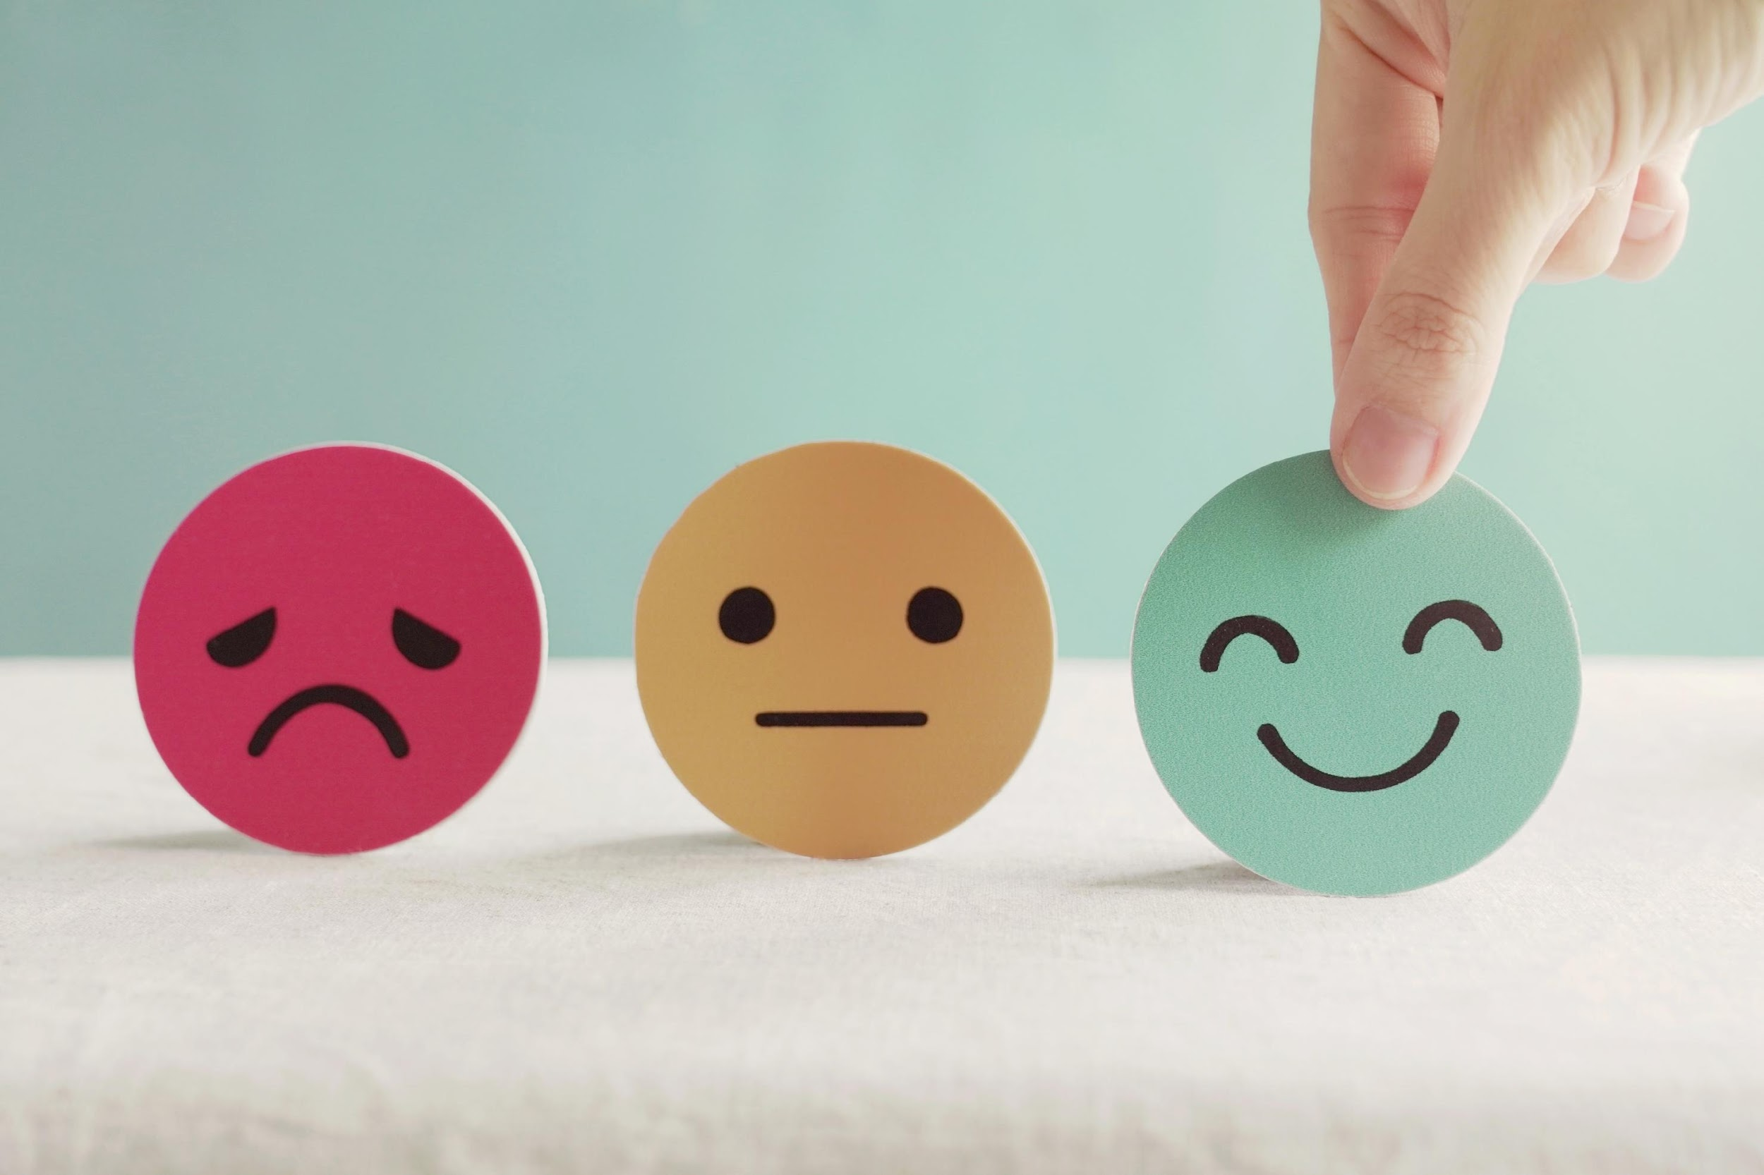
Monday, November 25th, 2024
Unit 4: TOURISM
Lesson 1: NEW WORDS AND READING
Homework
Review nouns related to traveling.
Make sentences using the nouns in SB
Prepare for the next lesson GRAMMAR
Play the consolidation games on www.eduhome.com.vn
Stay positive and have a nice day!

Slide 35
THANK YOU FOR YOUR LISTENING.
Goodbye Everybody

