Slide 1
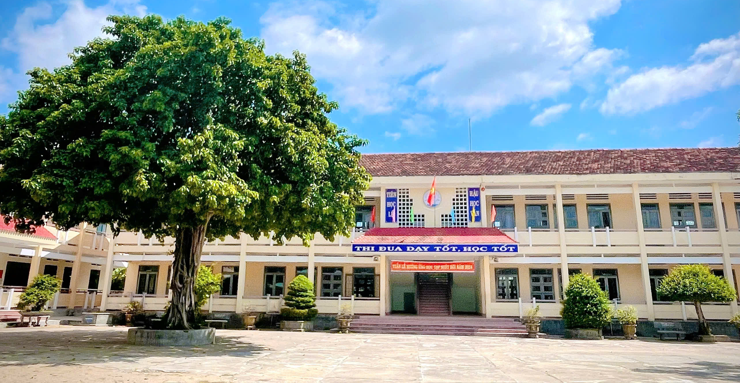
Binh Hoa Secondary School
Good morning Everybody
WELCOME TO OUR CLASS
Bùi Thị Minh Thảo

Slide 2
Unit 4
COMMUNITY SERVICES
Lesson 1
GRAMMAR

Slide 3
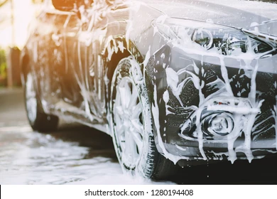
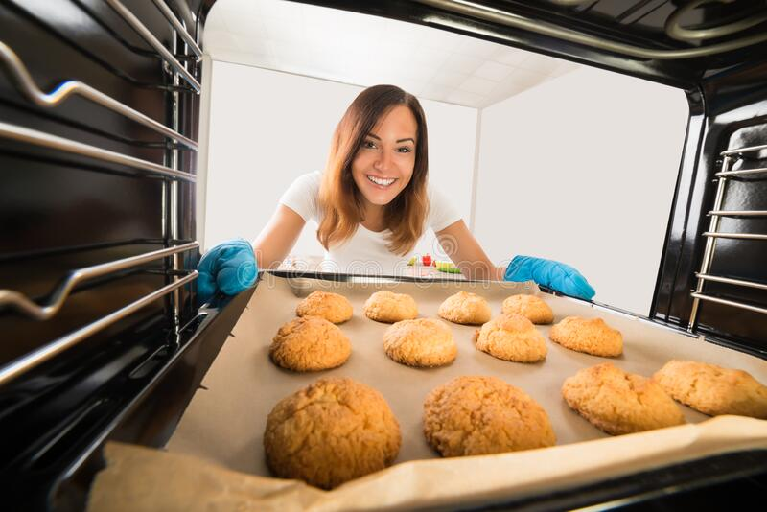
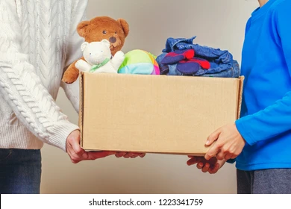
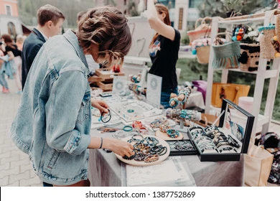
Tuesday, November 5th, 2024
Unit 4: COMMUNITY SERVICES
Lesson 1: GRAMMAR
Match the pictures with the words
Baking cookies
Having a craft fair
Washing cars
Donating old clothes
Washing cars
Baking cookies
Donating old clothes
Having a craft fair

Slide 4
Tuesday, November 5th, 2024
Unit 4: COMMUNITY SERVICES
Lesson 1: GRAMMAR

Slide 5
Tuesday, November 5th, 2024
Unit 4: COMMUNITY SERVICES
Lesson 1: GRAMMAR
Grammar
a. Fill in the blanks with should, let’s or How about
Making suggestions
1. should
I think we should organize a fun run.
Form: I think we should + bare infinitive
2. Let’s
Let’s wash cars.
Form: Let’s + bare infinitive
Let’s not argue about this.
Form: Let’s + not + bare infinitive
3. How about …?
How about selling cakes?
Form: How about + V-ing …?
How about we sell cakes?
Form: How about + S + V (S. Present) + …?
Let's organize a car wash.
__________ we have a craft fair?
_______ not organize an art show.
___________organizing a talent show?
We ________ have a fun run.
__________we bake and sell cookies?
How about
Let’s
How about
should
How about

Slide 6
Tuesday, November 5th, 2024
Unit 4: COMMUNITY SERVICES
Lesson 1: GRAMMAR
Grammar
a. Fill in the blanks with should, let’s or How about
Making suggestions
1. should
I think we should organize a fun run.
Form: I think we should + bare infinitive
2. Let’s
Let’s wash cars.
Form: Let’s + bare infinitive
Let’s not argue about this.
Form: Let’s + not + bare infinitive
3. How about …?
How about selling cakes?
Form: How about + V-ing …?
How about we sell cakes?
Form: How about + S + V (S. Present) + …?
Let's organize a car wash.
__________ we have a craft fair?
_______ not organize an art show.
___________organizing a talent show?
We ________ have a fun run.
__________we bake and sell cookies?
How about
Let’s
How about
should
How about

Slide 7
Tuesday, November 5th, 2024
Unit 4: COMMUNITY SERVICES
Lesson 1: GRAMMAR
b. Circle the correct words
1. A bake sale will raise more money than a craft fair. Let's/Let's not make some pies to sell this weekend.
2. We should/shouldn't charge money for the fun run. More people will come if it's free.
3. Let's/Let's not have the craft fair at the school gym. It's too small to fit a lot of people.
4. My teacher said we should/shouldn't ask our parents to donate old clothes because we don't need them.
5. The weather report said it will rain this weekend. We should/shouldn't have the event outside.
6. I'm not very good at designing posters. Let's/Let's not ask your sister to help because she's an artist
Making suggestions
1. Should: I think we should organize a fun run.
Form: I think we should + bare infinitive
2. Let’s: Let’s wash cars. Let’s not argue about this.
Form: Let’s + bare infinitive
Form: Let’s + not + bare infinitive
3. How about …? How about selling cakes? How about we sell cakes?
Form: How about + V-ing …?
Form: How about + S + V (S. Present) + …?

Slide 8
Tuesday, November 5th, 2024
Unit 4: COMMUNITY SERVICES
Lesson 1: GRAMMAR
c. In pairs.
What kind of charity event should we organize?
What should we call (it)?

Slide 9
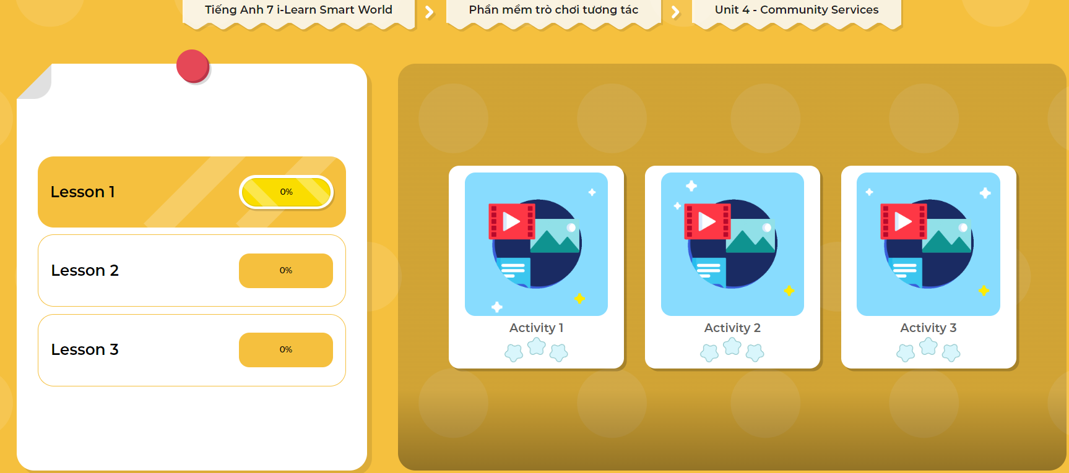
LET’S PLAY!
CLICK HERE TO PLAY THE GAMES

Slide 10
Tuesday, November 5th, 2024
Unit 4: COMMUNITY SERVICES
Lesson 1: GRAMMAR
Grammar
a. Fill in the blanks with should, let’s or How about
Making suggestions
1. should
I think we should organize a fun run.
Form: I think we should + bare infinitive
2. Let’s
Let’s wash cars.
Form: Let’s + bare infinitive
Let’s not argue about this.
Form: Let’s + not + bare infinitive
3. How about …?
How about selling cakes?
Form: How about + V-ing …?
How about we sell cakes?
Form: How about + S + V (S. Present) + …?
Let's organize a car wash.
__________ we have a craft fair?
_______ not organize an art show.
___________organizing a talent show?
We ________ have a fun run.
__________we bake and sell cookies?
How about
Let’s
How about
should
How about
b. Circle the correct words
Let’s
shouldn’t
Let's not
shouldn’t
shouldn’t
Let's

Slide 11
Tuesday, November 5th, 2024
Unit 4: COMMUNITY SERVICES
Lesson 1: GRAMMAR
Homework
Review the grammar point and make sentences using it.
Do the exercises on page 21 WB.
Prepare Pronunciation & Speaking.
Play the consolidation games on www.eduhome.com.vn
Stay positive and have a nice day!

Slide 12
THANK YOU FOR YOUR LISTENING.
Goodbye Everybody

