Slide 1
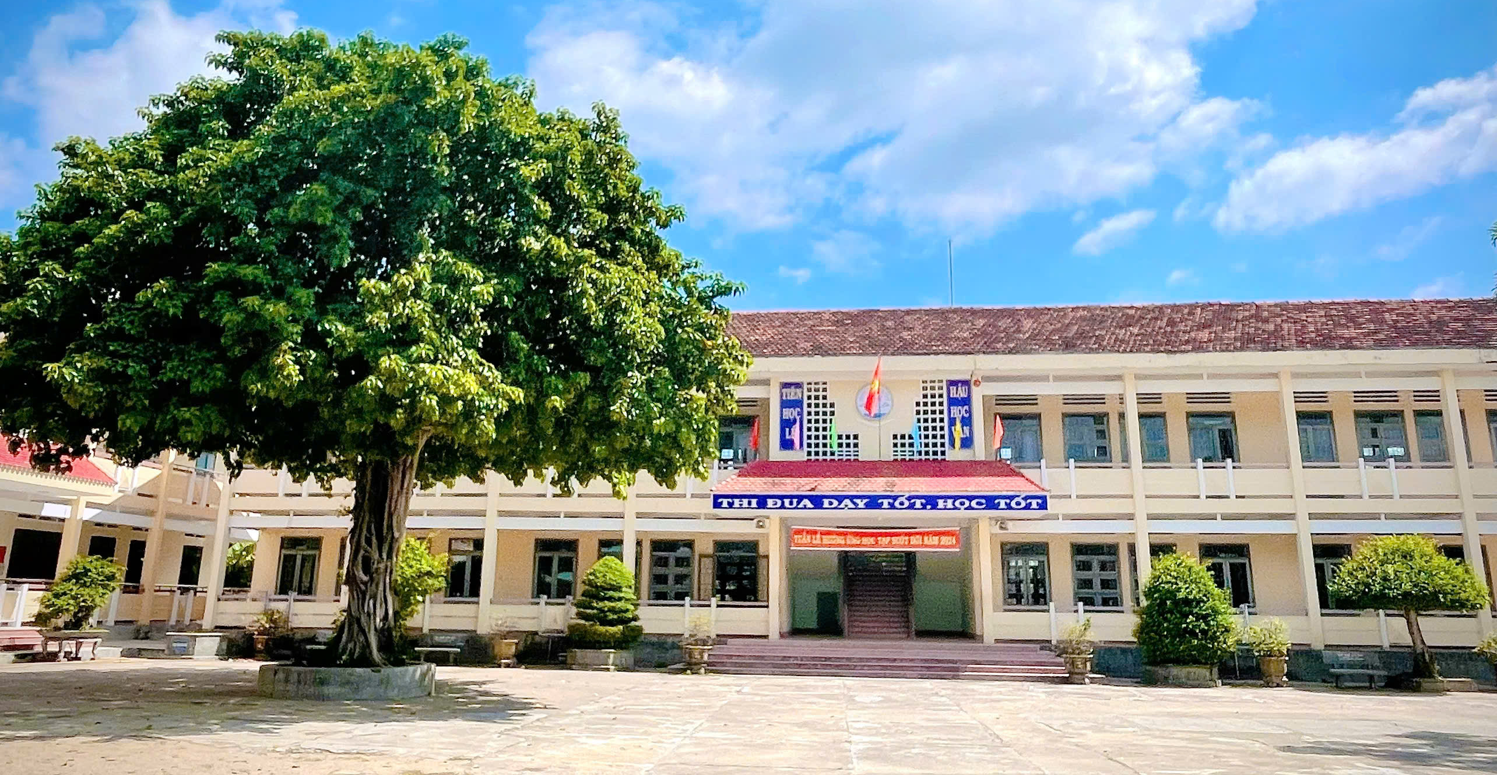
Binh Hoa Secondary School
Good morning Everybody
WELCOME TO OUR CLASS
Bùi Thị Minh Thảo

Slide 2
TOURISM
Lesson 3
READING

Slide 3
Monday, November 25th, 2024
Unit 4: TOURISM
Lesson 3: READING
In pairs: Look at the pictures.
1. Which of the places do you recognize?
The places in the picture are
Golden Bridge in Da Nang in Vietnam.
Great Sphinx and Pyramids of Giza in Egypt
Futuristic garden with Supertree Grove and conservatories Gardens by the Bay in Singapore
2. What do you know about them?
Golden Bridge in Ba Na Hills is located in the Truong Son range in Hoa Ninh commune, Hoa Vang District, about 25km southwest of Da Nang center.

Slide 4
Monday, November 25th, 2024
Unit 4: TOURISM
Lesson 3: READING
New words
admire (v) /ədˈmaɪər/ chiêm ngưỡng
ancient (adj) /ˈeɪnʃənt/ cổ xưa
fascinating (adj) /ˈfæsəneɪtɪŋ/ hấp dẫn, quyến rũ
impressive (adj) /ɪmˈpresɪv/ ấn tượng
mouth-watering (adj) /ˈmɑʊθˌwɔtərɪŋ/ thơm ngon, bắt mắt
refreshing (adj) /rɪˈfreʃɪŋ/ sảng khoái
sight (n) /saɪt/ cảnh đẹp, thắng cảnh

Slide 5
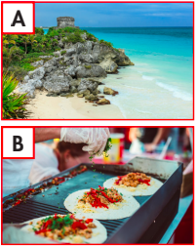
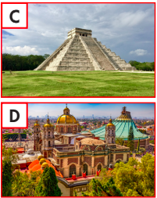
Monday, November 25th, 2024
Unit 4: TOURISM
Lesson 3: READING
a. Read and match the pictures (A–D) with the paragraphs numbered (1– 4)

Slide 6
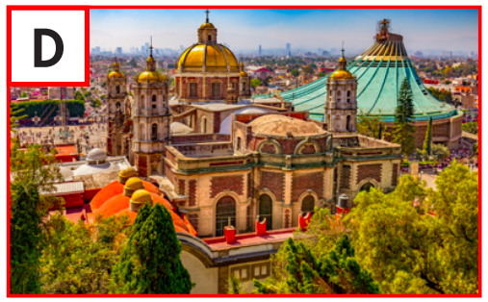
Monday, November 25th, 2024
Unit 4: TOURISM
Lesson 3: READING
a. Read and match the pictures (A–D) with the paragraphs numbered (1– 4)
1. Explore Mexico City. This capital city is incredibly rich in history and culture. You can spend days exploring amazing historic sites and museums and admiring the architecture styles from various periods.
architechture styles
historic sites
ANSWERS
D

Slide 7
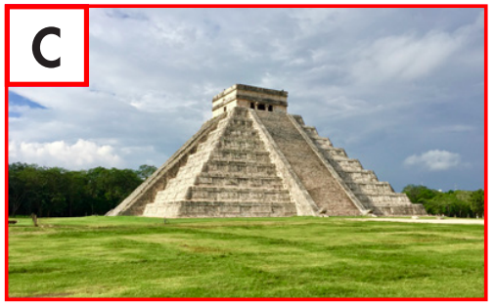
Monday, November 25th, 2024
Unit 4: TOURISM
Lesson 3: READING
a. Read and match the pictures (A–D) with the paragraphs numbered (1– 4)
1. D
2. Be amazed at the sight of Chichén Itzá. This ancient Maya city is incredible. At the center of it is El Castillo. Scientists believe it's a giant Maya calendar with 365 steps, one for each day of the year.
365 steps
ancient
ANSWERS
C

Slide 8
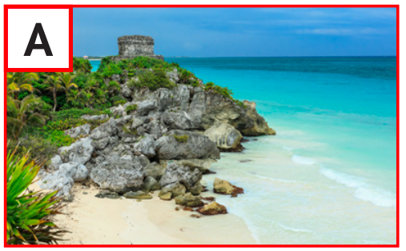
Monday, November 25th, 2024
Unit 4: TOURISM
Lesson 3: READING
a. Read and match the pictures (A–D) with the paragraphs numbered (1– 4)
1. D 2. C
3. Relax on Tulum beaches. This amazing town has it all – lovely white sand, clear waters, and impressive Maya structures. They're part of the only Maya city by the sea.
white sand
impressive structure
clear waters

Slide 9
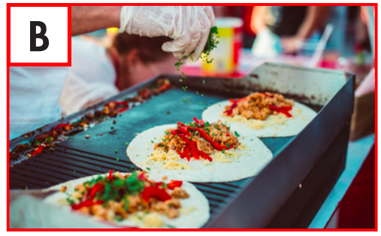
Monday, November 25th, 2024
Unit 4: TOURISM
Lesson 3: READING
a. Read and match the pictures (A–D) with the paragraphs numbered (1– 4)
1. D 2. C 3. A
4. Fill yourself with Mexican food. As you walk along the streets of Mexico, take in the incredible smell of food and the sound of cooking all around you. There, you'll find the best tacos, tamales, tostadas, and so much more.
tacos
smell of food
tamales
sound of cooking
tostadas

Slide 10
Monday, November 25th, 2024
Unit 4: TOURISM
Lesson 3: READING
b. Now, read and choose the correct answers.
Explore Mexico City. This capital city is incredibly rich in history and culture.
Notes:
GV click vào từng cụm nghe âm thanh

Slide 11
Monday, November 25th, 2024
Unit 4: TOURISM
Lesson 3: READING
b. Now, read and choose the correct answers.
At the center of it is El Castillo. Scientists believe it's a giant Maya calendar with 365 steps, one for each day of the year.
Notes:
GV click vào từng cụm nghe âm thanh

Slide 12
Monday, November 25th, 2024
Unit 4: TOURISM
Lesson 3: READING
b. Now, read and choose the correct answers.
At the center of it is El Castillo. Scientists believe it's a giant Maya calendar with 365 steps, one for each day of the year.
Notes:
GV click vào từng cụm nghe âm thanh

Slide 13
Monday, November 25th, 2024
Unit 4: TOURISM
Lesson 3: READING
b. Now, read and choose the correct answers.
As you walk along the streets of Mexico, take in the incredible smell of food and the sound of cooking all around you.
Notes:
GV click vào từng cụm nghe âm thanh

Slide 14
Monday, November 25th, 2024
Unit 4: TOURISM
Lesson 1: NEW WORDS AND READING
b. Now, read and choose the correct answers.
There, you'll find the best tacos, tamales, tostadas, and so much more.
Notes:
GV click vào từng cụm nghe âm thanh

Slide 15
Monday, November 25th, 2024
Unit 4: TOURISM
Lesson 3: READING
Reading
a. Read the email and choose the best subject line.
2. Our trip to Paris!
b. Now, read and write short answers.
Next year
Sunny and warm
The Eiffel Tower and the Louvre Museum
Le Petit Paris Restaurant
A socket adapter and a fanny pack
c. Listen and read

Slide 16
Monday, November 25th, 2024
Unit 4: TOURISM
Lesson 3: READING
Reading
a. Read the email and choose the best subject line.
1. C 2. D 3. A 4. B
b. Now, read and write short answers.
1. A 2. B 3. C 4. D 5. A
c. In pairs.
What else do you know about Mexico?
2. What would you like most about visiting it?

Slide 17
Monday, November 25th, 2024
Unit 4: TOURISM
Lesson 3: READING
Reading
I know Mexico has a rich cultural heritage, delicious cuisine, and beautiful beaches.
I'd love to visit the ancient ruins like Chichen Itza and try authentic Mexican food. How about you?
I'd enjoy exploring Mexico City and relaxing on the beaches of Cancun.
c. In pairs.
- What else do you know about Mexico?
- What would you like most about visiting it?

Slide 18
Monday, November 25th, 2024
Unit 4: TOURISM
Lesson 3: READING
Reading
a. Read the email and choose the best subject line.
1. C 2. D 3. A 4. B
b. Now, read and write short answers.
1. A 2. B 3. C 4. D 5. A
c. In pairs.
1. What else do you know about Mexico?
I know Mexico has a rich cultural heritage, delicious cuisine, and beautiful beaches.
2. What would you like most about visiting it?
I'd love to visit the ancient ruins like Chichen Itza and try authentic Mexican food. How about you?
I'd enjoy exploring Mexico City and relaxing on the beaches of Cancun.

Slide 19
Monday, November 25th, 2024
Unit 4: TOURISM
Lesson 3: READING
Homework
Review vocabulary and use them to make sentences
Prepare for Speaking & Writing
Play the consolidation games on www.eduhome.com.vn
Stay positive and have a nice day!

Slide 20
THANK YOU FOR YOUR LISTENING.
Goodbye Everybody

