Slide 1
Welcome to our class

Slide 2
Unscramle the sentences
1. like / he / play / to / Does / tug of war / ?
→ Does he like to play tug of war?
2. they / playing / enjoy / Do / spinning tops / ?
→ Do they enjoy playing spinning tops?

Slide 3
Unit 2: Life in the Country
Lesson 2.3
PRONUNCIATION + SPEAKING

Slide 4
1. PRONUNCIATION

Slide 5
a. Intonation for Yes/No questions
Intonation for Yes/No questions rises
For example:
Does he like to play folk games?
Do you enjoy jumping rope?

Slide 6
Task b
b. Listen to the words and how the intonation rises.
Does she like to eat hamburgers?
Do they like to jump rope?

Slide 7
c. Listen and cross out the sentence whose intonation doesn’t rise.
Does he love to pick flowers?
Do they prefer to play soccer?
Do you like to visit the country?
d. Read the sentences with the rising intonation to a partner.

Slide 8
2. PRACTICE

Slide 9
a. In pairs: Ask and answer about what young people like to do in these places.
Ex 1: What do young people like to do in Summerdale?
→ They like to play shuttlecock.
They often play at the park.
Ex 2: Do young people like to play spinning tops in Greenville?
→ No, they don't.
They prefer to pick flowers.

Slide 10
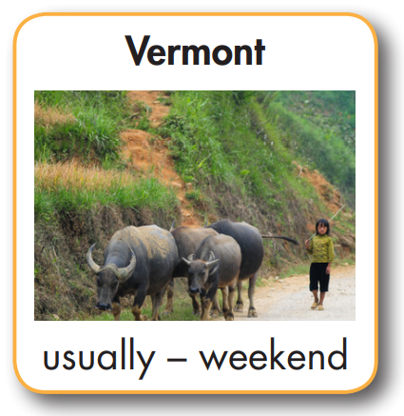
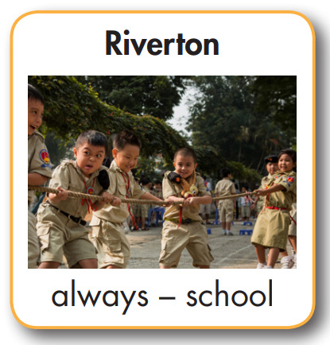
Ex 1: What do young people like to do in Summerdale?
→ They like to play shuttlecock.
They often play at the park.
Ex 2: Do young people like to play spinning tops in Greenville?
→ No, they don't.
They prefer to pick flowers.
Herd buffalo
Jump rope

Slide 11
What do young
people like to do
in Riverton?
They like to play
Tug of war. They always play at school.

Slide 12
Do young people
like to herd buffalo in Mapleton?
No, they don’t.
They prefer to jump rope.

Slide 13
What do young
people like to do in Vermont?
They like to herd buffalo. They usually do it at the weekend.

Slide 14
Do young people
like to play soccer in Hornsey?
No, they don’t.
They prefer to play shuttlecock.

Slide 15
II. Speaking

Slide 16
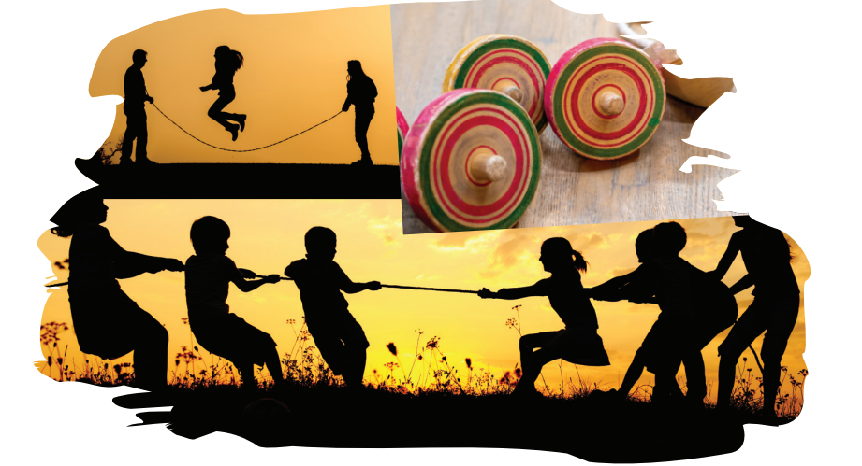
a. FUN AND GAMES IN THE COUNTRY
In pairs: What activities do young people often like to do in the country? Where and when do they usually do the activities? Talk about the activities below and some of your own ideas.

Slide 17
What do young people
like to do in the country?
They like to jump rope. They usually jump rope after school.
Do they like to play
tug of war?
Yes, they do, but I
think they prefer to...

Slide 18
b. Which activities do you prefer to do? Which activities don't you like? Why?
I prefer to play tug of war because it’s fun and I can play with my friends. I don’t like to herd buffalo because it’s boring.

Slide 19
Write four sentences about what you can do for fun in the country.
Example:
There are many things young people can do for fun in the country. Boys can play tug of war, and girls can jump rope. Some boys prefer spinning tops, and some girls prefer to pick flowers. Most of them like to do things with friends.

Slide 20
Homework
Practice saying Yes/No questions
Prepare the next lesson (pages 22 SB)
Play the consolidation games on www.eduhome.com.vn

Slide 21
Lesson 3
Stay positive and have a nice day!

