Slide 1
Welcome to our class

Slide 2
Unit 2: Life in the Country
Lesson 2.2:
GRAMMAR

Slide 3
1. Like / love / hate / prefer + to –V
2. Adverbs of frequency ( Trạng từ chỉ tần suất)
Example:
She usually plays tug of war with her cousins.
We always play sports at the park.
- Trạng từ tần suất đứng trước động từ thường và đứng sau động từ BE ( is/ am / are / was / were)
Ex: It is often warm in Summer.

Slide 4
3. Practice
a. Read the examples and notes above, then unscramble the sentences.
1. visit/to/love/We/the/country.
________________________________________
2. to/games./He/folk/prefers/play
________________________________________
3. play?/she/like/Where/does/to
________________________________________
4. play/to/don't/shuttlecock./like/I
________________________________________
We love to visit the country.
He prefers to play folk games.
Where does she like to play?
I don't like to play shuttlecock.

Slide 5
5. they/hometown?/to/their/Do/like/visit
________________________________________
6. spinning/with/never/play/tops/my/sister./I
________________________________________
7. herd/buffalo/you/always/on/weekends?/Do
________________________________________
8. play/games/folk/in/cities./rarely/People
________________________________________
Do they like to visit their hometown?
I never play spinning tops with my sister.
Do you always herd buffalo on weekends?
People rarely play folk games in cities.

Slide 6
1. I / like / visit/country.
_____________________________________________
2. she/prefer/jump rope?
_____________________________________________
3. What /kids/like/play/here?
_____________________________________________
4. He /like/play/tug of war.
_____________________________________________
I like to visit the country.
Does she prefer to jump rope?
What do kids like to play here?
He likes to play tug of war

Slide 7
5. We / not/ like /pick / flowers.
_____________________________________________
6. We / not/often/play spinning tops/after school.
_____________________________________________
7. Who /she /usually/jump rope/with?
_____________________________________________
8. People /my hometown/sometimes/play/folk games.
_____________________________________________
We don't like to pick flowers.
We don't often play spinning tops after school.
Who does she usually jump rope with?
People in my hometown sometimes play folk games.

Slide 8
Work in pairs
c. Ask and answer about what An likes to do.
Does An like to
jump rope?
No, she doesn't.
She never jumps rope.

Slide 9
Does An like to pick flowers?
No, she doesn't.
She rarely picks flowers.

Slide 10
Does An like to play tug of war?
Yes, she does.
She often plays with local children.

Slide 11
Does An like to play spinning tops?
Yes, she does.
She always plays with her sister.

Slide 12
Homework
Learn by hearts the grammar points and make sentences using them.
Do the grammar exercise on page 11 WB.
Do the exercises in Tiếng Anh 8 i-Learn Smart World Notebook on pages 16 & 17.
Prepare the next lesson (pages 20 & 21 SB)
Play the consolidation games on www.eduhome.com.vn

Slide 13
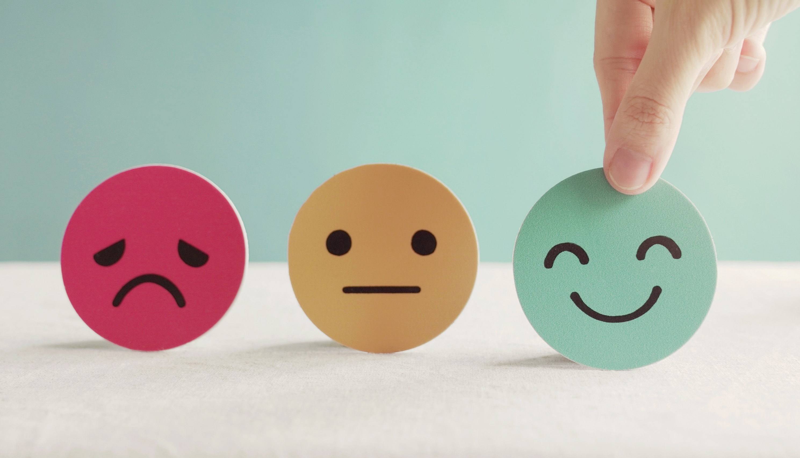
Lesson 3
Stay positive and have a nice day!

