Slide 1
Welcome to our class

Slide 2
Unit 1: Free Time
Period 3
Lesson 1.2: Grammar

Slide 3
Work in pairs.
Unscramble the words to make complete sentences.
1. loves/sports/Will/and/playing/hanging/with/ his/out/friends.
2. Will/like/doesn’t/or/rock/skateboarding/ climbing.
3. games/Jess/playing/prefers/home/board/at.
4. Jess/playing/and/jogging/hates/sports.
5. enjoys/clothes/and/bags/designing/Peter.

Slide 4
loves/sports/Will/and/playing/hanging/with/ his/out/friends.
→ Will loves playing sports and hanging out with his friends.
2. Will/like/doesn’t/or/rock/skateboarding/ climbing.
→ Will doesn’t like skateboarding or rock climbing.
3. games/Jess/playing/prefers/home/board/at.
→ Jess prefers playing board games at home.

Slide 5
4. Jess/playing/and/jogging/hates/sports.
→ Jess hates playing sports and jogging.
5. enjoys/clothes/and/bags/designing/Peter.
→ Peter enjoys designing clothes and bags.

Slide 6
Underline the verb after love, not like, prefer, hate, and enjoy.
1. Will loves playing sports and hanging out with his friends.
2. Jess prefers playing board games at home.
3. Jess hates playing sports and jogging.
4. Peter enjoys designing clothes and bags.

Slide 7
I. GRAMMAR
Verbs (to express preference) + gerund
Like
Love
Prefer
Enjoy
Hate
Examples:
A: What arts and crafts do you like doing?
B: I like designing jewelry.
A: Do you like playing board games?
B: No, I don't. I prefer playing sports.
+ V-ing
(Gerund)

Slide 8
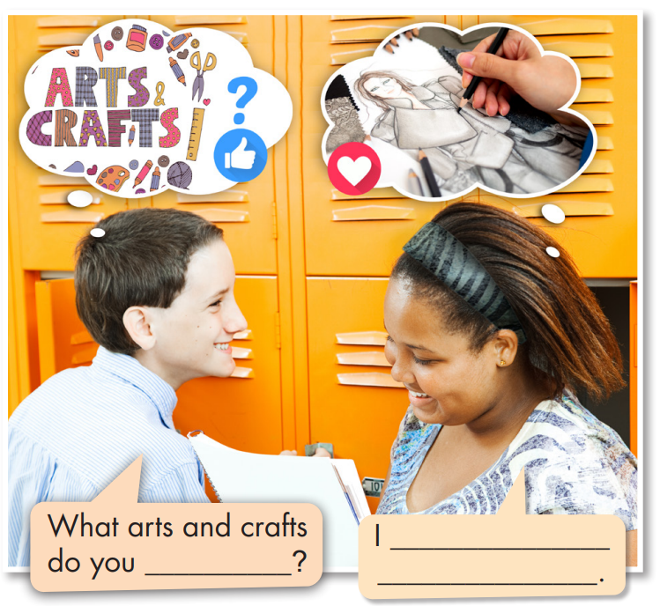
Fill in the blanks.
Listen and check your answers.
Listen again and repeat.
love designing clothes
like doing

Slide 9
The spelling rules of gerund (V-ing)
Rules | Example
Add -ing to most of the verbs.
watch – watching
Verbs that end in consonant + e: remove e and add -ing.
dance – dancing
One-syllable verbs that end in consonant + vowel + consonant: double the final consonant and add -ing.
swim – swimming
Do not double the final consonant when the verbs end in w, x, or y.
play – playing

Slide 10
II. Practice

Slide 11
Task a
Read the examples and notes above, then circle the correct words.
1. She loves/hates designing and making jewelry. She wants to open a jewelry store when she grows up.
2. I prefer/hate going fishing because I'm scared of water.

Slide 12
3. Lots of my friends enjoy/ don't like playing mobile games. They spend lots of their free time playing them.
4. Do you like/ hate going jogging? – Yes, my dad and I usually go jogging in the evening.
5. I don't like /love chatting online with friends. I prefer talking face to face.

Slide 13
Task b
Write sentences using gerunds and the prompts.
Jake/not enjoy/chat online/with his friends
→ Jake doesn’t enjoy chatting online with his friends.
2. what/activities/you/enjoy/do/free time?
→ What activities do you enjoy doing in your free time?
3. I/not really like/play/handball./I prefer/watch/it.
→ I don’t really like playing handball. I prefer watching it.

Slide 14
4. you/prefer/play/indoors or outdoors?
→ Do you prefer playing indoors or outdoors?
5. I/love/design clothes/free time
→ I love designing clothes in my free time.
6. I/hate/make jewelry/because/it/boring
→ I hate making jewelry because it’s boring.
7. we/like/chat online/but/prefer/hang out/at the mall
→ We like chatting online, but we prefer hanging out at the mall.

Slide 15
Extra practice
Use the pictures and the words given to make complete sentences.
My cousins/love
My sister/hate
My friends/enjoy
A. My cousins love hanging out.
B. My sister hates making jewelry.
C. My friends enjoys chatting.

Slide 16
Mary/not like
David/prefer
My parents/ not enjoy
D. Mary doesn’t like going rock climbing.
B. David prefers playing handball.
C. My parents don’t enjoy playing board games.

Slide 17
Task c
Work in pairs
Take turns saying one thing you enjoy, love, don't really like, and hate doing.
I enjoy going rock climbing with my friends.
Nice. I enjoy hanging out with my friends in the park.

Slide 18
Write four sentences about things you enjoy, love, prefer, don't really like, and hate doing

Slide 19
Today’s lesson
Grammar
Verb expressing preferences + gerund
Speaking
Talking about hobbies.

Slide 20
Homework
Learn by hearts the grammar point and make sentences using it.
Do the grammar exercises on page 3 WB.
Do the exercises in Tiếng Anh 8 i-Learn Smart World Notebook on page 6.
Prepare the next lesson (pages 6 & 7 SB).
Play the consolidation games on www.eduhome.com.vn

Slide 21
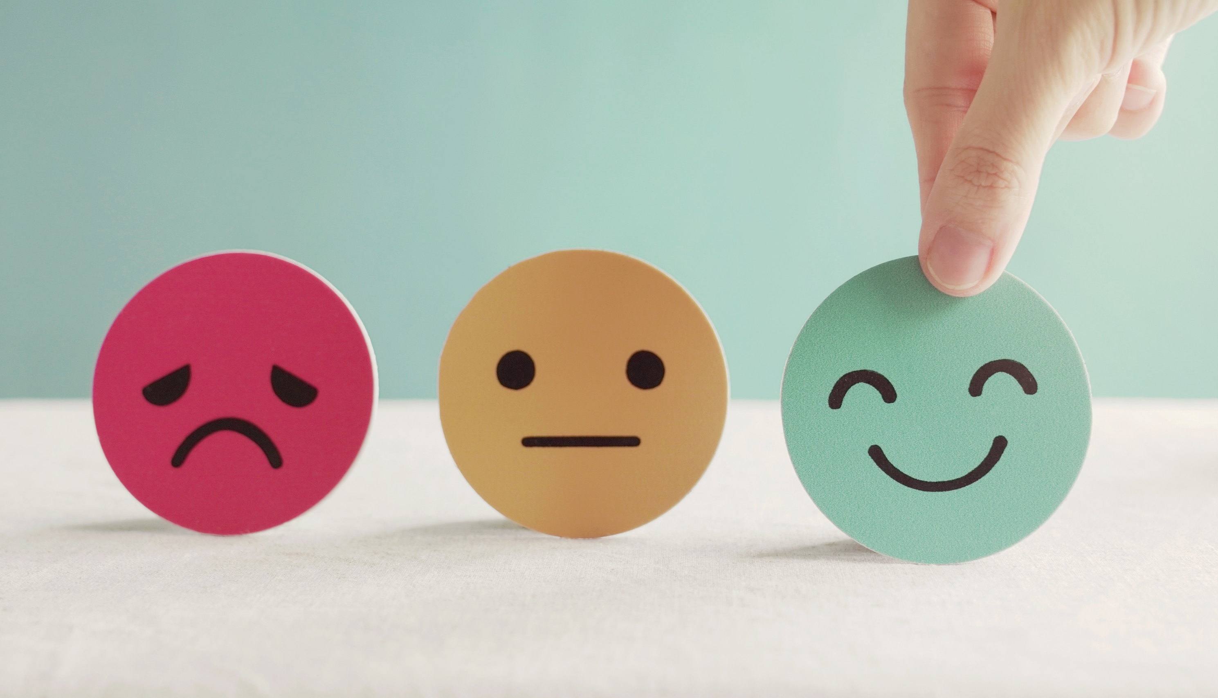
Lesson 3
Stay positive and have a nice day!

