Slide 1
Welcome to our class

Slide 2
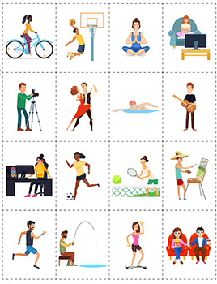
Memorizing game
Look at the pictures in 10 seconds
Then tell how many activities you can remember

Slide 3
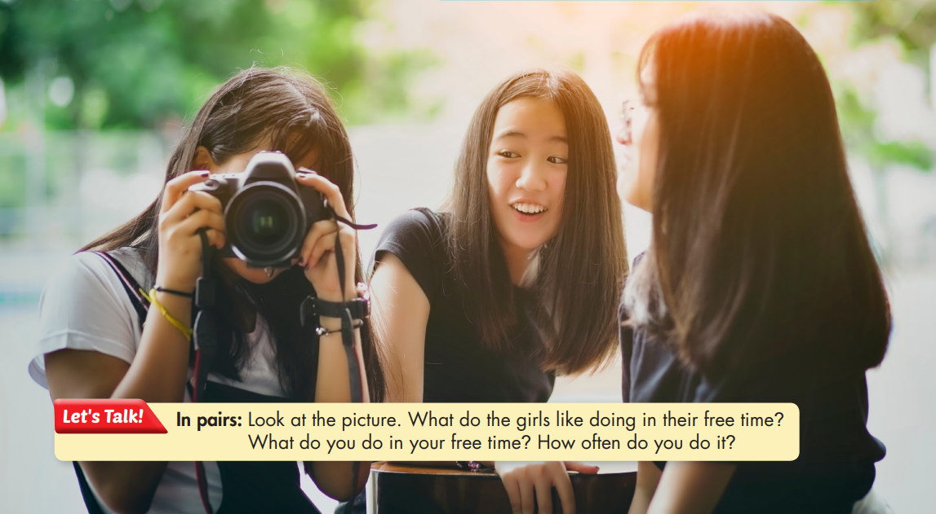

Slide 4
UNIT 1: FREE TIME
Lesson 1.1
New words + Reading

Slide 6
1. New words:
- Hang out (phr v) /hæŋ aʊt/ :
Đi chơi
- Jewelry (n) /ˈdʒuːəlri/:
Đồ trang sức
- Chat (v) /tʃæt/:
Trò chuyện, tán gẫu
- Rock climbing (n phr) /ˈrɑːk klaɪmɪŋ/:
(môn thể thao) leo núi đá
- Handball (n) /ˈhændbɔːl/:
(môn thể thao) bóng ném
- Board games (n phr) /ˈbɔːrd ɡeɪm/ :
Trò chơi có bàn cờ
- Jogging (n) /ˈdʒɑːɡɪŋ/:
(hoạt động) Chạy bộ

Slide 7
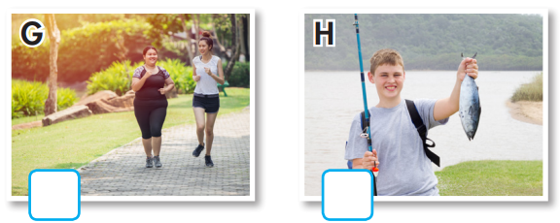
a. Number the pictures.
1. chat
2. fishing
3. hang out
4. jogging
5. jewelry
6. handball
7. rock climbing
8. board games
3
5
7
6
8
4
2

Slide 8
Listen and repeat. Click on each phrase to hear the sound.
chat (v) /tʃæt/ trò chuyện, tán gẫu
fishing (n) /ˈfɪʃɪŋ/ câu cá
hang out (phr v) /hæŋ aʊt/ đi chơi
jogging (n) /ˈdʒɑːɡɪŋ/ (hoạt động) chạy bộ
jewelry (n) /ˈdʒuːəlri/ đồ trang sức
handball (n) /ˈhændbɔːl/ (môn thể thao) bóng ném
rock climbing (n phr) /ˈrɑːk klaɪmɪŋ/ (môn thể thao) leo núi đá
board games (n phr) /ˈbɔːrd ɡeɪm/ trò chơi có bàn cờ
Notes:
GV click vào từng cụm nghe âm thanh

Slide 9
b. Write the new words into the table and add more words you know. Which activities do you do?
rock climbing
jewelry
jewelry
hang out
handball
jogging
cakes
clothes
chat online
fishing

Slide 11
Pair work: Name some indoor activities you know.
Reading books
Cooking
Drawing
Playing chess
Playing board games
Surfing the internet
Watching TV
Playing computer games

Slide 12
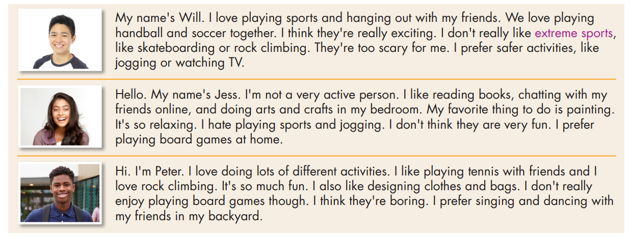
Scan the text. Underline the activities each person prefers doing.
a. Read the passages. Circle the name of the person who prefers indoor activities. Will Jess Peter

Slide 13
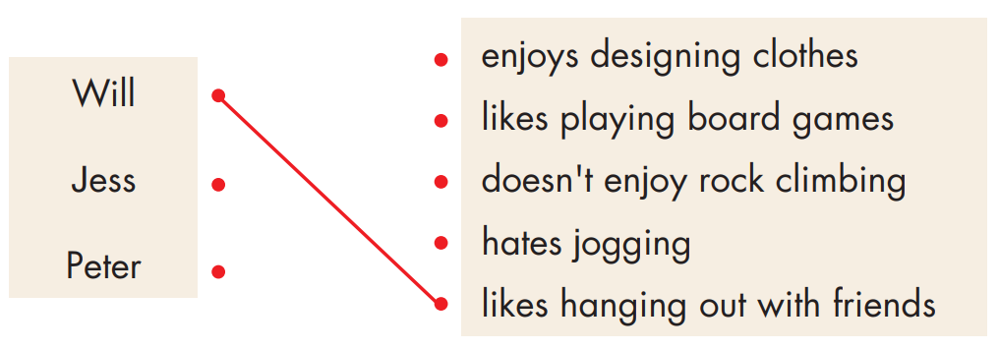
b. Now, read and draw lines to match the phrases and the person they describe.

Slide 14
b. Now, read and draw lines to match the phrases and the person they describe.
My name's Will. I love playing sports and hanging out with my friends. We love playing handball and soccer together. I think they're really exciting. I don't really like extreme sports, like skateboarding or rock climbing. They're too scary for me. I prefer safer activities, like jogging or watching TV.

Slide 15
b. Now, read and draw lines to match the phrases and the person they describe.
Hello. My name's Jess. I'm not a very active person. I like reading books, chatting with my friends online, and doing arts and crafts in my bedroom. My favorite thing to do is painting. It's so relaxing. I hate playing sports and jogging. I don't think they are very fun. I prefer playing board games at home.

Slide 16
b. Now, read and draw lines to match the phrases and the person they describe.
Hi. I'm Peter. I love doing lots of different activities. I like playing tennis with friends and I love rock climbing. It's so much fun. I also like designing clothes and bags. I don't really enjoy playing board games though. I think they're boring. I prefer singing and dancing with my friends in my backyard.

Slide 17
c. Listen and read.

Slide 18
Work in pairs
Which person are you most like?
How are you similar?
How are you different?
I'm most like Jess. I also like reading books, but I don't like playing board games.

Slide 19
I'm most like Jess. I also like reading books, but I don't like playing board games.

Slide 20
Talk to your partner about what teenagers like doing in their free time.

Slide 21
Today’s lesson
Vocabularies
1. chat
2. fishing
3. hang out
4. jogging
5. jewelry
6. handball
7. rock climbing
8. board games
Reading:
- Understanding instructions
Scanning for specific information
Speaking:
- Talking about hobbies

Slide 22
Homework
Learn by hearts vocab. and make sentences using them.
Do the vocab. and reading exercises on pages 2 & 3 WB.
Do the exercises in Tiếng Anh 8 i-Learn Smart World Notebook on pages 4 & 5.
Prepare the next lesson (pages 5 & 6 SB).
Play the consolidation games on www.eduhome.com.vn

Slide 23
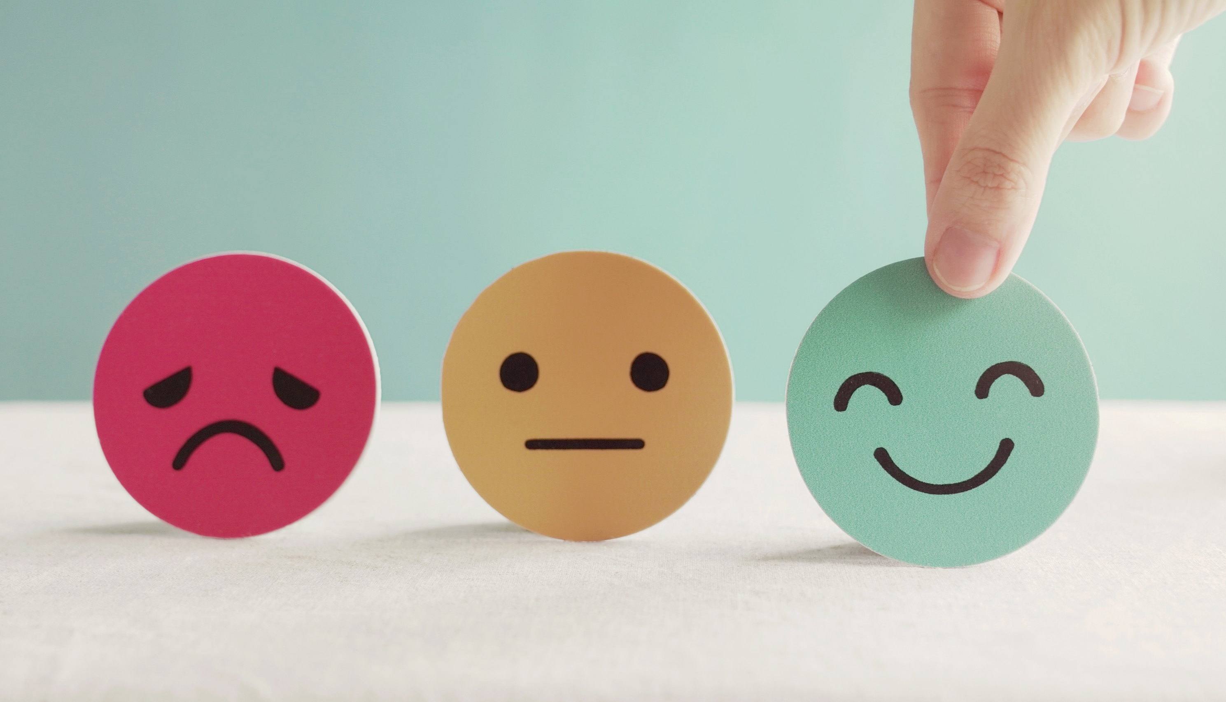
Lesson 3
Stay positive and have a nice day!

