Slide 1


Slide 2

.Period 70:
Unit 7: MOVIES
Lesson 3.1
NEW WORDS + LISTENING

Slide 3
2. NEW WORDS:
Nữ hoàng
- Queen /'kwi:n/ (n) :
- Soldier /'səʊldʒə[r]/(n):
Người lính
- Army /'ɑ:mi/ (n):
Quân đội
- King /kiη/ (n):
Vua
- Battle /'bætl/ (n):
Trận đánh
, (n):
- General (n):
Đại tướng
- Invader (n):
Kẻ xâm lược

Slide 4
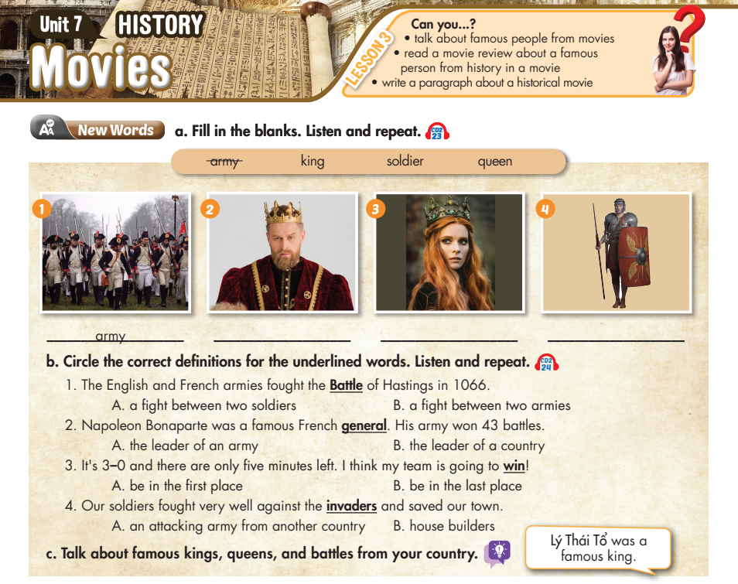

Lesson 3
king
queen
soldier

Slide 5


- Trưng Trắc was a famous genreral of Vietnam
- Quang Trung was a famous king of Vietnam

Slide 6
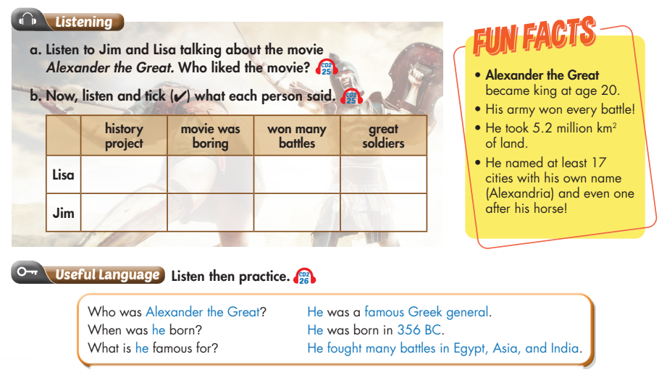
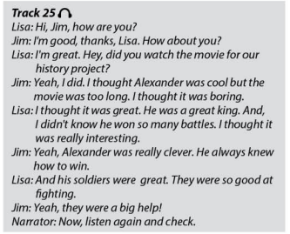

Lesson 3
Lisa

Slide 7


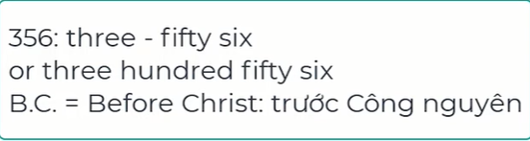
Lesson 3
Đánh nhau, chiến đấu

Slide 8
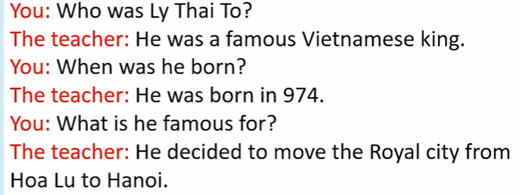
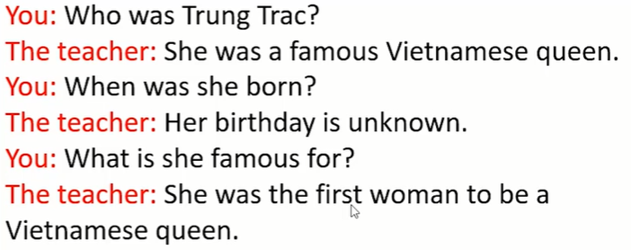

Slide 9

HOMEWORK
- Learn new words by heart.
- Practice talking about famous kings, queens, and battles from your country.
- Listening: Listen and fill in the blanks. (Workbook - page 42)
- Prepare for the next lesson: Unit 7: Lesson 3 - Reading, Speaking, Writing on page 61
- Study: What do you know about the story of Quang Trung...

Slide 10


