Slide 1


Slide 2

Lesson 1
Pick out one redundant letter in each word to make the correct words
1. supermarrket
2. train statioon
3. oppossite
4. beetween
5. post offiice
1. supermarket
2. train staion
3. opposite
4. between
5. post office
ANSWER

Slide 3

.Period 56:
Unit 6:
COMMUNITY SERVICES
Lesson 1.2
GRAMMAR

Slide 4

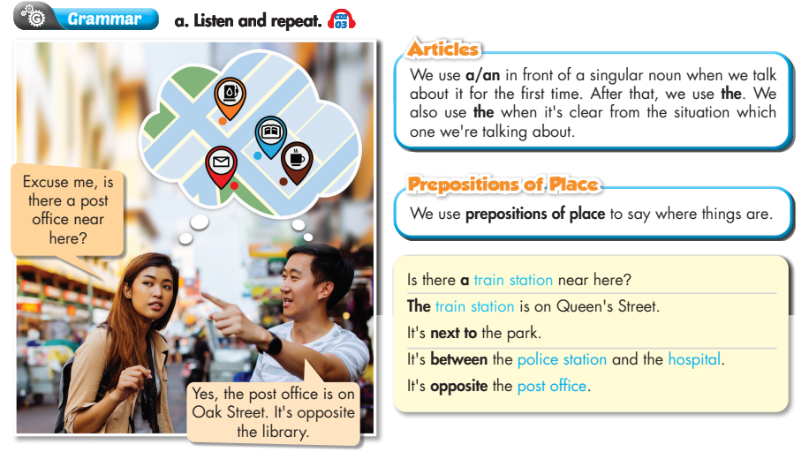
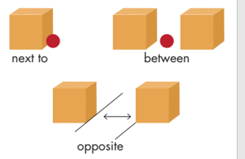
Lesson 1

Slide 5
1.Articles ( mạo từ)
A /An: ( Một)
+ dùng trước danh từ đếm được, số ít và được nhắc đến lần đầu tiên.
+ dùng sau There is
- THE dùng trước danh từ đã xác định hoặc trước danh từ được nhắc đến từ lần thứ 2 trở đi.
Lesson 1
2. Prepositions of place :
( giới từ chỉ vị trí)
- Between ( prep) : ở giữa

Slide 6
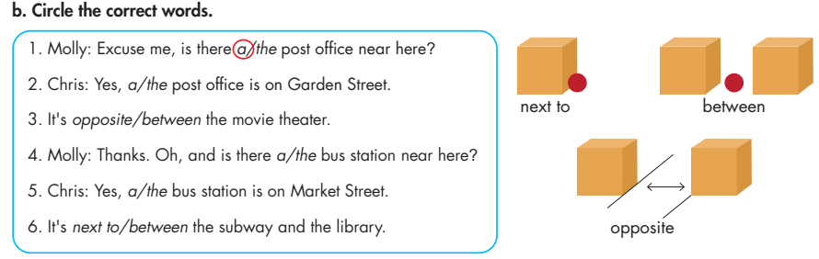
Lesson 1

Slide 7
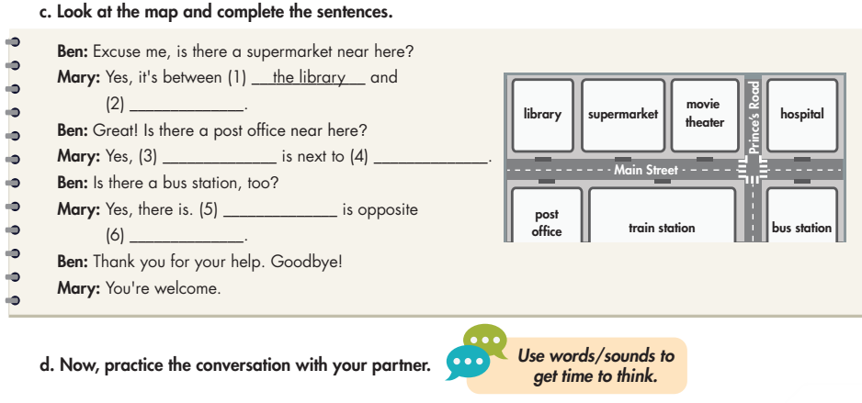
Lesson 1
the movie theater
the post office
the train station
the bus station
the hospital

Slide 8
Ben: Excuse me, is there a supermarket near here?
Mary: Yes, it's between the library and the movie theatre.
Ben: Great! Is there a post office near here?
Mary: Yes, the post office is next to the train station.
Ben: Is there a bus station, too?
Mary: Yes, there is. The bus station is opposite the hospital.
Ben: Thank you for your help. Goodbye!
Mary: You're welcome.

Slide 9

HOMEWORK
- Grammar 1 in workbook- page 33.
- Practice asking and answering about community services with a partner.
- Prepare for the new lesson: Pronunciation - Practice - Speaking (page 48)

Slide 10




The bye bye song
Bye, bye.
See you tomorrow.
Bye, bye.
See you tomorrow.
Bye, bye.
See you tomorrow.
Bye, bye. Bye, bye.
The bye bye
song
Notes:
10
10

