Slide 1


Slide 2
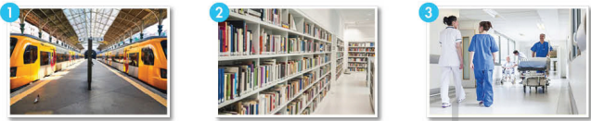
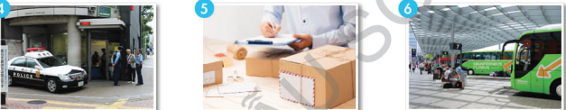
WHAT ARE THESE PICTURES ?
COMMUNITY SERVICES

Slide 3

Period 55:
Unit 6: COMMUNITY SERVICES
Lesson 1.1
NEW WORDS + LISTENING

Slide 4
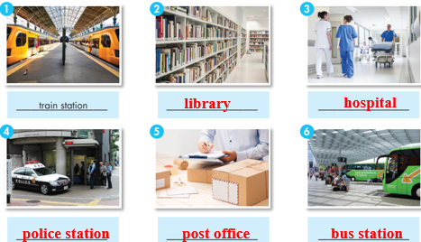
1. NEW WORDS:
- Train station (n):
Ga tàu lửa
- Library (n):
Thư viện
- Hospital (n):
Bệnh viện
- Police station (n):
Đồn cảnh sát
- Post office (n):
Bưu điện
- Bus station (n):
Bến xe buýt
- Near ( prep ) :
Gần
- Next to (prep):
Kế bên
- Opposite (prep):
Đối diện

Slide 5

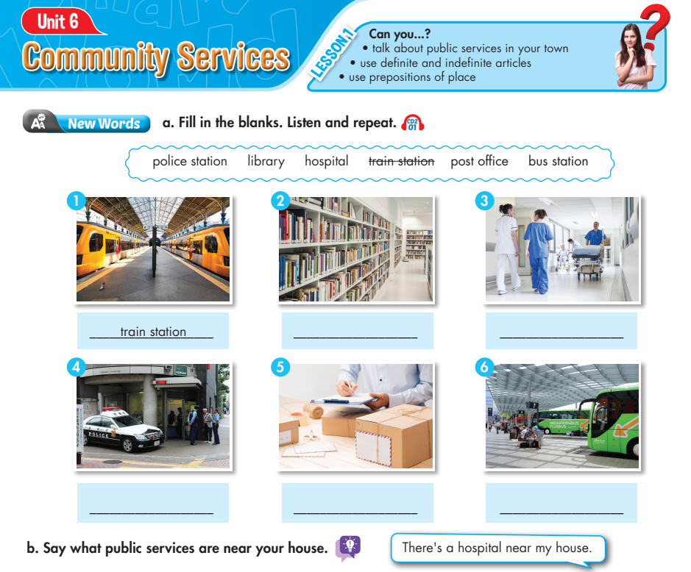
A. New Words:
Lesson 1
a. Fill in the blanks. Listen and repeat.
police station library hospital train station post office bus station
train station
library
hospital
police station
post office
bus station
b. Say what public services are near your house.
Ex: There’s a hospital near my house.

Slide 6
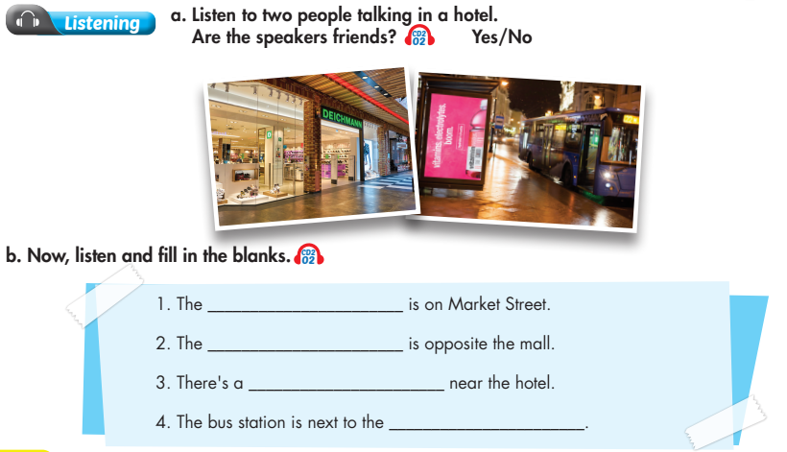
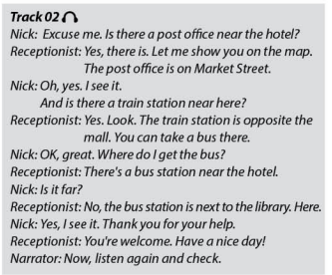
Lesson 1
post office
train station
bus station
library

Slide 7

HOMEWORK
- Learn new words about community services.
- Write four sentences about community services near their house/ neighborhood.
- Do exercises A. New Words in the workbook (page 32)
a. Unscramble the words
b. Read the sentences and number the pictures.
- Prepare for the new lesson – Grammar articles (a/ an/ the) and prepositions of place.

Slide 8




The bye bye song
Bye, bye.
See you tomorrow.
Bye, bye.
See you tomorrow.
Bye, bye.
See you tomorrow.
Bye, bye. Bye, bye.
The bye bye
song
Notes:
8
8

