Slide 1
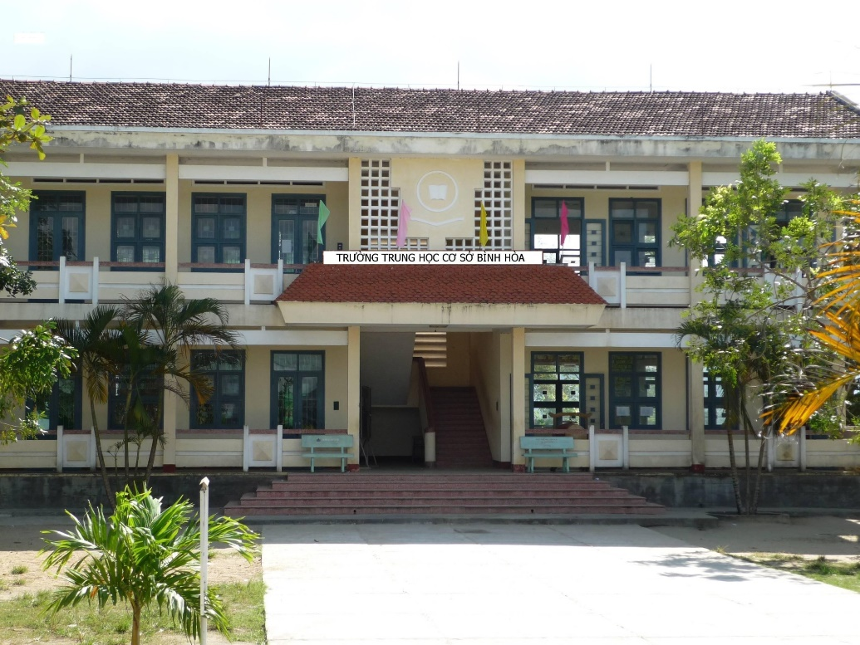
Binh Hoa Secondary School
Good morning everybody
WELCOME TO OUR CLASS
Minh Thảo

Slide 2
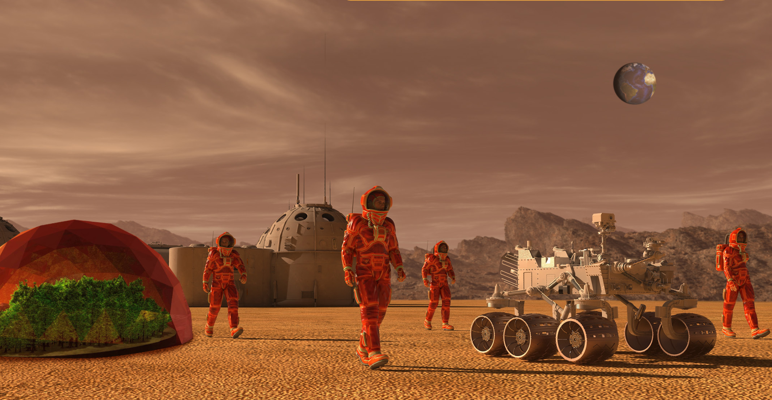
Look at the picture and answer the questions.
What can you see in the picture?
Who are they?
Where are they?
Do you think humans will live on a different planet in the future? Why (not)?

Slide 3
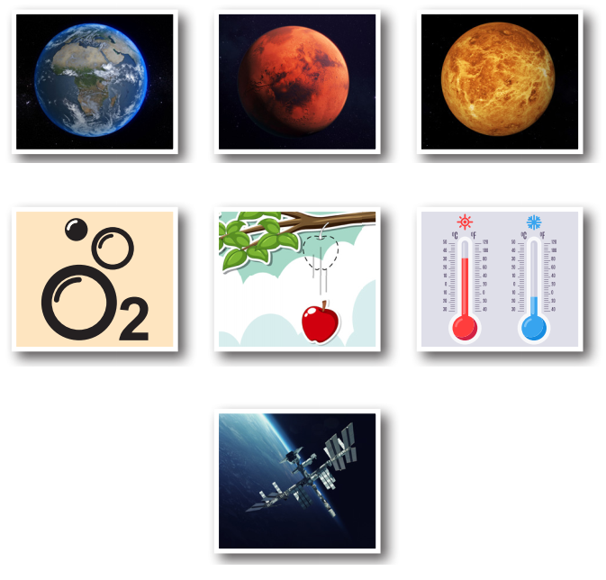
Look at the picture and answer the questions.
What can you see in each picture?

Slide 4
New words
- Earth (n) /ɝːθ/ Trái Đất
- Mars (n) /mɑːrz/ sao Hỏa
- Venus (n) /ˈviːnəs/ sao Kim
- planet (n) /ˈplænɪt/ hành tinh
- space station (np) /ˈspeɪs ˌsteɪʃən/ trạm vũ trụ
- oxygen (n) /ˈɑːksɪdʒən/ ô-xy
- gravity (n) /ˈɡrævəti/ trọng lực
- temperature (n) /ˈtempɚətʃɚ/ nhiệt độ
Notes:
GV click vào từng cụm nghe âm thanh

Slide 5
Can you remember?
Earth
Mars
Venus
oxygen
gravity
temperature
space station

Slide 6
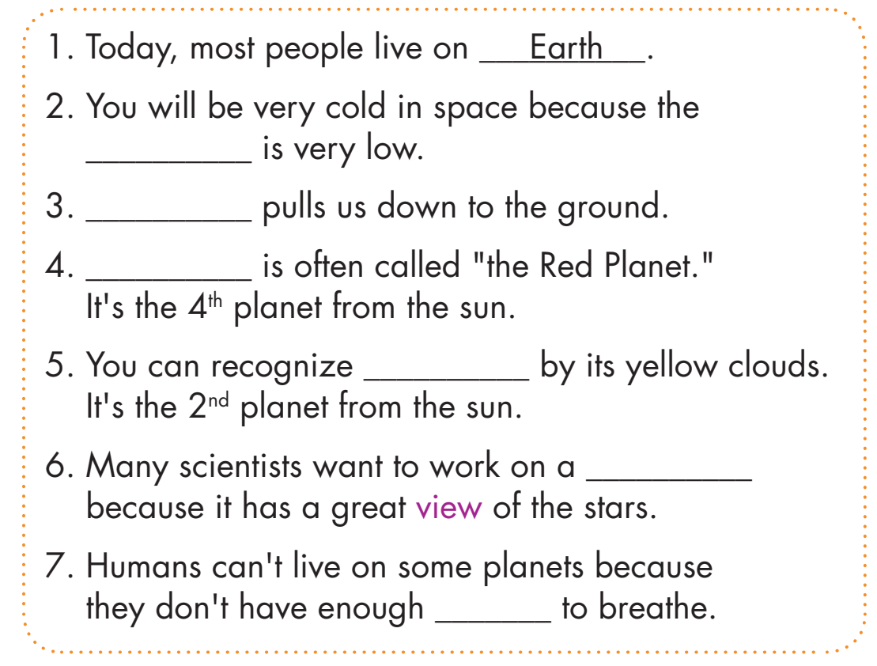
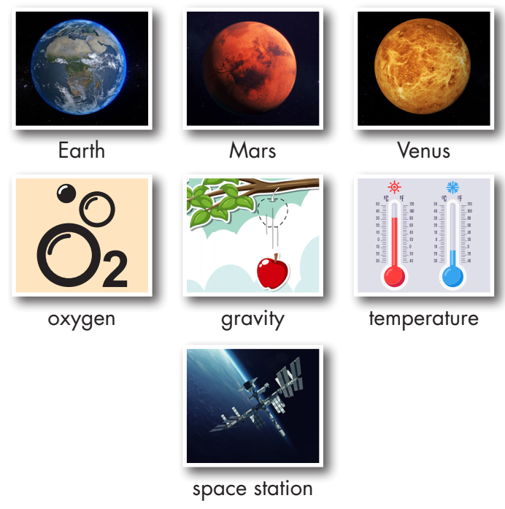
Look at the pictures and fill in the blanks
temperature
reading comics
Gravity
Mars
Venus
space station
oxygen

Slide 7
WORK IN PAIRS
Would you like to visit another planet or a space station? Why (not)?

Slide 8
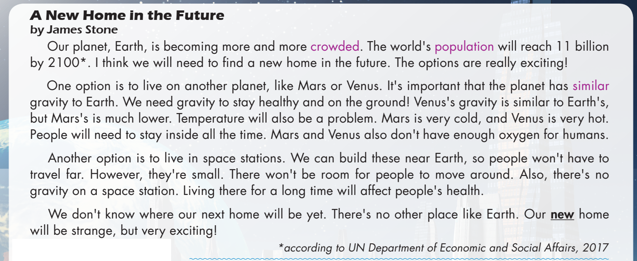
a. Read the magazine article. What is it about?
1. Different places people can live in the future
2. Why space stations will be the best places to live

Slide 9
b. Read and answer the questions.

Slide 11
11 billion
What will the world's population be by the year 2100?
How is Mars's gravity different from Earth’s?
Why will people need to stay inside on Venus?
It's much lower.
It’s very hot.
A New Home in the Future
by James Stone Our planet, Earth, is becoming more and more crowded. The world's population will reach 11 billion by 2100. I think we will need to find a new home in the future. The options are really exciting!
One option is to live on another planet, like Mars or Venus. It's important that the planet has similar gravity to Earth. We need gravity to stay healthy and on the ground! Venus's gravity is similar to Earth’s, but Mars's is much lower. Temperature will also be a problem. Mars is very cold, and Venus is very hot. People will need to stay inside all the time. Mars and Venus also don't have enough oxygen for humans.

Slide 12
4. Why is it good that we can build space stations near Earth?
5. The word new in paragraph 4 is closest in meaning to ______.
A. different from before B. recently made C. not known before
Because people won't have to travel far.
Another option is to live in space stations. We can build these near Earth, so people won't have to travel far. However, they're small. There won't be room for people to move around. Also, there's no gravity on a space station. Living there for a long time will affect people's health.
We don't know where our next home will be yet. There's no other place like Earth. Our new home will be strange, but very exciting!

Slide 13
Listen and read.

Slide 14
WORK IN PAIRS
Would you prefer to live on Mars, Venus, or a space station? Why?

Slide 15
Lesson 3
Homework
Learn the new words.
Practice talking about future home.
Do the exercises in WB pages 32 & 33.
Play the consolidation games in Tiếng Anh 8 i-Learn Smart World DHA App on www.eduhome.com.vn
Prepare Lesson 1.2 – Grammar. Pages 55 & 56 – SB.
Do the exercises in Notebook. Pages 46 & 47.

Slide 16
THANK YOU FOR YOUR LISTENING.
Lesson 2
Goodbye everybody

