Slide 1
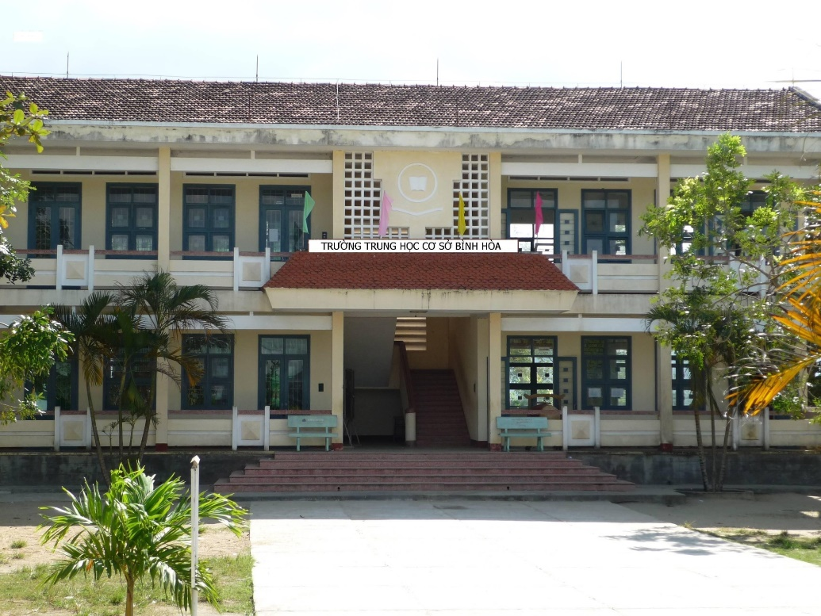
Binh Hoa Secondary School
Good morning everybody
WELCOME TO OUR CLASS
Minh Thảo

Slide 2
Lesson 2

Slide 3
Lesson 2
Grammar
Modal: might
- We might have robot helpers in the future.
- He might have robot pets in the future.
- In the future, doors might have cameras.
- Smart devices might not have screens in the future.
- How might homes change in the future?
Form:
(+) S + might + V ….
(-) S + might not + V ….
(?) Might + S + V ...?
(Wh) Wh- + might + S + V + …?

Slide 4
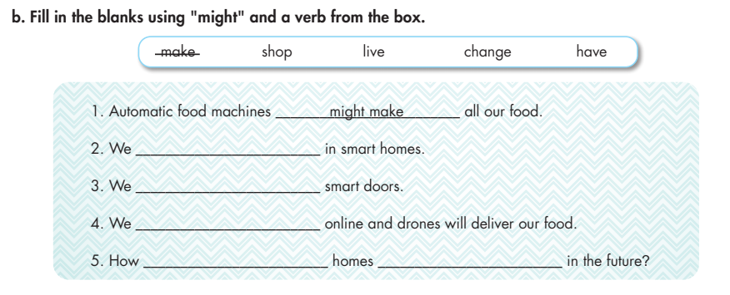
Lesson 2
might live
might have
might shop
might
change

Slide 5
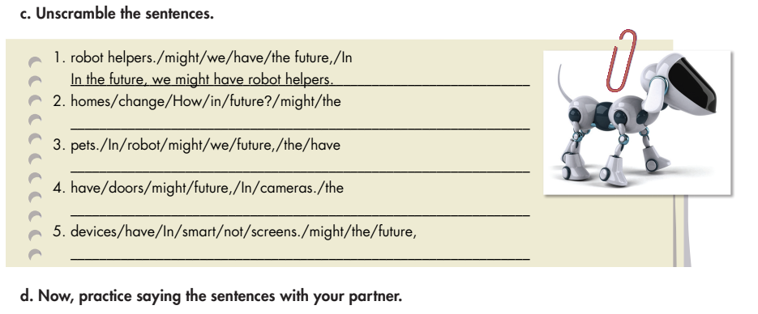
Lesson 2
How might homes change in the future?
In the future, we might have the robot pets
In the future, doors might have cameras.
In the future, smart devices might not have screens.

Slide 6
THANK YOU FOR YOUR LISTENING.
Lesson 2
Goodbye everybody

