Slide 1
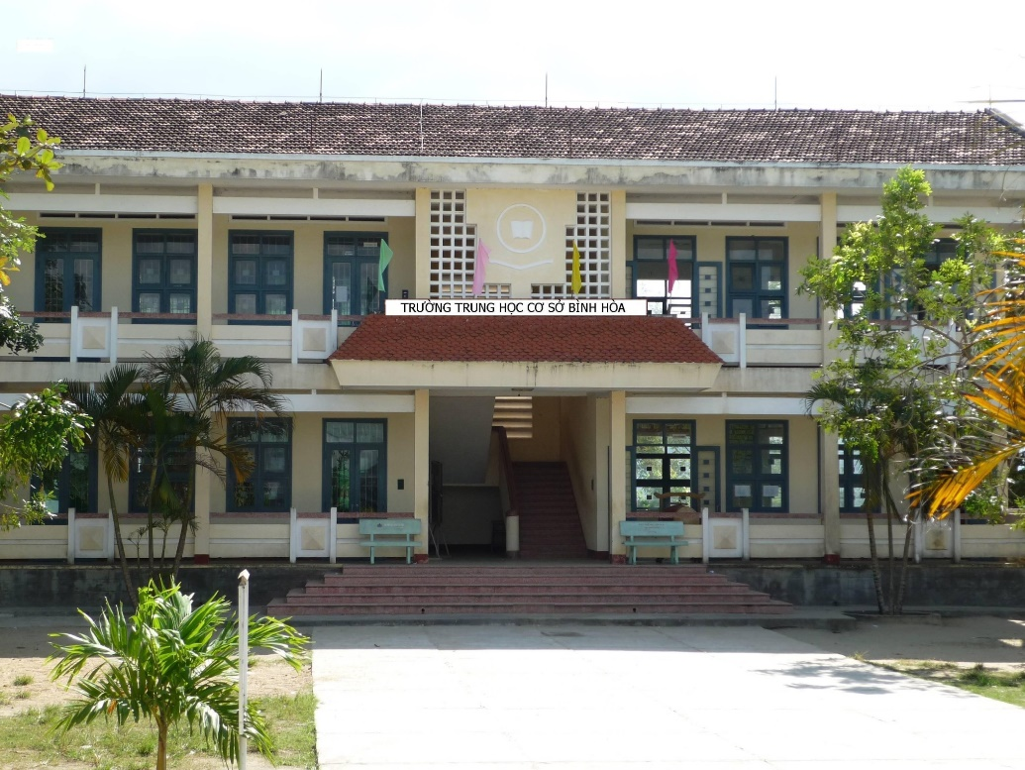
Binh Hoa Secondary School
Good morning everybody
WELCOME TO OUR CLASS
Minh Thảo

Slide 2
Lesson 2
great
funny
exciting

Slide 3
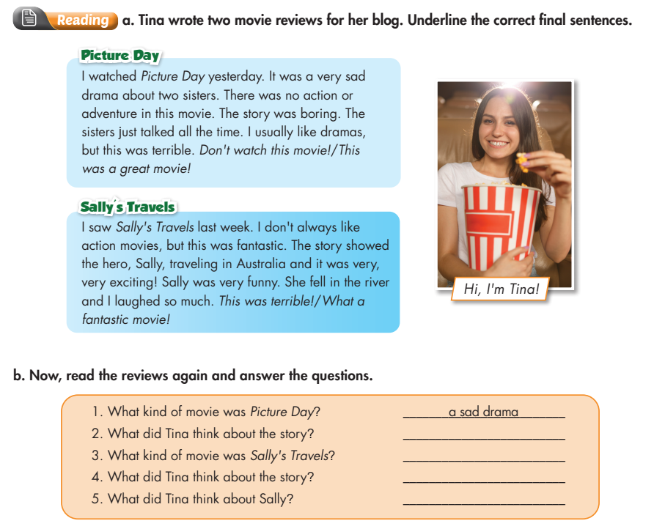
Lesson 2
It was boring
an action movie
It was exciting
She was very funny

Slide 4
Lesson 2
Put the words in correct order
1. movies are exciting I think action.
I think action movies are exciting.
2. story was boring Tina thinks the.
Tina thinks the story was boring.
3. really exciting The movie was
The movie was really exciting

Slide 5
THANK YOU FOR YOUR LISTENING.
Lesson 2
Goodbye everybody

