Slide 1
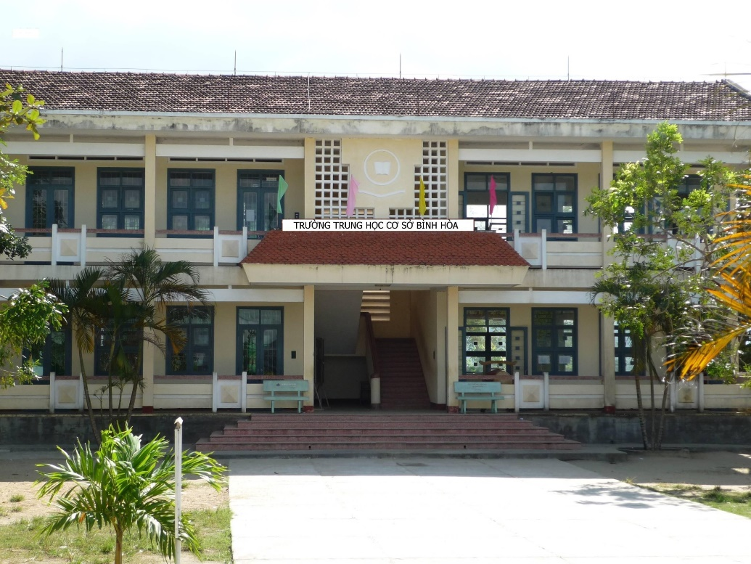
Binh Hoa Secondary School
Good morning everybody
WELCOME TO OUR CLASS
Minh Thảo

Slide 2
Lesson 2
plastic bottle
can
glass jar
plastic bag

Slide 3
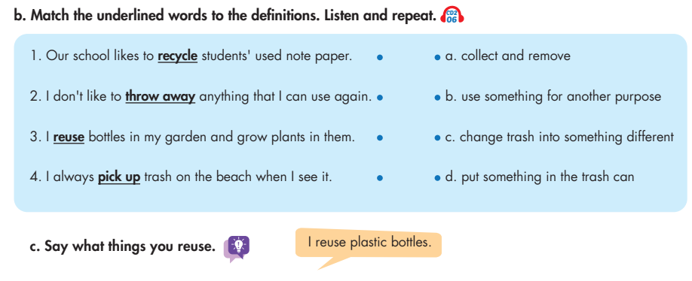
Lesson 2

Slide 4
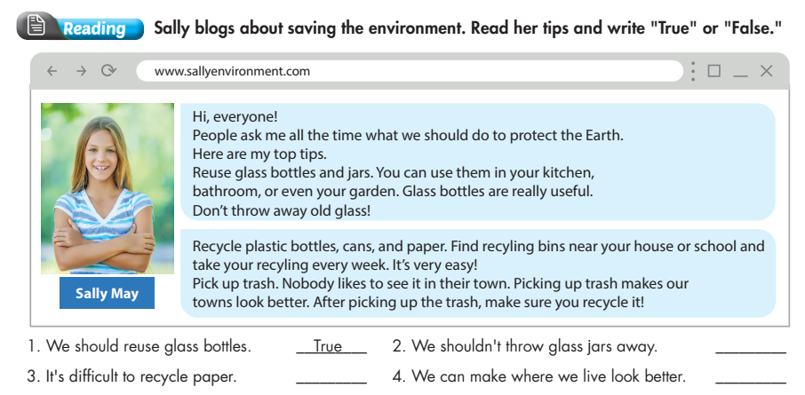
Lesson 2
True
False
True

Slide 5
Lesson 2
Put the words in correct order
1. bottles and jars Reuse glass.
Reuse glass bottles and jars.
2. away old glass Don't throw.
Don't throw away old glass!
3. bottles, cans, and paper Recycle plastic.
Recycle plastic bottles, cans, and paper.
4. reuse glass bottles We should.
We should reuse glass bottles.
5. throw glass jars We shouldn't away.
We shouldn't throw glass jars away.
throw glass jars

Slide 6
Lesson 2
THANK YOU FOR YOUR LISTENING.
Goodbye everybody

