Slide 1

Unit 5: Food and Drinks
Lesson 1.1: Vocabulary & Listening
Page 36

Slide 2

New words
spaghetti
lemon
tomato
onion
tablespoon
teaspoon
grams
milliliters

Slide 3

WARM UP

Slide 4

Work in groups
- Make a shopping list for things to buy to prepare dinner.
- Add quantity of the things you intend to buy.

Slide 5
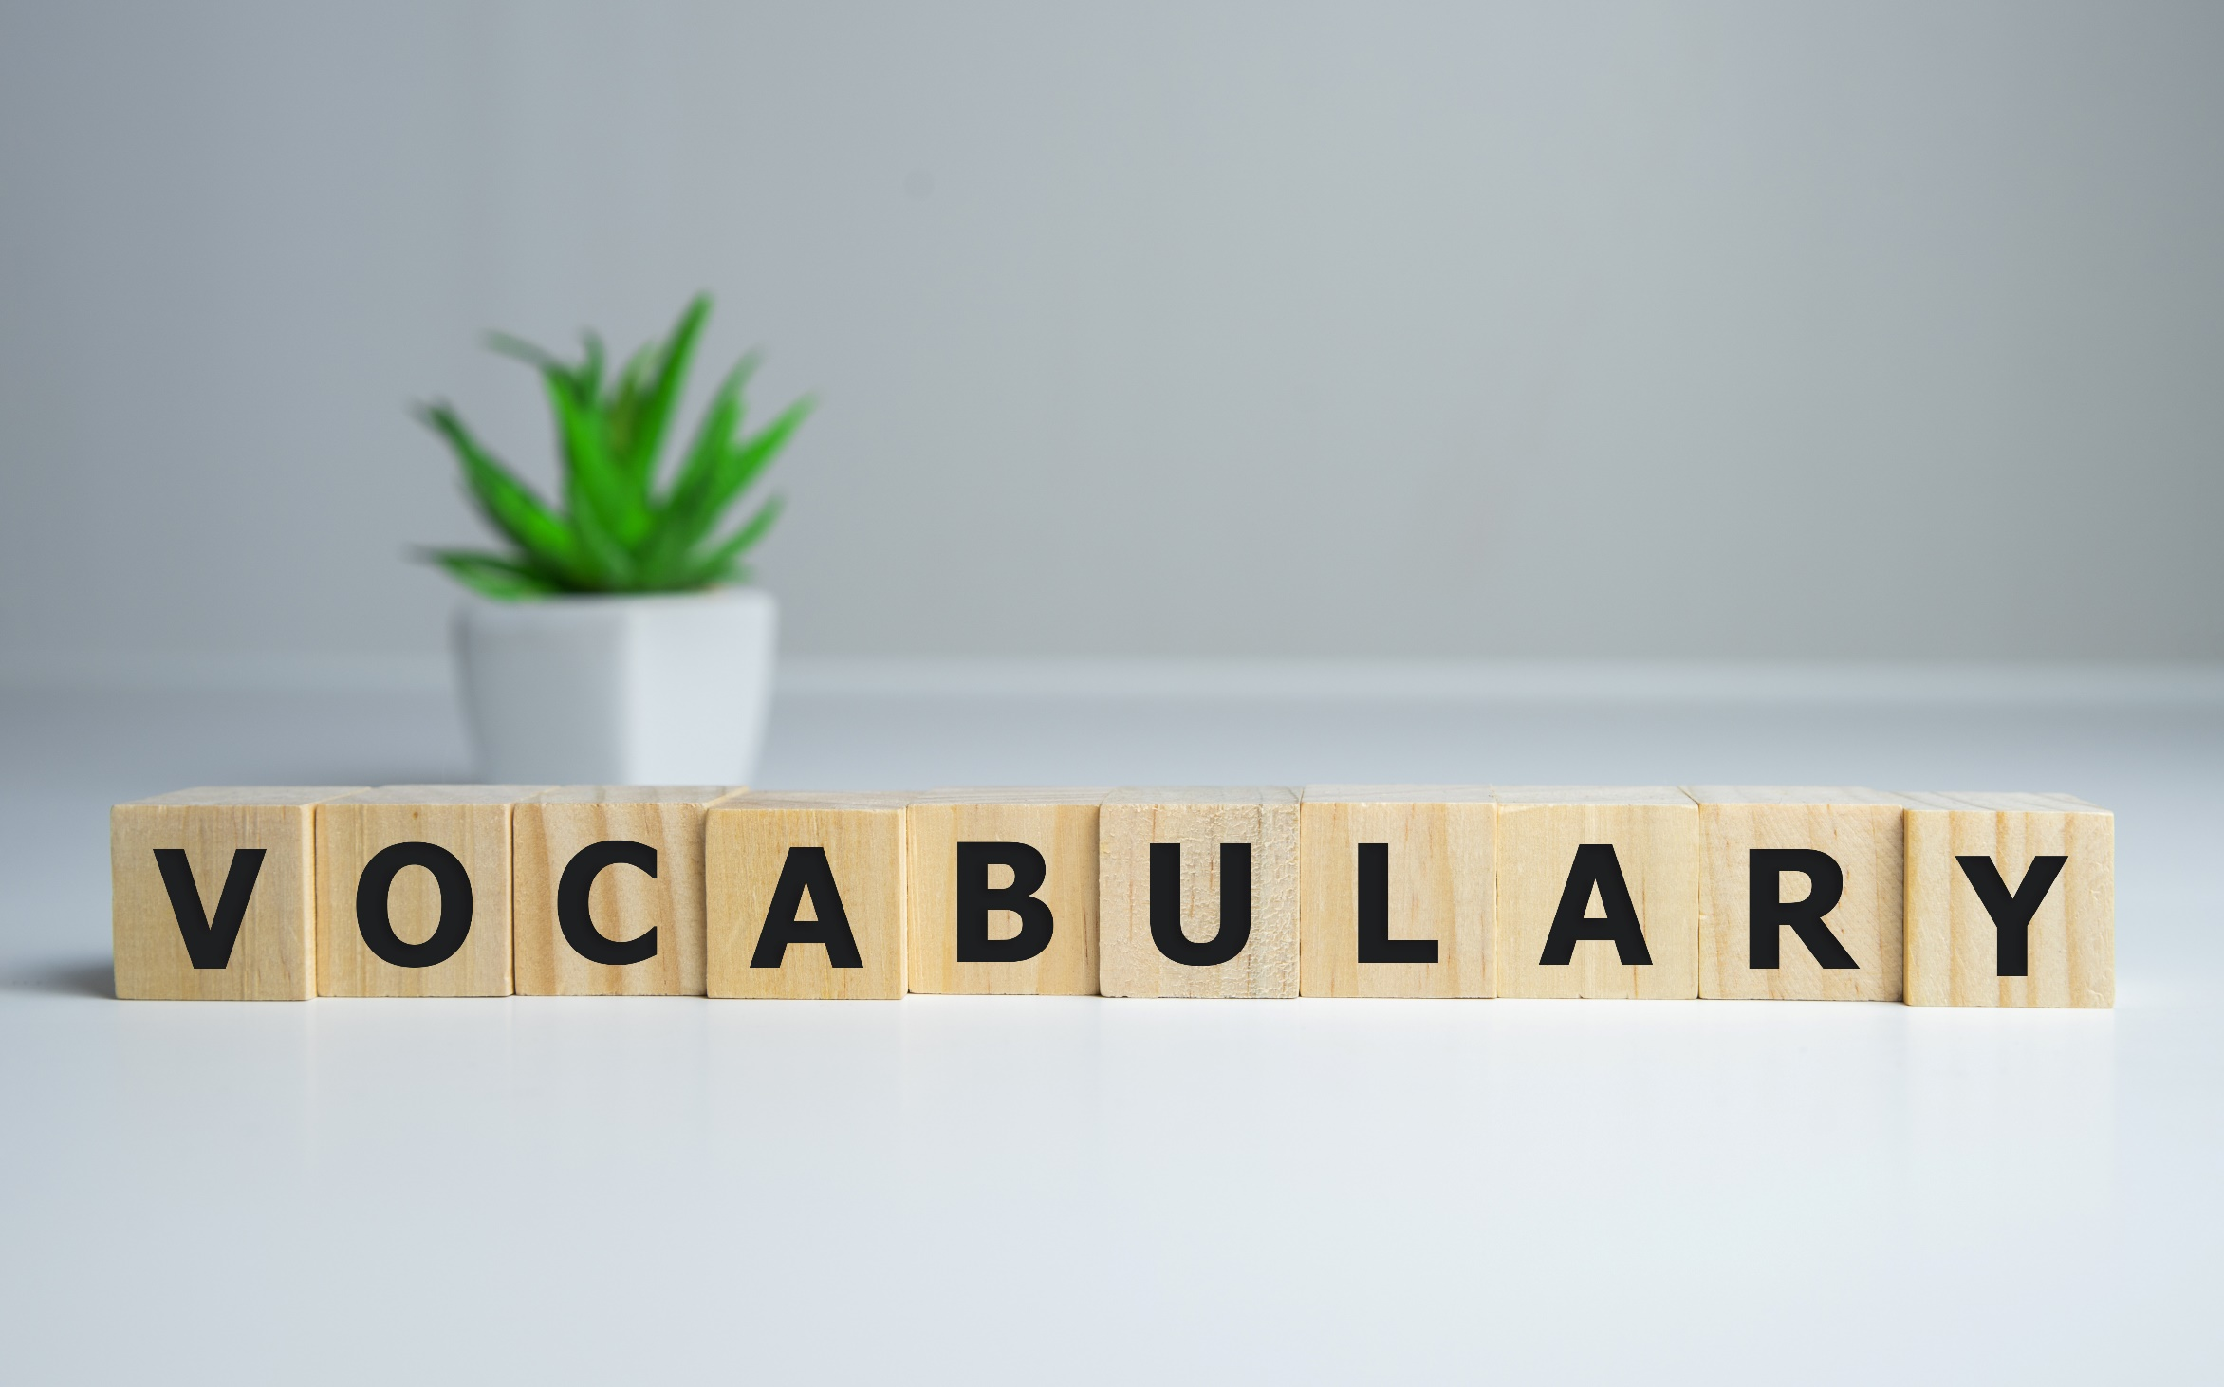


Slide 6

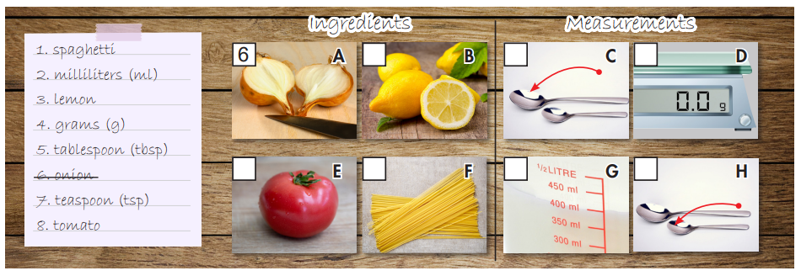
Work in pairs. Number the pictures.
3
5
4
8
1
2
7

Slide 7

Listen and repeat. Click each phrase to hear the sound.
1. spaghetti (n) / spəˈɡeti / mì Ý
2. milliliters (n) / mɪləˌliːt̬ɚz/ mi- li- lit
3. lemon(n) / ˈlemən / quả chanh
4. grams(n) / ɡræmz / gam / gram
5. tablespoons (n) / ˈteɪbəlspuːnz / muỗng lớn
6. onion (n) / ˈʌnjən / hành tây
7. teaspoon(n) / ˈtiːspuːn / muỗng nhỏ
8. tomato (n) / təˈmeɪt̬oʊ / quả cà chua
Notes:
GV click vào từng cụm nghe âm thanh

Slide 8
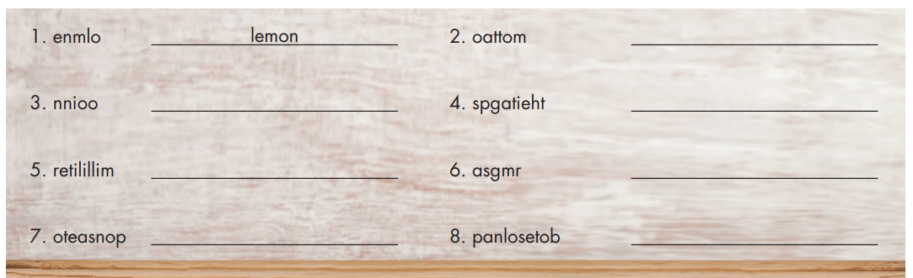
Extra Practice
WB, page 26
Unscramble the words.
tomato
onion
spaghetti
milliliter
grams
teaspoon
tablespoon

Slide 9
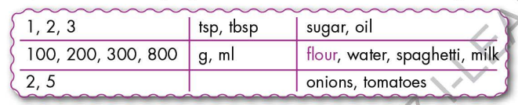
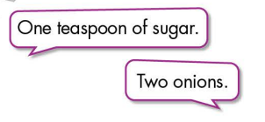
Work in pairs.
Practice saying units of measurement with the ingredients using the numbers below

Slide 10


It’s listening time….

Slide 11
Pre - listening
Read the instruction quickly. Underline the key words. What are we going to do?
Listen and choose the correct answer.
a. Listen to Logan talking to his mom. Where are they?

Slide 12
While - listening
a. Listen to Logan talking to his mom. Where are they?
☞ YOUR ANSWER?
☞ WHY?
Now, finish your homework and then we can go shopping!

Slide 13
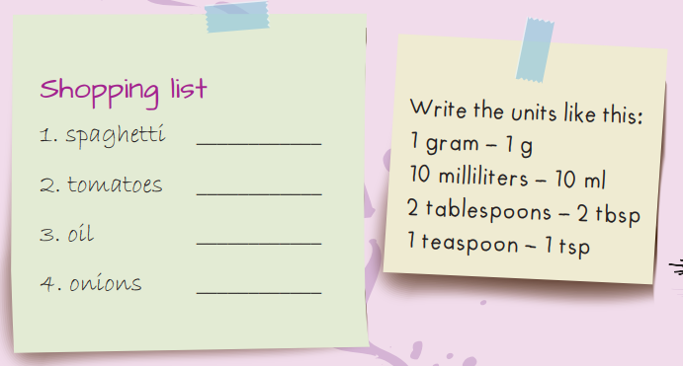
While - listening
b. Now listen and write the amounts or quantities they need.
450g
five
1 bottle
four

Slide 14

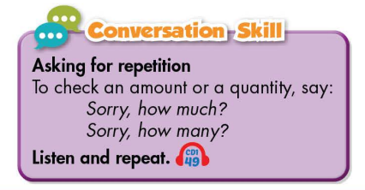
Work in pairs
Post - listening
What do you usually buy at the supermarket?

Slide 15

CONSOLIDATION

Slide 16
Make a shopping list for things to prepare for lunch / dinner

Slide 17

WRAP-UP

Slide 18
Today’s lesson
Vocabularies
spaghetti
lemon
tomato
onion
tablespoon
teaspoon
grams
milliliters

Slide 19
Today’s lesson
Listening:
Listening for main ideas and specific information
Speaking:
Talking about shopping list, amounts and quantities
Asking for repetition

Slide 20

Lesson 3
Stay positive and have a nice day!

