Slide 1
Unit 2: HEALTH
Lesson 2.1: Vocabulary & Listening
Page 15

Slide 2
New words
feel weak
have a sore throat
get some rest
take vitamins
have a fever
take medicine
stay up late
keep warm

Slide 3
WARM UP

Slide 5
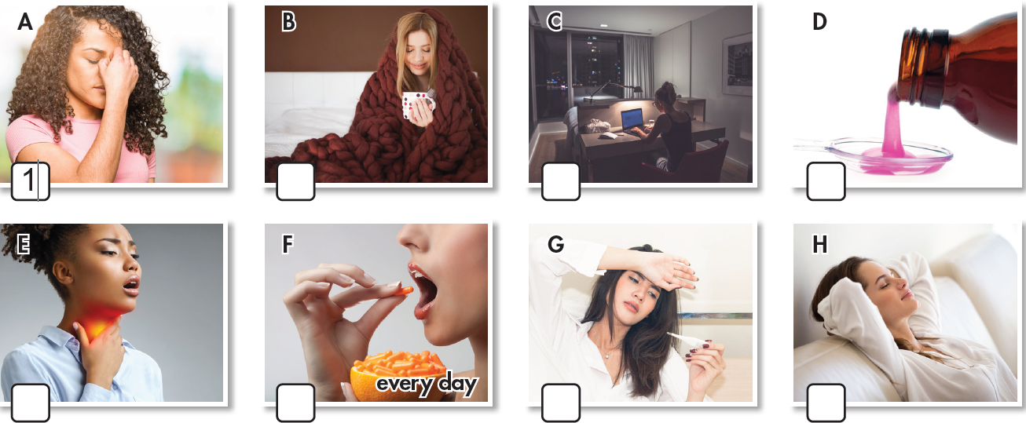
Work in pairs. What can you see in each picture?

Slide 6
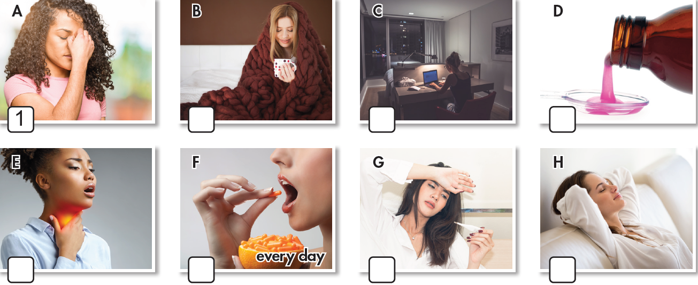
(Work in pairs) a. Match each phrase to each picture.
1. feel weak
2. have a sore throat
3. get some rest
4. take vitamins
5. have a fever
6. take medicine
7. stay up late
8. keep warm
8
7
6
2
4
5
3
Click here to show the answers.

Slide 7
Listen and repeat. Click each phrase to hear the sound.
feel weak (v phr) /fiːl wiːk/: có cảm giác yếu
have a sore throat (v phr) /hæv ə sɔːr θrəʊt/: bị đau họng
get some rest (v phr) /ɡet sʌm rest/: nghỉ ngơi
take vitamins (v phr) /teɪk ˈvaɪtəmɪnz/: ăn / uống vitamin
have a fever (v phr) /hæv ə ˈfiːvər/: bị sốt
take medicine (v phr) /teɪk ˈmedɪsn/: uống thuốc
stay up late (v phr) /steɪ ʌp leɪt/: thức khuya
keep warm (v phr) /kiːp wɔːrm/: giữ ấm
Notes:
GV click vào từng cụm nghe âm thanh

Slide 8
Work in pairs.
b. Discuss more health problems and give advice.

Slide 9
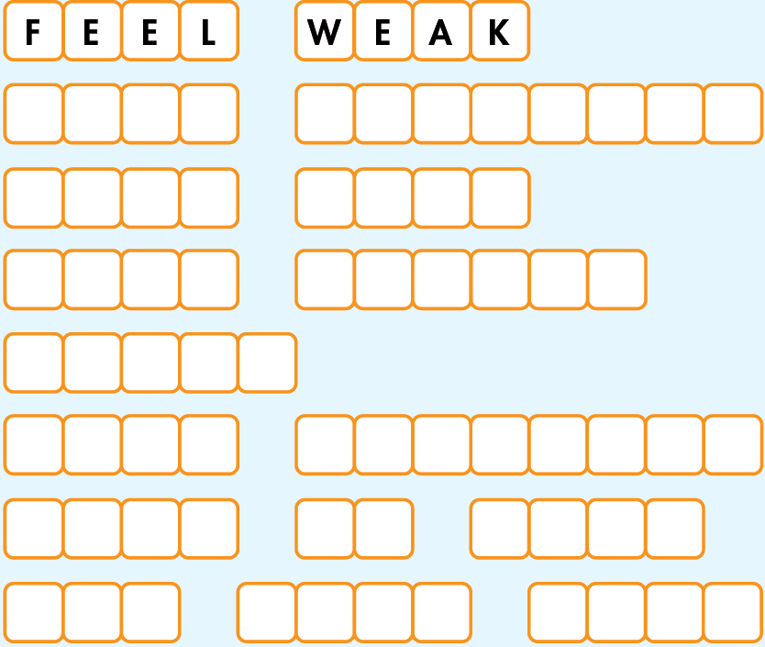
Workbook page 10
a. Unscramble the words and phrases.
1. E E L F E A W K
2. K A T E A V I T N I S M
3. P E E K M R W A
4. E O R S T A T O H R
5. R F V E E
6. K E T A C M E N D E I I
7. A Y S T P U L E A T
8. E G T O E S M S T E R
T A K E
V I T A M I N S
K E E P
W A R M
S O R E
T H R O A T
F E V E R
T A K E
M E D I C I N E
S T A Y
U P
L A T E
Click here for the answers.
G E T
S O M E
R E S T

Slide 10
Workbook p. 10
b. Fill in the blanks using the words from Task a.
1. I have no energy and can't do any work. I _____ _____.
2. I feel very hot and sick. I think I have a ______.
3. The doctor told me to _____ ________ after eating, three times a day.
4. If you eat a healthy diet, you don't need to _______ _______.
feel weak
fever
take medicine
take vitamins
Click here for the answers.

Slide 11
Workbook p. 10
b. Fill in the blanks using the words from Task a.
5. You should wear a thick jacket and scarf to ______ _____ in winter.
6. I have a cough and a _____ _____ . It hurts when I drink.
7. Many teens ____ ____ ____ to do homework or watch TV. That's bad for their health because they won't get enough sleep.
8. You look tired. You should ____ ____ ____.
keep warm
sore throat
stay up late
get some rest
Click here for the answers.

Slide 12
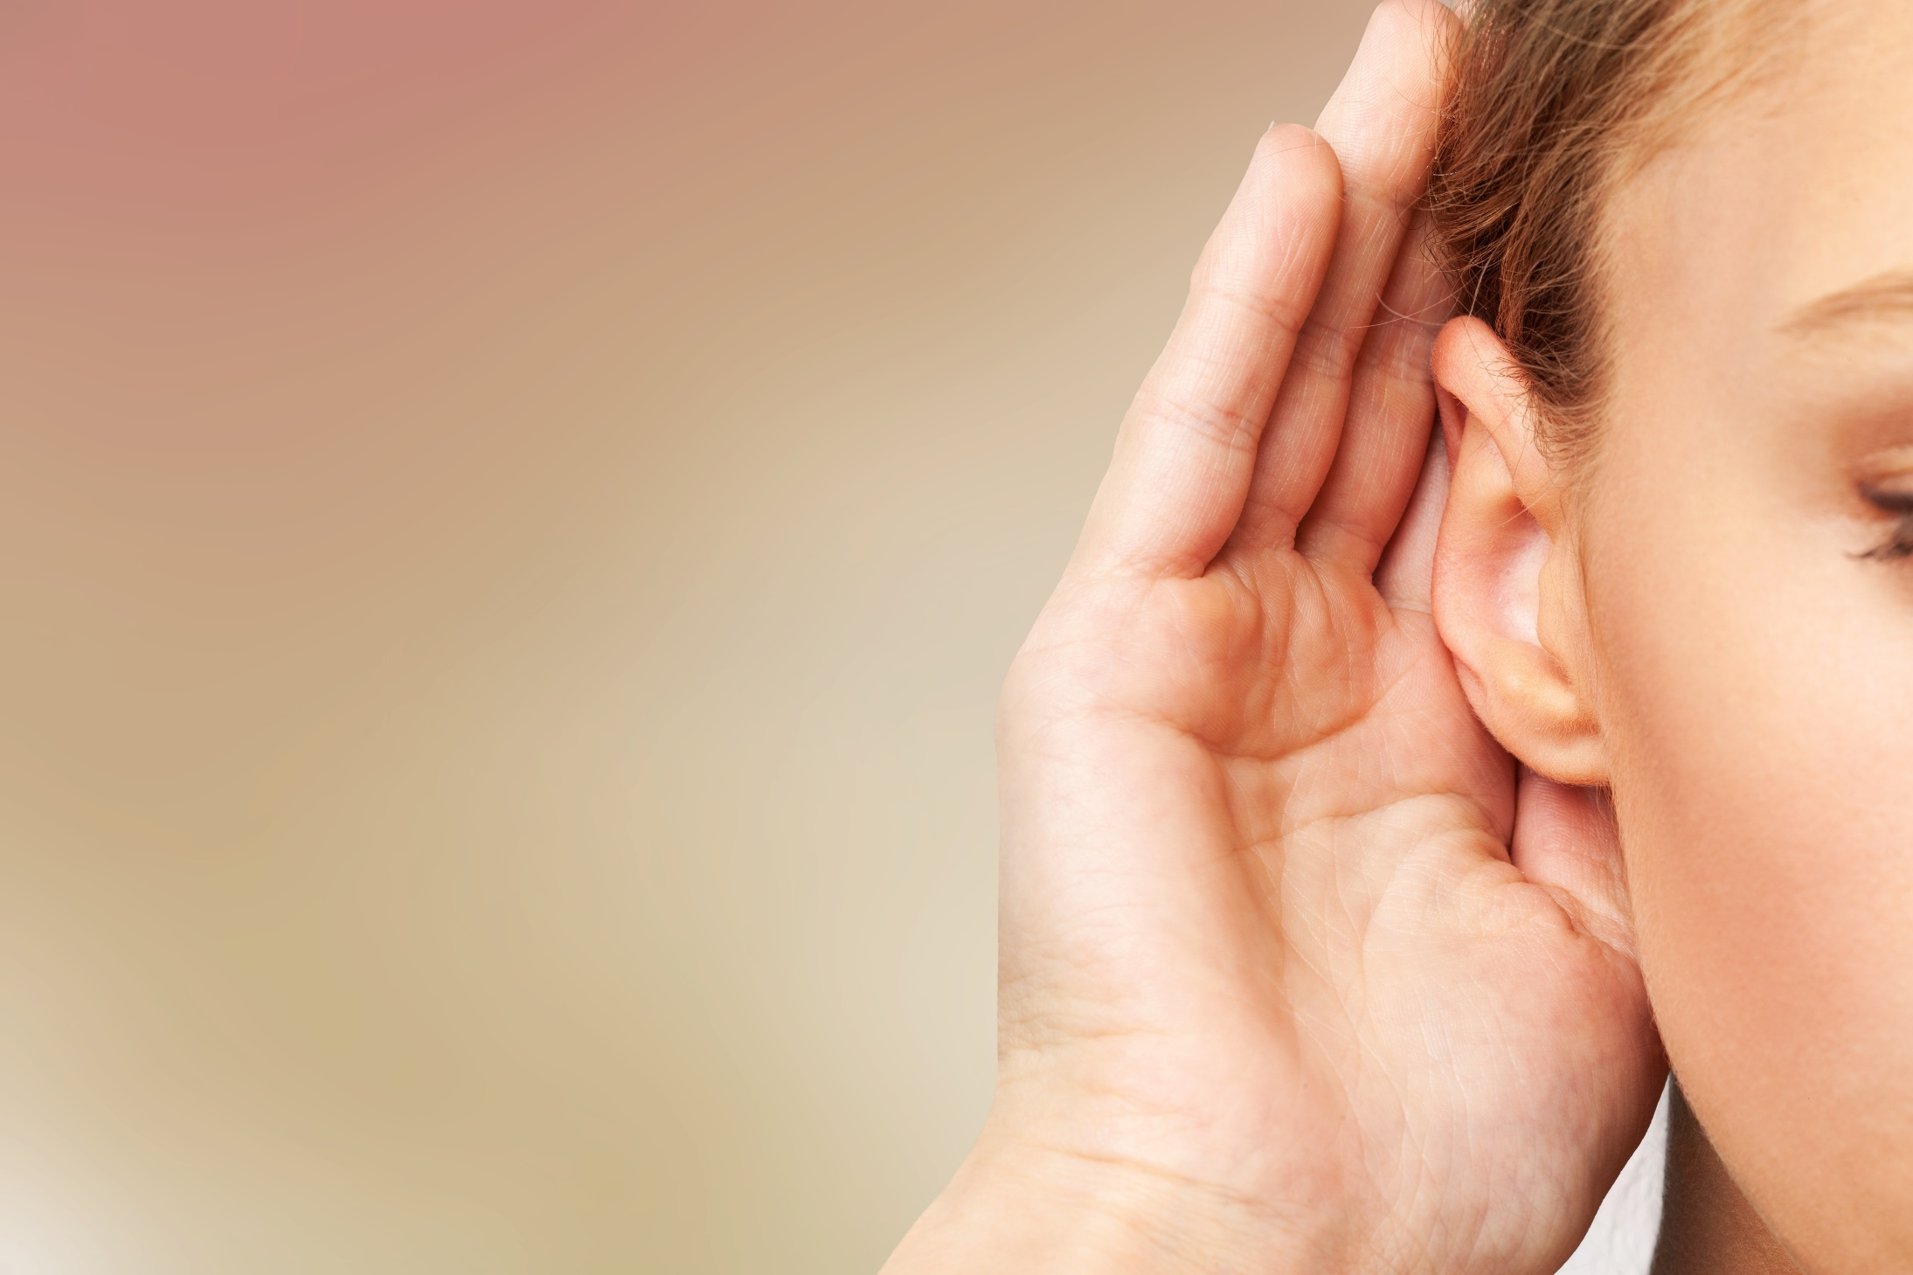

Slide 13
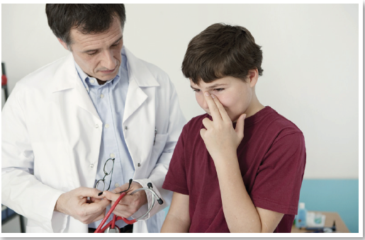
Work in pairs.
What’s wrong with the boy?

Slide 14
a. Listen to Jacob visiting the doctor. Circle the reason for Jacob's visit. (Click here for the audio)
1. He wants a health check. 2. He is sick.
Keywords: a sore throat, feel very tired
Click here to show the answers.

Slide 15
b. Listen and fill in the blanks. (Click here for the audio)
sore throat
very tired
late
laptop
7 / seven
Click here to show the answers.

Slide 16
SCRIPTS
Jacob: Good morning, Doctor.
Doctor: Good morning, Jacob. What can I do for you today?
Jacob: I'm not feeling very well.
Doctor: How are you feeling?
Jacob: I have a sore throat and I feel very tired.
Doctor: I see. Are you getting enough sleep every night?
Jacob: Hmm…Not really. I often stay up late because I
have a lot of homework.
Doctor: Do you use a computer for your homework?
Jacob: Yes. I use a laptop all the time.
Doctor: Well, you shouldn't stay up late or spend too
much time on your laptop.
Click here for the audio
Jacob: OK, I'll try.
Doctor: And you should get at least seven hours of sleep
every night. Eight or nine hours would be better.
Jacob: OK.
Doctor: Here's some medicine for your throat. Take it
every morning and night.
Jacob: Thanks, Doctor.
Doctor: You're welcome.
Narrator: Now, listen again and check.

Slide 17
Workbook page 10-11. (WB track 3. Click here for the audio)
a. Listen to two children talking at school. Who has a healthier lifestyle?
1. Brenda 2. Pete
Click here to show the answers.

Slide 18
Workbook page 10-11. (WB track 3. Click here for the audio)
b. Listen and circle A, B, or C.
Click here for the answers.
1. Pete has...
A. a headache. B. a sore throat. C. a stomachache.
2. Pete does...
A. a lot of exercise. B. a little exercise. C. no exercise.
3. Brenda eats...
A. some junk food. B. no fresh fruit. C. a lot of salad.
4. Pete eats...
A. a lot of salad. B. a little salad. C. no salad.
5. Pete should...
A. do more exercise. B. eat more junk food. C. watch less TV.

Slide 19
SCRIPT
G: Hey Pete. You don't look well today. Are you OK?
B: No. I feel sick. I didn't really want to come to school today.
G: What's wrong with you?
B: I had a headache last night, and now I have a sore throat. My mom says my lifestyle is unhealthy.
G: Do you eat healthy food and do any exercise?
B: Not really. I love fast food and I'm too lazy to do any exercise.
G: You know I stay healthy by doing exercise every day and I always eat healthy food.
B: What do you eat?
G: Well, things like salad and fresh fruit. And I don't eat junk food.
B: Salad? Urgh! I hate salad!
G: Well, you should eat less junk food and you should definitely try to exercise more.
Click here for the audio

Slide 20
Student’s book page 15
c. What do you do when you're sick? Why?
Click here for the audio.

Slide 21
CONSOLIDATION

Slide 22
Write three examples about what you should do when you have a sore throat or when you are tired. (about 25 words)
Ex: When I have a sore throat, I always drink warm water.

Slide 23
WRAP-UP

Slide 24
Lesson 3
Today’s lesson
Vocabulary
feel weak
have a sore throat
get some rest
take vitamins
have a fever
take medicine
stay up late
keep warm
Listening
listening for gist and for detail about health problems
Conversation skill
To offer to help someone, say:
What can I do for you?
How can I help?

Slide 25
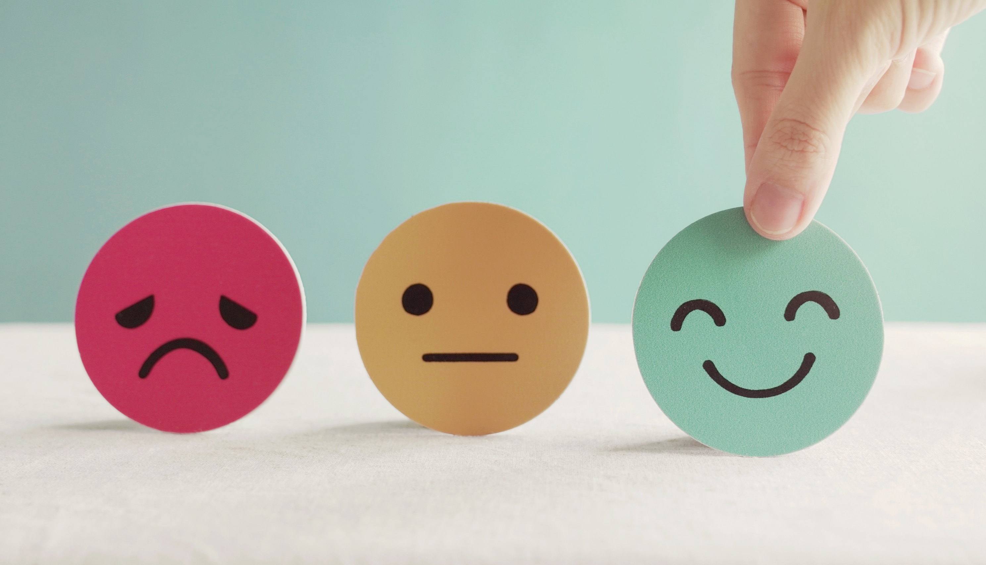
Lesson 3
Stay positive and have a nice day!

