Slide 1

UNIT 5: FREE TIME ACTIVITIES Lesson 2.1
Page 36

Slide 2

WARM UP

Slide 3

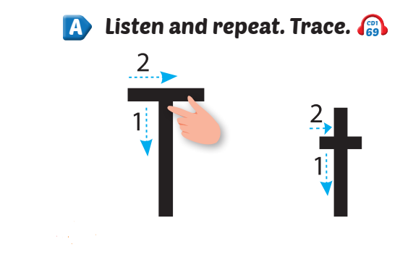


Click Alphabet to hear the sound

Slide 4
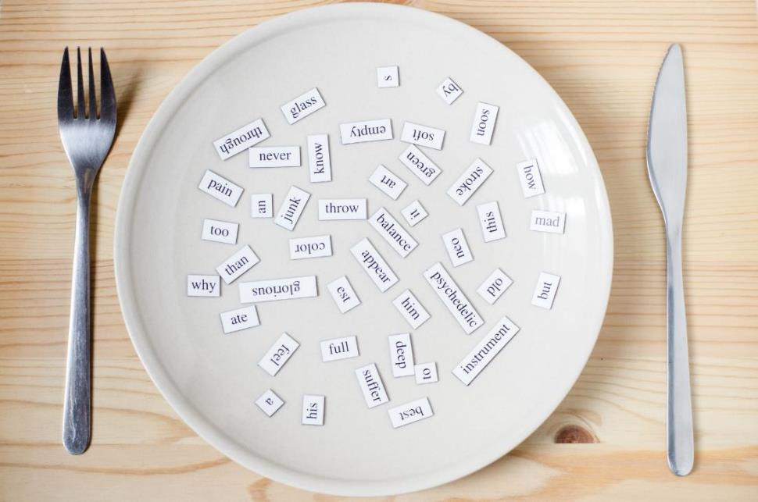
New words
tiger,
top

Slide 5
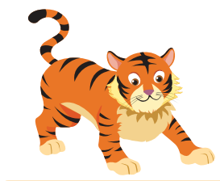
Click the picture to hear the sound.
/t/ /t/
tiger
/ˈtaɪɡər/
con hổ

Slide 6

Click the picture to hear the sound.
/t/ /t/
top
/tɒp/
con quay

Slide 7

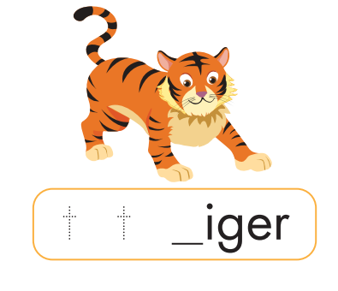
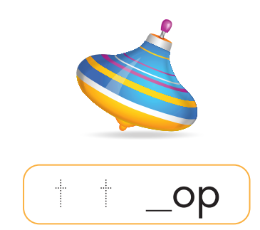
Click the picture to hear the sound.
t
t

Slide 8


tiger
two
tag
top

Slide 9

Practice

Slide 10



I can see a ,
t, t, .
I can see a ,
t, t, t.
Notes:
Click vào hình A. 1. Listen and point. Repeat để cho cả audio full chạy

Slide 11



Slide 12

CONSOLIDATION

Slide 13

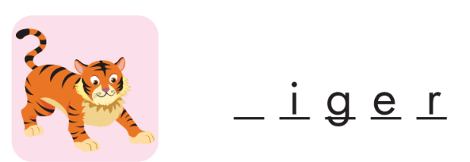

t
t

Slide 14
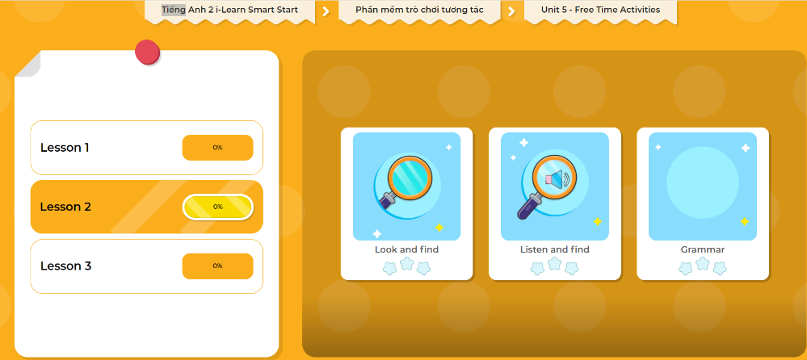
Extra Practice
DHA App
LET’S PLAY!
Click here to play the games

Slide 15

WRAP-UP

Slide 16
Today’s lesson
Structures/ Sentence patterns
I can see a…….
Vocabulary
tiger, top

Slide 17
Homework
Practice saying the sound.
Do the exercise in Tiếng Anh 2 i-Learn Smart Start Notebook (page 30).
Do the exercises in Tiếng Anh 2 i-Learn Smart Start Workbook (page 34).
Play the consolidation games in Tiếng Anh 2 i-Learn Smart Start DHA App on www.eduhome.com.vn
Prepare the next lesson (page 37).

Slide 18
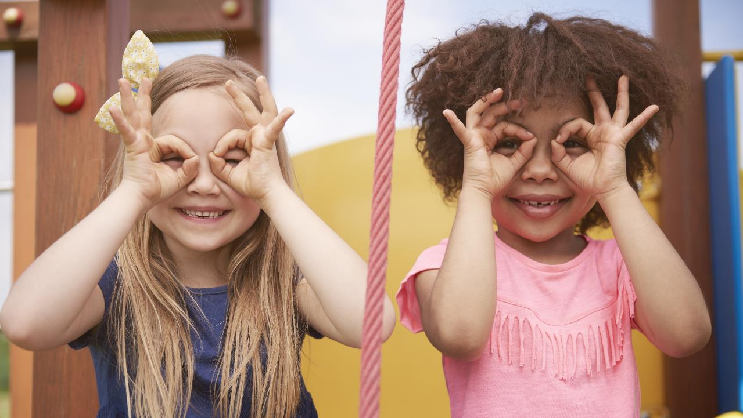
Enjoy your day!

