Slide 1

REVIEW
(From Unit 1 to Unit 5)

Slide 2
Contents
Listening
Reading
Warm-up
Writing
Fun corner and wrap-up
2
1
2
1
3
3
5
4
5
4

Slide 3
Warm-up
1
1
Sing

Slide 4


Slide 5
2
Listening
2
5

Slide 6

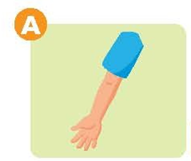
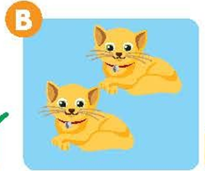




Task 1. Listen and put a tick ( ) or a cross ( ) in the box. There are two examples.
✔
✘
Example:
✔
✘
✘
✔
✘

Slide 7
Task 2. Listen and tick the box. There is one example.
Example:
4
✔
✔
This is my brother.
Touch your head.
This is my father.
Touch your leg.
5
6
This is a bear.
It’s yellow.
✔
✔
This is my monkey.
It’s red.

Slide 8
3
Reading
3

Slide 9




Task 3. Look and read. Put a tick in the box. There is a example.
(✔)
Example:
1
This is my brother.
It’s a book.
This is my sister.
✔
It’s a bag.
✔
2
3
Touch your leg.
It’s blue flower.
✔
Touch your head.
✔
It’s pink flower.

Slide 10
4
Writing
3

Slide 11
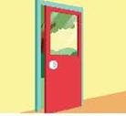
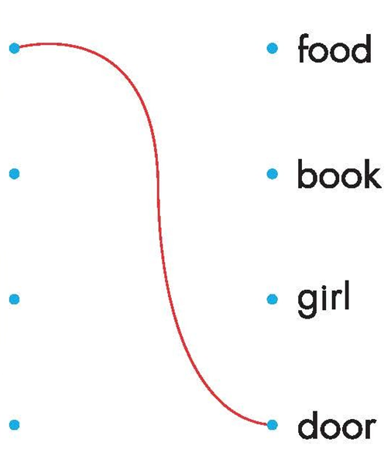

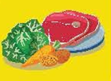
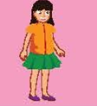
Task 4.
Look and draw lines. There is one example.

Slide 12
5
Fun corner and wrap-up
5
Guessing game
Notes:
Step 1: Divide the class into 4 teams.
Step 2: Invite 1 pupil from each team to come to the front and say aloud the answer. If correct, give points for the teams.
Step 3: Encourage pupils to practise speaking English.
Step 4: Give points for pupils.

Slide 13
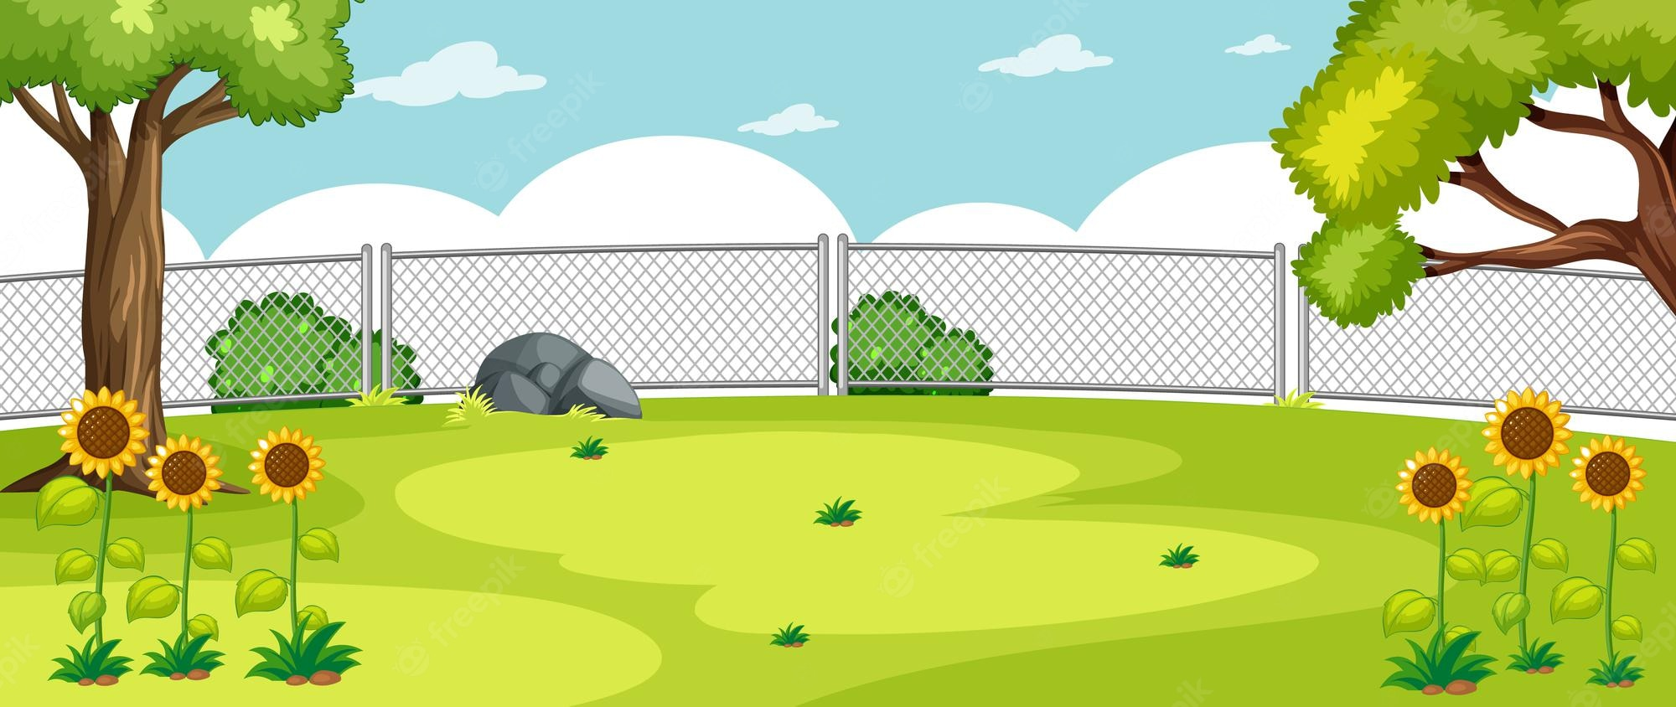

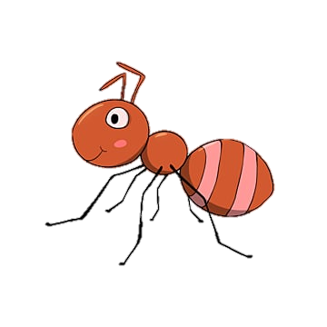

father
mother

Slide 14

yellow
red

Slide 15

white
pink

Slide 16

arm
head

Slide 17

elephant
monkey

Slide 18

cat
dog

Slide 19
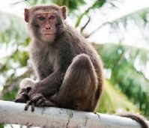
bear
monkey

Slide 20
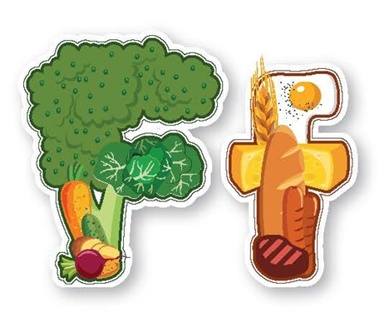
juice
food

Slide 21
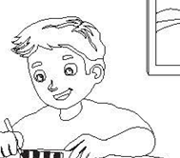
girl
boy

Slide 22



