Slide 1


GETTING STARTED
Lesson 2
Pages 6 & 7

Slide 2
Objectives
By the end of this lesson, students will be able to understand basic classroom language.
Vocabulary: stand up, sit down, listen

Slide 3
Lesson 1
Lesson Outline
Warm-up
Vocabulary
Practice
Consolidation
Wrap-up

Slide 4

WARM UP

Slide 5

Let’s play!
Greetings Mingle Game
Notes:
Choose a fun song. Play the song and ask students to walk/dance around the class when the music is playing. When the music stops, students should meet the closest student to them and shake their hands and say ”Hello!”

Slide 6
Let’s sing!

Slide 7
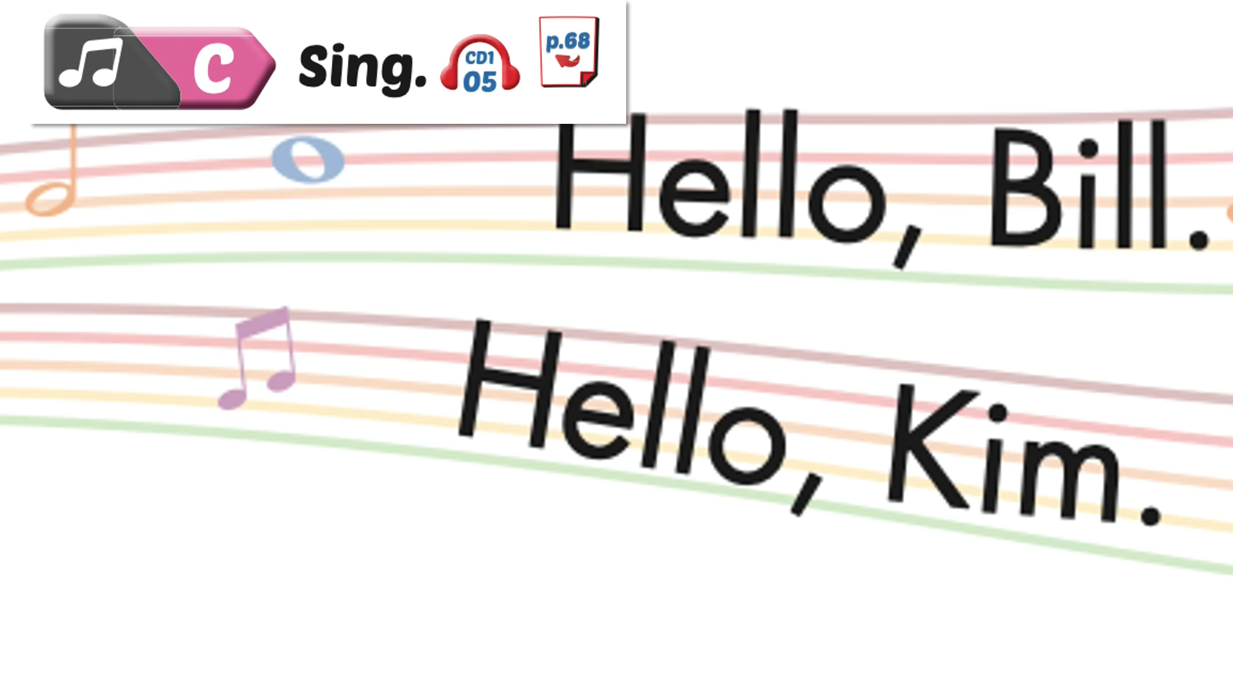

Slide 8

It’s time to learn …

Slide 9
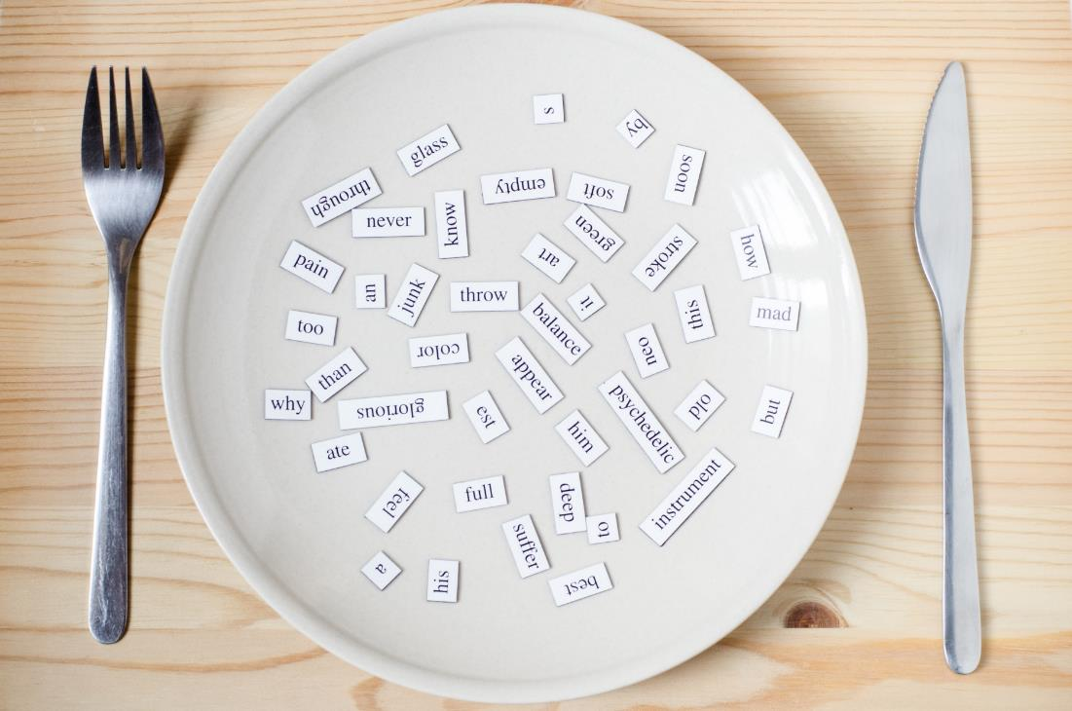
New words
Stand up,
Sit down,
Listen

Slide 10

Presentation

Slide 11

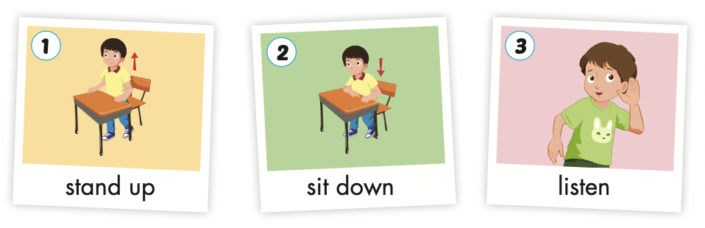
Click the icon to hear the sound.

Slide 12

Practice

Slide 13

Listening

Slide 14
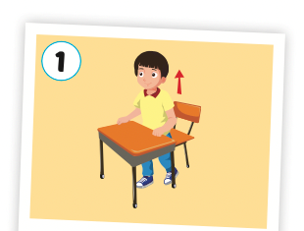
Click the picture to hear the sound.
Stand up
/stænd ˈʌp/ đứng dậy

Slide 15
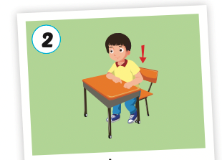
Click the picture to hear the sound.
Sit down
/sɪt ˈdaʊn/ ngồi xuống

Slide 16
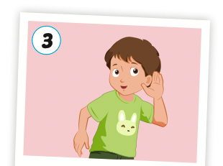
Click the picture to hear the sound.
listen
/ˈlɪsn/
lắng nghe

Slide 17

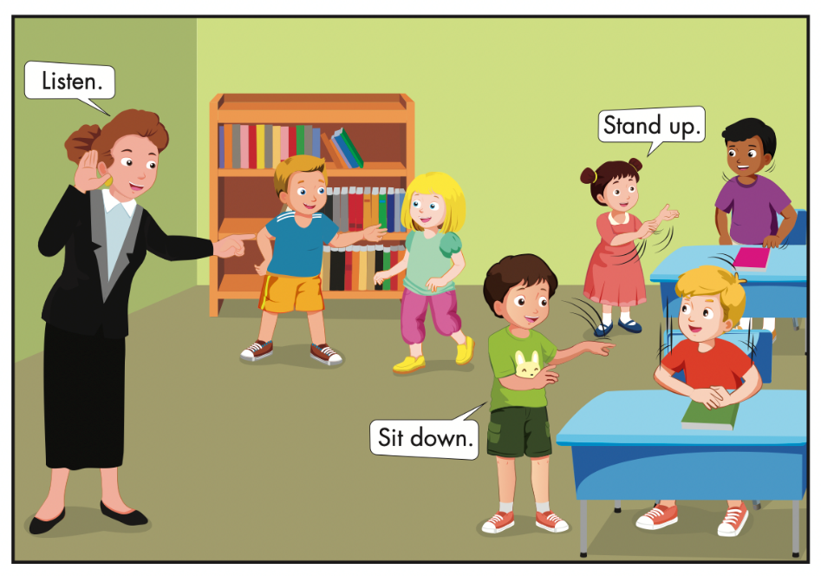
Click the icon to hear the sound.

Slide 18



Slide 19


Slide 20

Speaking

Slide 21
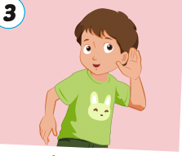
Let’s say!
Listen

Slide 22
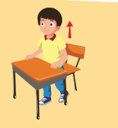
Let’s say!
Stand up

Slide 23
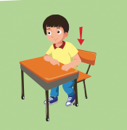
Let’s say!
Sit down

Slide 24



Slide 25
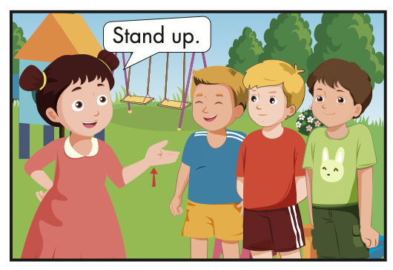

Slide 26
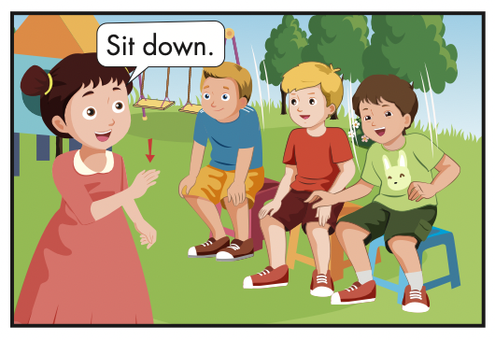

Slide 27
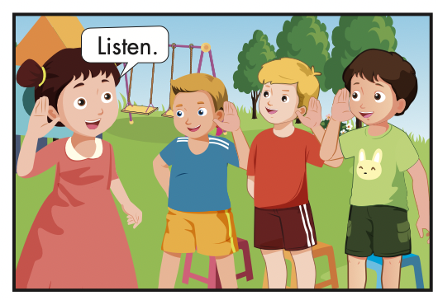

Slide 28

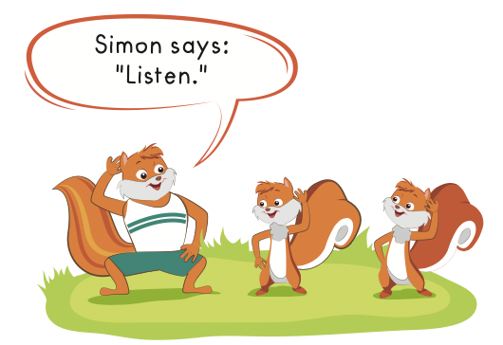
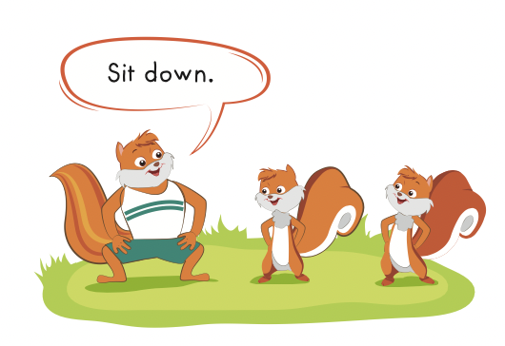

Slide 29

Production

Slide 30
Let’s play!

Slide 31

Look and choose

Slide 32
Hello!
Listen

Slide 33
Sit down
Stand up

Slide 34
Stand up
Sit down

Slide 35

Stand up
Listen

Slide 36
Good job!

Slide 37
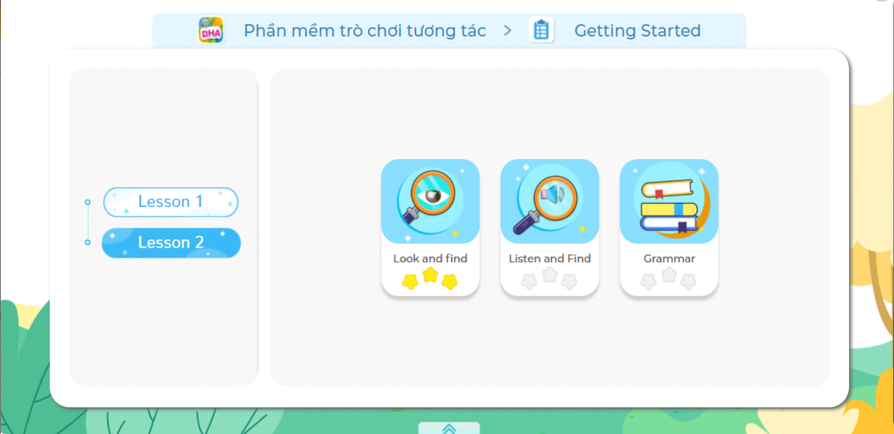
Extra Practice
DHA on Eduhome
LET’S PLAY!
Click on the picture below to play the games.

Slide 38

CONSOLIDATION

Slide 39

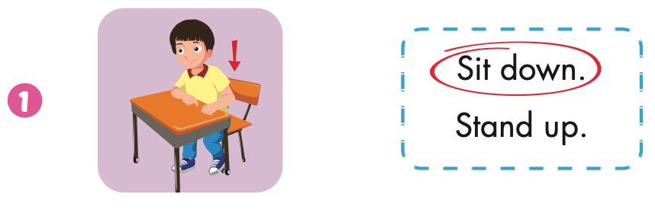
Extra Practice
WB, page 4

Slide 40
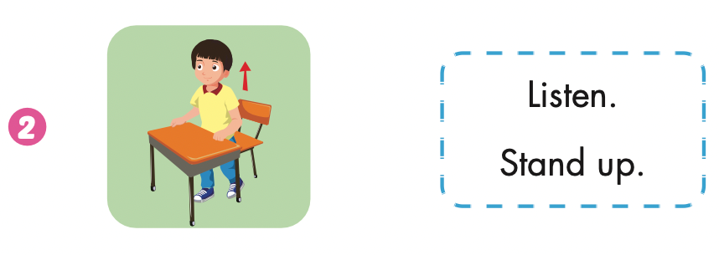
Extra Practice
WB, page 4

Slide 41
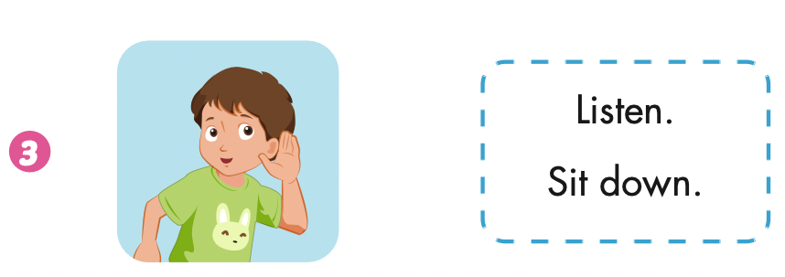
Extra Practice
WB, page 4

Slide 42

WRAP-UP

Slide 43
Lesson 3
Today’s lesson
Vocabularies
Stand up,
Sit down,
Listen.

Slide 44
Lesson 3
Homework
Practice the vocabularies and structure; and make sentences using them.
Do the exercises in Tiếng Anh 1 i-Learn Smart Start WB (pages 4, 5)
Do the exercises in Tiếng Anh 1 i-Learn Smart Start Notebook (page 3).
Prepare the next lesson (page 8 SB)
Play the consolidation games in Tiếng Anh 1 i-Learn Smart Start DHA App on www.eduhome.com.vn

Slide 45

Enjoy your day!

Slide 46

Have a nice day!

