Slide 1


GETTING STARTED
Lesson 1
Pages 4 & 5

Slide 2
Objectives
By the end of this lesson, students will be able to say “Hello!”, “Goodbye!”
Vocabulary: Hello, goodbye

Slide 3
Lesson 1
Lesson Outline
Warm-up
Vocabulary
Practice
Consolidation
Wrap-up

Slide 4

WARM UP

Slide 5

Let’s play!
Greetings Mingle Game
Notes:
Choose a fun song. Play the song and ask students to walk/dance around the class when the music is playing. When the music stops, students should meet the closest student to them and shake their hands and say ”Hello!”

Slide 6

It’s time to learn …

Slide 7
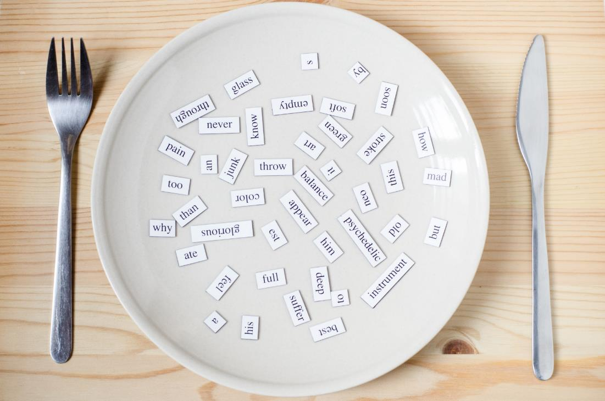
New words
Hello
Goodbye

Slide 8

Presentation

Slide 9

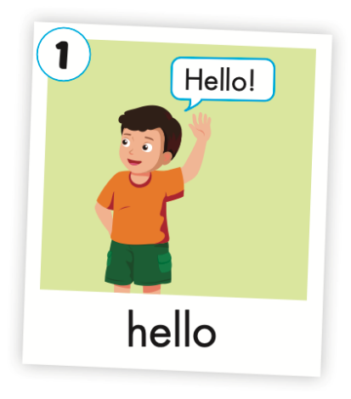
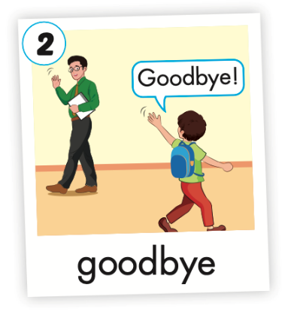
Click the icon to hear the sound.

Slide 10

Practice

Slide 11

Listening

Slide 12
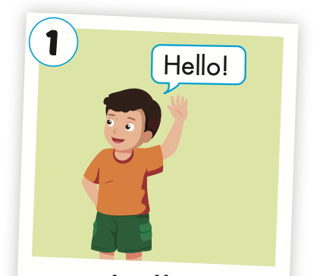
Click the picture to hear the sound.
hello
/həˈloʊ/
xin chào

Slide 13
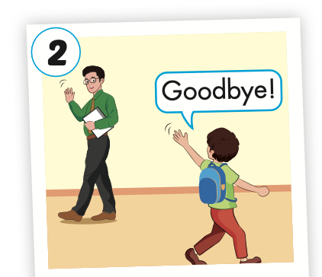
Click the picture to hear the sound.
goodbye
/ɡʊdˈbaɪ/
tạm biệt

Slide 14
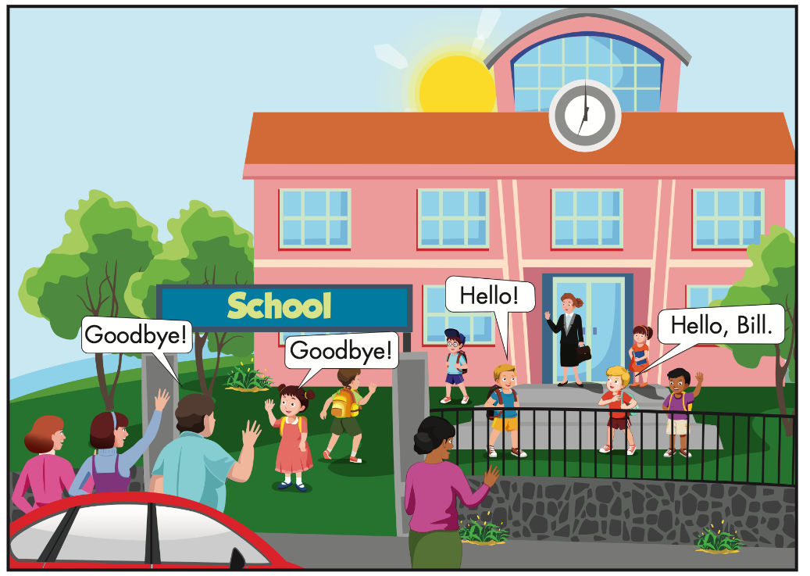

Click the icon to hear the sound.

Slide 15



Slide 16
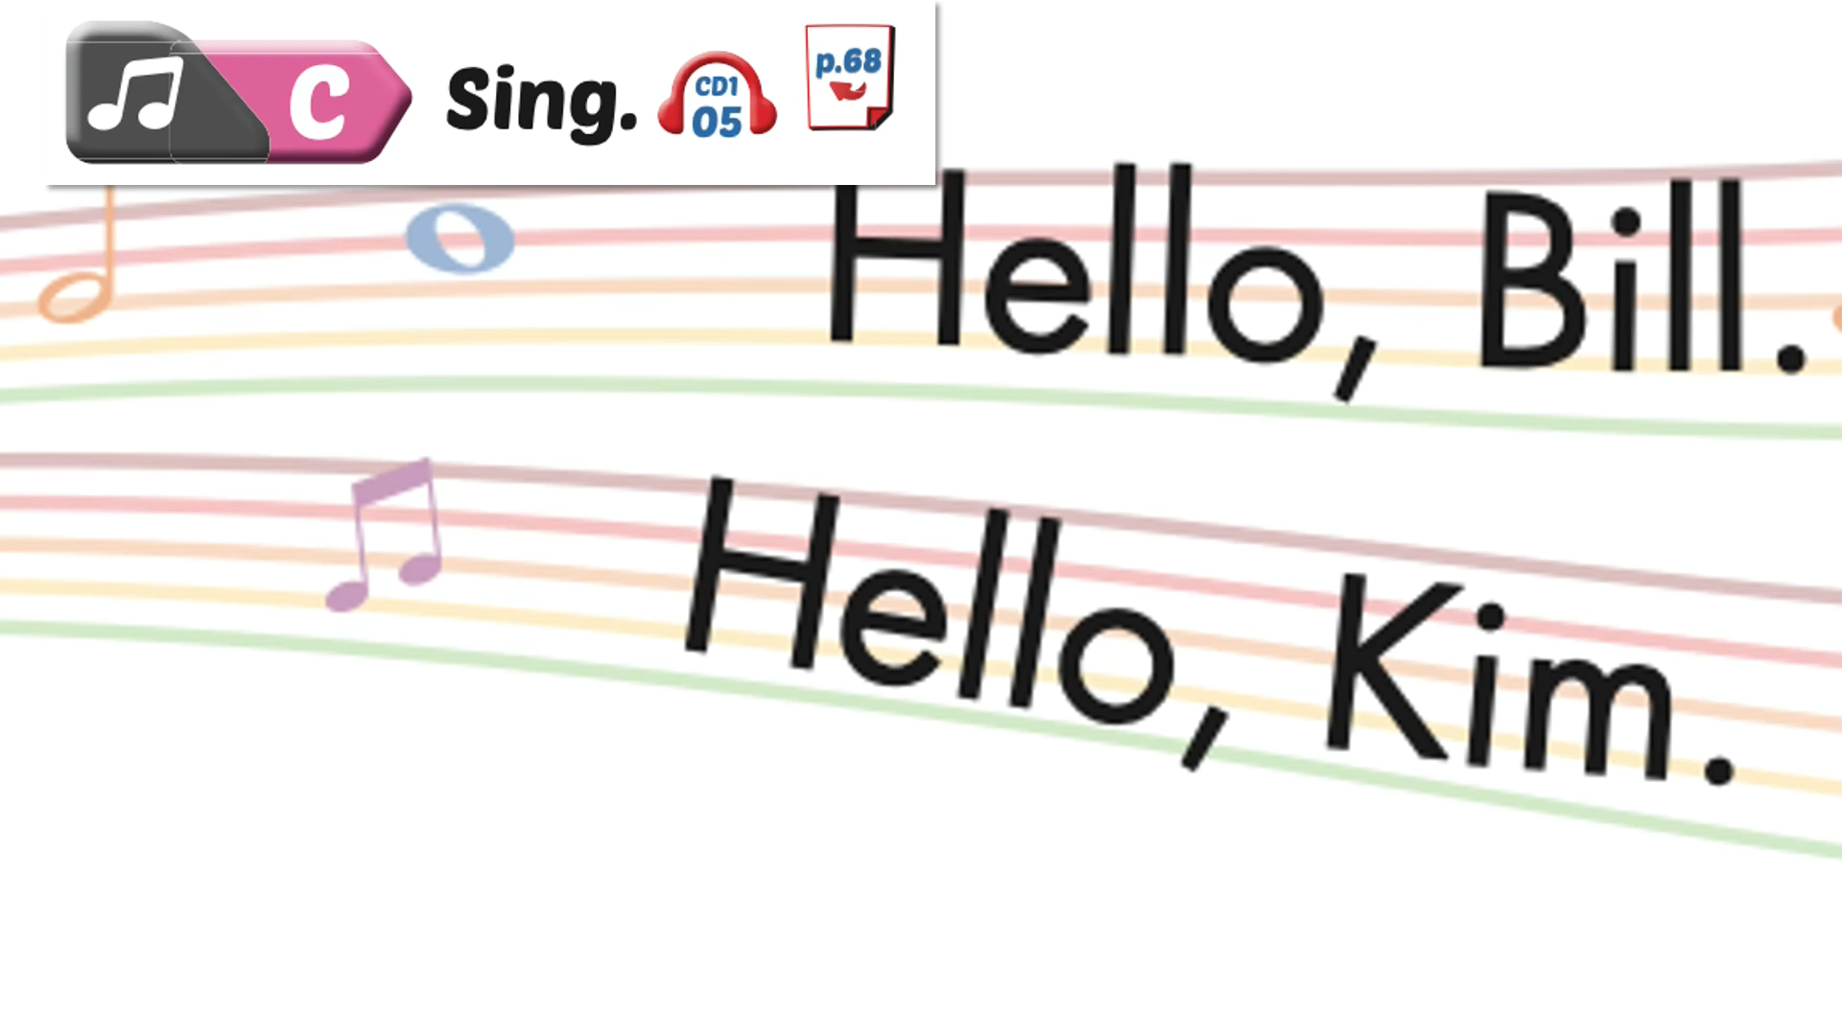

Slide 17

Speaking

Slide 18

Let’s say!
Bill
Hello, Bill.

Slide 19

Let’s say!
Kim
Hello, Kim.

Slide 20
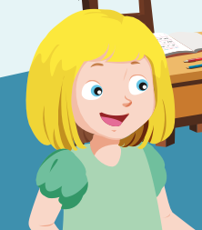
Let’s say!
Lola
Hello, Lola.

Slide 21

Let’s say!
Lily
Hello, Lily.

Slide 22

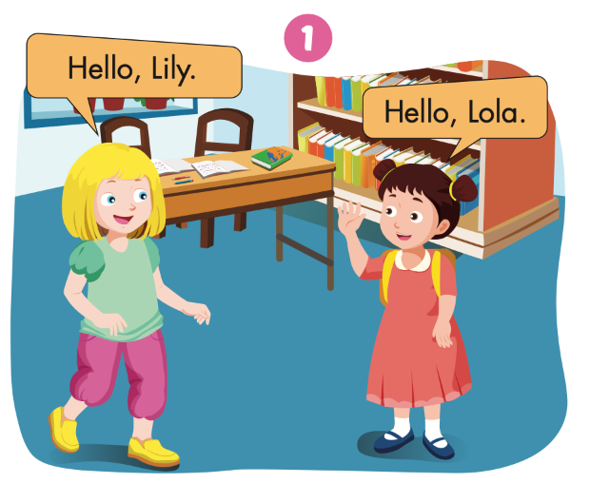

Slide 23
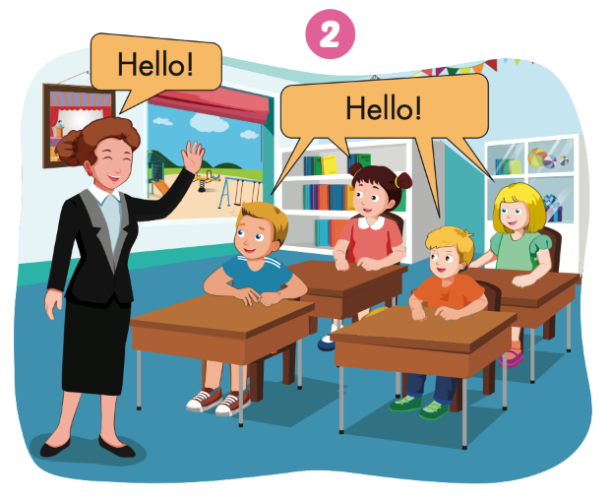

Slide 24


Slide 25
Let’s play!

Slide 26


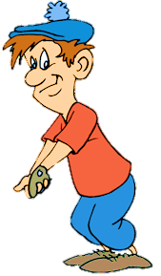
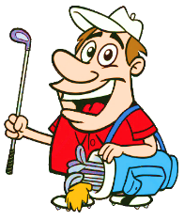



Listen and choose

Slide 27

Goodbye!
Hello!
NEXT

Slide 28
Goodbye!
Hello!
NEXT

Slide 29
Hello!
Goodbye!
NEXT

Slide 30
Goodbye!
Hello!
END

Slide 31

Production

Slide 32




Slide 33
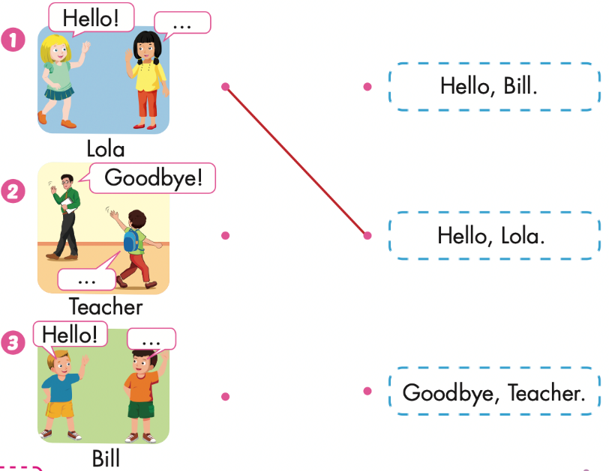

Extra Practice
WB, page 2

Slide 34
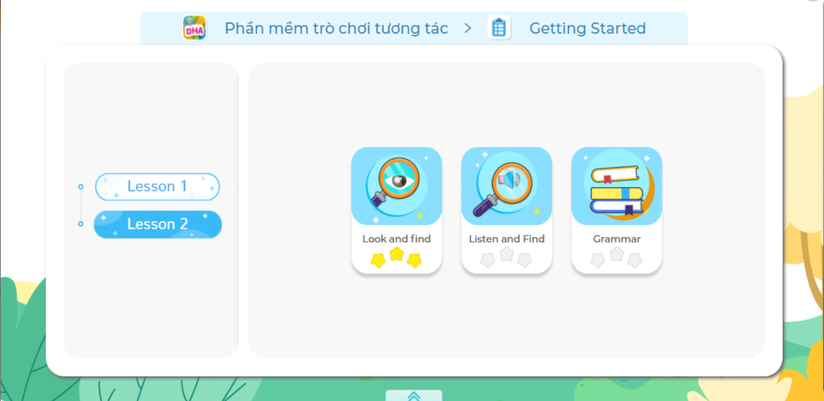
Extra Practice
DHA on Eduhome
LET’S PLAY!
Click on the picture below to play the games.

Slide 35

CONSOLIDATION

Slide 36
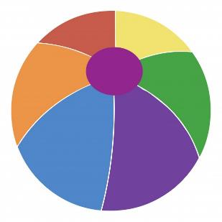
Let’s play!
Pass the ball game
Notes:
Choose a small soft ball. Play a song. When the music is playing, students must pass the ball. When the music stops, the student with the ball must stand up, everyone says: ”Hello!” or “Goodbye!”

Slide 37

WRAP-UP

Slide 38
Lesson 3
Today’s lesson
Vocabularies
Hello,
Goodbye

Slide 39
Lesson 3
Homework
Practice the vocabularies and structure; and make sentences using them.
Do the exercises in Tiếng Anh 1 i-Learn Smart Start WB (pages 2, 3) Do the exercises in Tiếng Anh 1 i-Learn Smart Start Notebook (page 2).
Prepare the next lesson (pages 6, 7 SB)
Play the consolidation games in Tiếng Anh 1 i-Learn Smart Start DHA App on www.eduhome.com.vn

Slide 40

Enjoy your day!

Slide 41

Have a nice day!

