Slide 1
UNIT 5: FREE TIME ACTIVITIES Lesson 1.2
Page 35

Slide 2
WARM UP

Slide 3
Click on the right Word.
A. tag
B. hopscotch
C. soccer

Slide 4
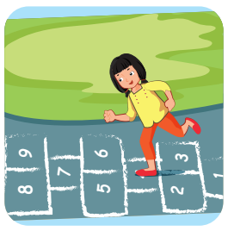
Click on the right Word.
A. tag
B. hopscotch
C. hide and seek

Slide 5
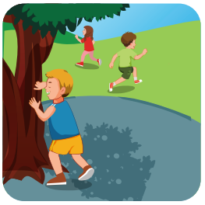
Click on the right Word.
A. tag
B. hide and seek
C. soccer

Slide 6
Click on the right Word.
A. hide and seek
B. hopscotch
C. tag

Slide 7
It’s time to learn …

Slide 8
Speaking

Slide 9
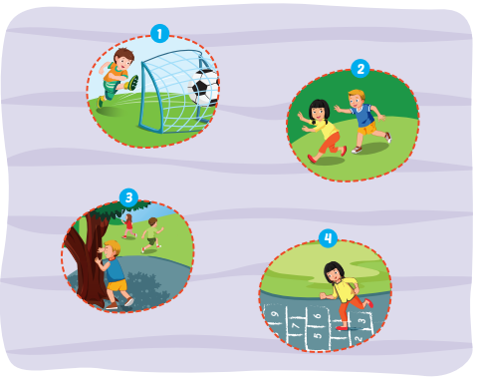
Let’s play soccer.
OK.

Slide 10
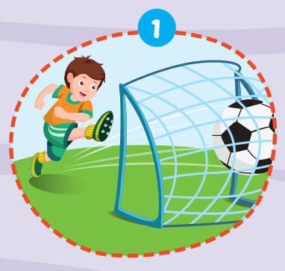
Let’s play soccer.
OK.

Slide 11
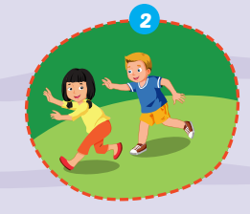
OK.
Let’s play tag.

Slide 12
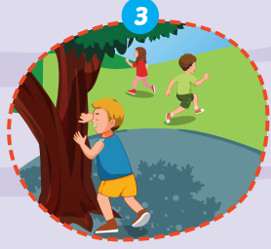
Let’s play
hide and seek.
OK.

Slide 13
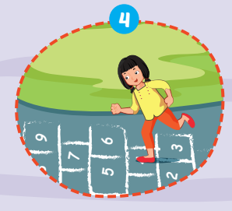
OK.
Let’s play hopscotch.

Slide 14
Practice

Slide 16
Further Practice

Slide 17
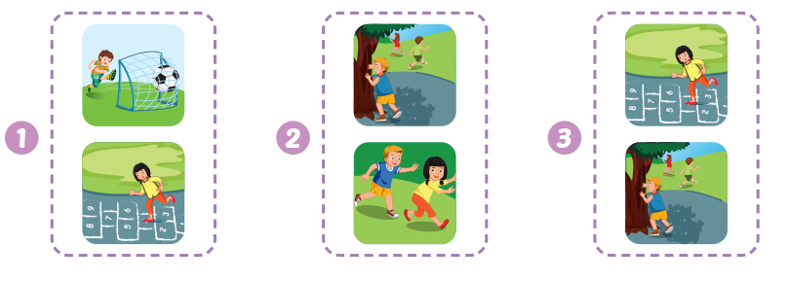

Slide 22
CONSOLIDATION

Slide 23
Choose a letter to fill in.
_ _ _ _ _ _
S o c c e
r
a
b
c
d
r
f
g
e
i
j
k
l
m

Slide 24
Choose a letter to fill in.
h
o p s c o t c h
_ _ _ _ _ _ _ _ _
a
b
c
d
e
o
g
l
i
j
k
h
m

Slide 25
Choose a letter to fill in.
_ _ _ _ _ _ _ _ _ _ _
h i d a n d s e e k
e
a
b
c
d
k
f
g
h
i
j
e
l
m

Slide 26
Choose a letter to fill in.
t g
_ _ _
a
n
b
c
d
e
f
g
h
i
j
k
l
a

Slide 27
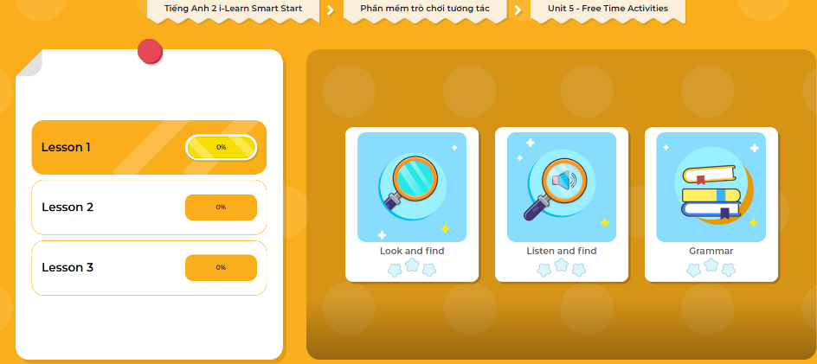
Extra Practice
DHA App
LET’S PLAY!
Click here to play the games

Slide 28
WRAP-UP

Slide 29
Today’s lesson
Structures/ Sentence patterns
Let’s play (soccer).
OK.
Vocabulary
soccer, tag, hopscotch,
hide and seek.

Slide 30
Homework
Practice vocabularies and structure. Make sentences using them.
Practice the vocabulary and structure in Tiếng Anh 2 i-Learn Smart Start Notebook (page 29).
Do the exercises in Tiếng Anh 2 i-Learn Smart Start Workbook (page 33).
Play the consolidation games in Tiếng Anh 2 i-Learn Smart Start DHA App on www.eduhome.com.vn
Prepare the next lesson (page 36).

Slide 31
Enjoy your day!

