Slide 2
Unit 6
Artificial Intelligence
LESSON 7
COMMUNICATION & CULTURE / CLIL

Slide 3
LESSON 7
COMMUNICATION & CULTURE / CLIL
WARM-UP
Watch a video
Task 1: Listen and complete the conversations.
Task 2: Make similar conversations.
EVERYDAY ENGLISH
CLIL
Task 1: Complete the timeline showing the evolution of robots.
Task 2: Discussion.
CONSOLIDATION
Wrap-up
Homework

Slide 4
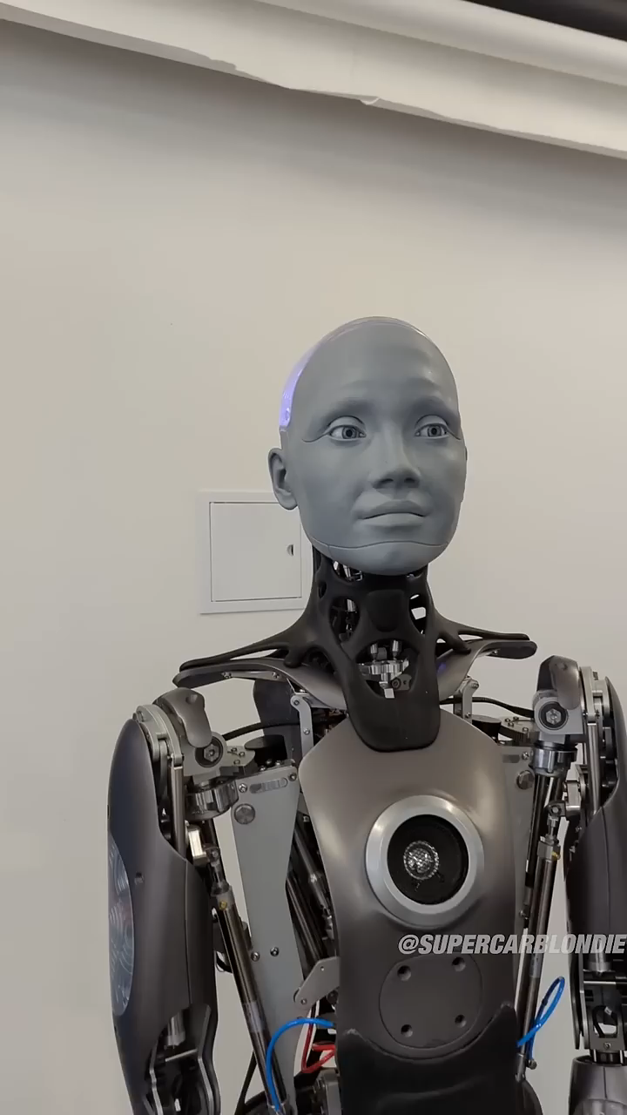
WARM-UP
WARM-UP
Watch the video and answer the question.
What’s your impression on Ameca – the robot?
Notes:
https://www.youtube.com/watch?v=Q1d5aiBFNpM

Slide 5

EVERYDAY ENGLISH
1
Listen and complete the conversations.
1
C. Hey
Nam: (1) _________, Nick!
Nick: Yes, Nam.
Nam: (2) __________________ if I ask you a few questions about our project on robots?
Nick: Not at all. Go ahead.
B. Do you mind

Slide 6
EVERYDAY ENGLISH
1
Listen and complete the conversations.
2
D. May I have your attention
Speaker: (3) ____________________________, please? Today, I’m going to talk about some applications of AI in education.
Phong: (4) __________________________, but could you please explain the topic of your talk?
Speaker: Sure, we’re going to find out how AI can support teachers and students.
Phong: I understand now. Thanks.
A. I’m sorry for interrupting

Slide 7
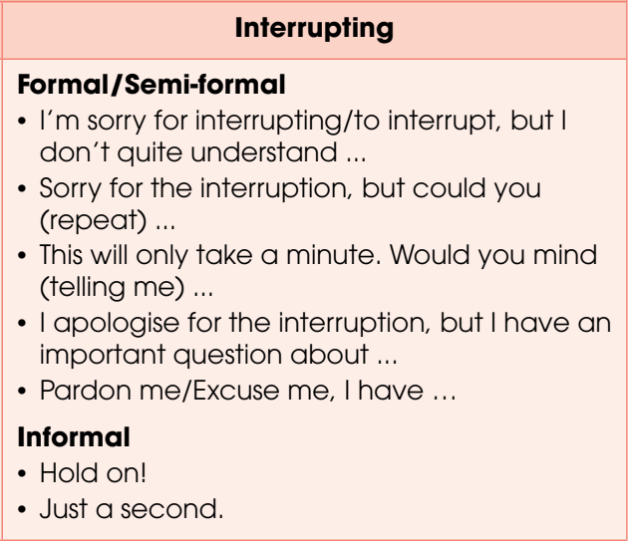
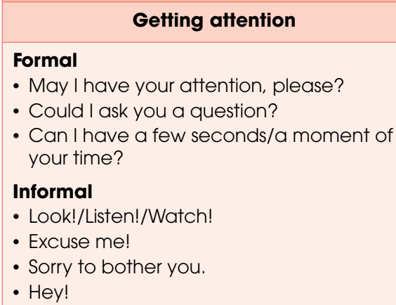
EVERYDAY ENGLISH

Slide 8

EVERYDAY ENGLISH
2
Use the models in Task 1 to make similar conversations for these situations. One of you is A, the other is B.
1. A is at a museum or robot exhibition where he/she can see B in the crowd, A wants to get B’s attention.
2. A is a scientist giving a talk on the use of AI at home. B is in the audience, and he/she wants to interrupt the scientist to ask a question.

Slide 9
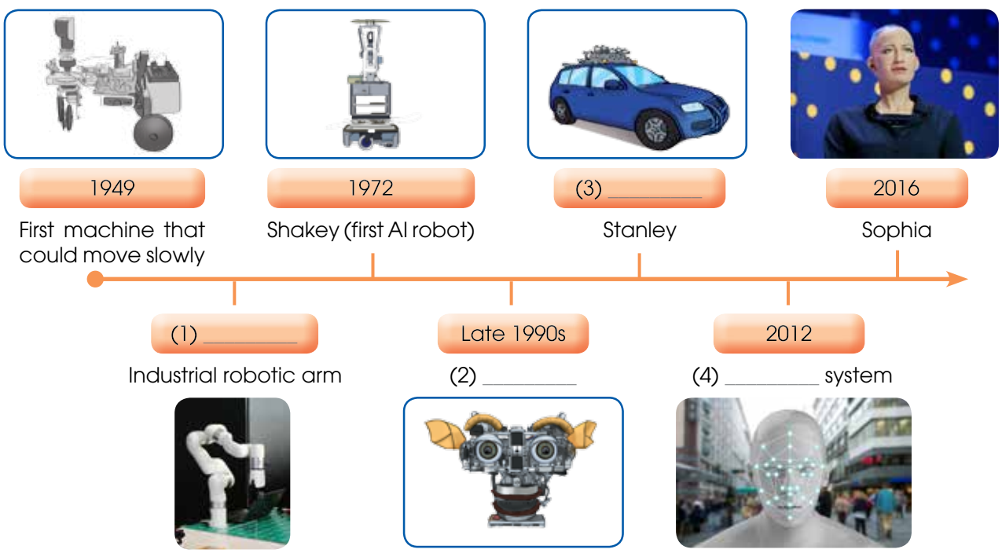
CLIL
1
Read the text and complete the timeline showing the evolution of robots
2005
1959
Kismet
visual recognition

Slide 10

CLIL
2
Work in groups. Discuss the questions.
What types of AI are widely used in Viet Nam? How do you think robots and AI will develop in Viet Nam in the future?

Slide 11
CONSOLIDATION
1
Wrap-up
What have you learnt today?
Gain knowledge about the evolution of robots;
Review expressions for getting attention and interrupting.
Talk about future of AI in Vietnam.

Slide 12
CONSOLIDATION
2
Homework
- Do exercises in the workbook.
- Prepare for the next lesson – Looking back and Project.

Slide 13
Website: hoclieu.vn
Fanpage: facebook.com/www.tienganhglobalsuccess.vn

