Slide 2
WARM - UP
Which are the advantages/ disadvantages of urbanization?
good schools modern hospitals expensive goods and services
traffic jams high home prices convenient public transport
air pollution health problems better communication services
higher salaries
Advantages:
- good schools
- modern hospitals
- higher salaries
- convenient public transport
- better communication services
Disadvantages:
traffic jams
air pollution
health problems
high home prices
expensive goods and services

Slide 3
Unit 4
urbanization
LISTENING
A radio talk about Urbanization

Slide 4


VOCABULARY
rapidly (v)
/ˈræpɪdli/
very quickly; at a great rate

Slide 5

VOCABULARY
Go up (phr.v)
/ɡəʊ/ /ʌp/
to move higher, rise, or increase
Go down (phr.v)
decrease

Slide 6

VOCABULARY
reliable (adj)
/rɪˈlaɪ.ə.bəl/
can be trusted or believed

Slide 7
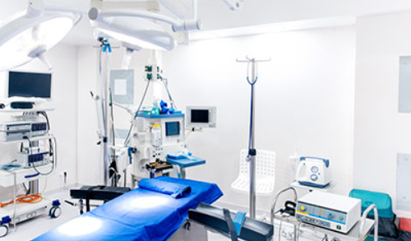
VOCABULARY
medical facilities
/ˈmɛdɪkəl/ /fəˈsɪlətiz/
to places or establishments where medical care, treatment, and health-related services are provided.

Slide 8
VOCABULARY
Form | Pronunciation | Meaning
1. reliable (adj) | /rɪˈlaɪ.ə.bəl/ | be trusted or believed
2. rapidly (v) | /ˈræpɪdli/ | very quickly; at a great rate
3. Go up >< go down | /ɡəʊ/ /ʌp/ | to move higher, rise, or increase
4. medical facilities | /ˈmɛdɪkəl/ /fəˈsɪlətiz/ | to places or establishments where medical care, treatment, and health-related services are provided.

Slide 9
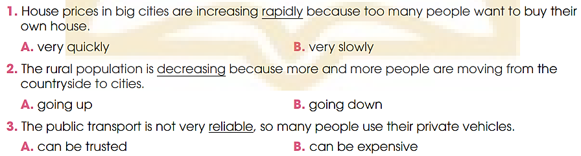
PRE- LISTENING
1
Choose the correct meanings of the underlined words.

Slide 10



WHILE- LISTENING
2
Listen to a radio talk about urbanisation. Choose the correct answer a, B, or C.
Hello and welcome to FM radio. I'm Jenifer Ha, your host today. I'll talk about urbanisation in the global world.

Slide 11
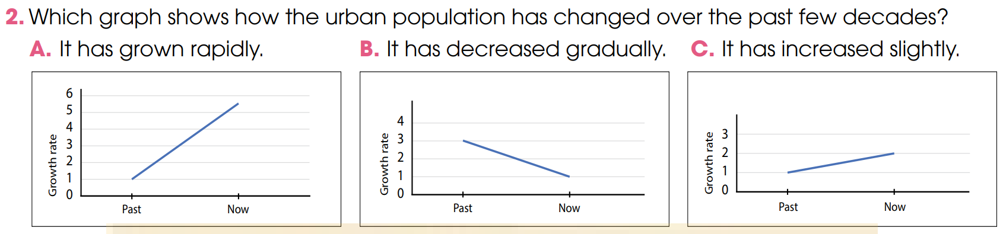
WHILE- LISTENING
2
Listen to a radio talk about urbanisation.
Choose the correct answer a, B, or C.
But over the past few decades, the urban population has increased rapidly, and the rural population has decreased.

Slide 12
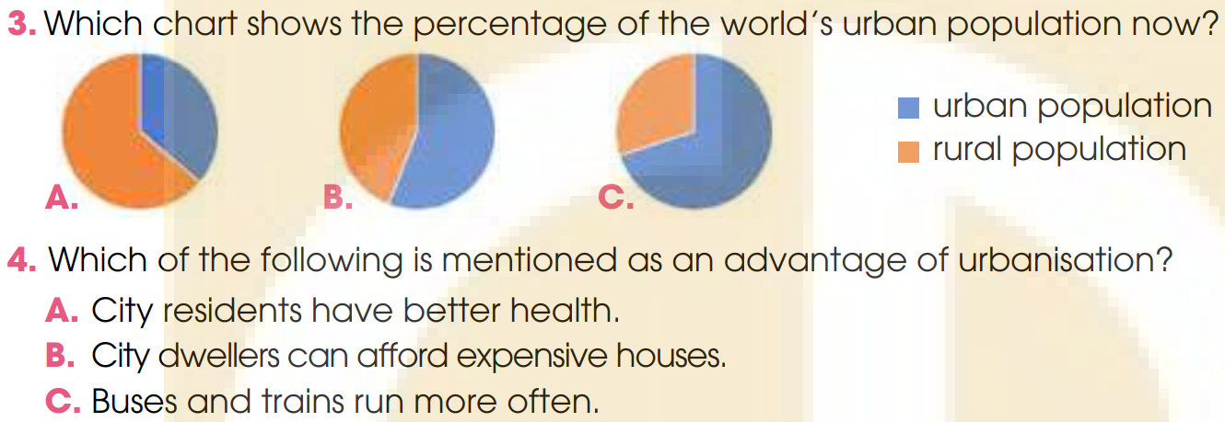
WHILE- LISTENING
2
Listen to a radio talk about urbanisation. Choose the correct answer
Today, over 55 per cent of the world's population lives in cities.
At the same time, they try to get more people into public transport by making bus and train services more convenient and frequent.

Slide 13
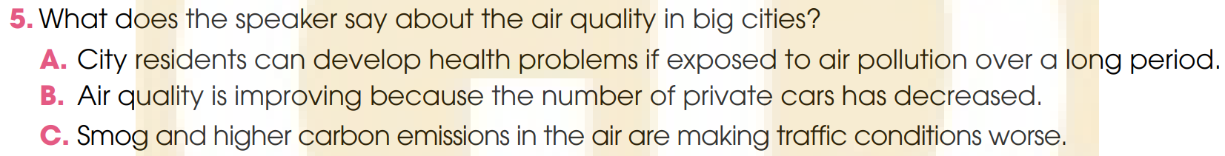

WHILE- LISTENING
2
Listen to a radio talk about urbanisation.
Choose the correct answer a, B, or C.
Long-term exposure to air pollution can cause a range of diseases.

Slide 14
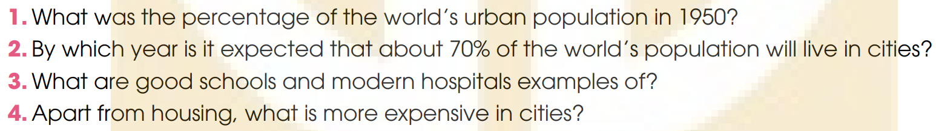


WHILE- LISTENING
3
Listen to the talk again and answer the questions.
Use no more than THREE words and/or a number.
*ANSWER
1. About 30 % (thirty percent)
2. By 2050
3. (City’s) better facilities
4. Goods and services

Slide 15
POST- LISTENING
4
Work in groups. Choose the correct answer.
Game: Passing the micro
Rules:
A song is played while students are passing a micro one by one.
When the music stops, the student who keeps the micro will answer the question.

Slide 16
In 1950, only ___ of the world’s population lived in cities
50%
30%
40%
25%

Slide 17
City residents are looking for better _____.
health services
facilities
public transport
All are correct

Slide 18
Which of the following is mentioned as an disadvantaged of urbanization?
Better communication services
Air pollution
Higher salaries
Private cars

Slide 19
In 2050, around ____ of the world’s population will live in cities.
70%
55%

Slide 20
What is the talk about?
The world’s population
The world’s urbanisation

Slide 21
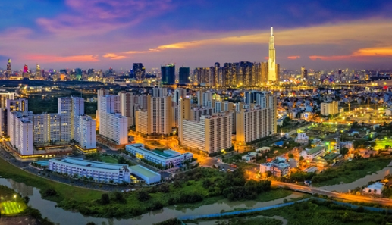
POST- LISTENING
4
Work in groups. Discuss the following question.

Slide 22


POST- LISTENING
4
*Sample answers:
I think the biggest advantage of urbanisation is the opportunity to get access to better health services. This is because most of the big hospitals with the best medical facilities are often located in big cities. When people have better health services, they will have a healthier body and enjoy their life.
I think the biggest advantage of urbanisation is having modern facilities.
When people have access to more and better facilities, their life also gets easier and more comfortable.

Slide 23
CONSOLIDATION
1
Wrap-up
What have you learnt today?
Listen for main ideas and specific information in a conversation about an ASEAN school tour programme.

Slide 24

CONSOLIDATION
2
Homework
Learn new words by heart.
Do exercises in the workbook.
Prepare for Lesson 6 - Unit 4.

Slide 25
Website: hoclieu.vn
Fanpage: facebook.com/www.tienganhglobalsuccess.vn

