Slide 1


Slide 2
WORD SEARCH

Slide 3


word search
- Have 2 teams: A and B
- 3 members in each team will take turn to go to the board and highlight the words we have learnt in UNIT 6.
- Time limited: 1’30’’
- The team has more correct answers will be the winner.

Slide 4

word search
PROMOTE
PRESERVE
CULTURAL HERITAGE
SOCIAL MEDIA
AWARENESS
INVOLVED
COMPETITION
FESTIVAL

Slide 5
Unit
6
Preserving our heritage
Unit
FAMILY LIFE
LESSON 4
SPEAKING
Preserving cultural heritage

Slide 6

VOCABULARY
1. SPREAD (V)
LAN TRUYỀN
2. INVOLVED (A)
part of an activity or event
CÓ LIÊN QUAN

Slide 7
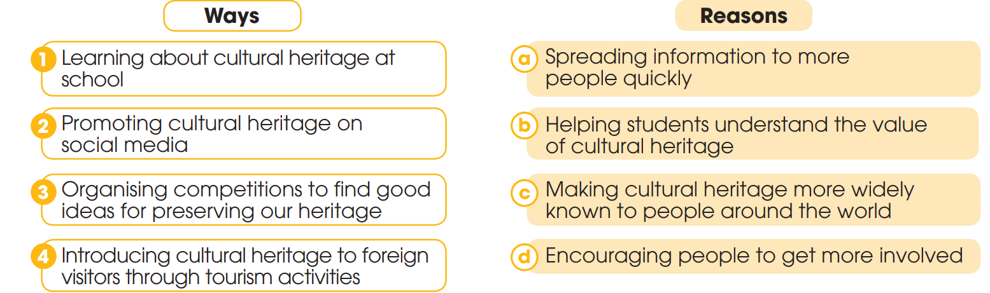
1
Work in pairs. Match the ways to preserve our heritage with the reason for doing so.

Slide 8
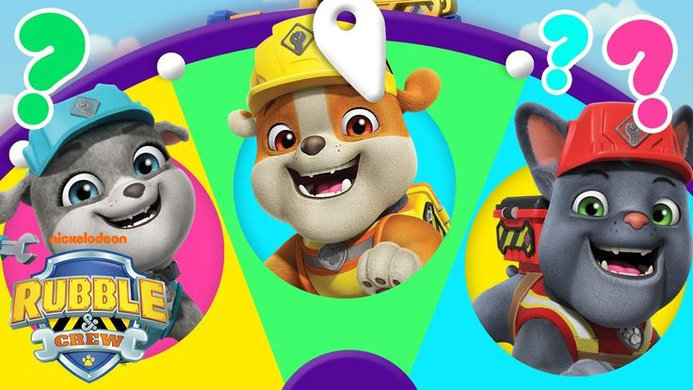
2. Complete the conversation with the words and phrase in the box. Then practise it in pairs.
SPIN
THE
WHEEL

Slide 9



Huyen Linh
Văn Qúy
Tra My
Phuong Linh
Hùng Vĩ
Bao Nam
Thanh Tra
Kim Ngoc
Tien Dat
Hoang Nguyen
Thùy Như
Nhat Vy
Văn Phương
Thanh Thuy
Yen Nhi
Minh Thu
Hong Tham
Do Tai
SPIN
Quang Thuan
Thuy Trien
Kieu Trinh
Thanh Tuyen
Quoc Thang
My Linh
Quynh Tran
Van Khang
Pham Thuy
Thu Hong
Anh Thư
Quy Tai
Trung Thach
Thu Nam
Le Quyen
Thanh Thảo
Huong Giang
Chi Quoc
Anh Khoa
Hoang Gia
Nhat Huy
Ngoc Hoa
NEXT

Slide 10
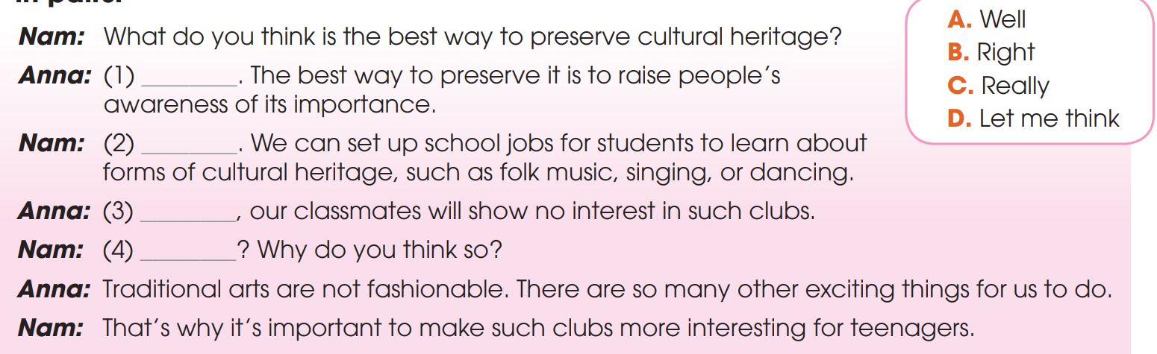
2
Complete the conversation with the words and phrase in the box. Then practise it in pairs.
D
B
A
C

Slide 11
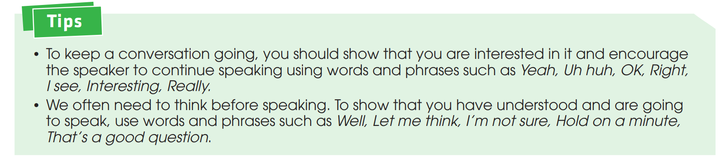
3
Work in pairs. Make a similar conversation about ways to preserve cultural heritage. Use the ideas in 1, the model in 2, and the tips below to help you.

Slide 12

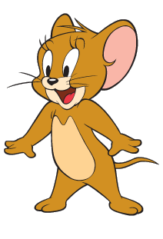

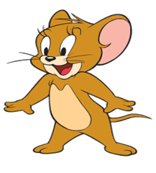
- What do you think is the best way to preserve cultural heritage?
- That’s a good question. The best way to preserve it is to promote cultural heritage on social media. By this way, we can spread information more quickly.
1
2
- Yeah, this could help people around the world learn more about our culture and appreciate its value.
- That's a great idea. Another way could be introducing cultural heritage to foreign visitors through tourism activities.
4
3

Slide 13



- What do you think is the best way to preserve cultural heritage?
- That’s a good question. The best way to preserve it is to promote cultural heritage on social media. By this way, we can spread information more quickly.
- That's a great idea. Another way could be introducing cultural heritage to foreign visitors through tourism activities.
- Yeah, this could help people around the world learn more about our culture and appreciate its value.

Slide 14

4
Work in groups. Think of a form of cultural heritage (such as a tradition, a festival, or a form of music) and discuss ways to preserve it. Report your group’s ideas to the whole class.

Slide 15
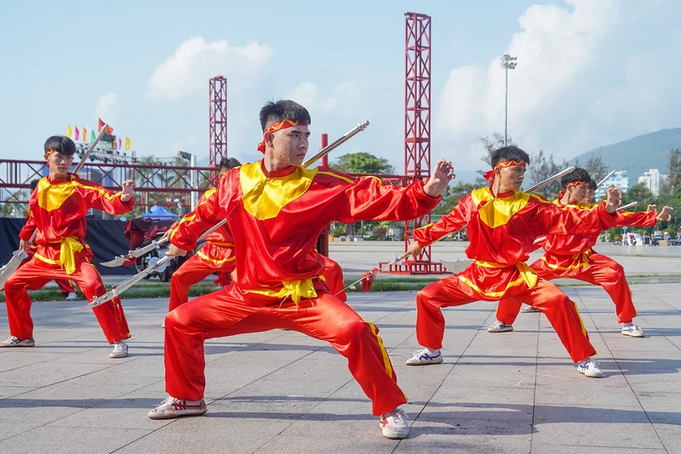
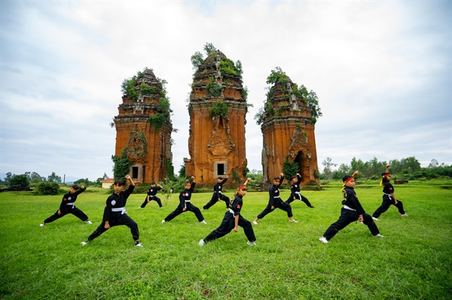
Traditional Martial Arts

Slide 16
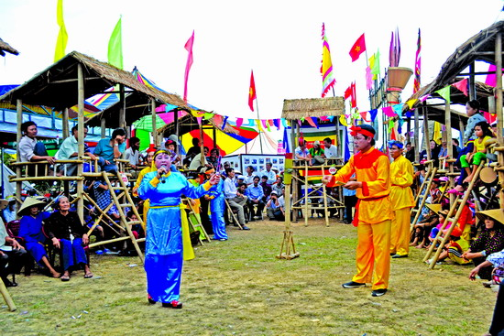
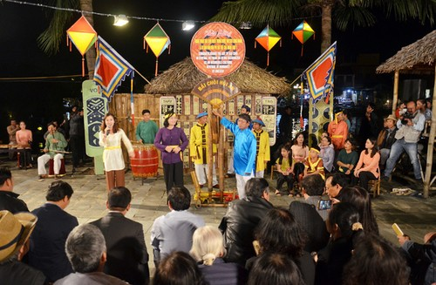
BAI CHOI

Slide 17

PLICKER GAME
- Each student will be received a PLICKERCARD.
- Teacher shows the question on the screen.
- Student has to show the correct answer from their card.

Slide 18
Homework
Do exercises in the workbook.
Prepare for Lesson LISTENING.

Slide 19

Website: hoclieu.vn
Fanpage: facebook.com/tienganhglobalsuccess.vn/
Website: hoclieu.vn
Fanpage: facebook.com/sachmem.vn/

