Slide 1


Slide 2
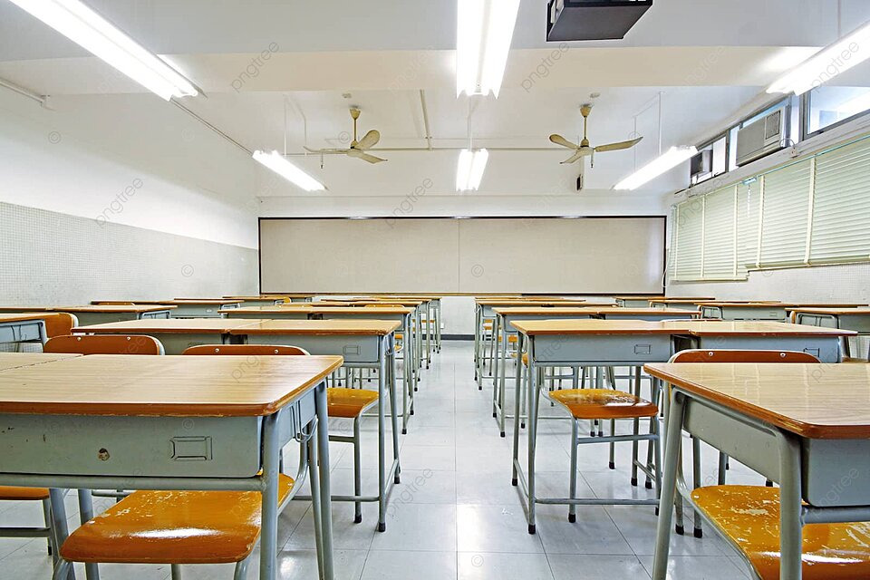
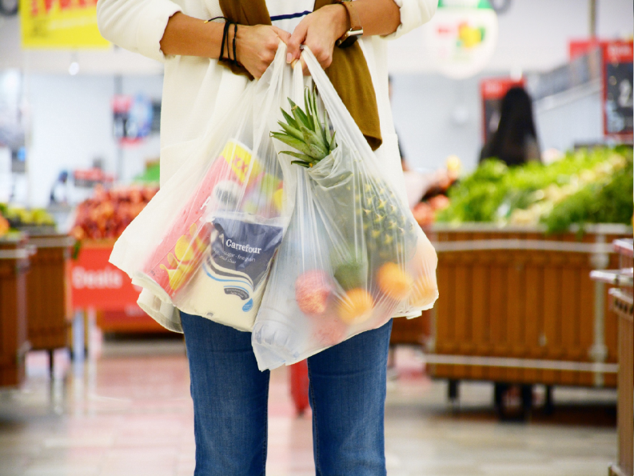
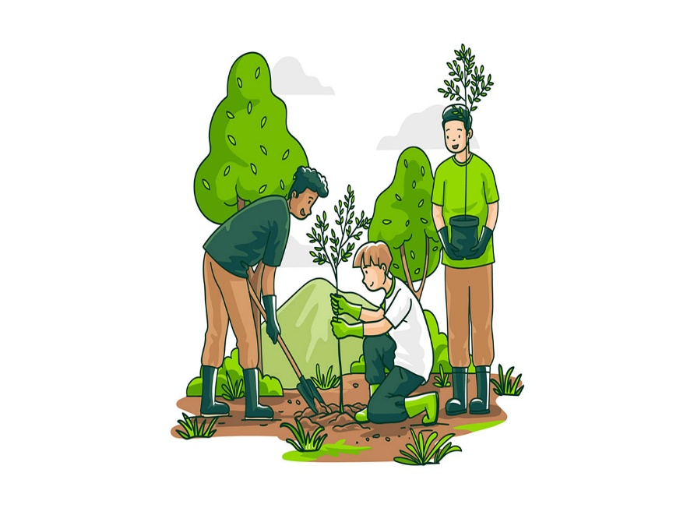
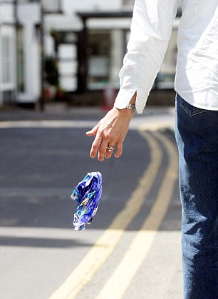
What should or shouldn’t we do to protect the environment?

Slide 3

We should plant more trees.

Slide 4
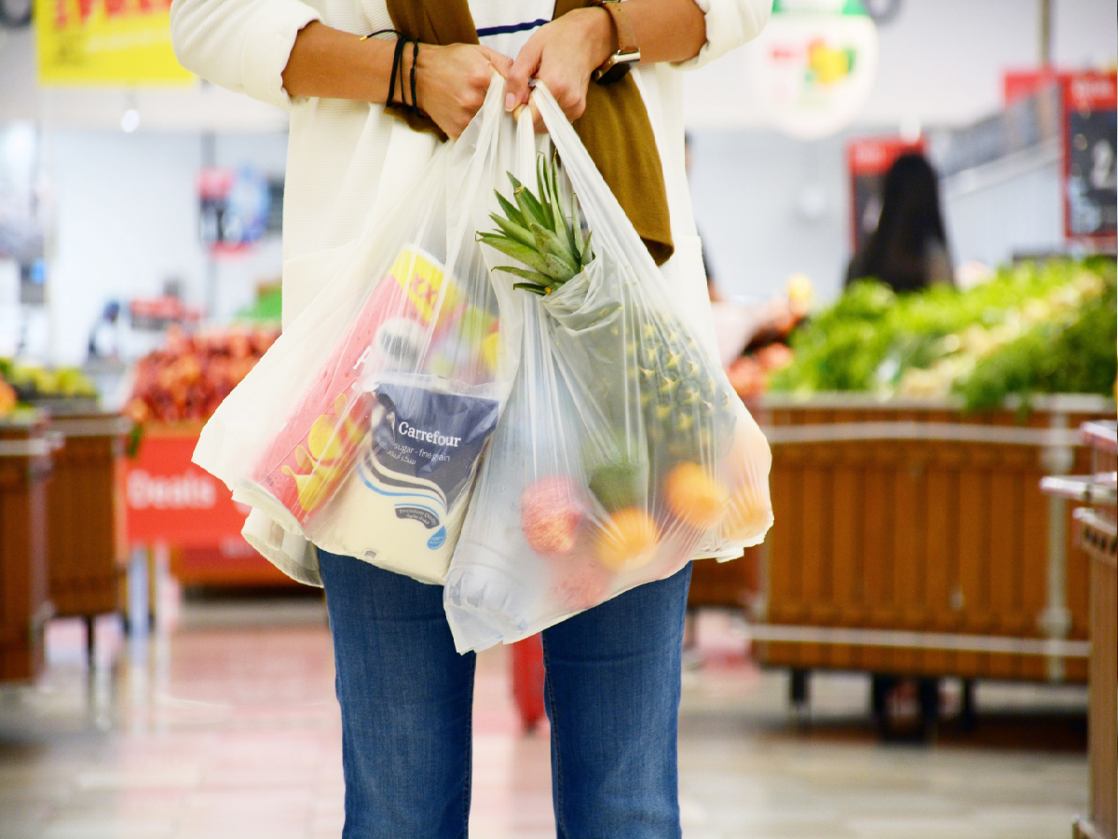
We shouldn’t use plastic bags when shopping.

Slide 5
We shouldn’t drop litter in the street.

Slide 6
v
v
v
v
We shouldn’t leave our appliances on when not in use.

Slide 7

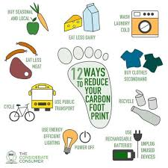

Unit
2
1
Unit
FAMILY LIFE
HUMANS AND THE ENVIRONMENT
LESSON 7
COMMUNICATION AND CULTURE/CLIL

Slide 8

I. EVERYDAY ENGLISH: asking for and giving advice
1
Listen and complete the conversation with the expressions in the box.
You should B. What should I do
C. I advise you D. Should I
Lan: I was asked to give a presentation on climate change next week. (1) ______________, Mai?
Mai: (2) __________ search for information about the topic on the Internet.
Lan: (3) __________ also read books in the library?
Mai: That’s a good idea. (4) ___________ to collect information from different sources. Then you can decide what to include in the presentation.
What should I do
You should
Should I
I advise you

Slide 9
EVERYDAY ENGLISH
2
Work in pairs. Make a similar conversation asking for and giving advice about green living. Use the expressions below to help you.
USEFUL EXPRESSIONS
Asking for advice | Giving advice
What should I do? | I think you should …
What do you advise me to do? | I advise you to …
Do you have any suggestions for me? | How about …?
What would you do if you were me? | If I were you, I would …
Can you give me some advice about…? | My advice would be to …

Slide 10
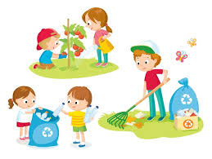
EVERYDAY ENGLISH
Make a similar conversation asking for and giving advice about green living.
2
Clean-up activities in the schoolyard.

Slide 11
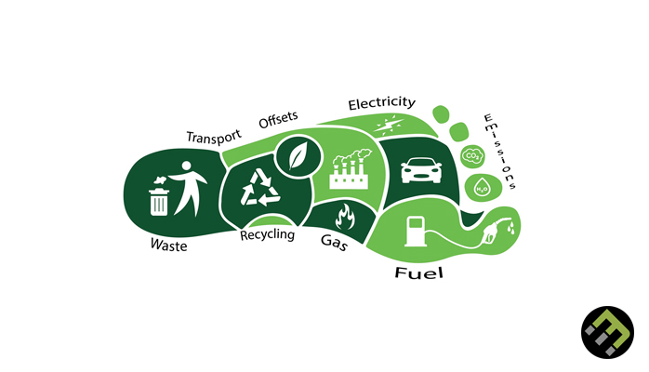
Carbon footprint

Slide 12
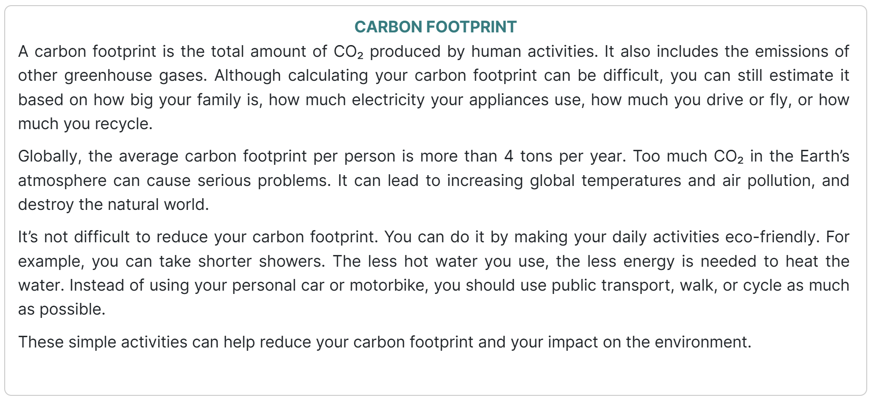
CLIL
PRACTICE
1
Read the text and complete the table.

Slide 13
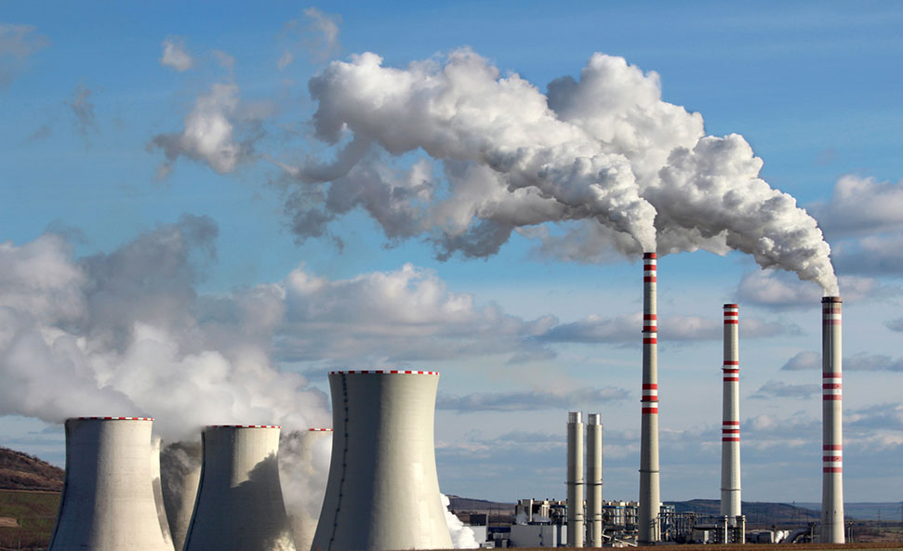
VOCABULARY
emission (n)
/ɪˈmɪʃn/
an amount of something, especially a gas that harms the environment, that is sent out into the air
khí thải

Slide 14
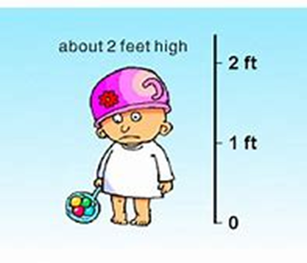
VOCABULARY
estimate (v)
/ˈestɪmeɪt/
guess or calculate the cost, size, value, etc. of something
ước tính

Slide 15
VOCABULARY
average (n)
/ˈævərɪdʒ/
Average = 10 + 15 + 20
3
= 15
An average number is the number you get by adding two or more amounts together and dividing the total by the number of amounts
trung bình

Slide 16
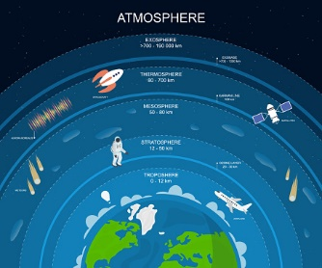
VOCABULARY
atmosphere (n)
/ˈætməsfɪə(r)/
the mixture of gases that surrounds the earth
bầu khí quyển

Slide 17
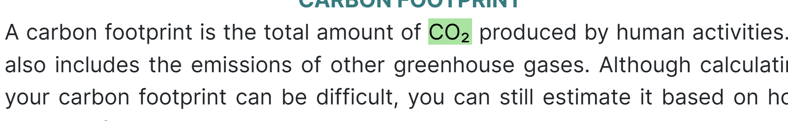
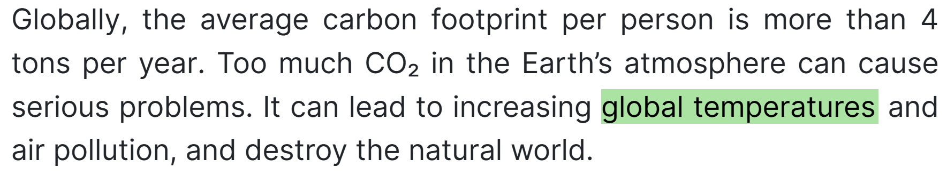
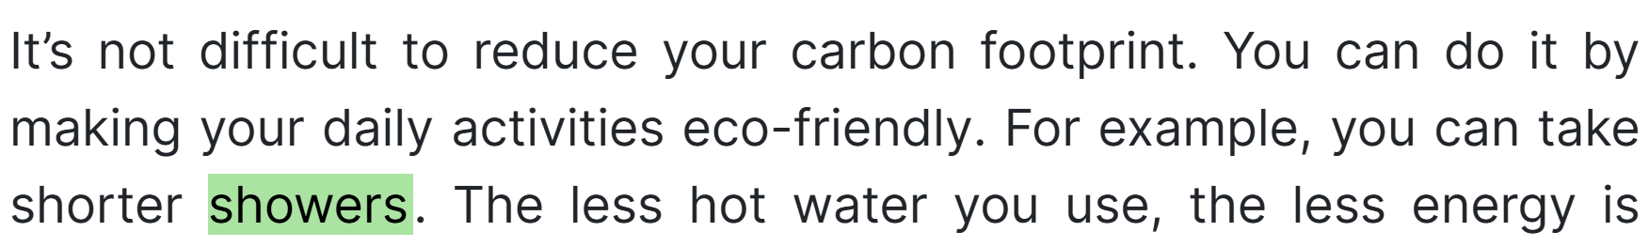
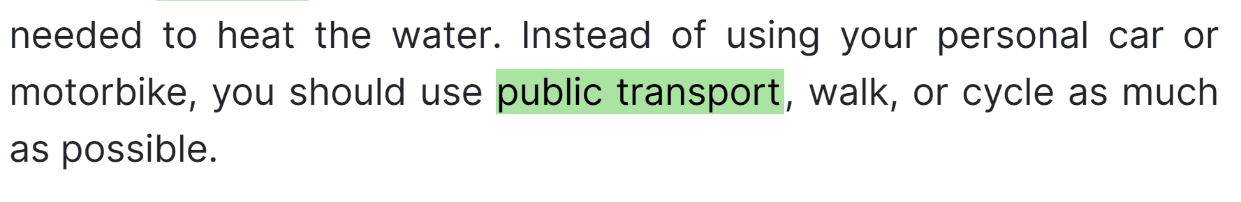
CLIL
PRACTICE
1
Read the text and complete the table.
Carbon footprint
Definition | Effects of large carbon footprint | Ways to reduce it
Carbon footprint is: - the total amount of (1) _______ produced by human activities - emissions of other greenhouse gases | - Increasing (2) __________________ and air pollution - Destroying the natural world | Make your daily activities eco-friendly by: - taking shorter (3) ________ - using (4) ______________, walking or cycling
global temperatures
CO2
showers
public transport

Slide 18

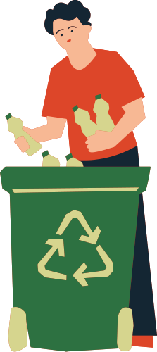

2
Discuss things you can do to reduce your carbon footprint.

Slide 19


Slide 20


CONSOLIDATION

Slide 21
CONSOLIDATION
2
Homework
Do exercises in the workbook

Slide 22

Website: sachmem.vn
Fanpage: facebook.com/sachmem.vn/

