Slide 1

Unit 4: ACTIVITIES
LESSON 2
Page 51

Slide 2

WARM UP

Slide 3

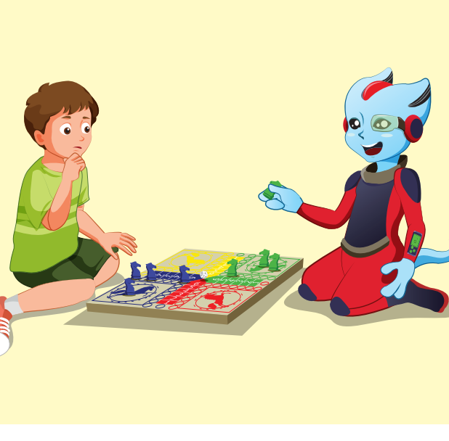
REVIEW 1
Look and say.
START
CHECK
Play a board game

Slide 4

REVIEW 1
Look and say.
START
CHECK
read a comic book

Slide 5
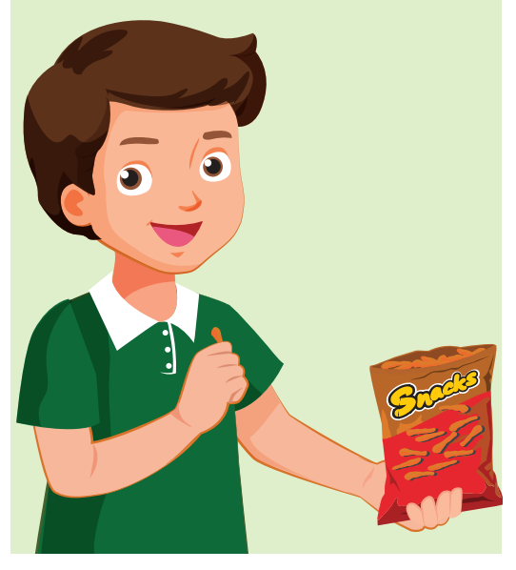
REVIEW 1
Look and say.
START
CHECK
eat snacks

Slide 6
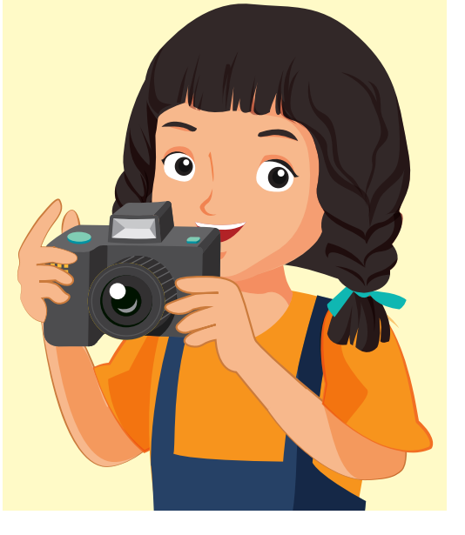
REVIEW 1
Look and say.
START
CHECK
take photos

Slide 7
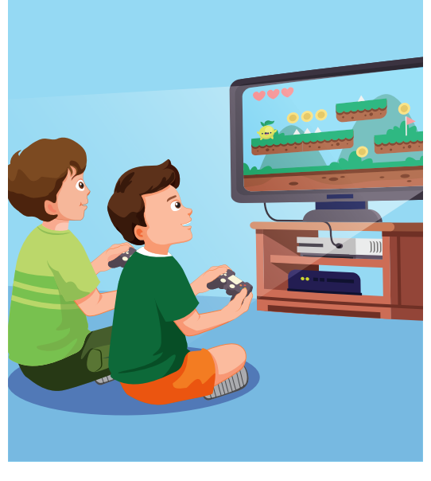
REVIEW 1
Look and say.
START
CHECK
play video games

Slide 8

It’s time to learn …

Slide 9

New words
listen to music, watch television, play table tennis, do martial arts, skate, play chess

Slide 10

Presentation

Slide 11

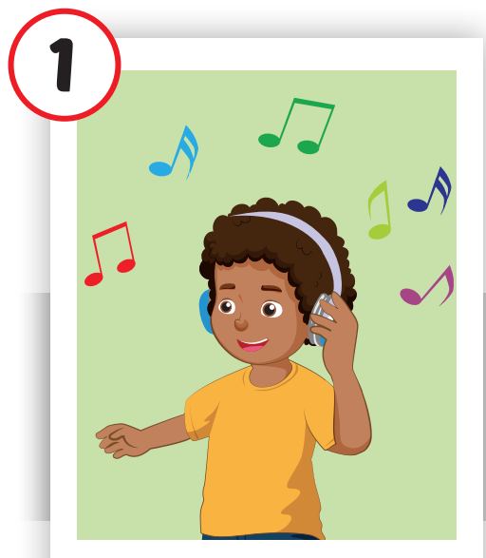
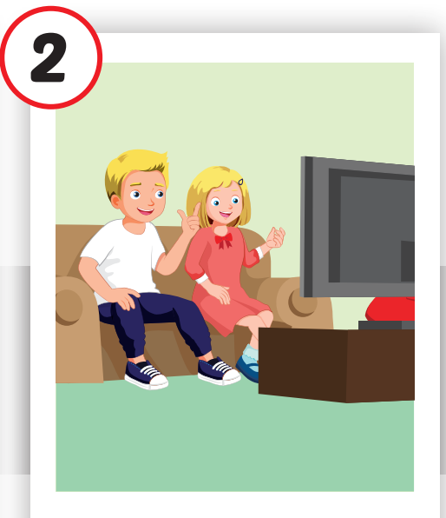
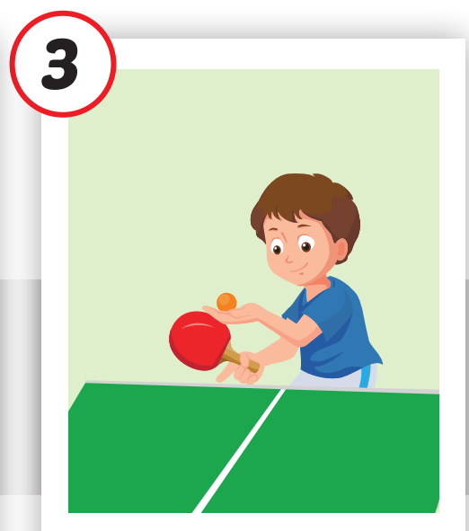

Click each English word to hear the sound.
listen to music
watch television
play table tennis
/ ˈlɪsn tə ˈmjuːzɪk /
nghe nhạc
/ wɑːtʃ ˈteləvɪʒən /
xem tivi
/pleɪˈteɪbl tenɪs/ chơi bóng bàn

Slide 12
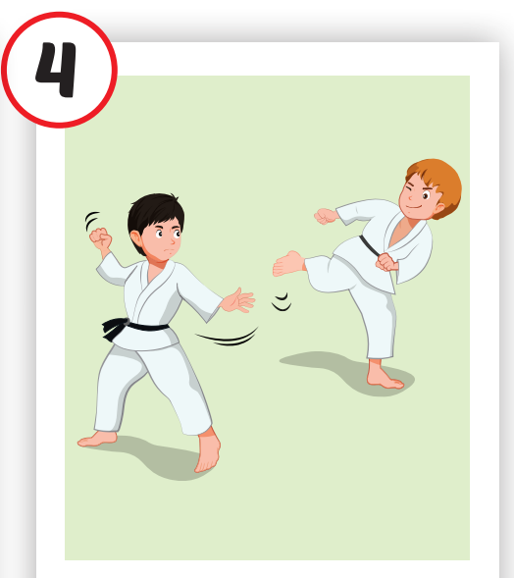
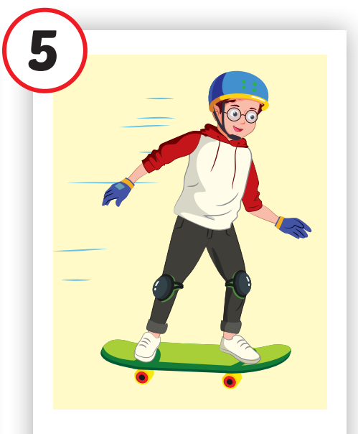
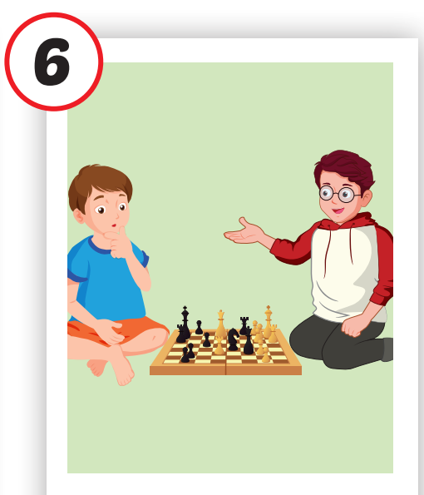
do martial arts
skate
play chess
/duː ˌmɑːrʃl ˈɑːrts/ tập võ
/skeɪt /
trượt ván
/ˈplei ˈtʃes/ chơi cờ vua

Slide 13

Practice

Slide 14
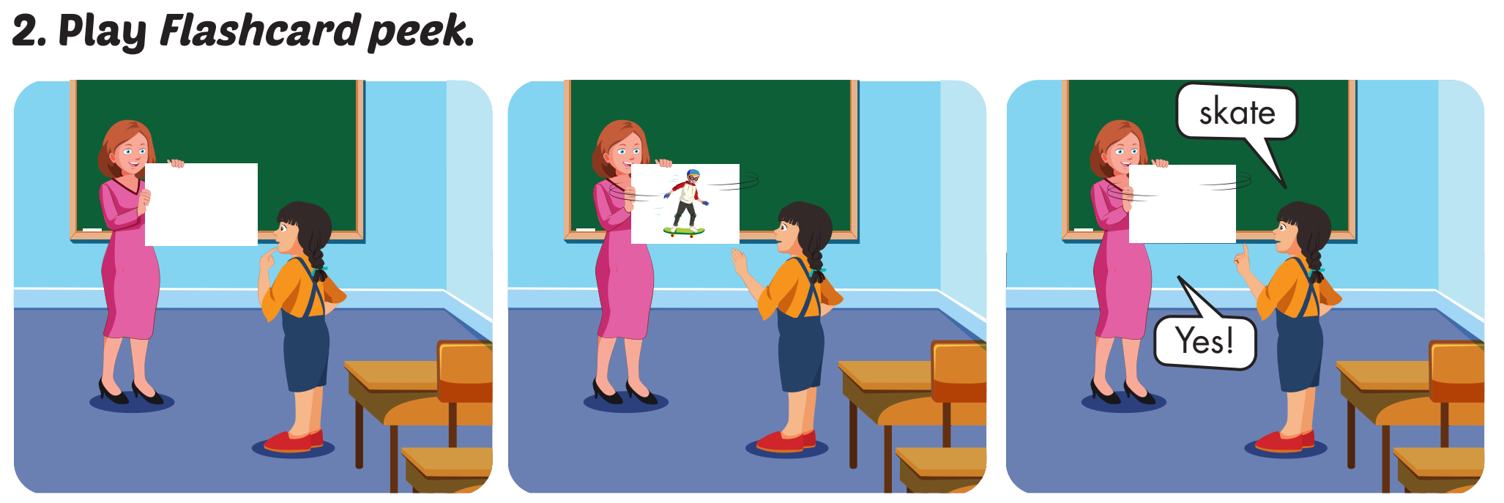

Slide 15
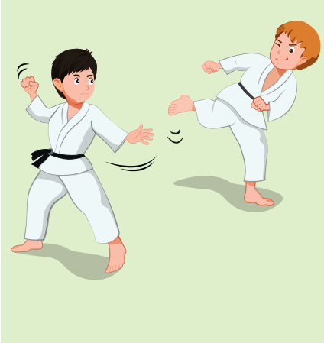
do martial arts
SHOW

Slide 16
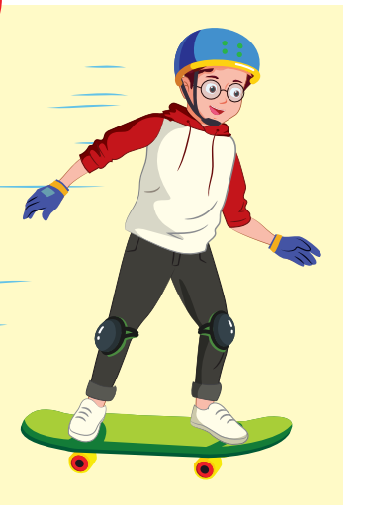
skate
SHOW

Slide 17
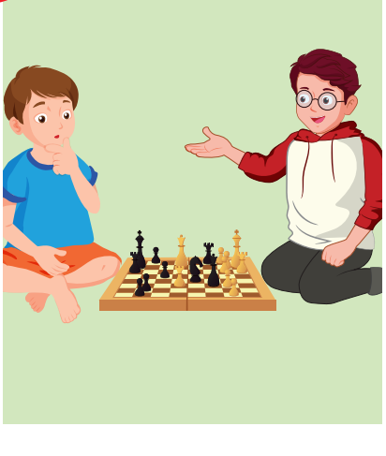
play chess
SHOW

Slide 18
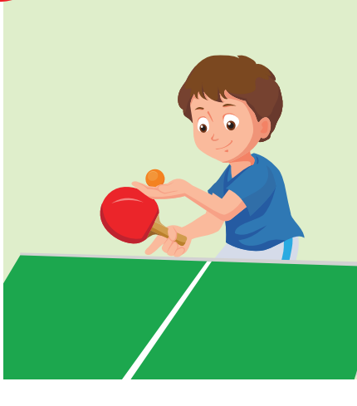
play table tennis
SHOW

Slide 19
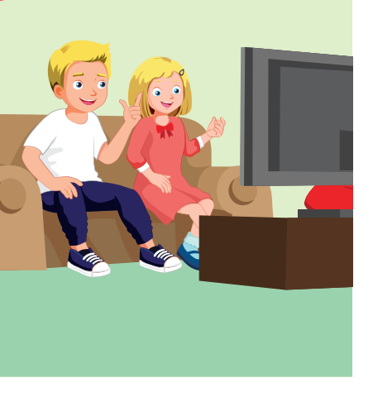
watch television
SHOW

Slide 20
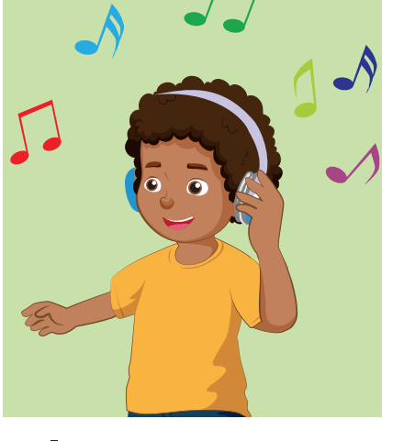
listen to music
SHOW

Slide 21
WHAT’S MISSING?
do martial arts
listen to music
play table tennis
skate
listen to music
skate
do martial arts
watch television
skate
skate
listen to music
play table tennis
listen to music
do martial arts
play table tennis
do martial arts
watch television
watch television
listen to music
skate
skate
play table tennis
watch television
play table tennis

Slide 22
Structures
Is he playing chess?
– Yes, he is.
Are they doing martial arts?
- No, they aren’t. They’re skating.

Slide 23
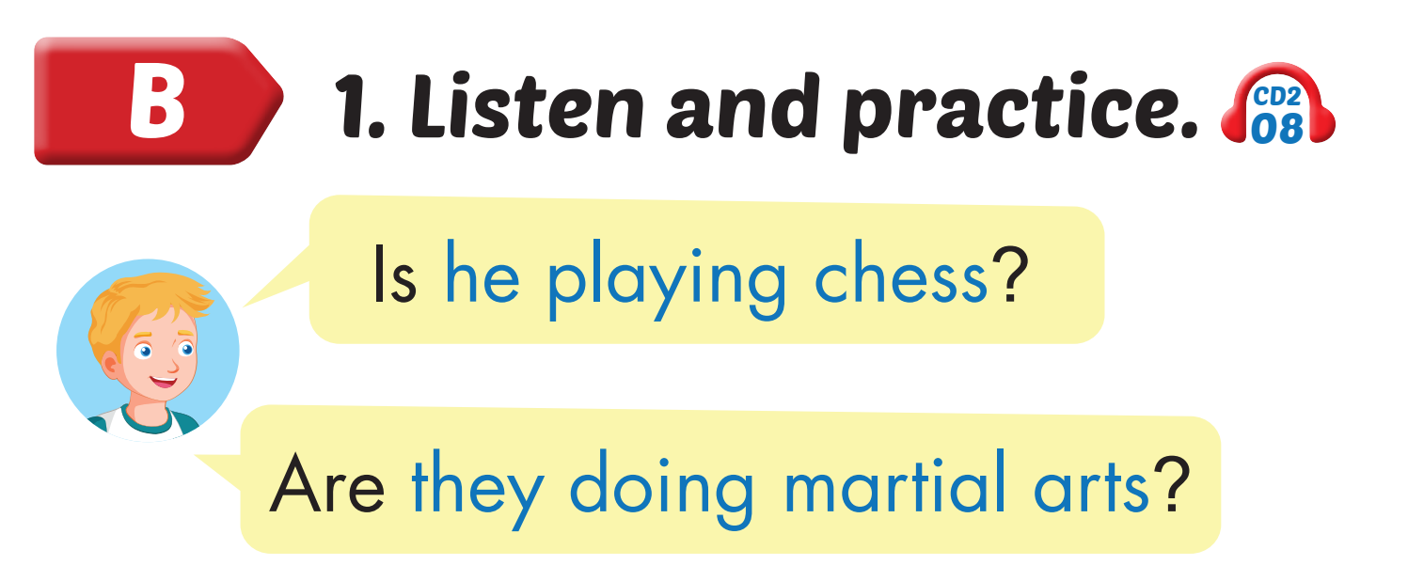
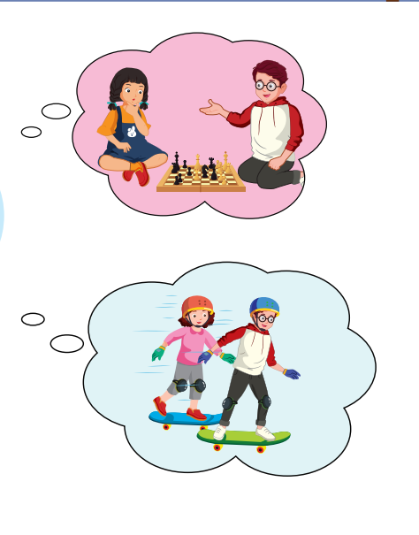
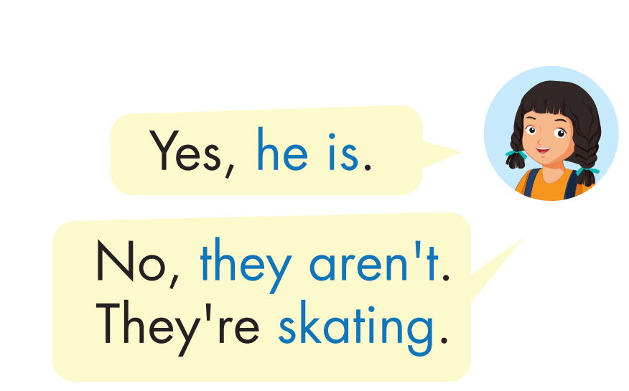
Click on the headphone icon to hear the sound.

Slide 24

Practice

Slide 25
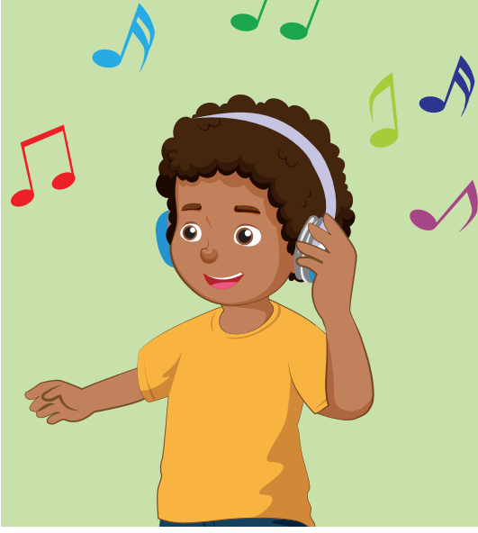



Is he listening to music?
Yes, he is.

Slide 26
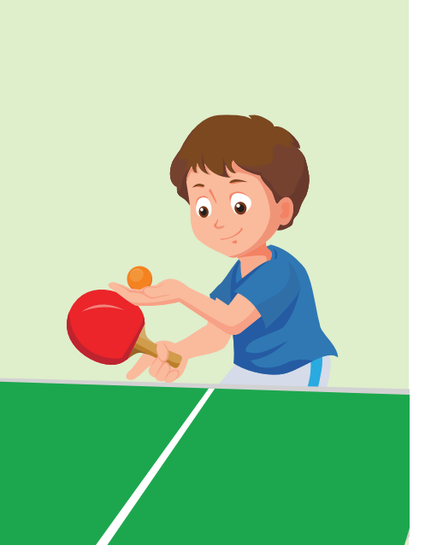
Is he ……..?
Yes,…...

Slide 27
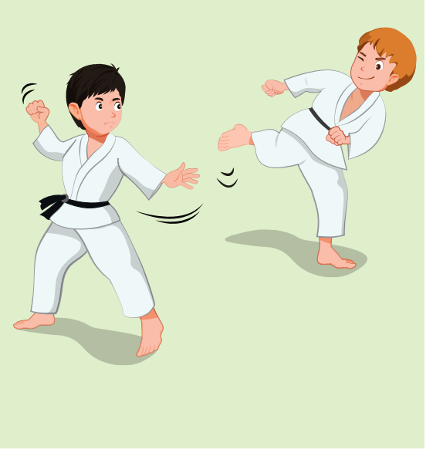
Are they ……..?
Yes,…...

Slide 28
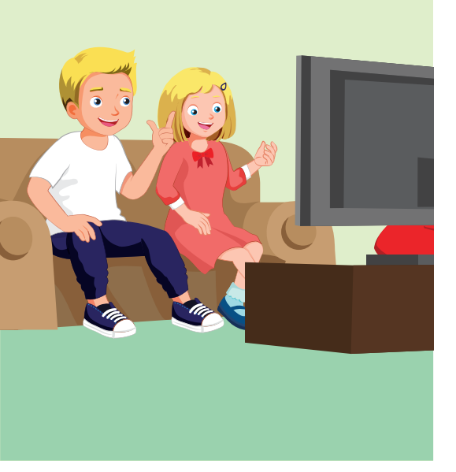

Are they ……..?
No,….... They are….

Slide 29
Are they ……..?
No,….... They are….

Slide 30
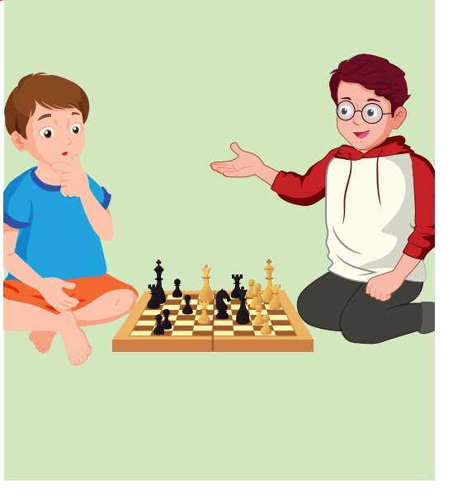
Are they ……..?
No,….... They are….

Slide 31
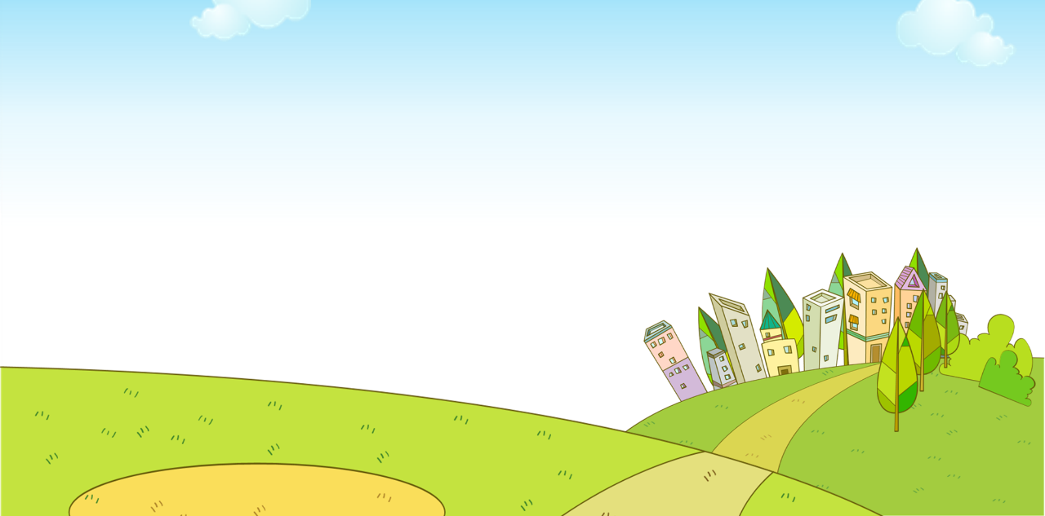


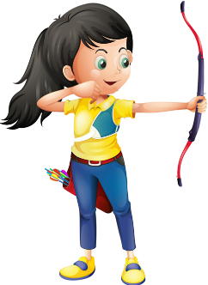
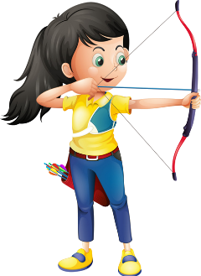


Ms Huyền Phạm
0936.082.789

Slide 32
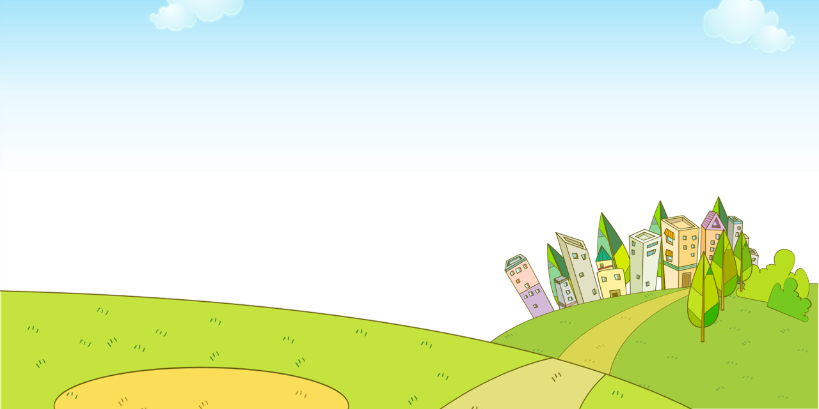

Is he listening
to music?
Yes, he is.
No, he isn’t.
Ms Huyền Phạm
0936.082.789
Notes:
Ms Huyền Phạm - 0936.082.789 – YOUTUBE: MsPham. Facebook: Dạy và học cùng công nghệ.

Slide 33
Is he playing table tennis?
Yes, he is.
No, he isn’t.
Ms Huyền Phạm
0936.082.789

Slide 34
Are they
playing a board
game?
Yes, they are.
No, they aren’t. They are playing chess.
Ms Huyền Phạm
0936.082.789

Slide 35
Are they
watching
television?
Yes, they are.
No, they aren’t. They are doing martial arts.
Ms Huyền Phạm
0936.082.789

Slide 36
Are they watching television?
Yes, they are.
No, they aren’t.
Ms Huyền Phạm
0936.082.789

Slide 37

CONSOLIDATION

Slide 38
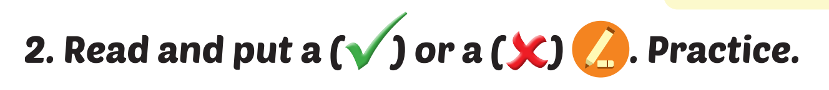
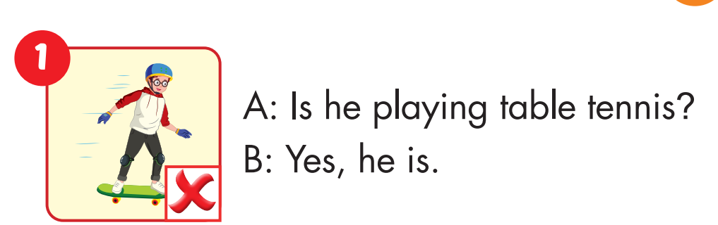

Slide 39
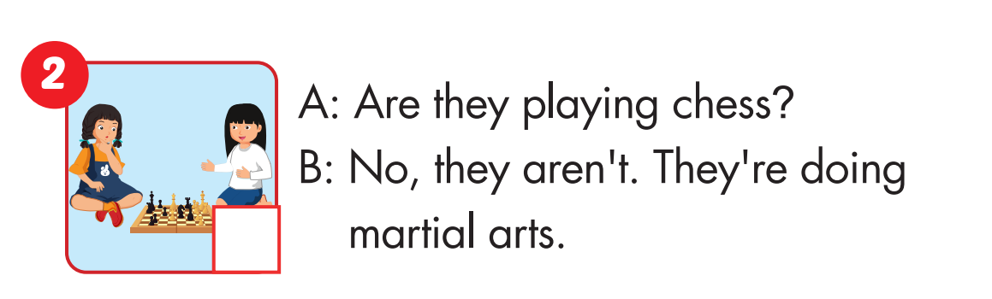

Slide 40
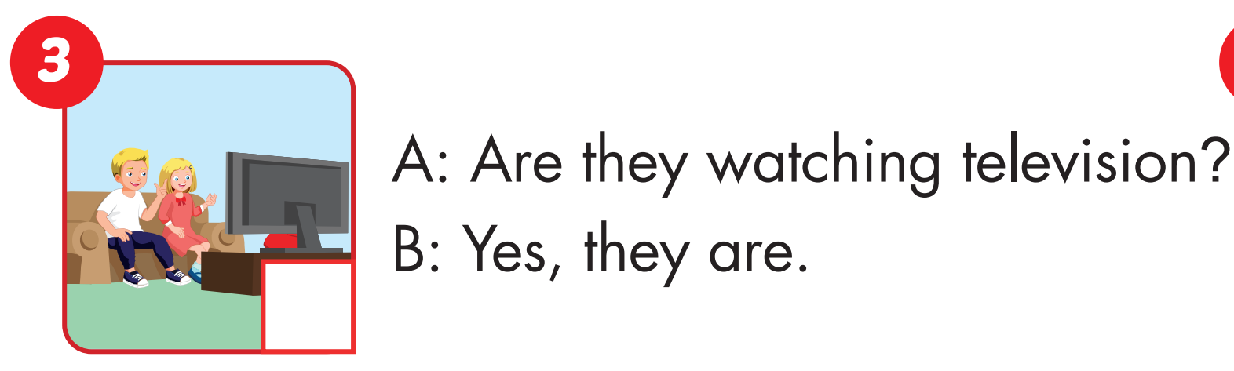

Slide 41
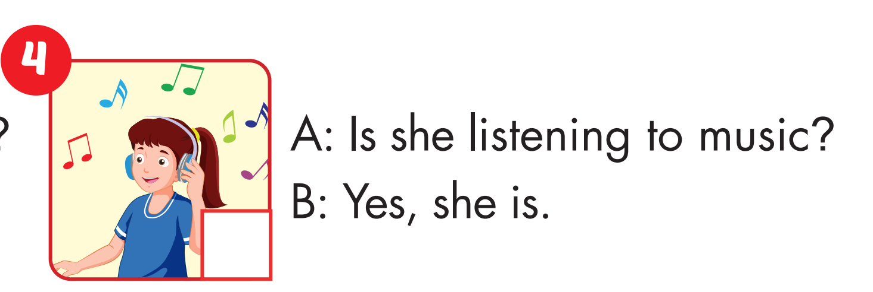

Slide 42
Today’s lesson
Vocabularies
listen to music, watch television, play table tennis, do martial arts, skate, play chess.
Structures/ Sentence patterns
Is he playing chess?
– Yes, he is.
Are they doing martial arts?
- No, they aren’t. They’re skating.

Slide 43
Homework
Practice the vocabularies and structure, and make sentences using them.
Do the exercises in Tiếng Anh 4 i-Learn Smart Start WB (page 34)
Do the exercises in Tiếng Anh 4 i-Learn Smart Start Notebook (page 23).
Prepare the next lesson (page 52 SB)
Play the consolidation games in Tiếng Anh 4 i-Learn Smart Start DHA App on www.eduhome.com.vn

