Slide 1

Unit 3: MY FRIENDS AND I
Culture – Lesson 1
Page 43

Slide 2

WARM-UP

Slide 3

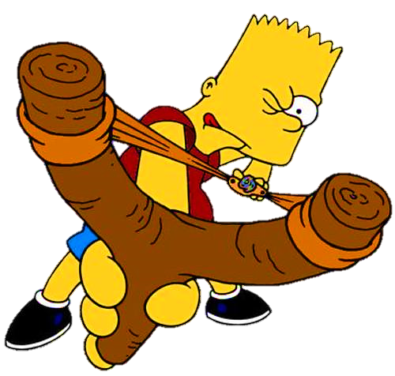



Slide 4
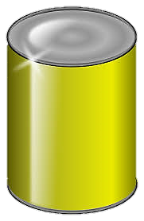



planted
I __________ some flowers yesterday.
planted
painted
played
NEXT
Click on the right can

Slide 5
They __________ soccer last weekend.
played
stayed
painted
played
NEXT
Click on the right can

Slide 6
painted
She __________ a picture last Sunday.
stayed
painted
baked
Click on the right can
NEXT

Slide 7
stayed
We __________ at home last night.
stayed
visited
baked
NEXT
Click on the right can

Slide 8

It’s time to learn …

Slide 9

New words
have a sleepover,
go camping,
have a barbecue,
sing karaoke,
go bowling,
make paper crafts.

Slide 10

Presentation

Slide 11

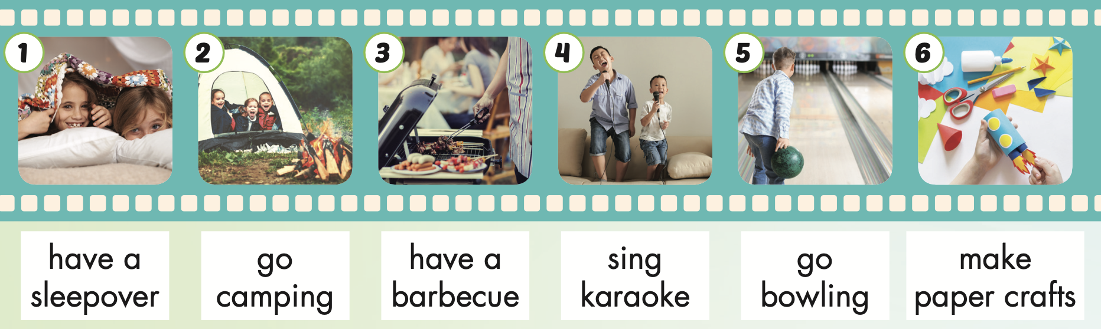
Notes:
Click vào hình A. 1. Listen and point. Repeat để cho cả audio full chạy

Slide 12

have a sleepover
/hæv ə ˈsliːpoʊvər/
tổ chức tiệc ngủ (ở nhà bạn)

Slide 13
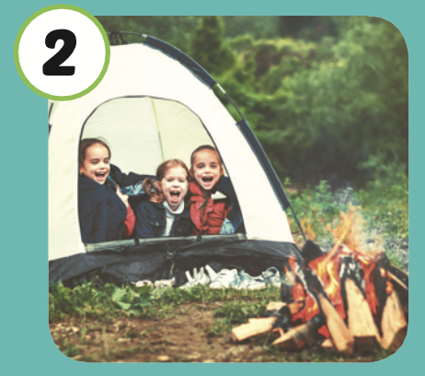
go camping
/ɡoʊ ˈkæmpɪŋ/
đi cắm trại

Slide 14
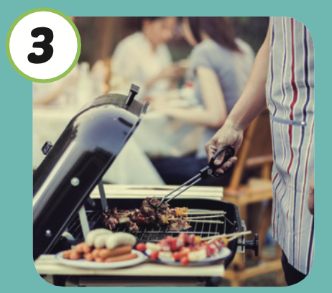
have a barbecue
/ hæv ə ˈbɑːrbəkjuː /
tổ chức tiệc nướng ngoài trời

Slide 15
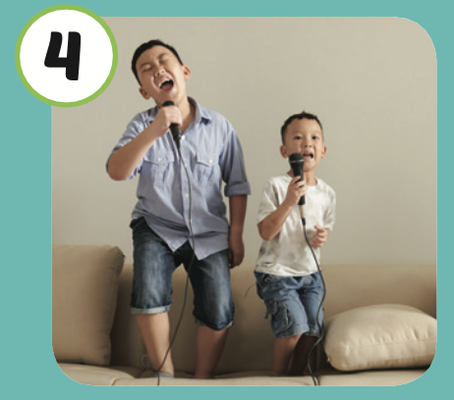
sing karaoke
/ sɪŋ ˌkæriˈoʊki /
hát karaoke

Slide 16
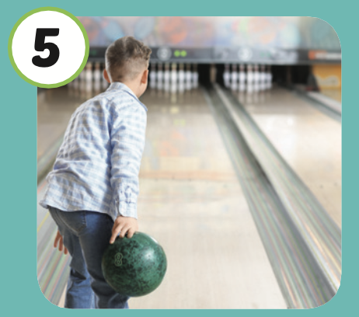
go bowling
/ɡoʊ ˈboʊlɪŋ /
chơi bowling

Slide 17

make paper crafts
/ meɪk ˈpeɪpər kræfts/
làm đồ thủ công giấy

Slide 18
Practice

Slide 19
Listen and choose.
Then say.

Slide 20

Listen and choose
A
B
C

Slide 21
Listen and choose
A
B
C

Slide 22
Listen and choose
A
B
C

Slide 23
Listen and choose
A
B
C

Slide 24
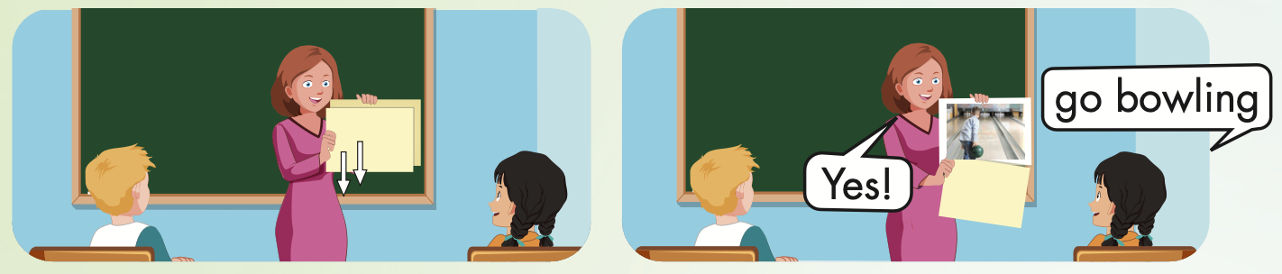

Slide 25
Structure
I went camping last week.

Slide 26
Presentation

Slide 27

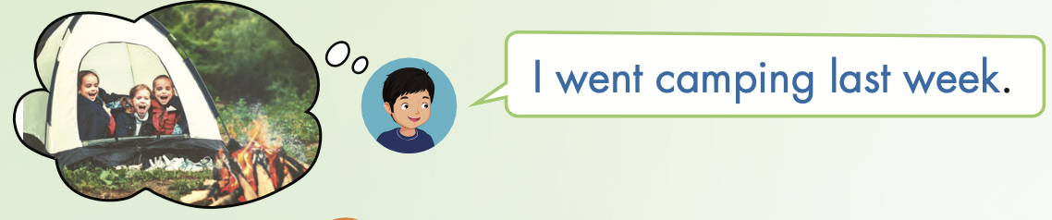
Structure

Slide 28
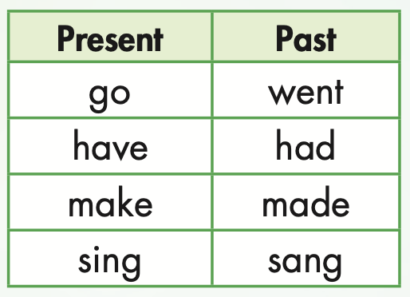

Slide 29

Practice

Slide 30

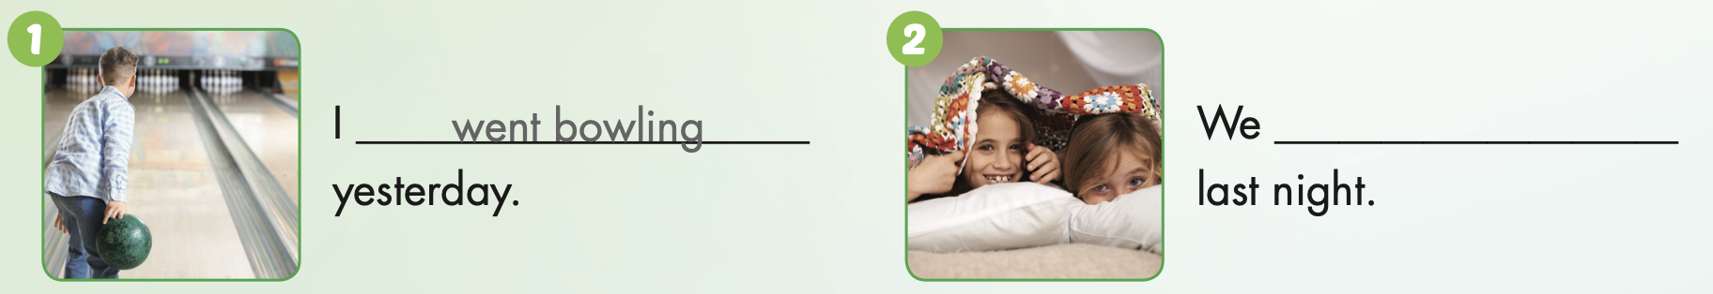
had a sleepover

Slide 31
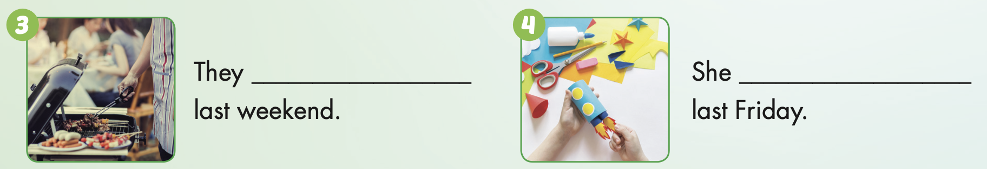
had a barbecue

Slide 32
made paper crafts

Slide 33
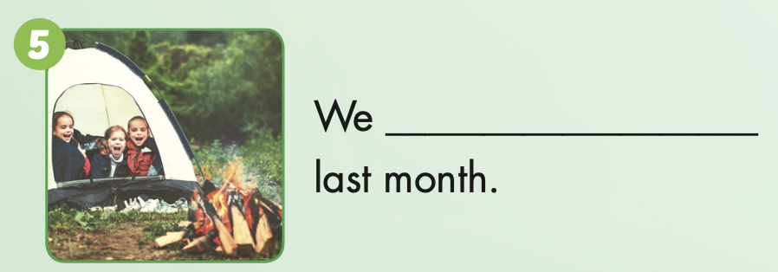
went camping

Slide 34
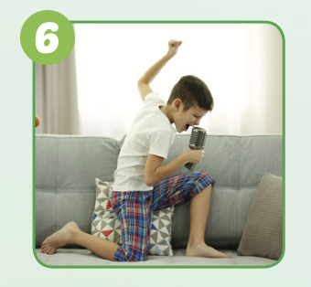
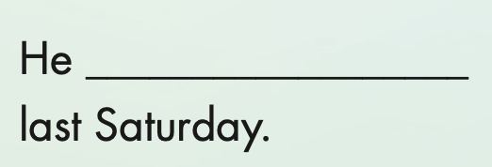
sang karaoke

Slide 35

Production

Slide 36

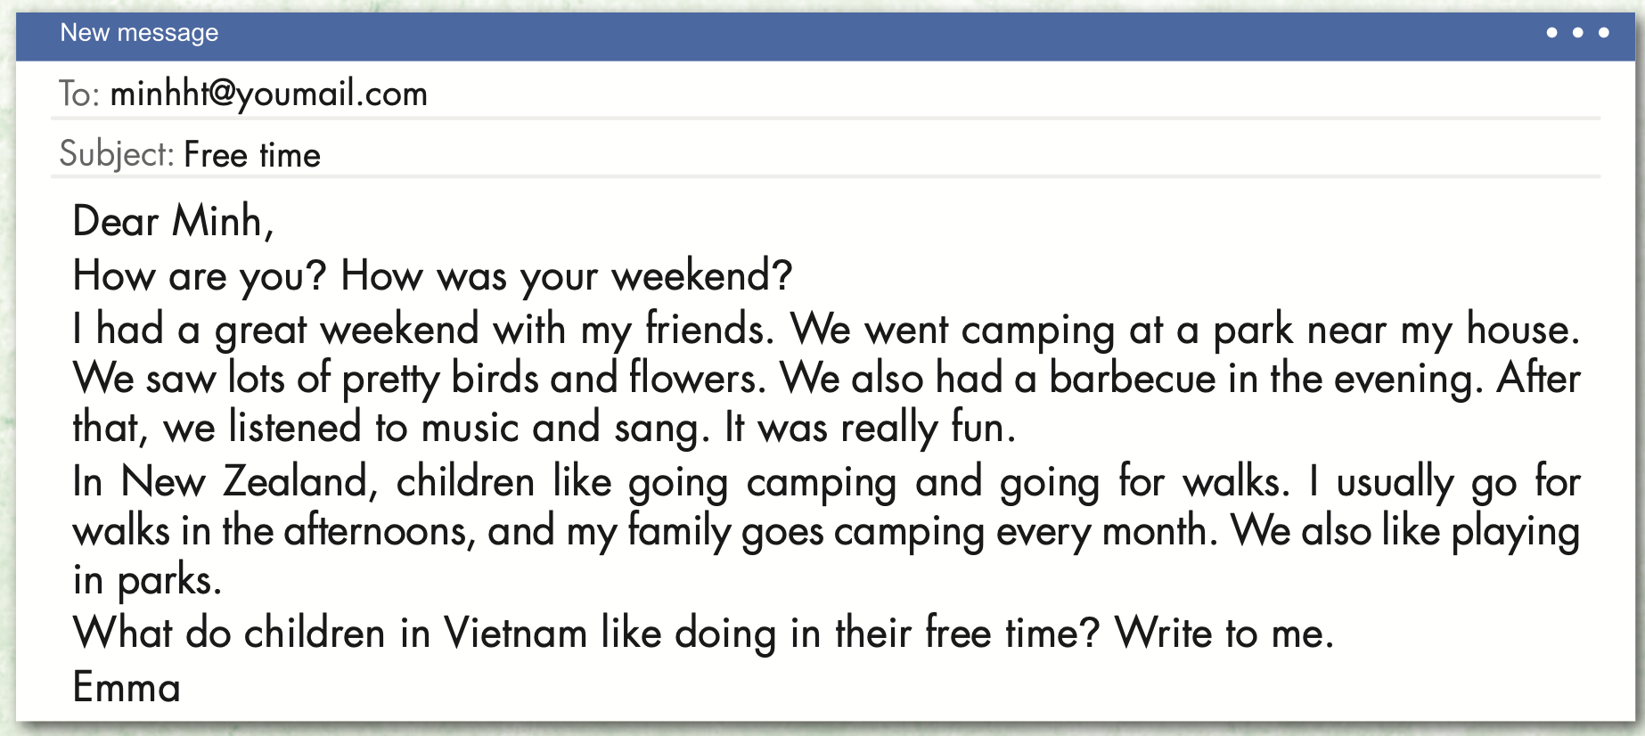
Extra Practice
WB, page 28

Slide 37
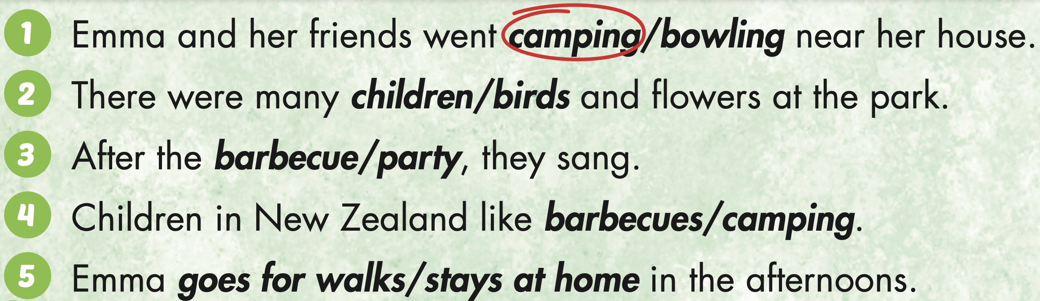
Extra Practice
WB, page 28

Slide 38

CONSOLIDATION

Slide 39
Memory game

Slide 40
- The first student chooses 2 numbers.
If the pictures match (a verb in present tense and its past tense), the student wins a point.

Slide 41
Memory
Sing
Watch
Had
planted
stayed
played
1
2
3
4
5
6
Hide All
Show All
Go
8
11
12
plant
stay
Watched
play
paint
7
9
10
Went
14
15
17
13
were
Have
Walk
Sang
make
16
18
Walked
20
22
23
was
made
19
21
are
is
painted
24

Slide 42
Today’s lesson
Vocabularies
have a sleepover,
go camping,
have a barbecue,
sing karaoke,
go bowling,
make paper crafts.
Structures/ Sentence patterns
I went camping last week.

Slide 43
Homework
Practice the vocabularies and structure, and make sentences using them.
Do the exercises in Tiếng Anh 5 i-Learn Smart Start WB (page 28).
Do the exercises in Tiếng Anh 5 i-Learn Smart Start Notebook.
Prepare the next lesson (page 44 SB).
Play the consolidation games in Tiếng Anh 5 i-Learn Smart Start DHA App on www.eduhome.com.vn

