Slide 1

Unit 2
WHAT I CAN DO
LESSON 1.1 - PAGE 20

Slide 2

WARM UP

Slide 3

4 things
1 animal

Slide 4

It’s gray.
It’s big.
It has 4 legs.
It has a tail.
e
l
e
p
h
a
n
t

Slide 5
It’s small.
It has 2 legs.
It has feather.
It has 2 wings.
b
i
r
d

Slide 6
It’s tall.
It has 4 legs.
It has a long neck.
It has a tail.
g
i
r
a
f
f
e

Slide 7

It’s time to learn …

Slide 8

New words
dance,
sing,
play the keyboard, paint,
draw,
act

Slide 9

Presentation

Slide 10


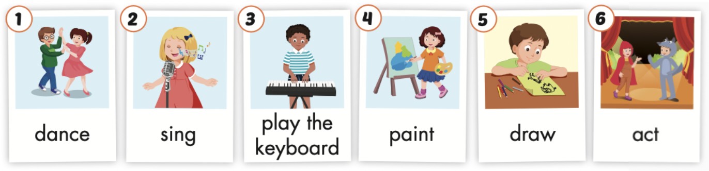
Click the icon to hear the sound.

Slide 11
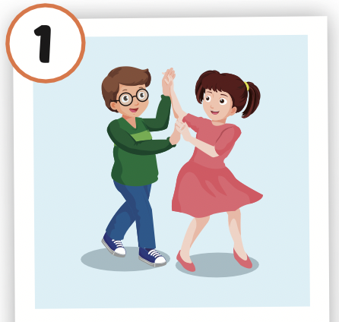
Click the picture to hear the sound.
dance
/ˈdæns/
nhảy múa

Slide 12
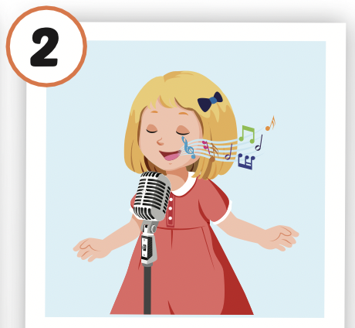
Click the picture to hear the sound.
sing
/sɪŋ/
hát

Slide 13
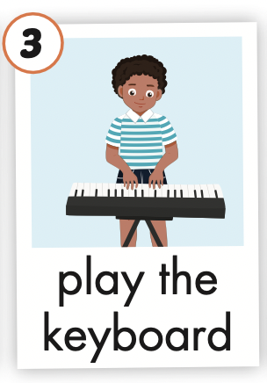
Click the picture to hear the sound.
play the keyboard
/pleɪ ðə ˈkiːbɔːrd/
chơi đàn phím

Slide 14
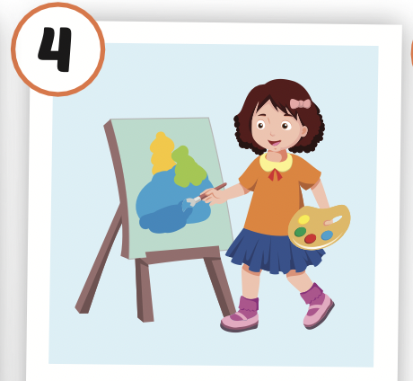
Click the picture to hear the sound.
paint
/peɪnt/
vẽ, sơn

Slide 15
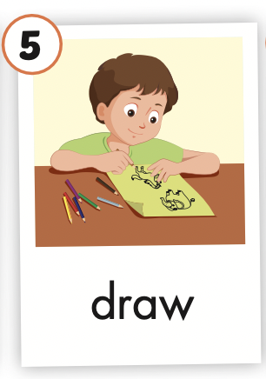
Click the picture to hear the sound.
draw
/drɑː/
vẽ

Slide 16
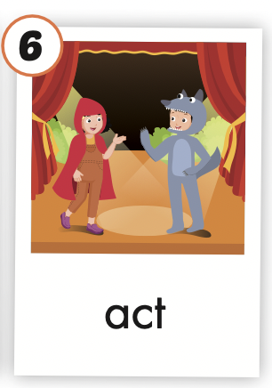
Click the picture to hear the sound.
act
/ækt/
diễn xuất

Slide 17

Practice

Slide 18



LISTEN AND CHOOSE

Slide 20
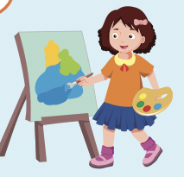

Slide 23

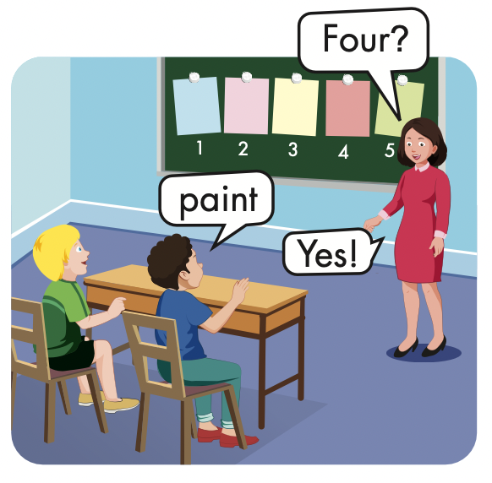
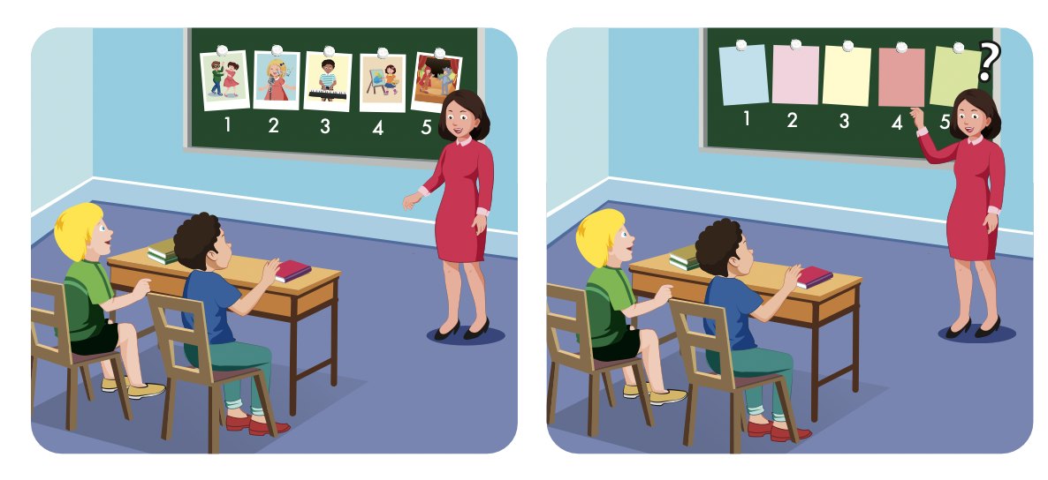

Slide 24
Structures
I can dance.
I can't draw.

Slide 25
Presentation

Slide 26

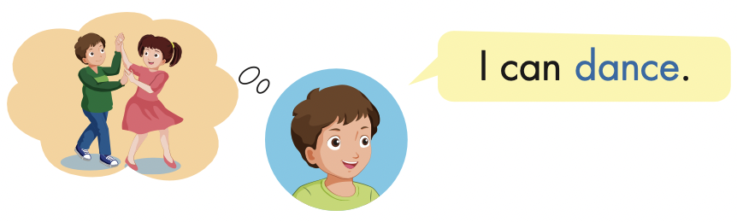
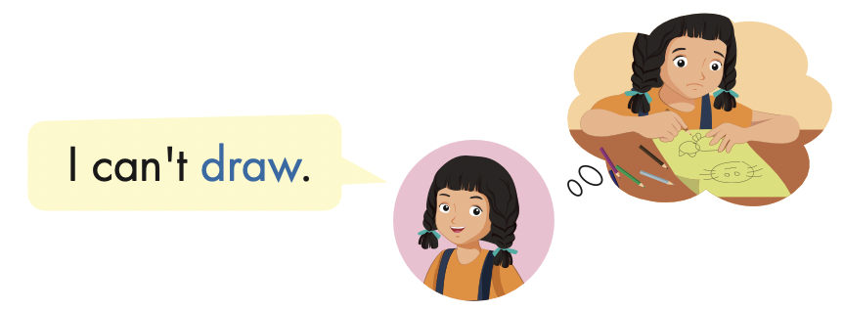

Slide 27
Practice

Slide 28
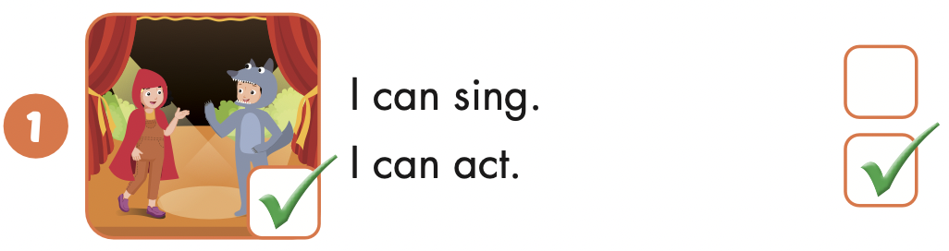
I can act.

Slide 29
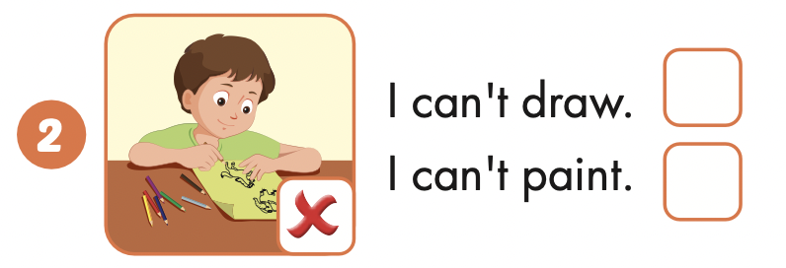
I can’t draw.

Slide 30
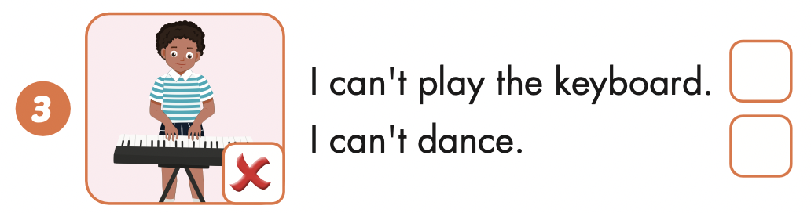
I can’t play the keyboard.

Slide 31
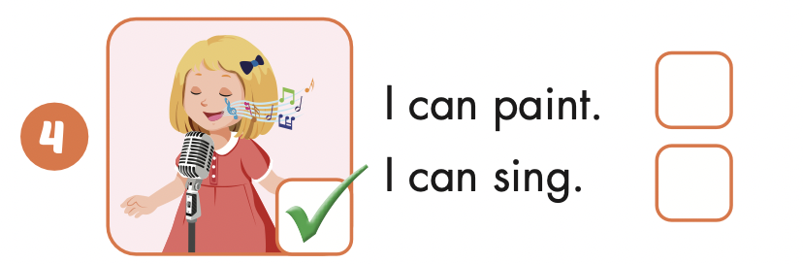
I can sing.

Slide 32

Writing

Slide 33


Slide 34


Slide 37

Production

Slide 38
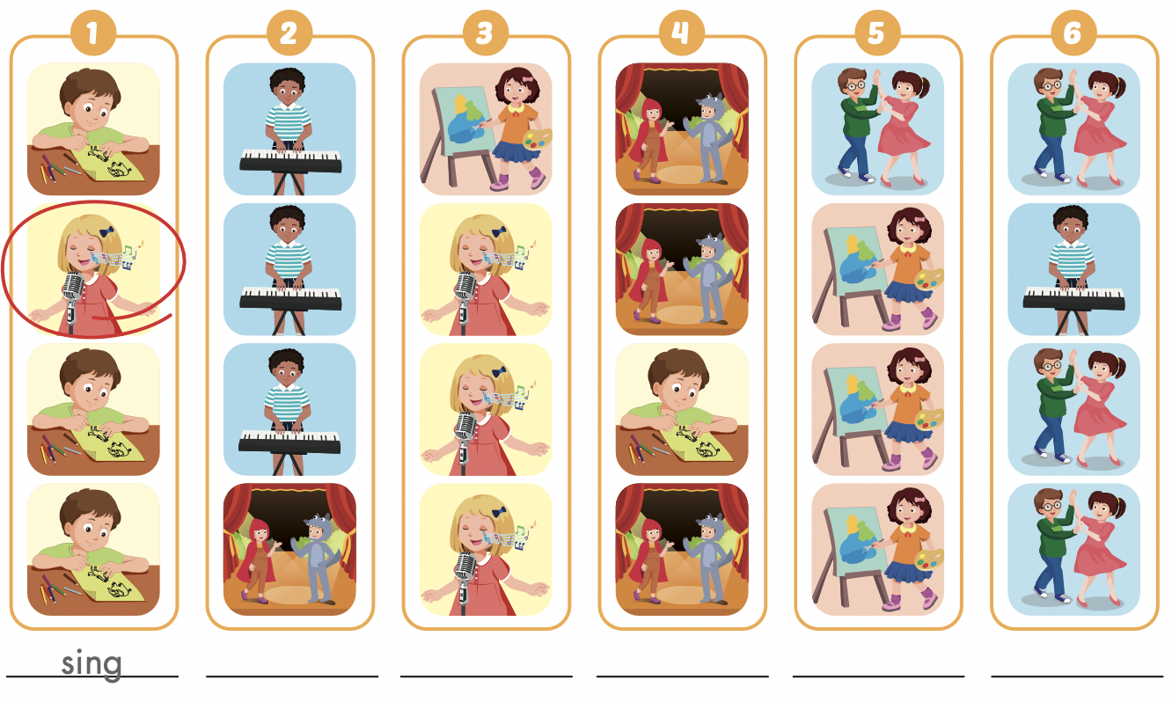

Extra Practice
WB, page 12
act
paint
draw
dance
play the keyboard

Slide 39

CONSOLIDATION

Slide 40
LET’S PLAY!
WHAT’S MISSING?

Slide 47
Today’s lesson
Vocabularies
dance,
sing,
play the keyboard, paint,
draw,
act
Structures/ Sentence patterns
I can dance.
I can't draw.

Slide 48
Homework
Practice the vocabularies and structure; and make sentences using them.
Do the exercises in Tiếng Anh 4 i-Learn Smart Start WB (page 12)
Do the exercises in Tiếng Anh 4 i-Learn Smart Start Notebook (page 10)
Prepare the next lesson (page 21 SB)
Play the consolidation games in Tiếng Anh 4 i-Learn Smart Start DHA App on www.eduhome.com.vn

