Slide 1

WARM-UP

Slide 2


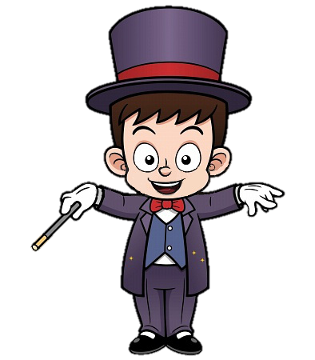

Slide 3


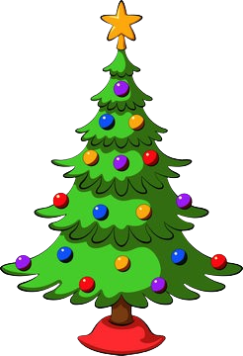

Christmas tree
NEXT

Slide 4

fireworks
NEXT

Slide 5
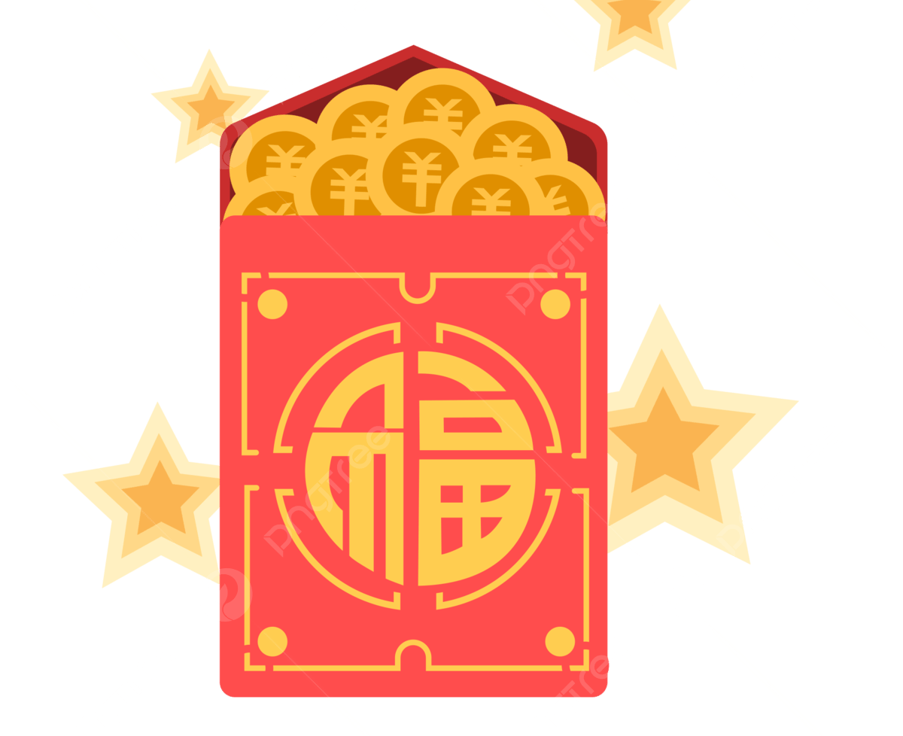
lucky money
NEXT

Slide 6
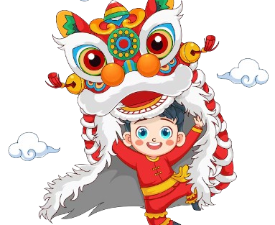
lion dance
NEXT

Slide 7
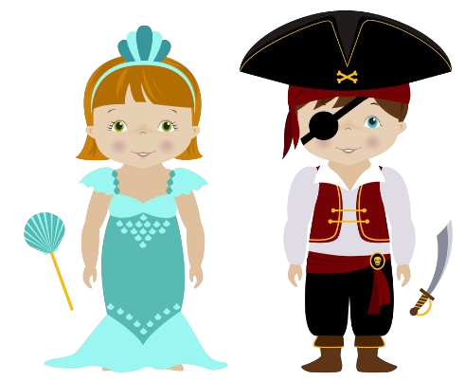
customes
NEXT

Slide 8
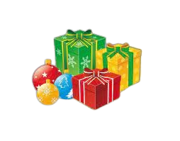
presents
NEXT

Slide 9
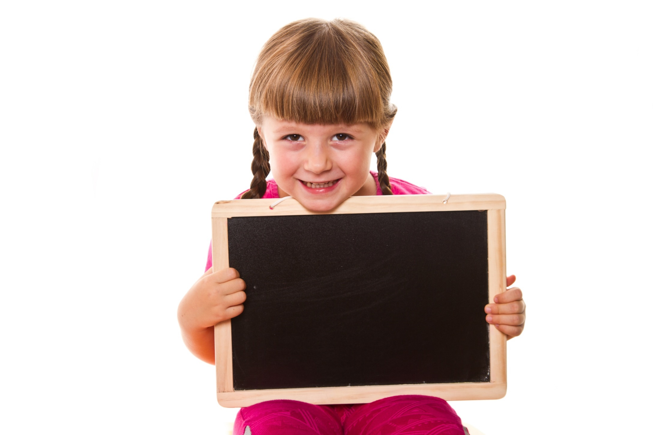
Presentation

Slide 10


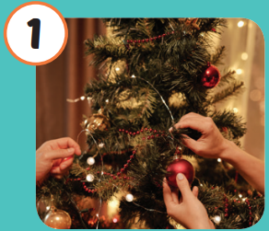
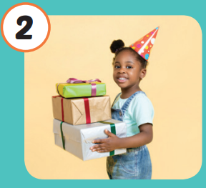
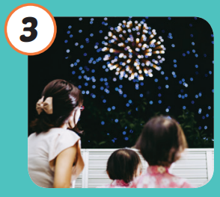
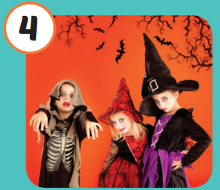
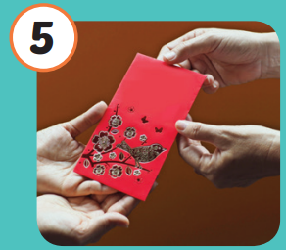
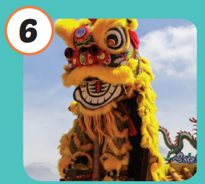
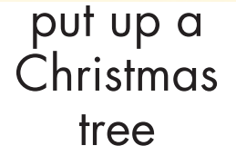
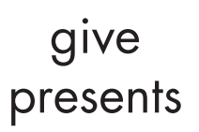
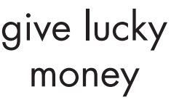


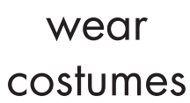
/pʊt ʌp ə ˈ
krɪsməs tri/
trang trí
cây thông Noel
/ɡɪv ˈprɛzənts/
tặng quà
/wɑtʃ ˈfaɪərwɜrks/
xem pháo hoa
/wɛər ˈkɑːstuːmz/
mặc trang phục cải trang
/ɡɪv ˈlʌki ˈmʌni/
lì xì
/wɑtʃ ðə ˈ
laɪən dæns/
xem múa lân/múa sư tử
Notes:
Click vào hình A. 1. Listen and point. Repeat để cho cả audio full chạy

Slide 11
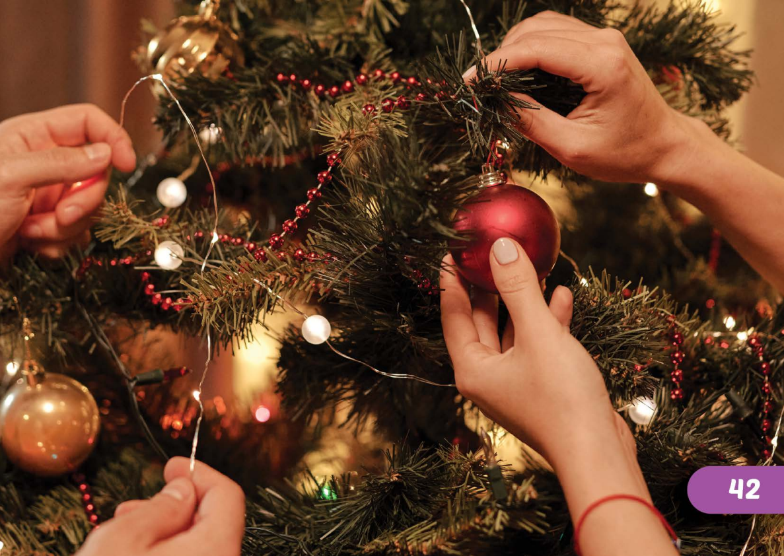

/pʊt ʌp ə ˈ
krɪsməs tri/
trang trí
cây thông Noel

Slide 12
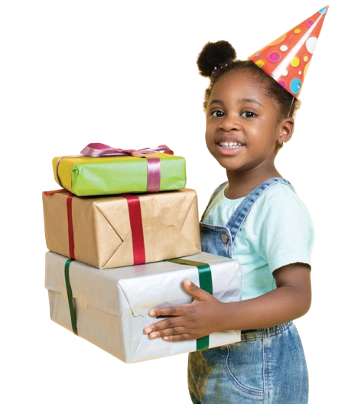

/ɡɪv ˈprɛzənts/
tặng quà

Slide 13
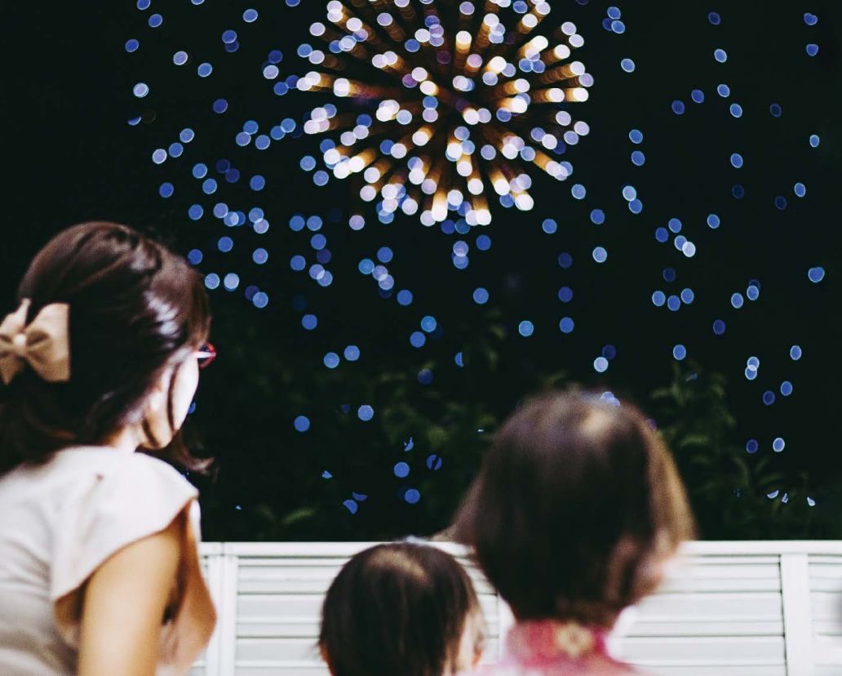

/wɑtʃ ˈfaɪərwɜrks/
xem pháo hoa

Slide 14
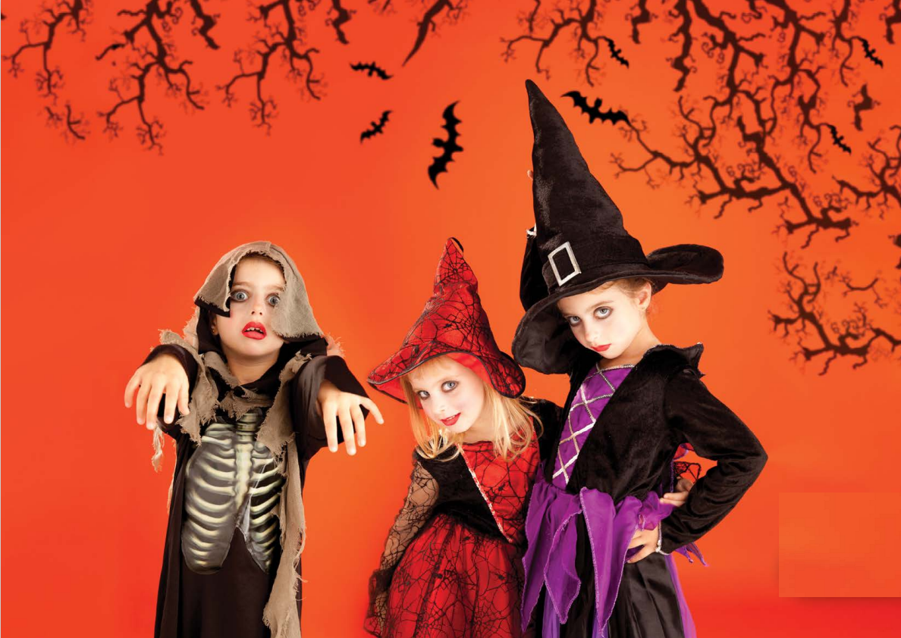

/wɛər ˈkɑːstuːmz/
mặc trang phục cải trang

Slide 15
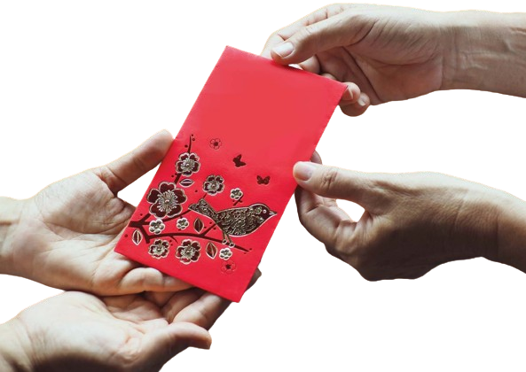

/ɡɪv ˈlʌki ˈmʌni/
lì xì

Slide 16

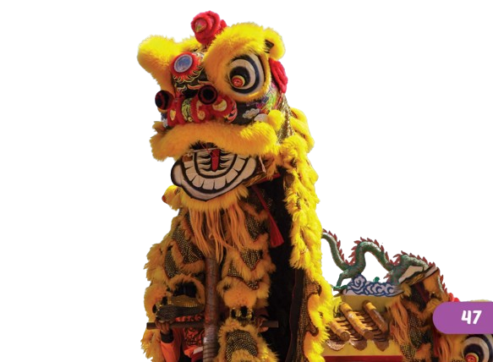
/wɑtʃ ðə ˈ
laɪən dæns/
xem múa lân/múa sư tử

Slide 17
Practice

Slide 18
Check your memory

Slide 19
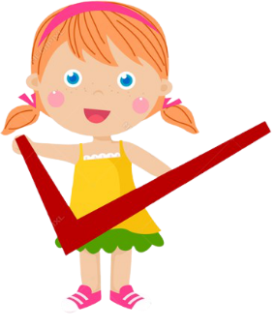
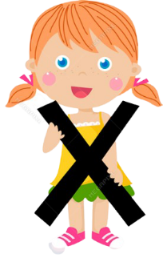


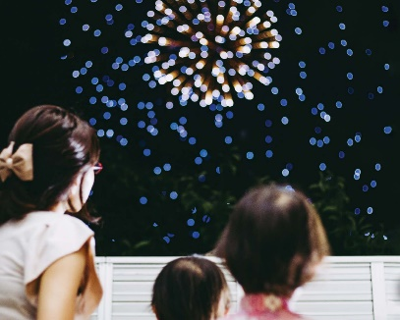


Listen and choose
A
C
B

Slide 20

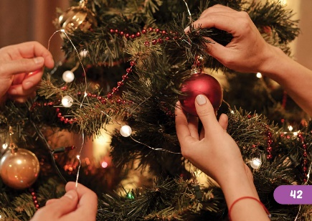
Listen and choose
A
C
B

Slide 21


Listen and choose
A
B
B

Slide 22


Listen and choose
A
C
B

Slide 23

Listen and choose
A
C
B

Slide 24

Listen and choose
A
B
B

Slide 25
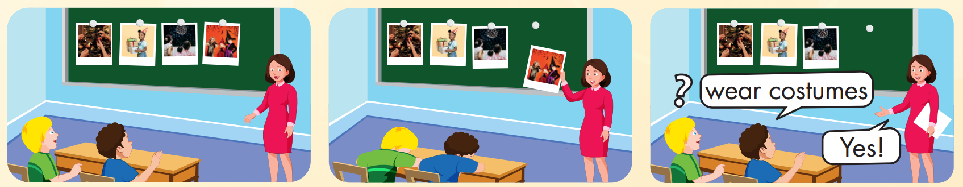

Slide 26
Presentation

Slide 27
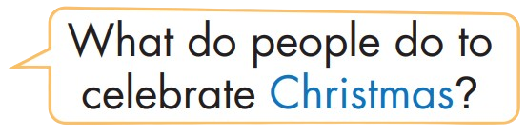
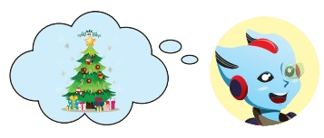
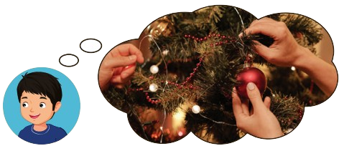
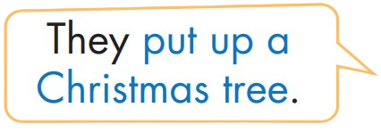
Structure

Slide 28
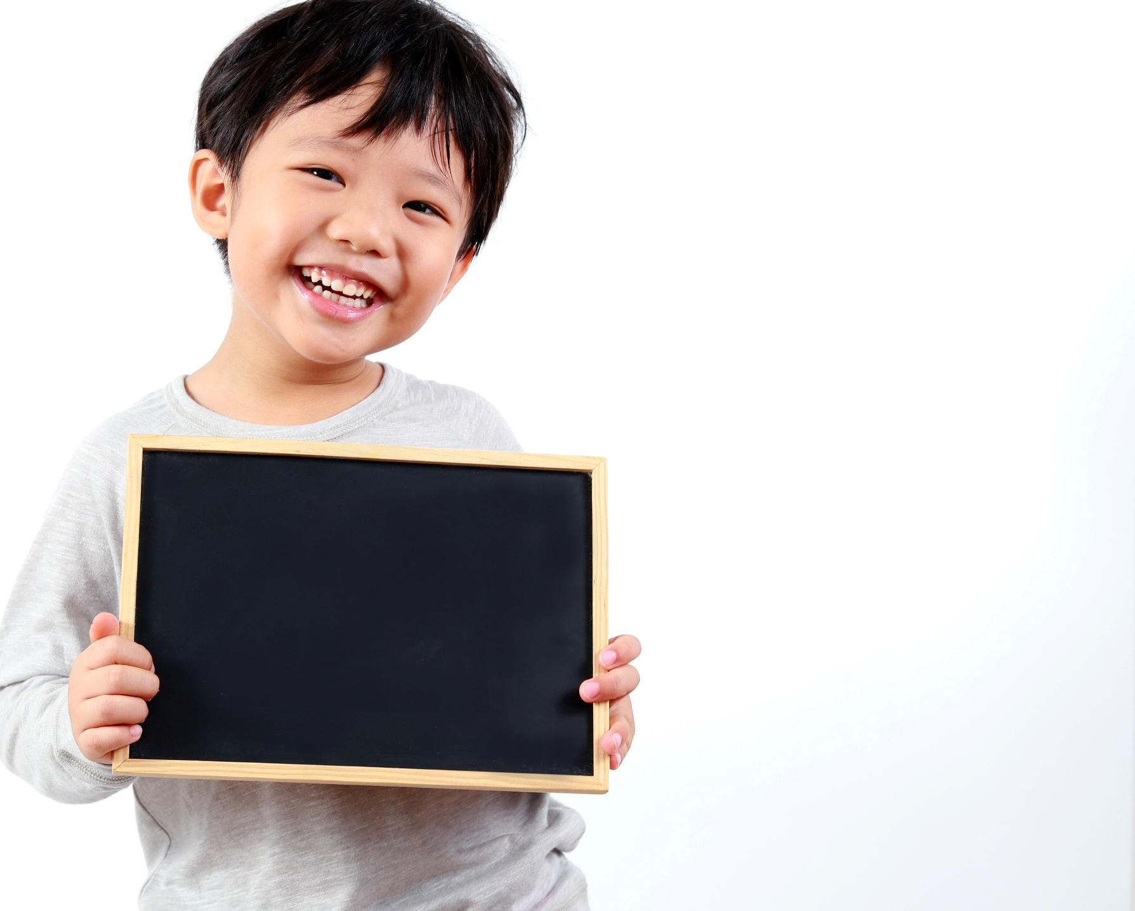
Practice

Slide 29


Slide 30
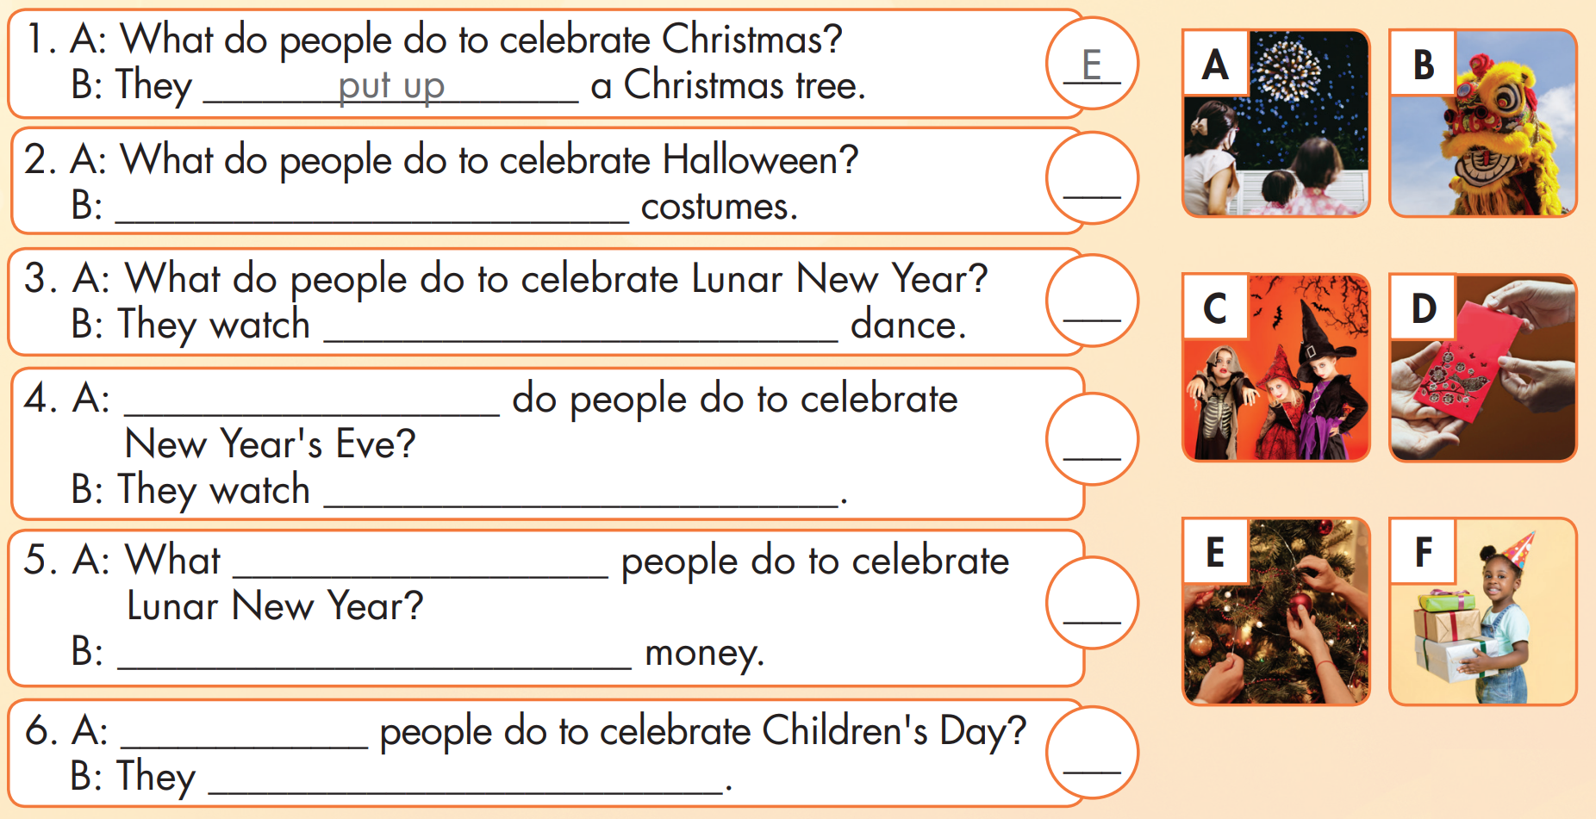
C
They wear
B
the lions
What
A
fireworks
do
D
They give lucky
What
F
give presents

Slide 31

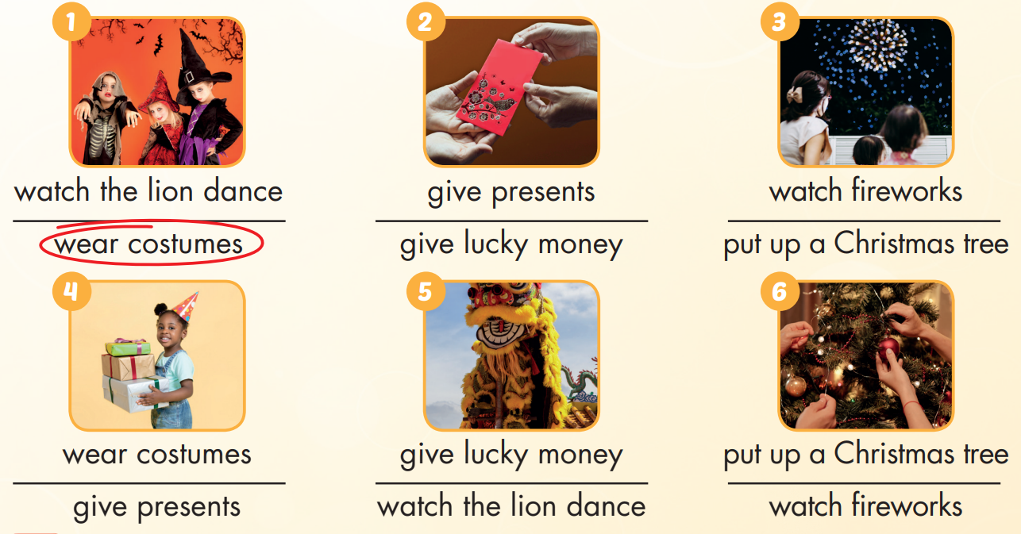

Extra Practice
WB, page 18

Slide 32

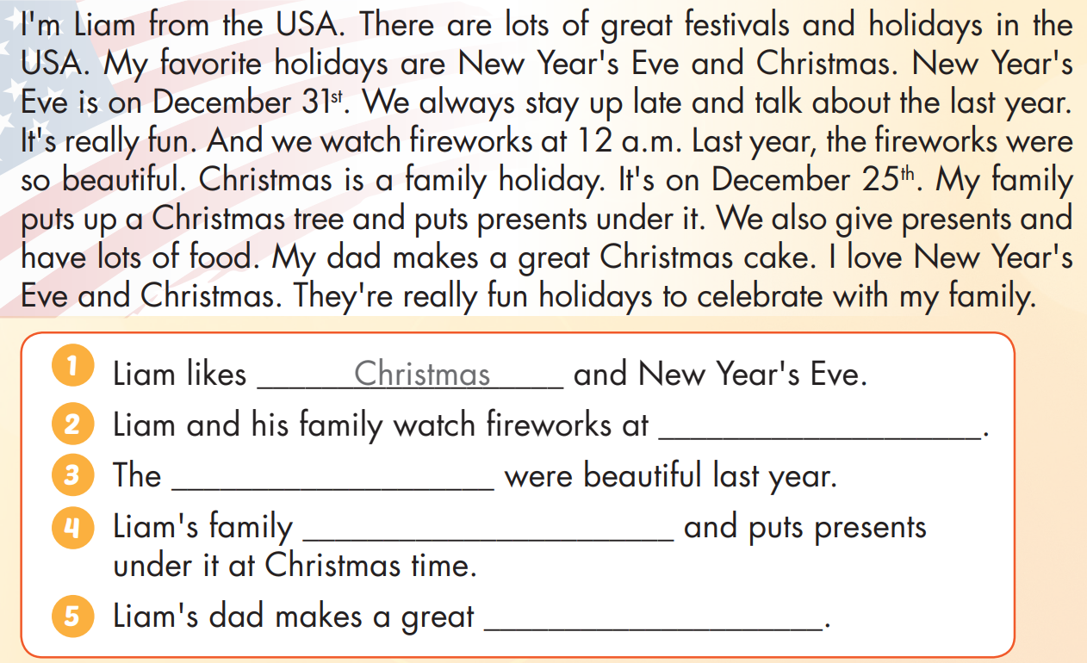
Extra Practice
WB, page 18

Slide 33
Extra Practice
WB, page 18
12 a.m
fireworks
puts up a Christmas tree
Christmas cake

Slide 34
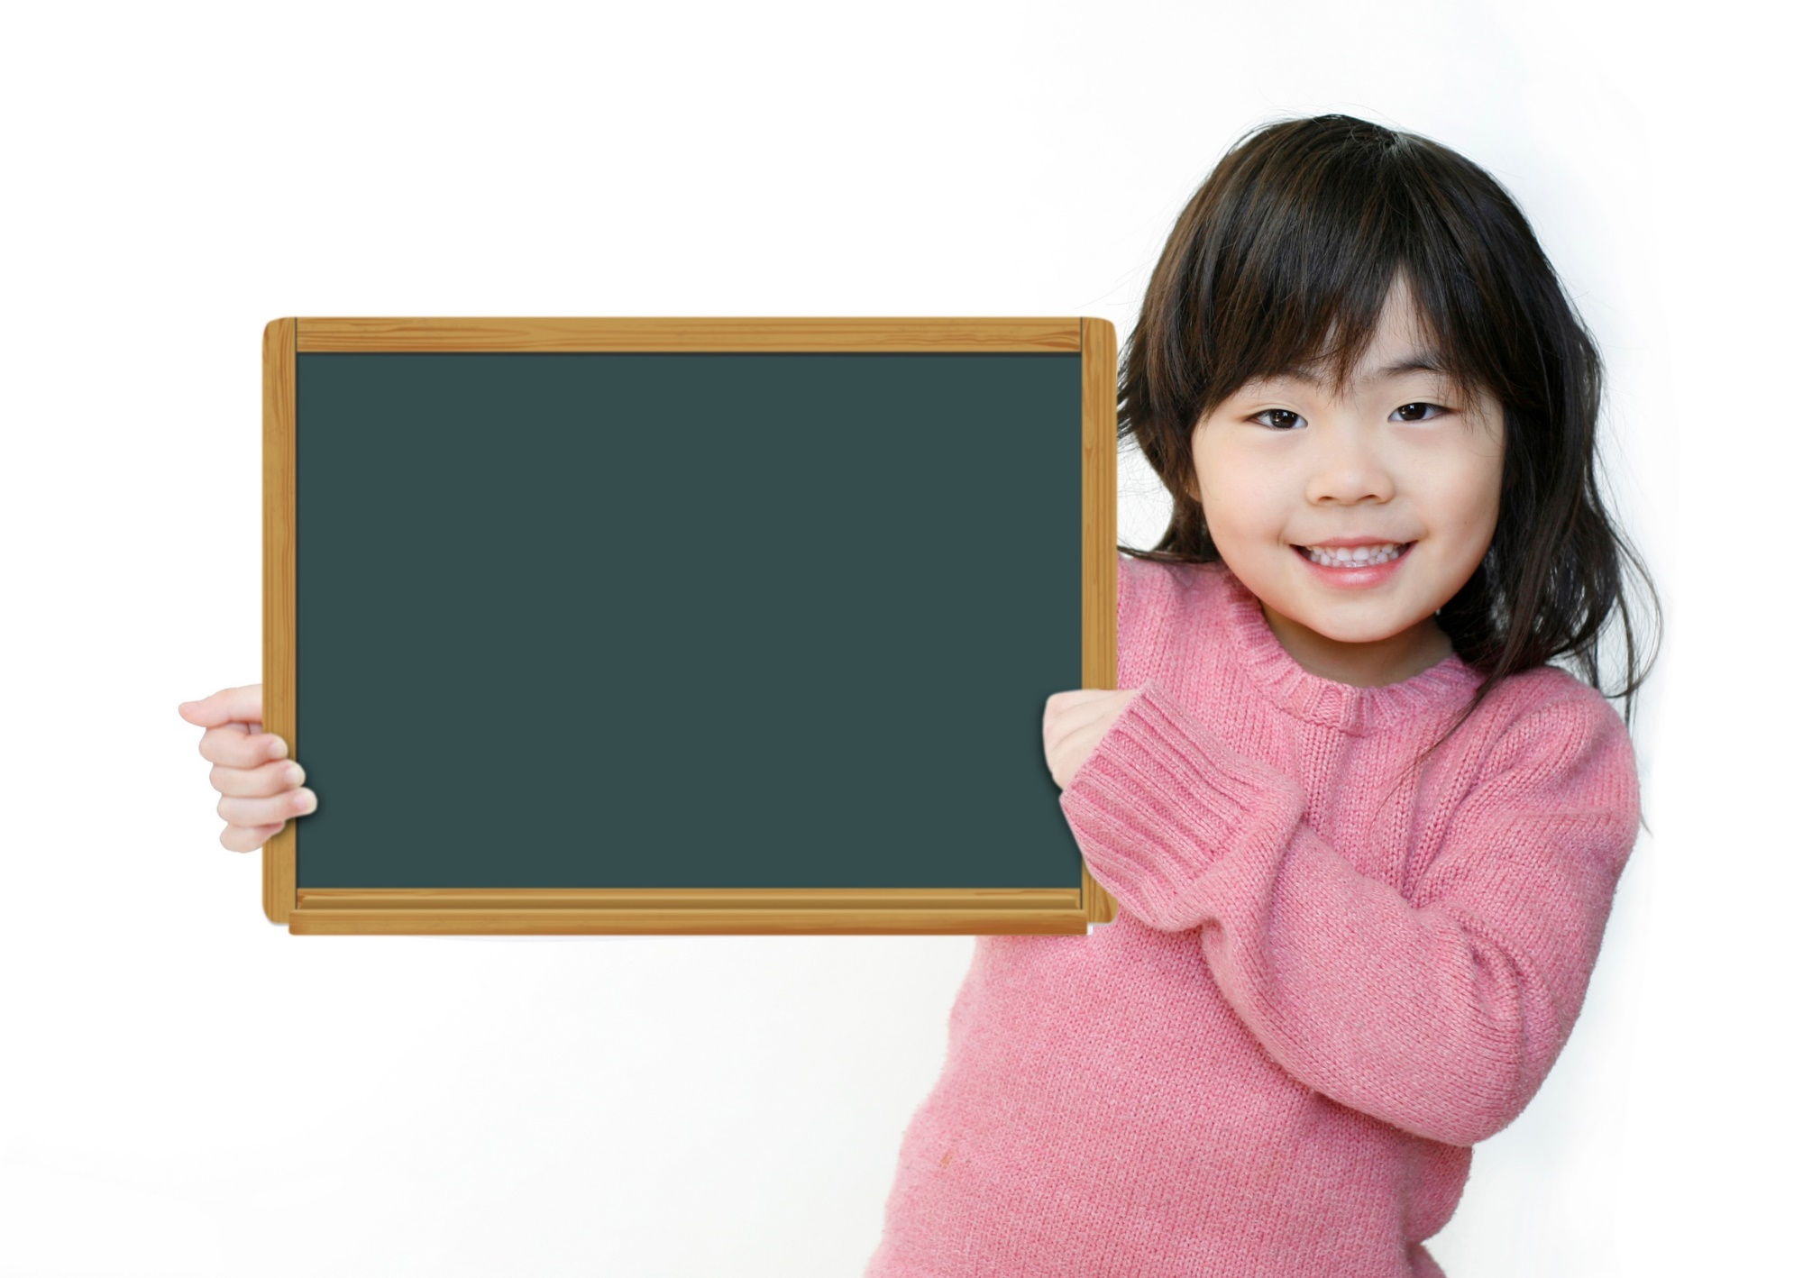
Production

Slide 35
UNIT2: lesson 4.1
1. Vocabularies
put up a Christmas tree give presents
watch fireworks
wear costumes
give lucky money
watch the lion dance
2. Sentences
What do people do to celebrate Christmas?
- They put up a Christmas tree.

Slide 36

Enjoy your day!

Slide 37
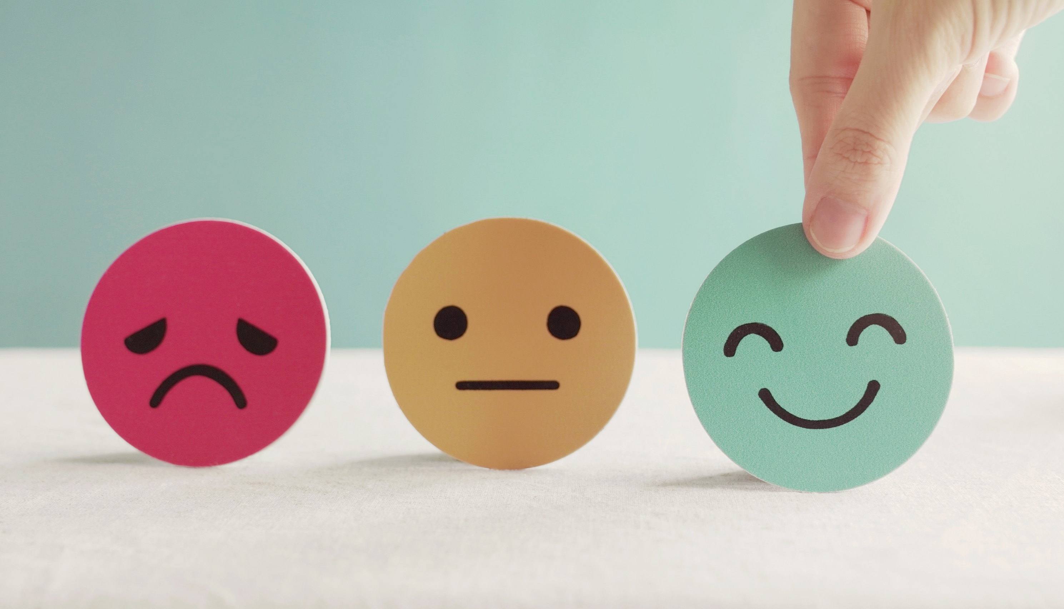
Lesson 3
Stay positive and have a nice day!

