Slide 1
Unit 2: Family
Lesson 2.3
Page 29

Slide 2

Practice

Slide 3
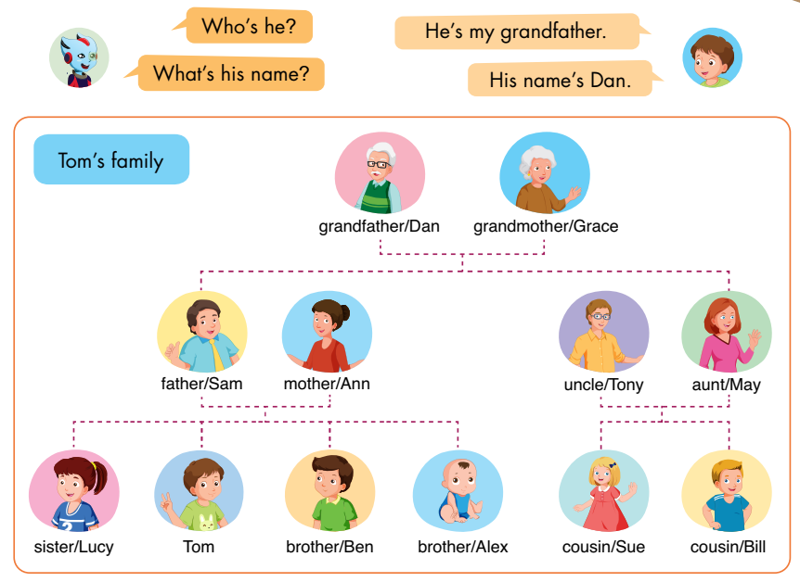
E
Point, ask, and answer.

Slide 4

Speaking

Slide 5
E
2. Role-play.
Example:
Tina: This is my brother, Ben.
Mark: Hello, Ben. I’m Mark.
Ben: Hello, Mark.
Notes:
2. Role-play.
Divide the class into groups of three.
Demonstrate the activity using the example.
Ask them to role-play the activity.
Swap roles and repeat.
Afterwards, have some pairs demonstrate the activity in front of the class.

Slide 6
Speaking

Slide 7
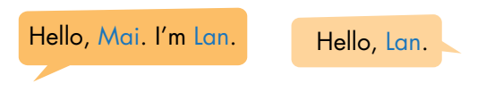
F
2. Role-play.
Example:
Lily: This is my sister, Mary.
Sam: Hello, Mary. I’m Sam.
Mary: Hello, Sam.
Notes:
2. Role-play.
Divide the class into groups of three.
Demonstrate the activity using the example.
Ask them to role-play the activity.
Swap roles and repeat.
Afterwards, have some pairs demonstrate the activity in front of the class.

Slide 8

CONSOLIDATION

Slide 9

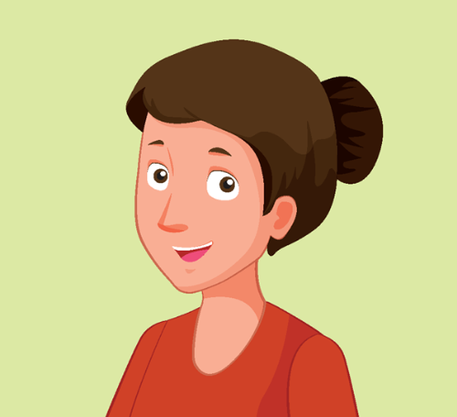
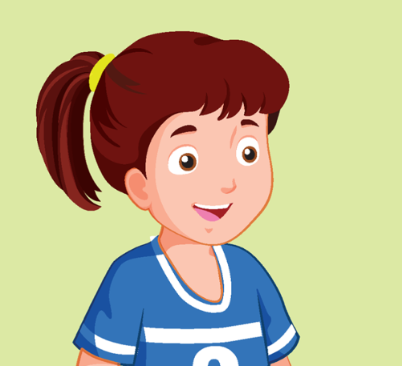
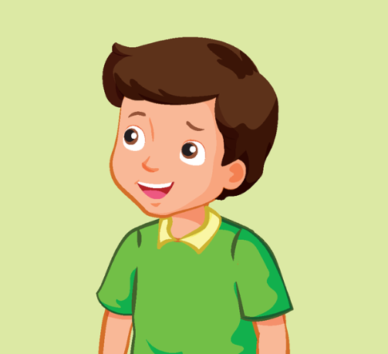
Look and say.
This is my… .
Notes:
Look and say.
Demonstrate the activity in front of the class.
Ask the class to look at the flashcards.
Have them use the structure: “This is my… .” to introduce family members.
Help them with their pronunciation and grammar (if any).

Slide 10
Unit2. lesson 2(2,3)
2. Sentences
Who’s he?
He’s my grandfather.
What’s his name?
His name’s Dan.
3. Practice:
This is Tom’s family
1.Who’s he?
He’s Tom’s grandfather
What’s his name? Hisname’s Dan
1.Vocabularies: review
Grandfather, grandmother
Uncle, aunt ,cousin
*Phonic: /ð/
Mother, grandmother

Slide 11

Enjoy your day!

