Slide 1
Unit 2: Family
Lesson 2.1
Page 27

Slide 2

WARM UP

Slide 3
Guessing game ☺☺

Slide 4


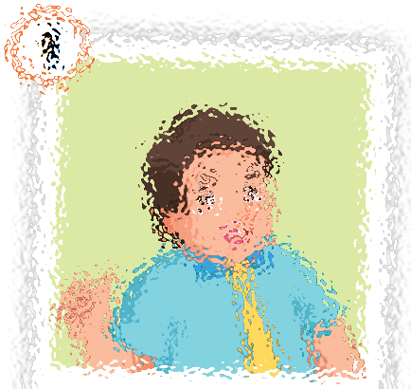
father

Slide 5
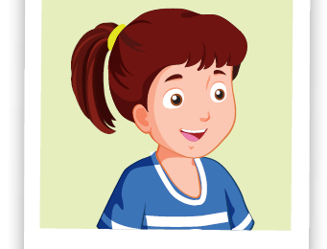
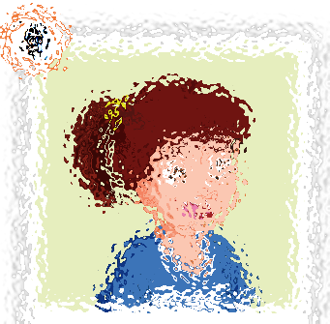
sister

Slide 6
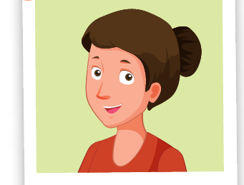
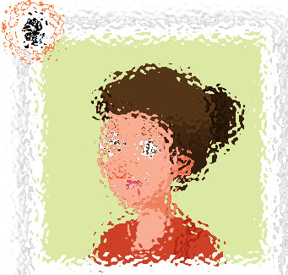
mother

Slide 7
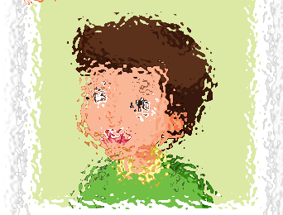
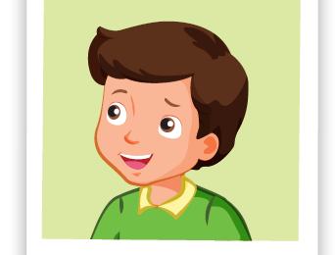
brother

Slide 8

Presentation

Slide 9

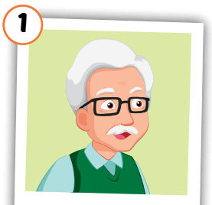
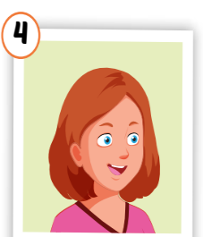
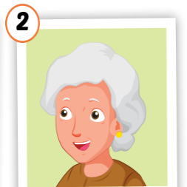
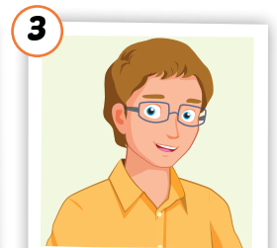
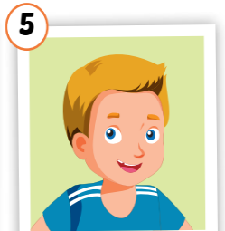
Click on each word to hear the sound.
grandfather
grandmother
uncle
aunt
cousin
/ˈɡrænfɑːðər/
ông nội,
ông ngoại
/ˈɡrænmʌðər/
bà nội,
bà ngoại
/ˈʌŋkl/
chú, bác, cậu
/ænt/
cô, dì, mợ
/ˈkʌzn/
anh/chị/em họ

Slide 10

Practice

Slide 11

Choose a number and fill in the blank.
au_t
gr_nd_athe_
1
a
2
n
f
r
c _us_n
uncl_
Click on each word to hear the sound.
3
4
o i
e
g_an_mo_her
5
r d t
Click here to show answers.
1
2
3
4
5

Slide 12
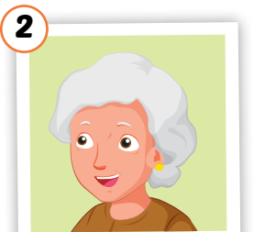





Slide 13
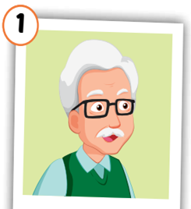
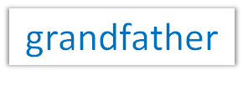
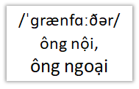

Slide 15

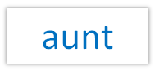


Slide 17


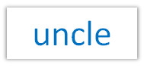
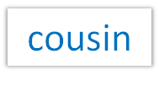



Slide 18

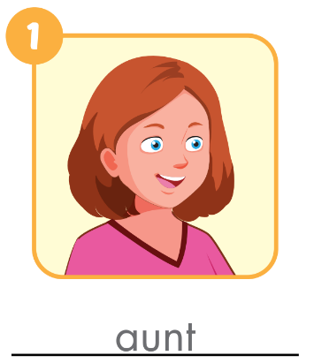
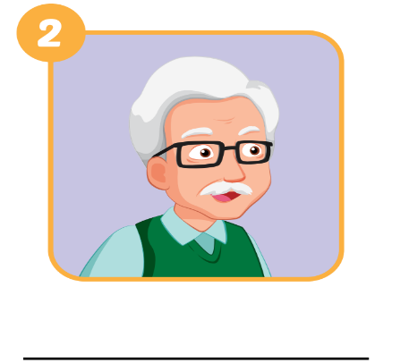
Extra Practice
WB, page 20.
grandfather

Slide 19
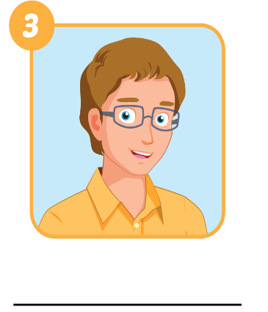
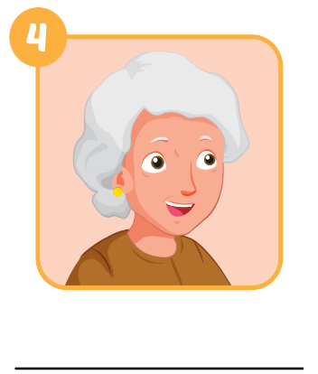
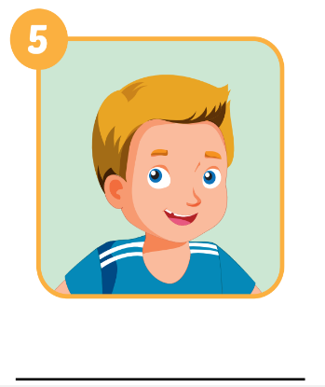
Extra Practice
WB, page 20.
uncle
grandmother
cousin

Slide 20

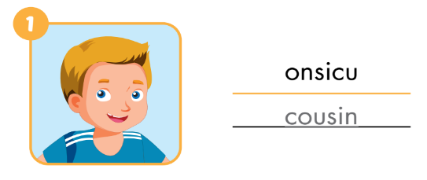
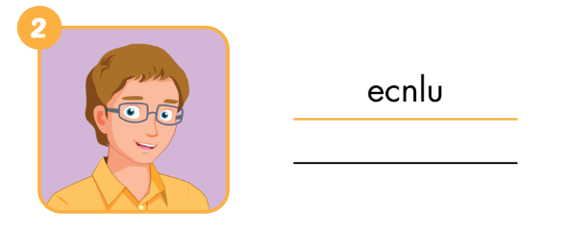
Extra Practice
WB, page 20
uncle

Slide 21
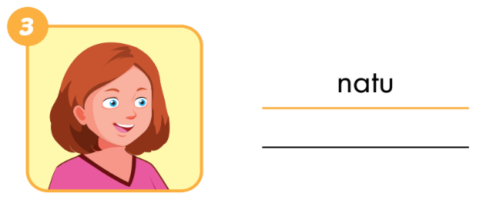

Extra Practice
WB, page 20
aunt
grandmother

Slide 22
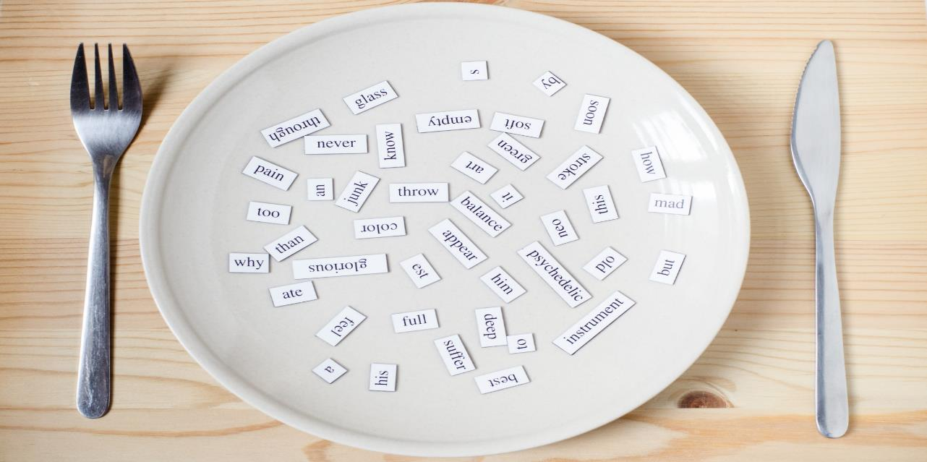
Structures
Who's he/she? - He’s/ She's my….
What's his/her name? - His/her name's ...

Slide 23
Presentation

Slide 24




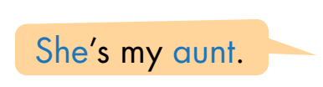



Slide 25
Practice

Slide 26

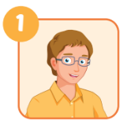
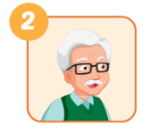
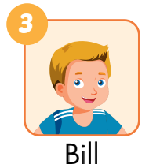
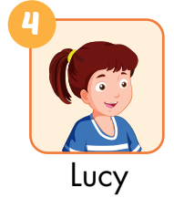
he
A: Who’s he?
B: He’s my________.
A: Who’s ___________?
B: He’s _____________.
uncle
my grandfather
A: What’s his name?
B: His name’s ______.
her name
A: What’s___________?
B: Her___________.
Bill
name’s Lucy

Slide 27

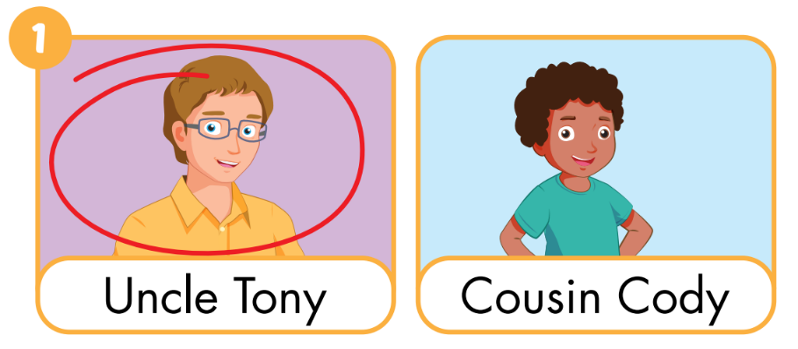
Extra Practice
WB, page 20

Slide 28
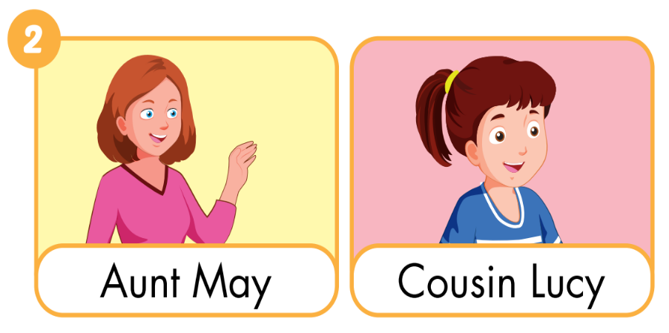

Slide 29
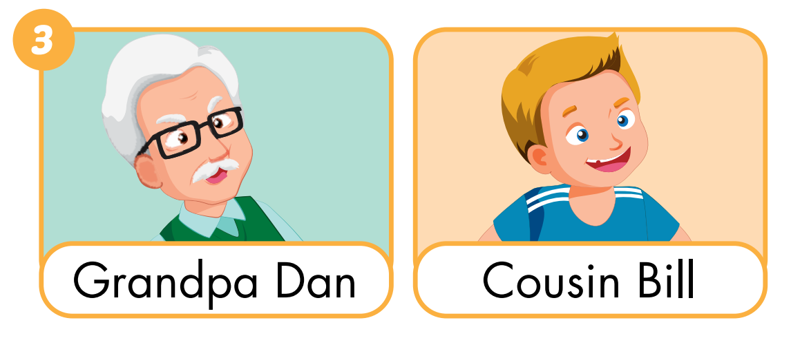

Slide 30
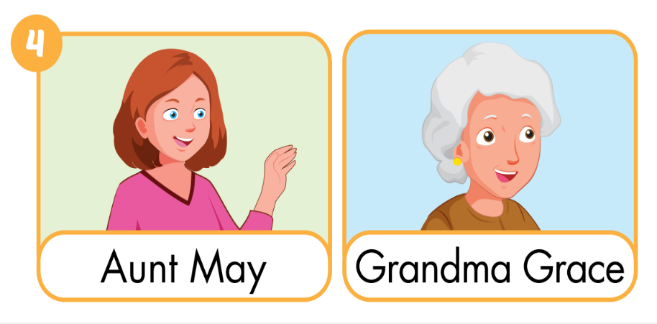

Slide 31

CONSOLIDATION

Slide 32

Early
Production

Slide 33


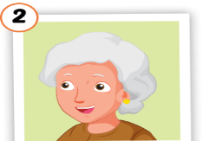


Lost turn
☹
1
SPIN
5
2
4
3
Notes:
GV dùng vòng quay để HS chọn số ngẫu nhiên. Khi chọn vào ô số nào thì sẽ làm câu cho số đó

Slide 34
Thursday, October 16th
Unit2. Lesson2
1. Vocabualaries:
grandfather
grandmother
uncle
aunt
cousin
2. Sentence:
Who's he/she?
-> He’s/ She's my….
What's his/her name?
-> His/her name's ...
3. Practice:ask and answer

Slide 35

Have a nice day!

