Slide 1




VO VAN DUNG PRIMARY SCHOOL
18.11
2024
Welcome to class 4C
Teacher: Lê Lữ Kiều Ngân
2024 - 2025

Slide 2


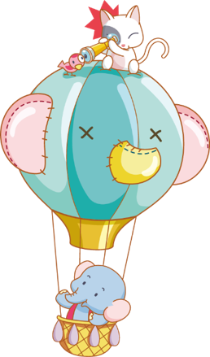
WARM- UP
&
REVIEW
Notes:
Thanh Yến Trần 0967 255 149 zalo/ FB https://www.facebook.com/thanhyentrananhngutaymy/

Slide 3


Slide 4



START

Slide 5


What is this?
SPIN
CHECK
Notes:
Thanh Yến Trần 0967 255 149 zalo/ FB https://www.facebook.com/thanhyentrananhngutaymy/

Slide 6



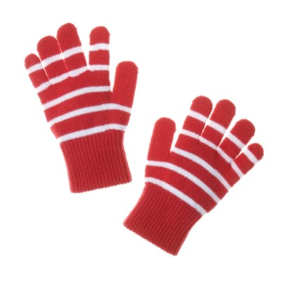
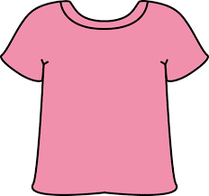
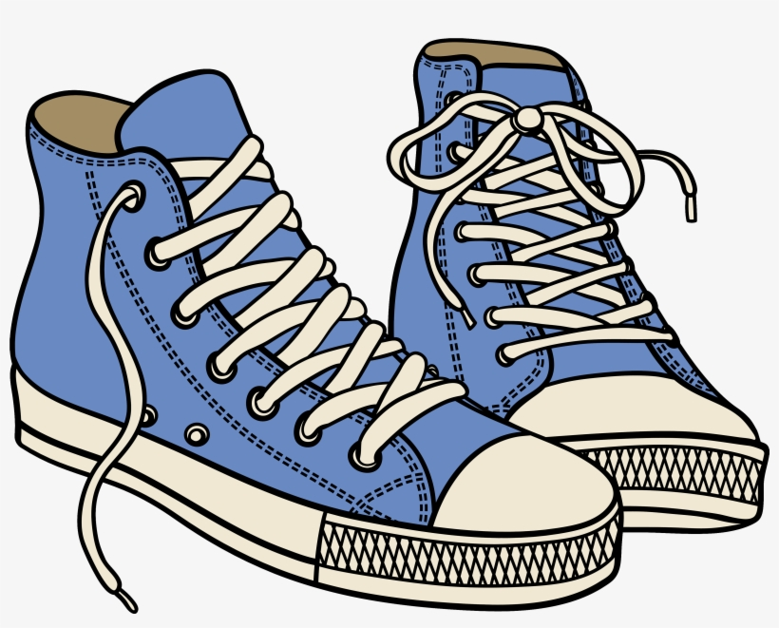

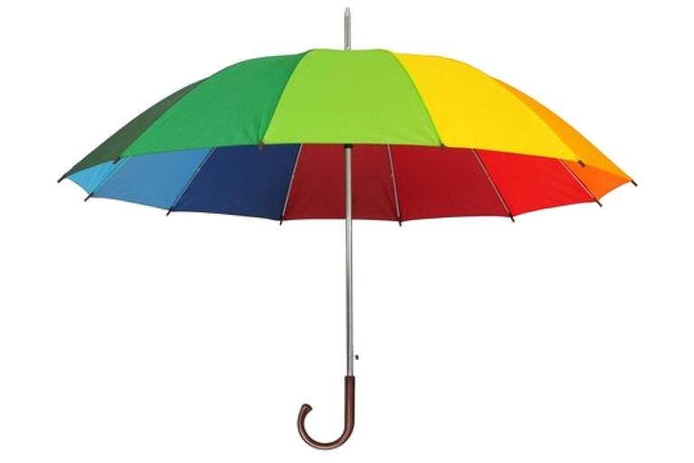
SPIN
sunglasses
CHECK
Notes:
Thanh Yến Trần 0967 255 149 zalo/ FB https://www.facebook.com/thanhyentrananhngutaymy/

Slide 7
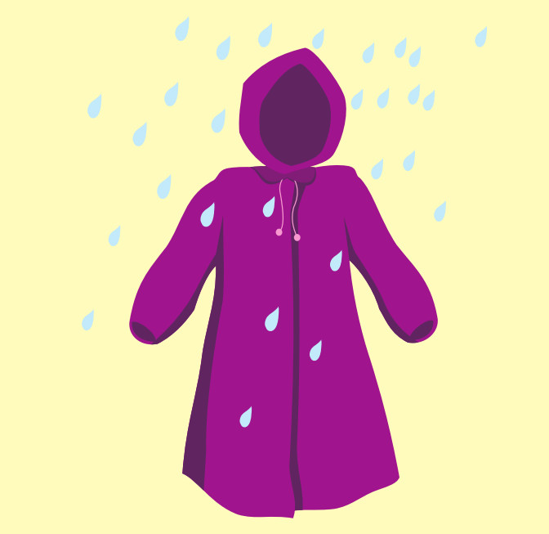
SPIN
raincoat
CHECK
Notes:
Thanh Yến Trần 0967 255 149 zalo/ FB https://www.facebook.com/thanhyentrananhngutaymy/

Slide 8
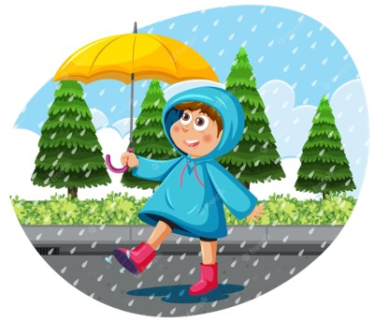
SPIN
coat
CHECK
Notes:
Thanh Yến Trần 0967 255 149 zalo/ FB https://www.facebook.com/thanhyentrananhngutaymy/

Slide 9
SPIN
gloves
CHECK
Notes:
Thanh Yến Trần 0967 255 149 zalo/ FB https://www.facebook.com/thanhyentrananhngutaymy/

Slide 10
SPIN
cap
CHECK
Notes:
Thanh Yến Trần 0967 255 149 zalo/ FB https://www.facebook.com/thanhyentrananhngutaymy/

Slide 11
SPIN
umbrella
CHECK
Notes:
Thanh Yến Trần 0967 255 149 zalo/ FB https://www.facebook.com/thanhyentrananhngutaymy/

Slide 12

UNIT 3
WEATHER
GEOGRAPHY ( A,B )
Notes:
Thanh Yến Trần 0967 255 149 zalo/ FB https://www.facebook.com/thanhyentrananhngutaymy/

Slide 13
Vocabulary

Slide 14
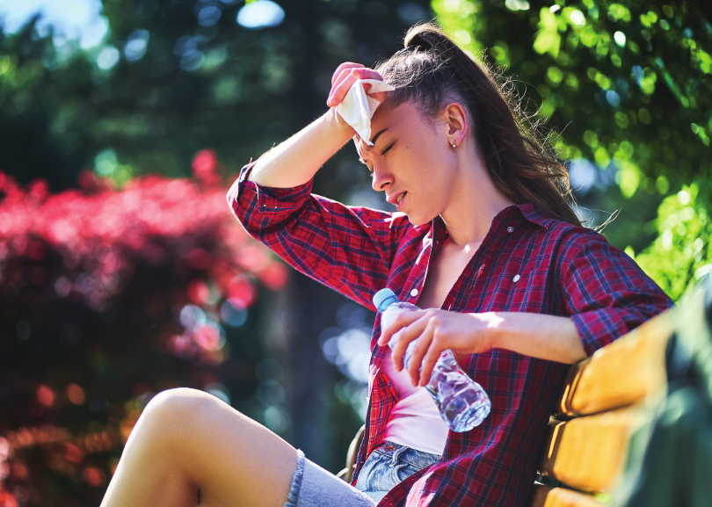

hot

Slide 15
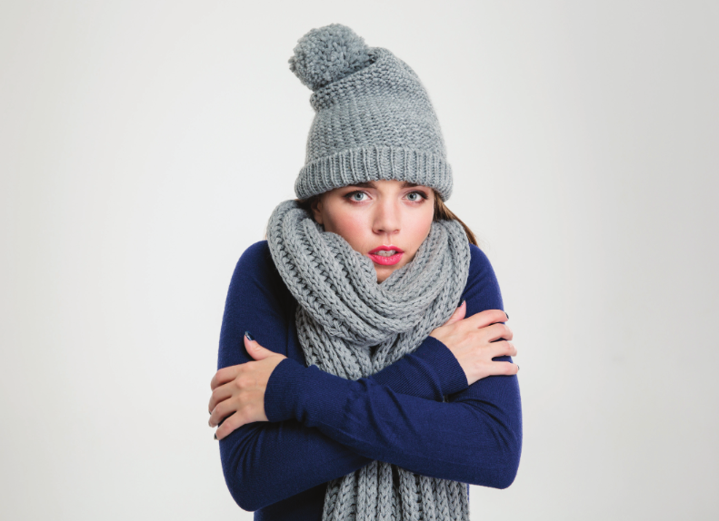
cold

Slide 16
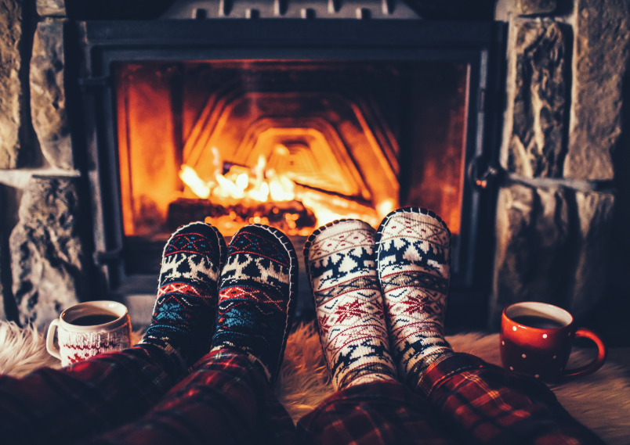
warm

Slide 17
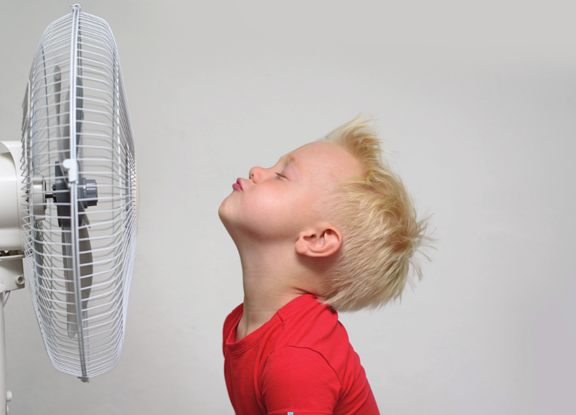
cool

Slide 18
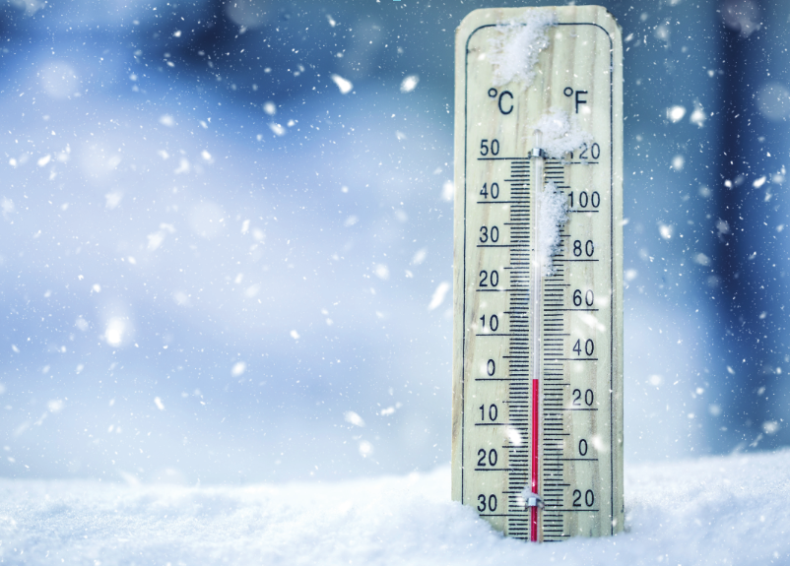
freezing

Slide 19
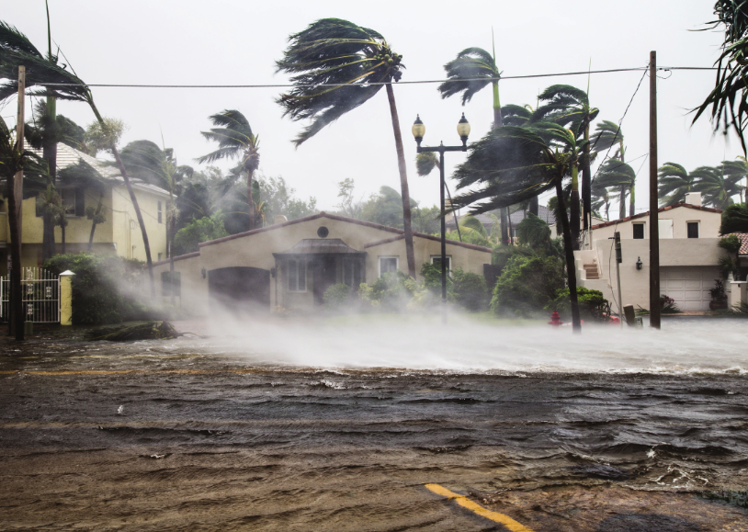
stormy

Slide 20
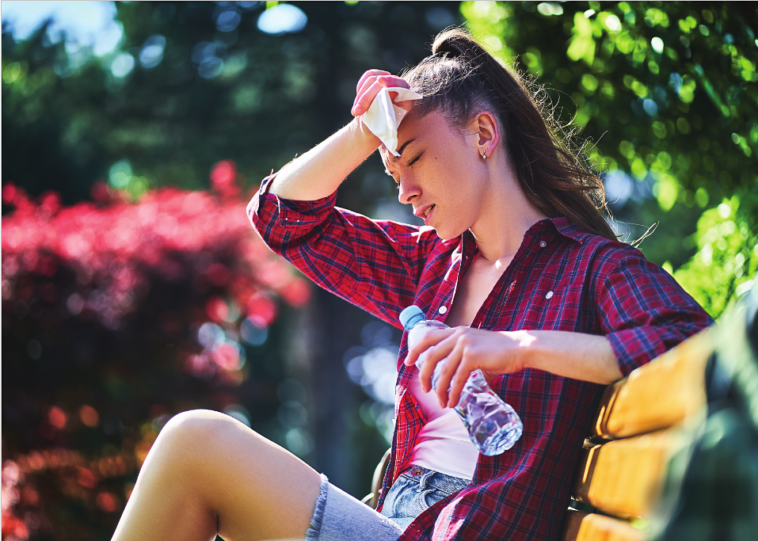
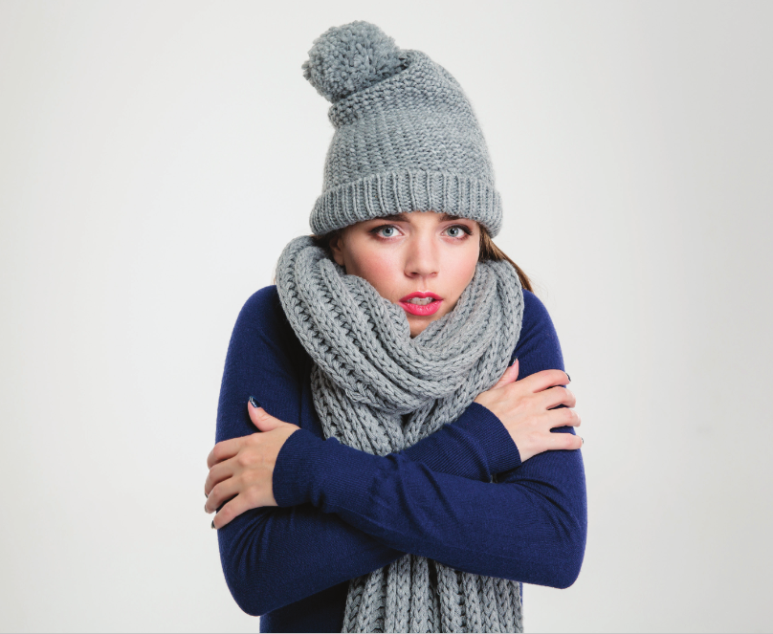
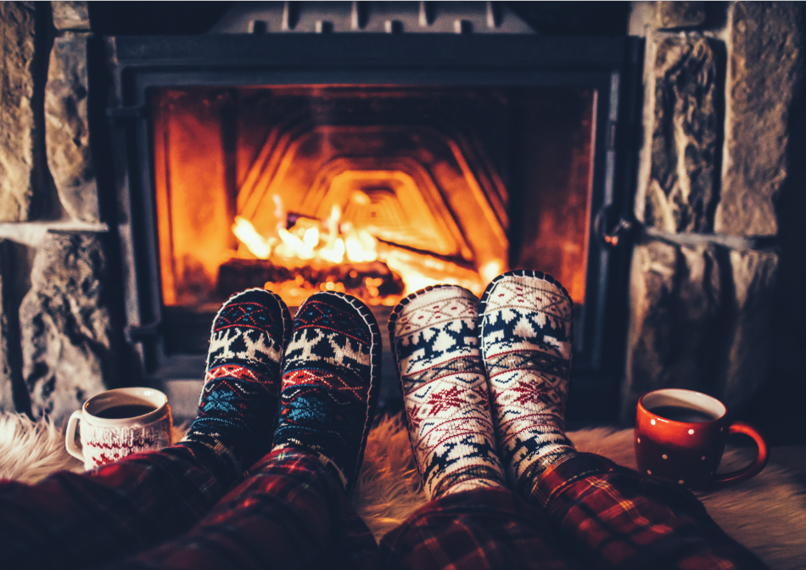
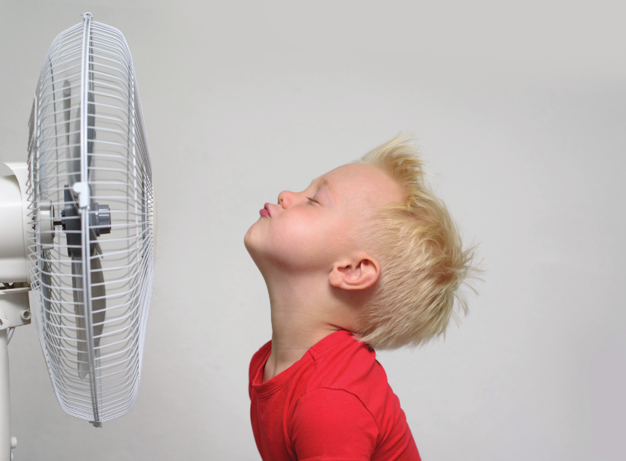
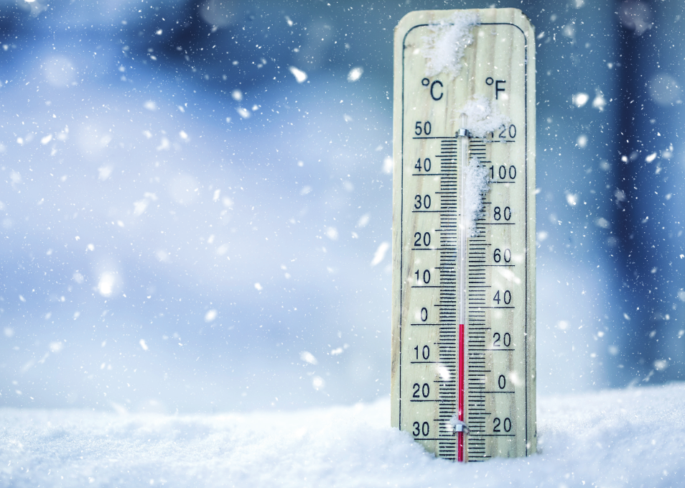
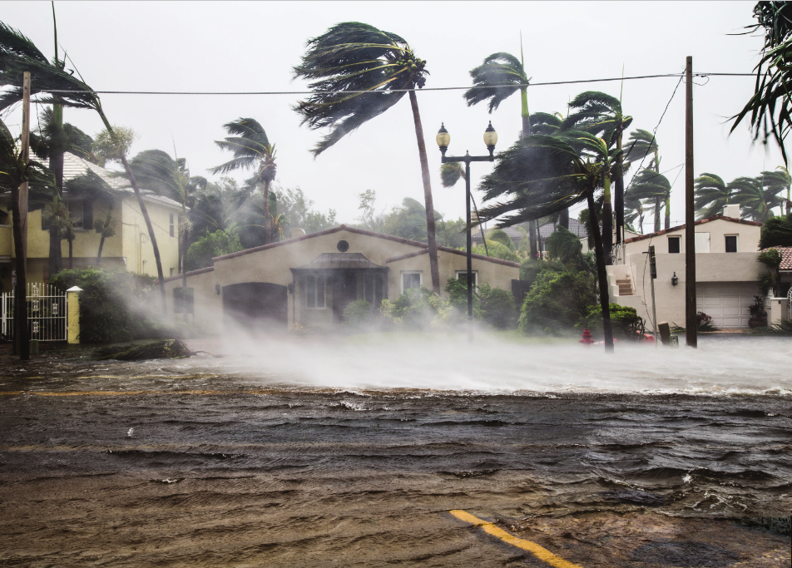
A. 1.Listen and point. Repeat

Slide 21


RULES
There are 4 words with missing letters
Students choose the correct letter to fill in the blank and land at one of the planets sucessfully
1 correct answer = 1 point
All students say aloud the answer
Note:
- Click on the letters to check
- Click NEXT to continue
Game
Notes:
Thanh Yến Trần 0967 255 149 zalo/ FB https://www.facebook.com/thanhyentrananhngutaymy/

Slide 22
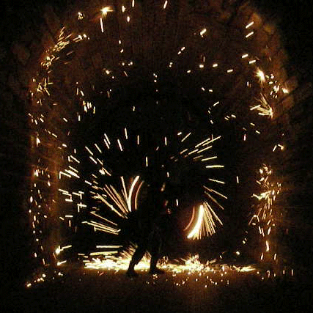




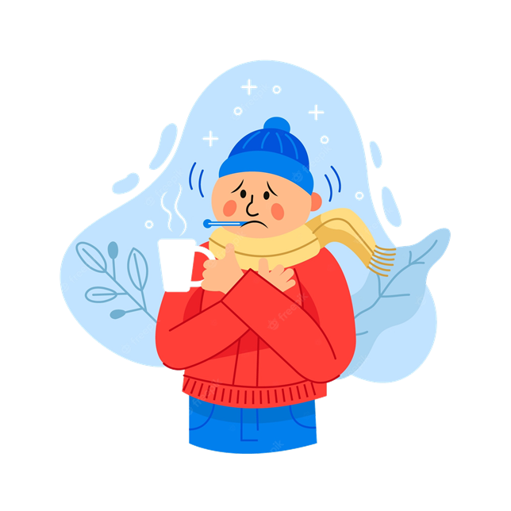

a. freezing
b. cold
c. hot
d. stormy
NEXT
Notes:
Thanh Yến Trần 0967 255 149 zalo/ FB https://www.facebook.com/thanhyentrananhngutaymy/

Slide 23
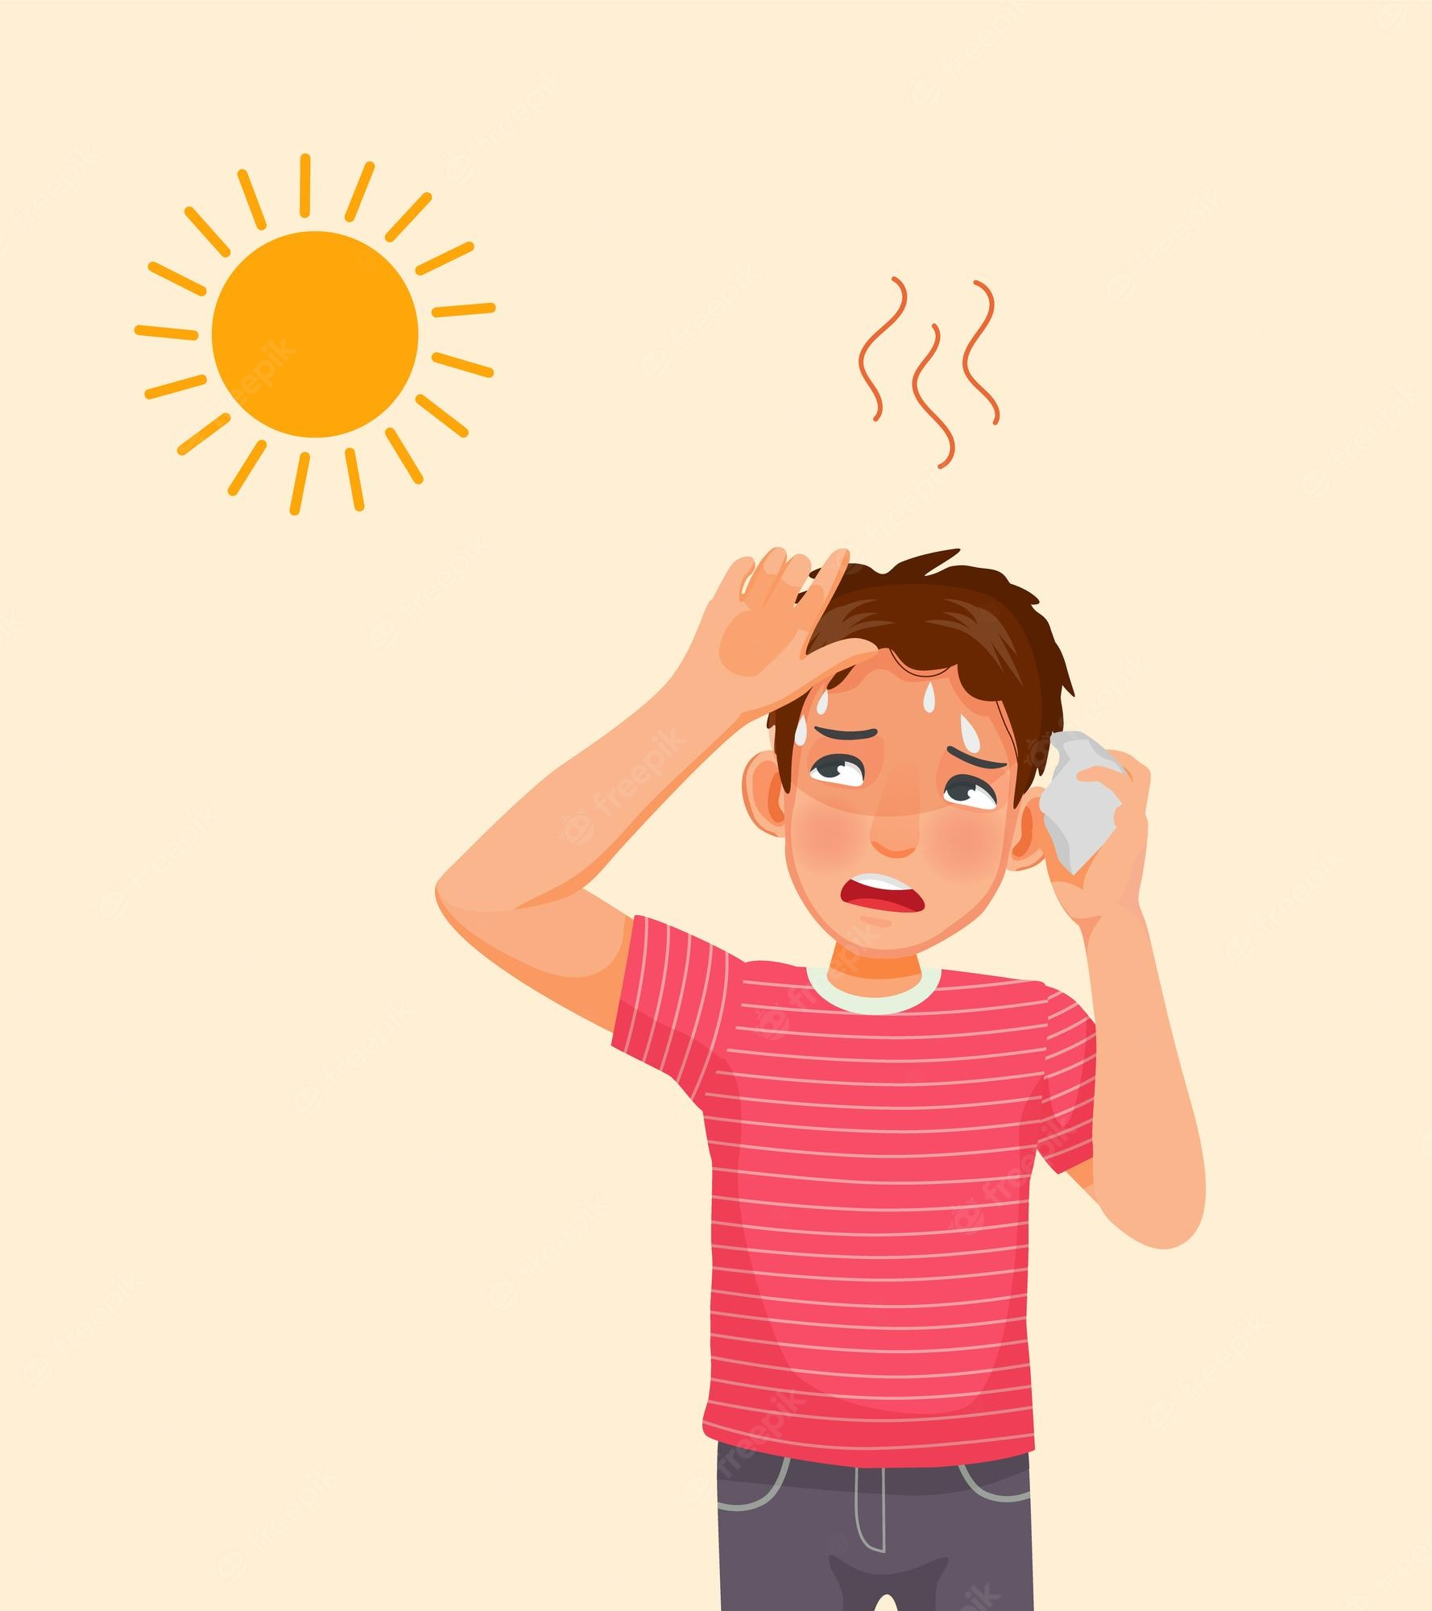

o
a
e
i
h _ t
NEXT
Notes:
Thanh Yến Trần 0967 255 149 zalo/ FB https://www.facebook.com/thanhyentrananhngutaymy/

Slide 24
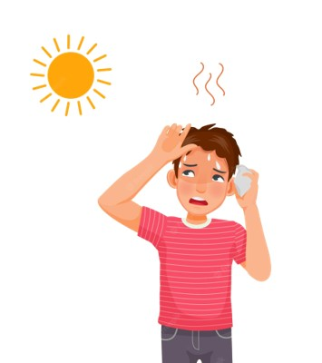
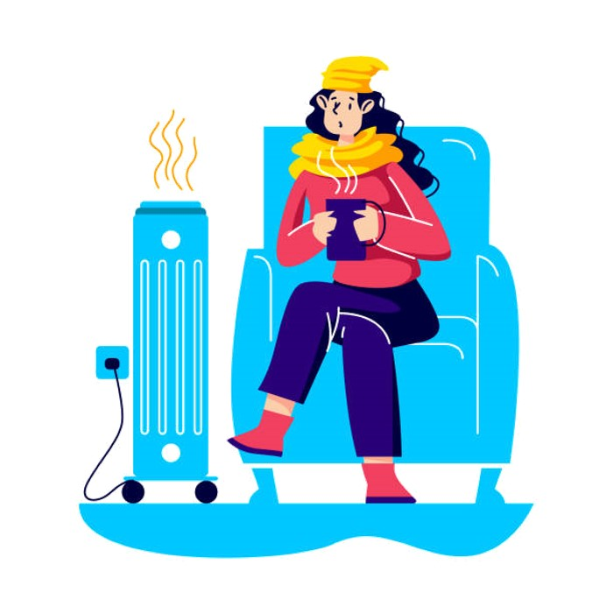
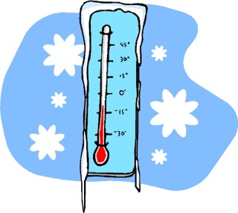
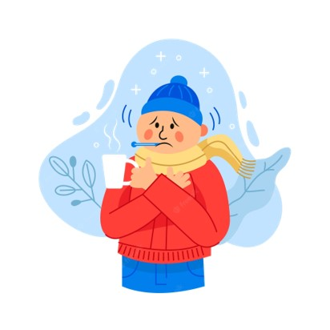
a
b
c
d
Warm
NEXT
Notes:
Thanh Yến Trần 0967 255 149 zalo/ FB https://www.facebook.com/thanhyentrananhngutaymy/

Slide 25
a. freezing
b. warm
c. stormy
d.
hot
NEXT

Slide 26
a. colo
b. oolc
c. looc
d. cool
o-c-l-o
NEXT
Notes:
Thanh Yến Trần 0967 255 149 zalo/ FB https://www.facebook.com/thanhyentrananhngutaymy/

Slide 27

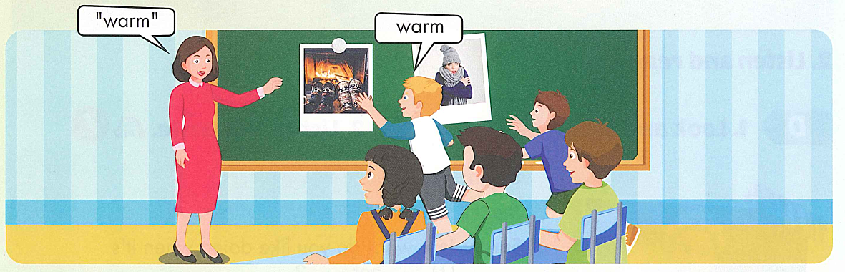

Slide 28
STRUCTURE
Notes:
Thanh Yến Trần 0967 255 149 zalo/ FB https://www.facebook.com/thanhyentrananhngutaymy/

Slide 29



B. 1.Listen and practice.
What do you like doing when it’s hot ?
I like swimming.

Slide 30
PRACTICE
Notes:
Thanh Yến Trần 0967 255 149 zalo/ FB https://www.facebook.com/thanhyentrananhngutaymy/

Slide 31


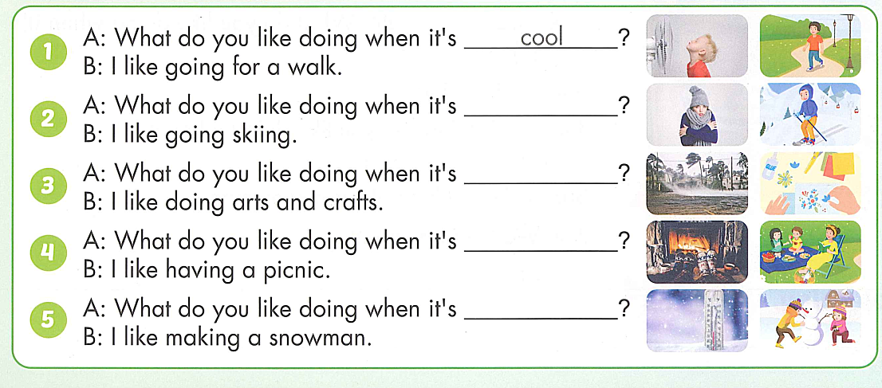
cold
stormy
warm
freezing

Slide 32
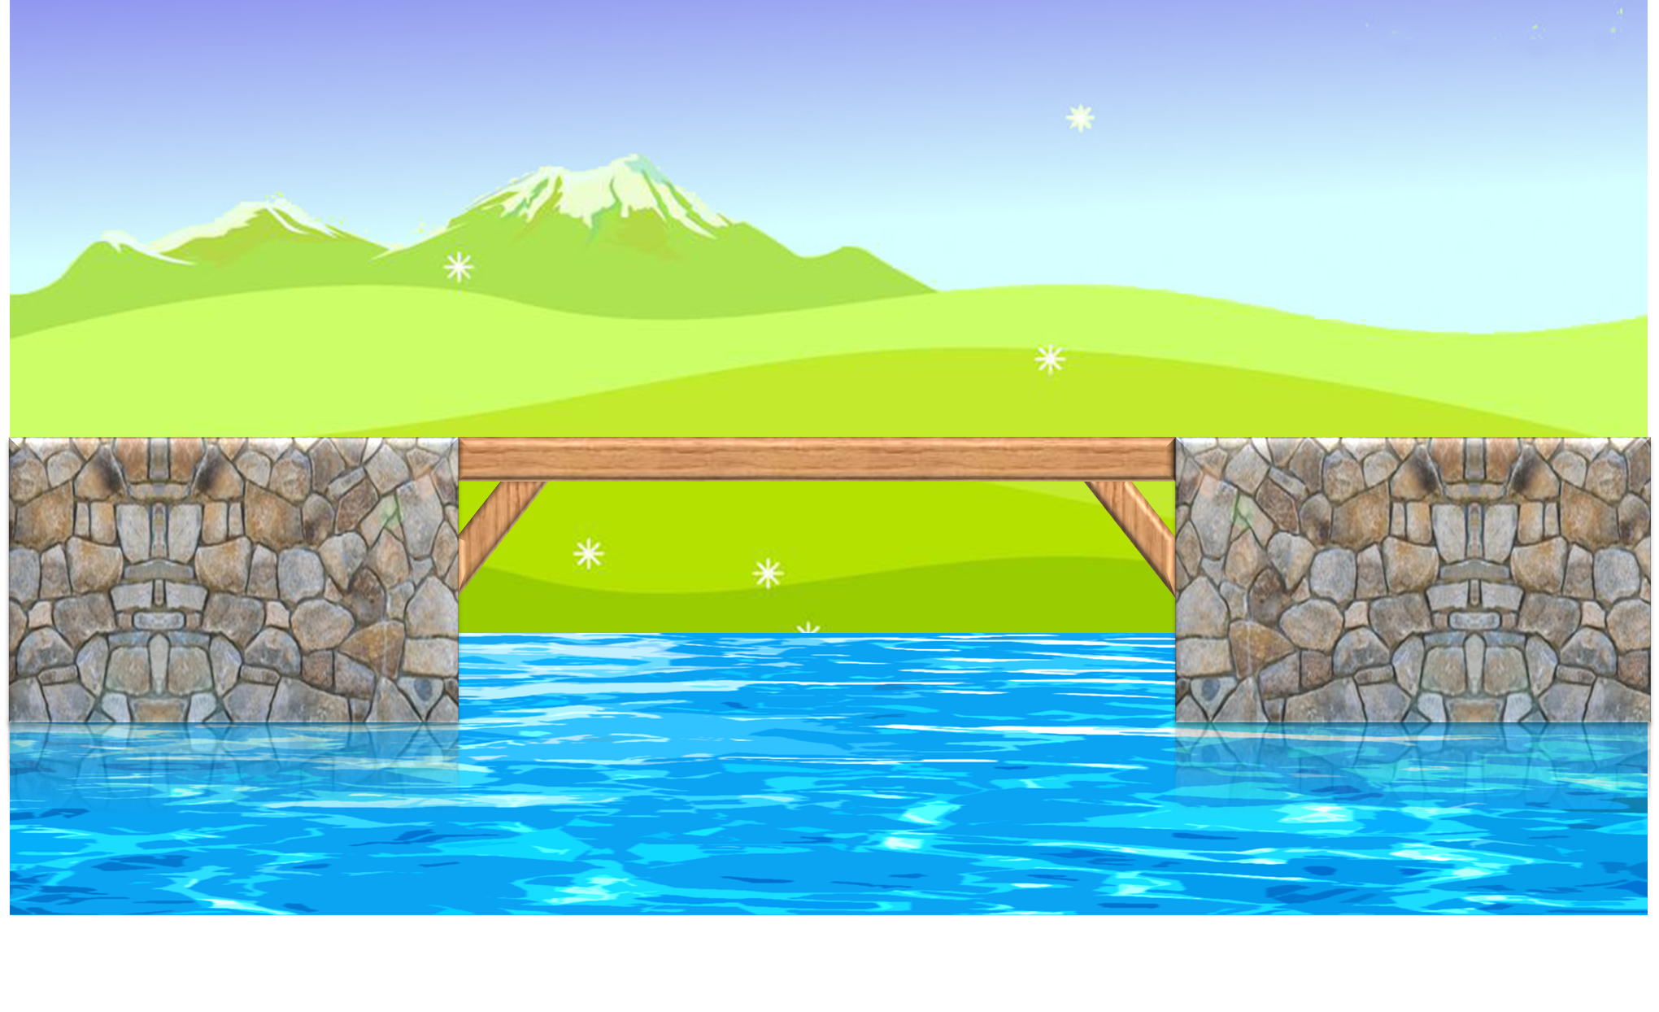
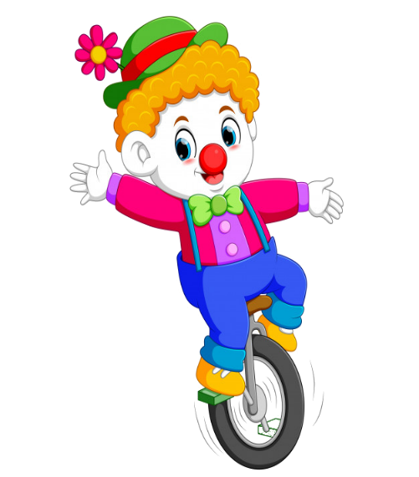



PLAY
Notes:
Yên Trần 0967 255 149 zalo/ FB https://www.facebook.com/thanhyentrananhngutaymy/

Slide 33



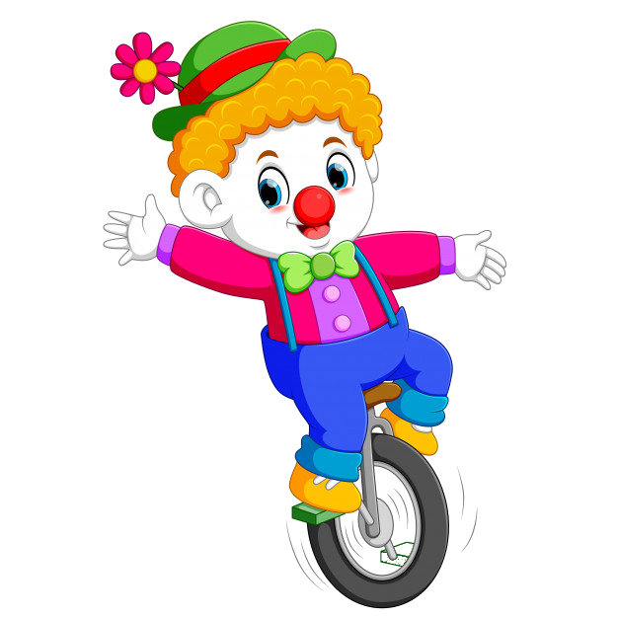
What do you like doing when it’s ……?
a. freezing
b. warm
c. hot
d. cold

Slide 34
……… do you like doing when it’s cold ?
I like drinking hot milk .
a. When
b. Where
c. Who
d. What

Slide 35
sunny / what / like / it’s / doing / when / you / do / ?
a . What you do like doing when it’s sunny ?
b. What do you like doing when it sunny?
c. What do you like doing when it’s sunny?
d.What do you like doing when is sunny?

Slide 36
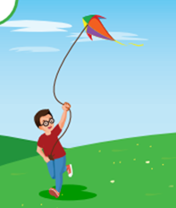
: tìm
What do you like doing when it’s cool ?
a. I like fly a kite.
b. I fly a kite .
c. I like flying a kite .
d. I flying a kite .

Slide 37
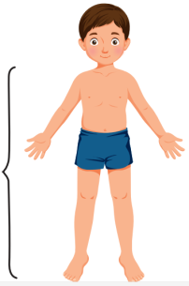
Listen and choose:
a. cool
b. cold
c. hot
d. warm
Notes:
Yên Trần 0967 255 149 zalo/ FB https://www.facebook.com/thanhyentrananhngutaymy/

Slide 38
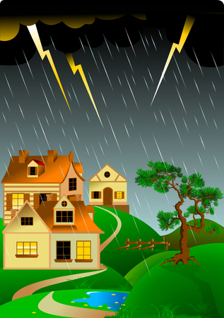
: tìm
What do you like doing when it’s ………?
a. sunny
b. freezing
c. stormy
d. cool

Slide 39
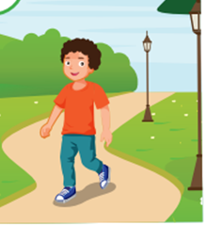
What does he like doing when it’s cool ?
a. He likes going for a walk .
b. He likes go for a walk .
c. He like going for a walk .
d. He likes go for a walking .

Slide 40
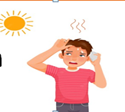
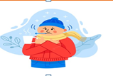

What do you like doing when it’s…….. ?
I like wearing scarf .
a.
b.
c.
d.

Slide 41


EXIT

Slide 42

1. Vocabulary :
- hot : nóng
- cold : lạnh
- warm : ấm áp
- cool : mát mẻ
- freezing : lạnh cóng
- stormy : có bão
2. Structure:
What do you like doing when it’s hot ?
- I like swimming .
Monday November 18th 2024
Unit 3: WEATHER
Geography (A,B)

Slide 43


Thank you very much
for attending this lesson.
The End
Goodbye. See you again

