Slide 1

Unit 1: SCHOOL
Lesson 2.1
Page 9

Slide 2

WARM-UP

Slide 3

Guess the SCHOOL SUBJECT

Slide 4

You learn about kings, queens, wars and facts from the past.
H I S T O R Y

Slide 5
You add, subtract, divide and multiply numbers.
M A T H S
3 x 4 = 12
25 : 5 = 5
10 + 7 = 17

Slide 6

You learn about continents, countries, oceans, rivers, lakes and cities.
G E O G R A P H Y

Slide 7

You do gymnastics and play sports there.
P.E.

Slide 8
You learn about plants, animals and human body.
S C I E N C E

Slide 9

You learn about composers, singing and listening to music.
M U S I C

Slide 10

You draw and paint there.
A R T

Slide 11

You learn how to use a computer there.
I.T.
Microsoft
Windows

Slide 12

It’s time to learn …

Slide 13
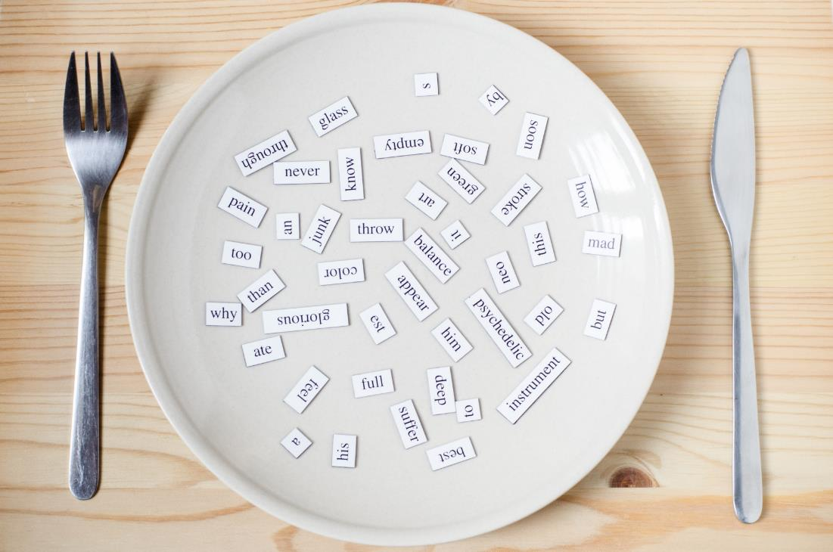
New words
solving problems,
doing experiments,
making things,
using computers,
reading stories,
learning languages.

Slide 14

Presentation

Slide 15

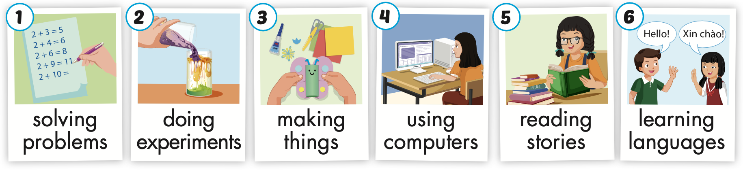
Click on A to hear the sound.
Notes:
Click vào hình A. 1. Listen and point. Repeat để cho cả audio full chạy

Slide 16
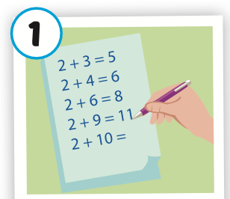
Click on the picture to hear the sound.
solving problems
/ ˈ sɑːlvɪŋ ˈprɑːbləmz/
giải bài toán

Slide 17
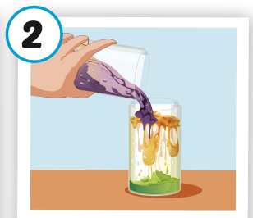
Click on the picture to hear the sound.
doing experiments
/ˈduːɪŋ ɪkˈsperəmənts/
làm thí nghiệm

Slide 18
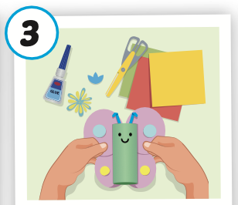
Click on the picture to hear the sound.
making things
/ ˈmeɪkɪŋ θɪŋz/
làm đồ vật

Slide 19
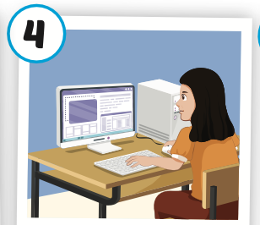
Click on the picture to hear the sound.
using computers
/ˈjuːzɪŋ kəmˈpjuːtərz/
sử dụng máy vi tính

Slide 20

Click on the picture to hear the sound.
reading stories
/ ˈ riːdɪŋ ˈstɔːriz/
đọc truyên

Slide 21
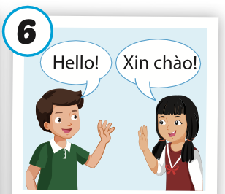
Click on the picture to hear the sound.
learning languages
/ ˈlɜːrnɪŋ ˈlæŋɡwɪdʒiz/
học ngôn ngữ

Slide 22
Practice

Slide 23
Read and choose. Then say.

Slide 24




Read and choose
A
B
C
solving problems

Slide 25


Read and choose
A
B
C
making things

Slide 26

Read and choose
A
B
C
using computers

Slide 27

Read and choose
A
C
B
doing experiments

Slide 28

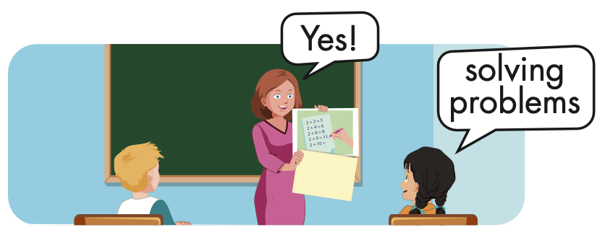


Slide 29
Structure
Why do you like math?
- Because I like solving problems.

Slide 30
Presentation

Slide 31
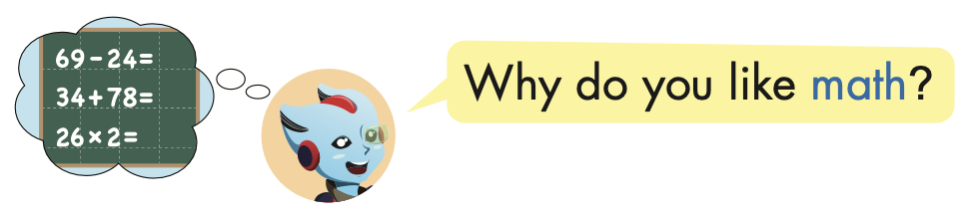
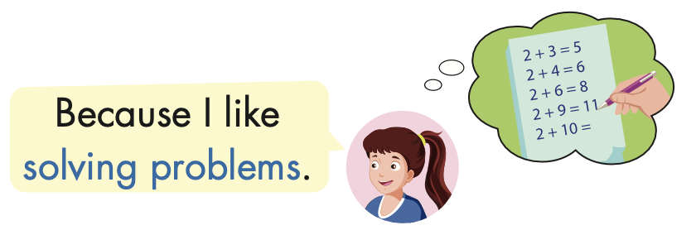
Structure

Slide 32

Practice

Slide 33



Slide 34

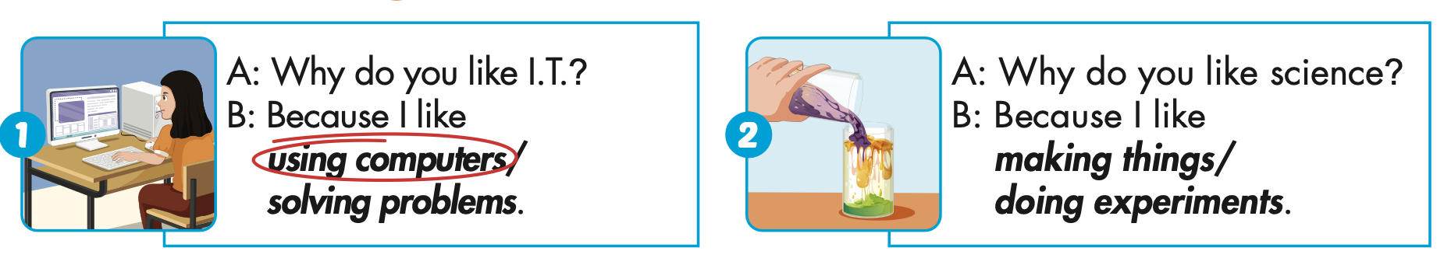

Slide 35
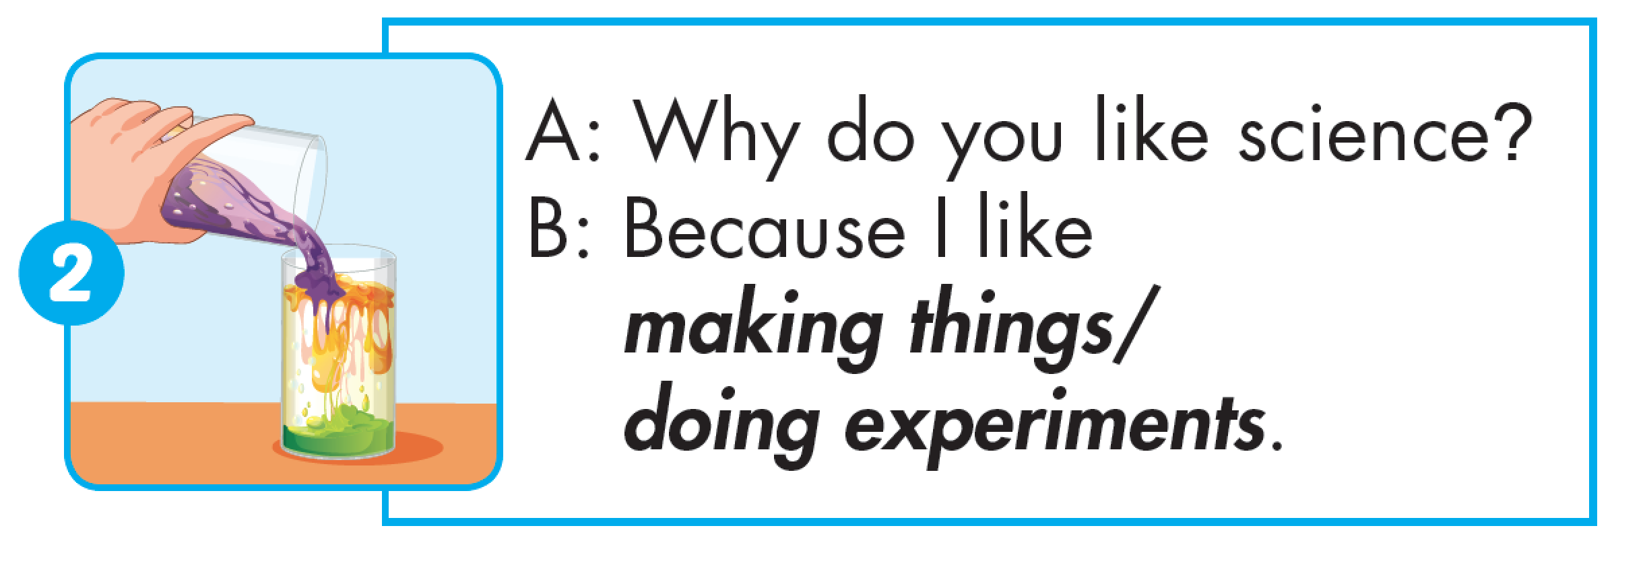

Slide 36
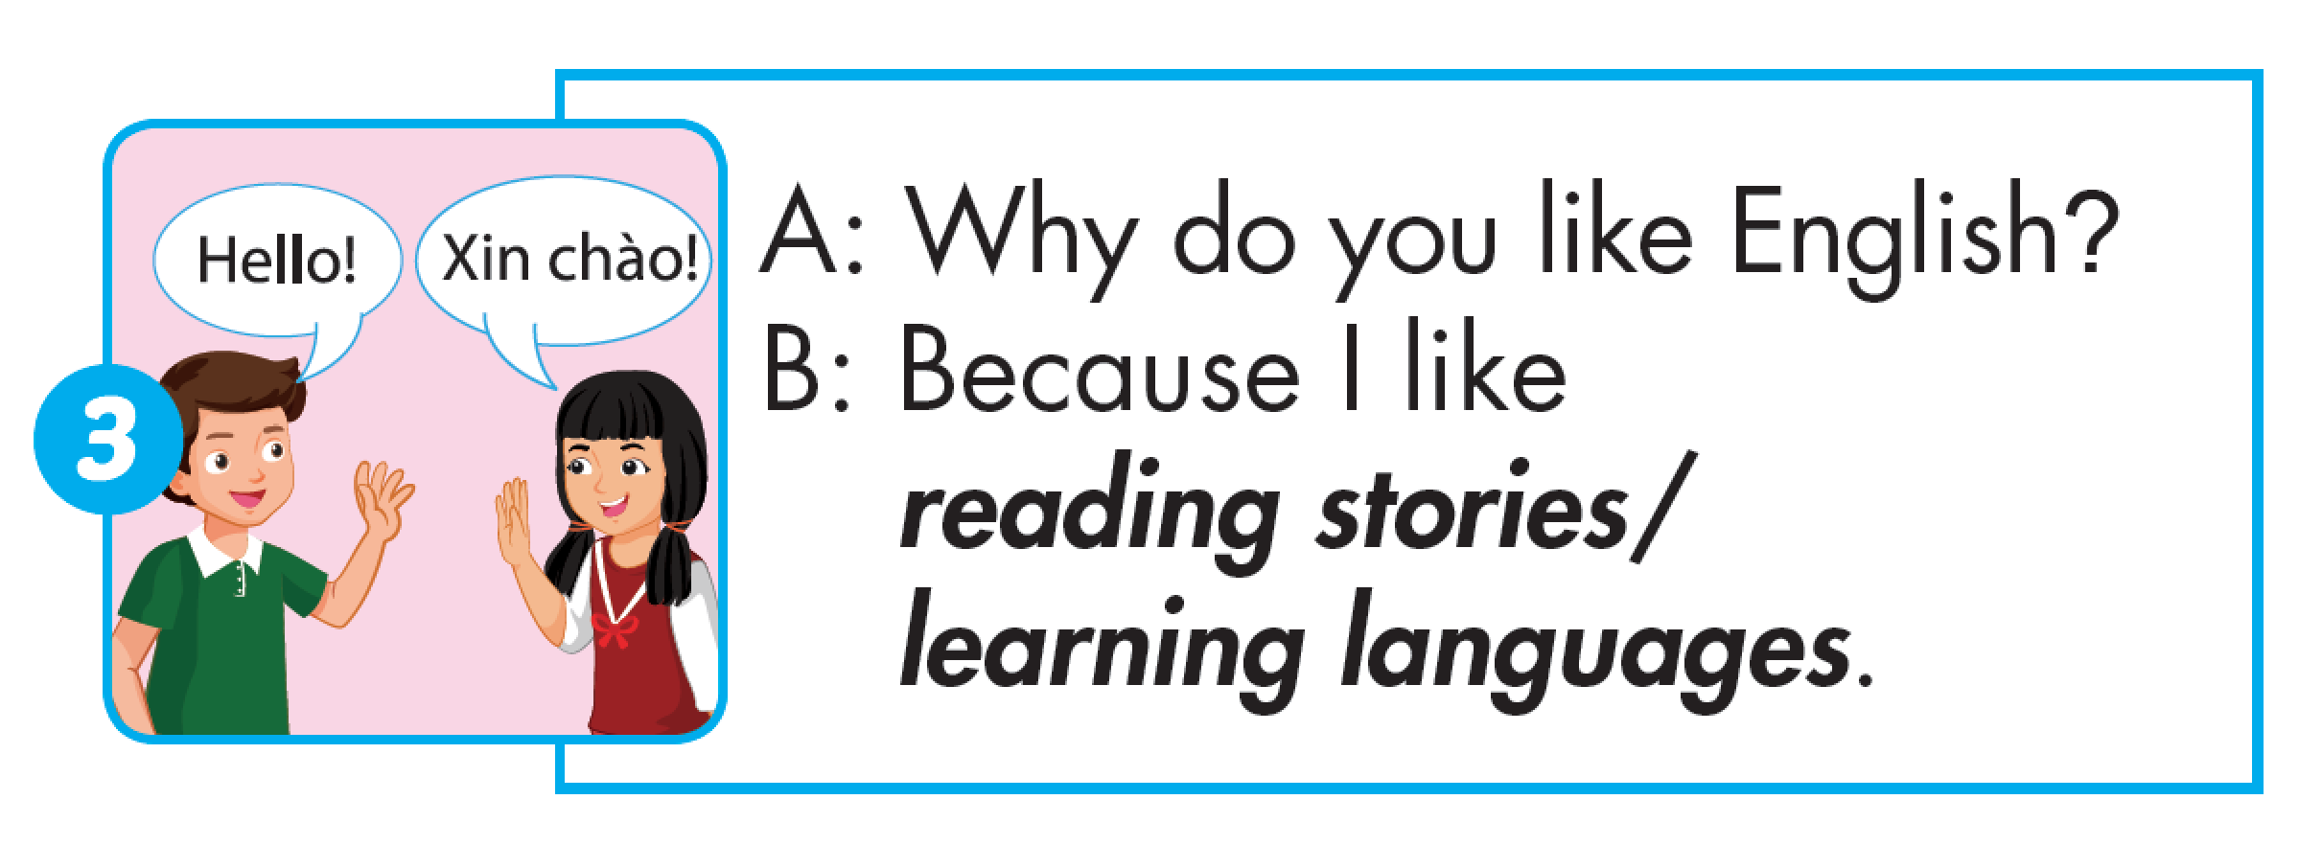

Slide 37
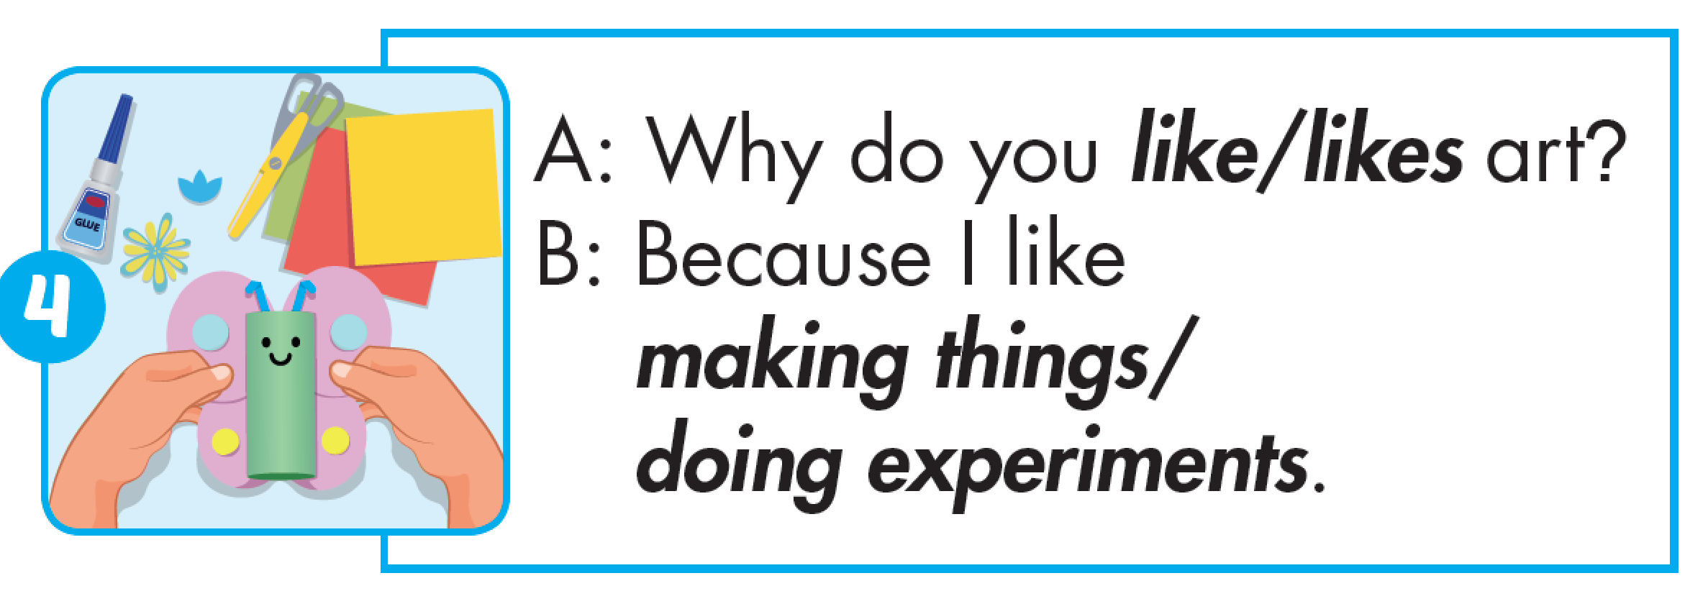

Slide 38
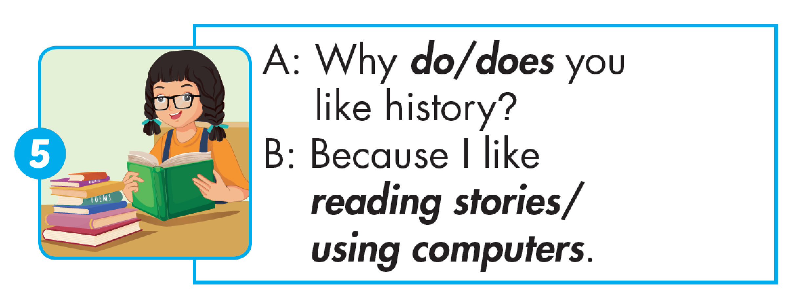

Slide 39
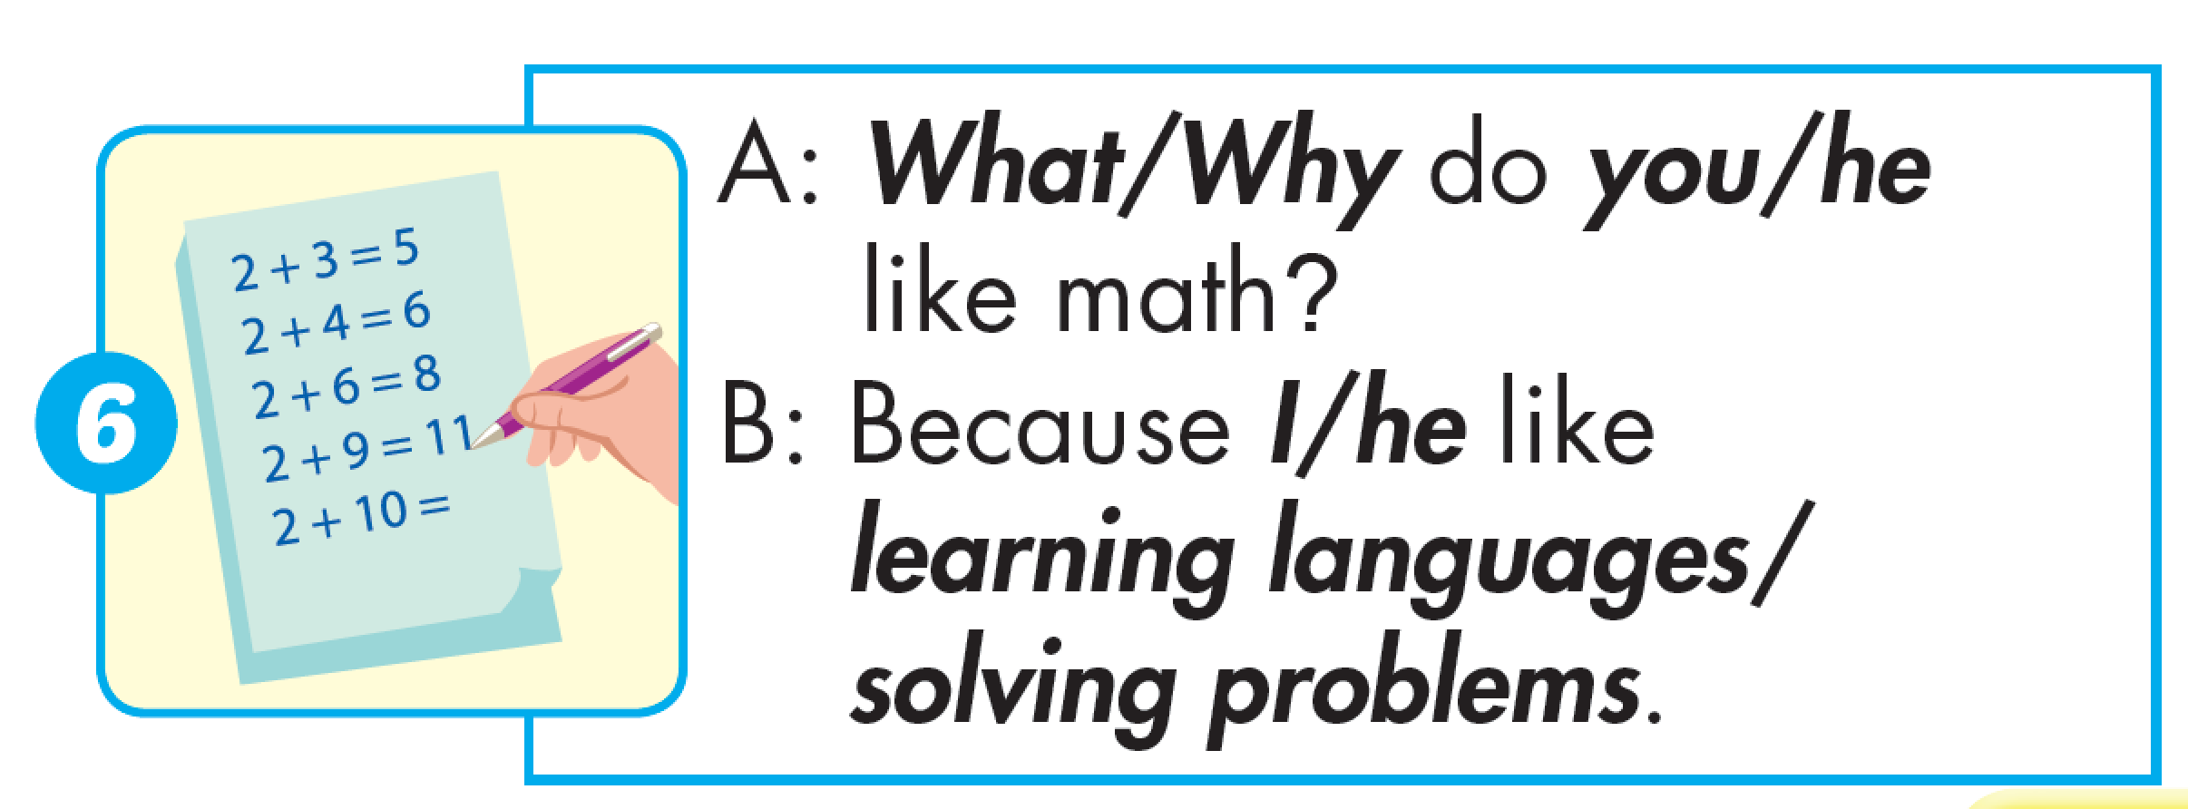

Slide 40

Production

Slide 41

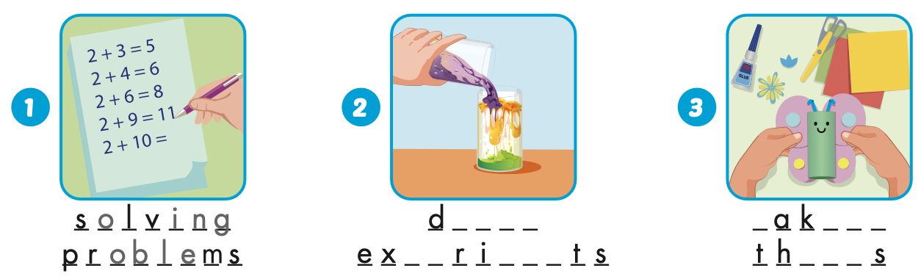
Extra Practice
WB, page 4
o i n g
m
i n g
p e
men
i n g

Slide 42
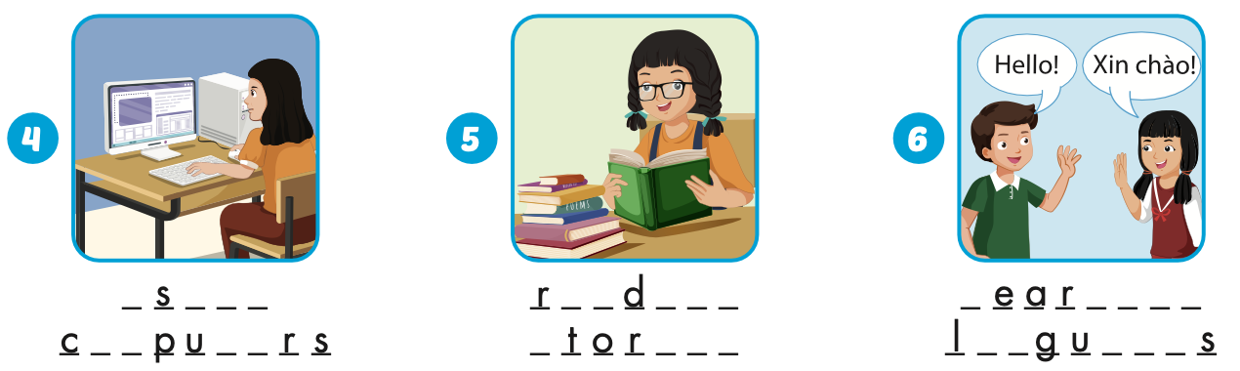
Extra Practice
WB, page 4
u
i n g
e a
i n g
l
n i n g
om
t e
s
i e s
a n
a g e

Slide 43

CONSOLIDATION

Slide 44
Homework
Practice the vocabularies and structure, and make sentences using them.
Do the exercises in Tiếng Anh 5 i-Learn Smart Start WB (page 4).
Do the exercises in Tiếng Anh 5 i-Learn Smart Start Notebook.
Prepare the next lesson (page 10 SB).
Play the consolidation games in Tiếng Anh 5 i-Learn Smart Start DHA App on www.eduhome.com.vn

