Slide 1

Unit 3: WEATHER
Lesson 4.1
Page 43

Slide 2

WARM UP

Slide 3




What is this?
Coat
Gloves
Sunglasses

Slide 4
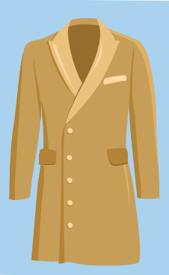
What is this?
Umbrella
Coat
Cap

Slide 5

What is this?
Cap
Raincoat
Gloves

Slide 6
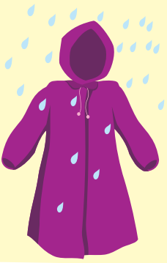
What is this?
Sunglasses
Raincoat
Umbrella

Slide 7

What is this?
Coat
Umbrella
Cap

Slide 8

What is this?
Raincoat
Cap
Gloves

Slide 9

Vocabulary

Slide 10

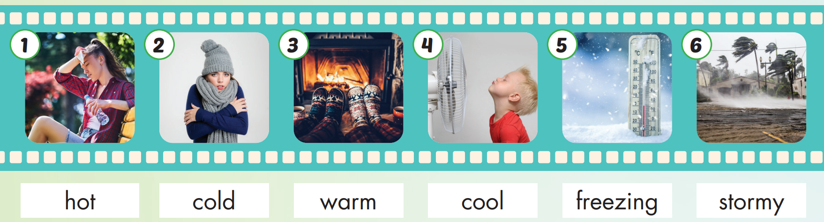

Slide 11
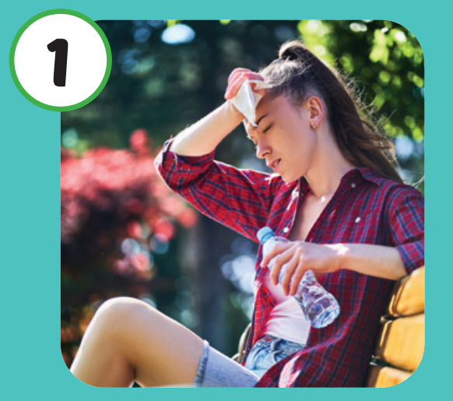
Listen and repeat.
Click each picture to hear the sound.
Hot
/hɑːt/
Nóng

Slide 12
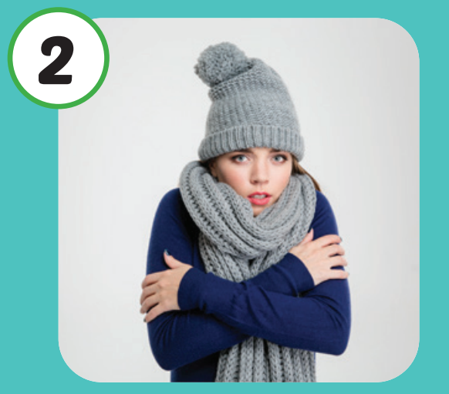
Listen and repeat.
Click each picture to hear the sound.
Cold
/koʊld/
Lạnh

Slide 13

Listen and repeat.
Click each picture to hear the sound.
Warm
/wɔːrm/
Ấm áp

Slide 14
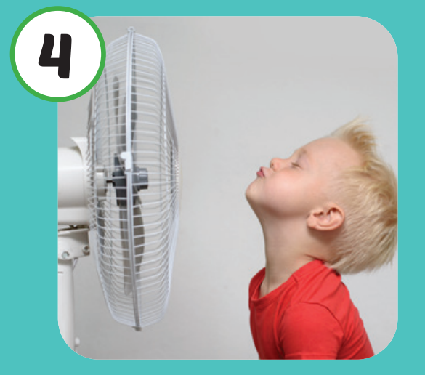
Listen and repeat.
Click each picture to hear the sound.
Cool
/kuːl/
Mát mẻ

Slide 15
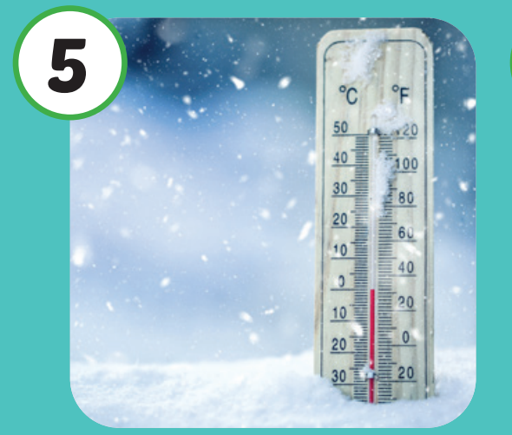
Listen and repeat.
Click each picture to hear the sound.
Freezing
/ˈfriːzɪŋ/
Lạnh cóng

Slide 16
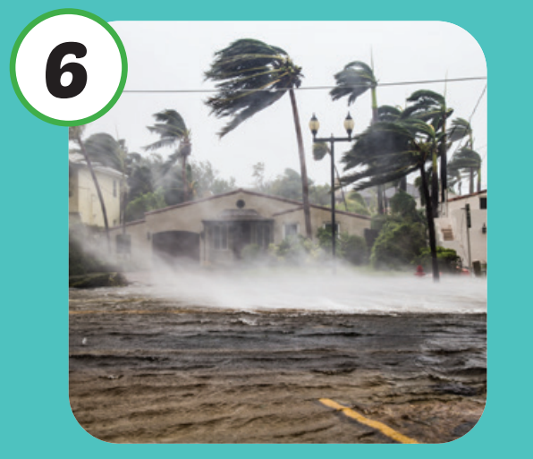
Listen and repeat.
Click each picture to hear the sound.
Stormy
/ˈstɔːrmi/
Có bão

Slide 17

Practice

Slide 18

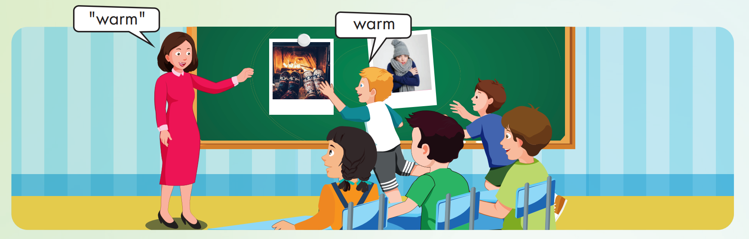

Slide 19
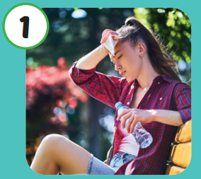

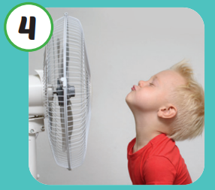
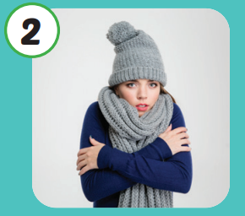
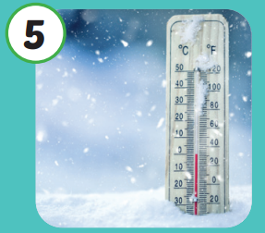

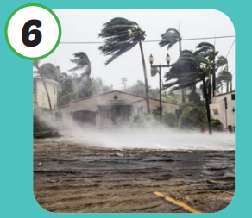
Hot
Cool
Cold
Freezing
Warm
Stormy

Slide 20

Structure

Slide 21

Structures
What do you like
doing when it's hot?
I like swimming.

Slide 22



What do you like doing when it's hot?
I like swimming.

Slide 23

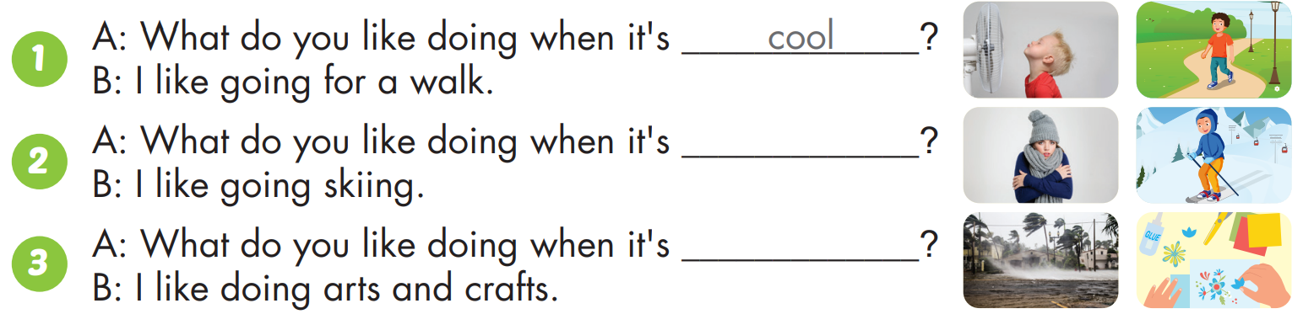
cold
stormy

Slide 24
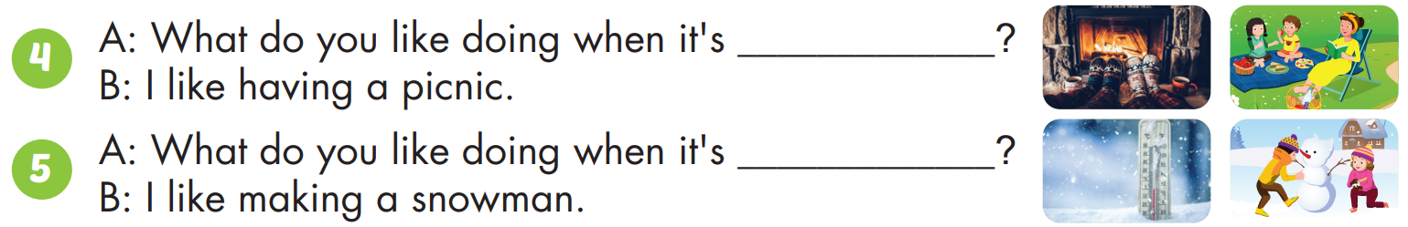
warm
freezing

Slide 25

CONSOLIDATION

Slide 26

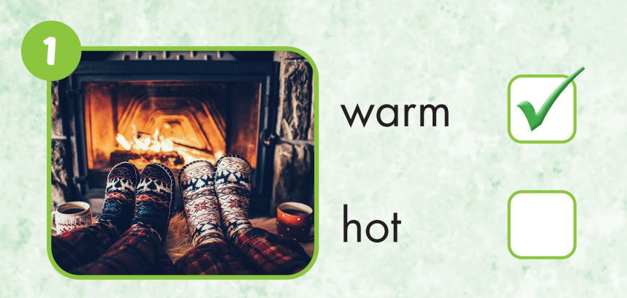

Slide 27

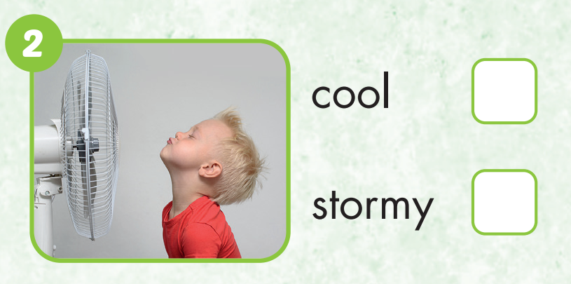

Slide 28
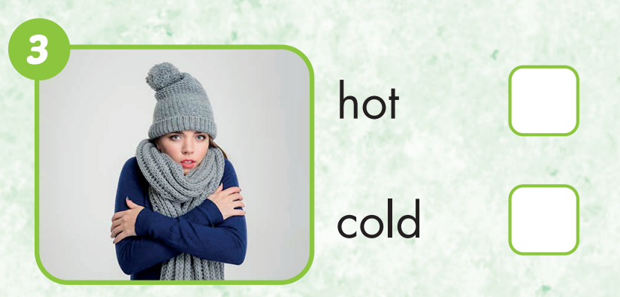

Slide 29
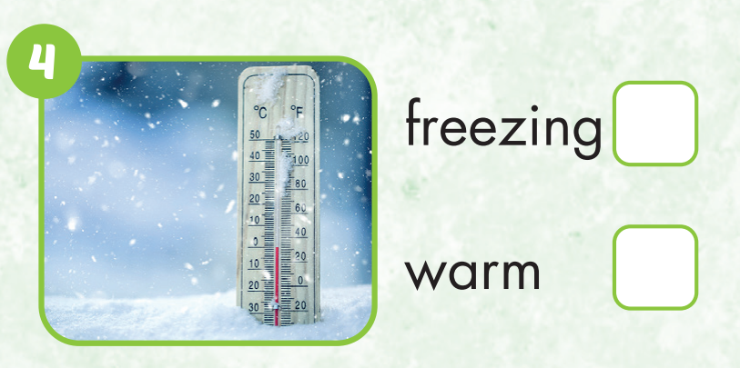

Slide 30
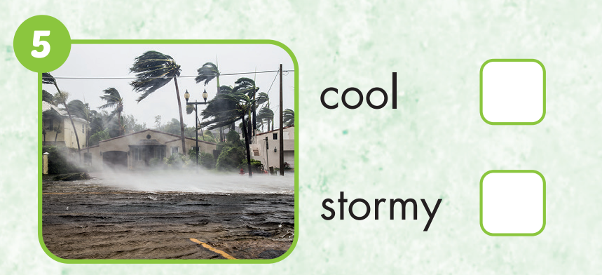

Slide 31
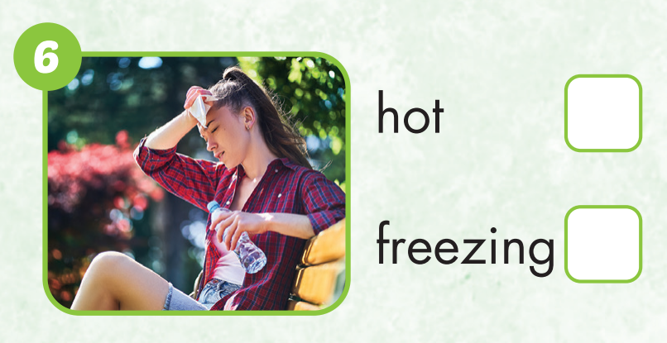

Slide 32
Homework
Practice the vocabularies and structure; and make sentences using them.
Do the exercises in Tiếng Anh 4 i-Learn Smart Start WB (page 28).
Do the exercises in Tiếng Anh 4 i-Learn Smart Start Notebook (page 19).
Prepare the next lesson (page 44 SB).
Play the consolidation games in Tiếng Anh 4 i-Learn Smart Start DHA App on www.eduhome.com.vn

