Slide 1
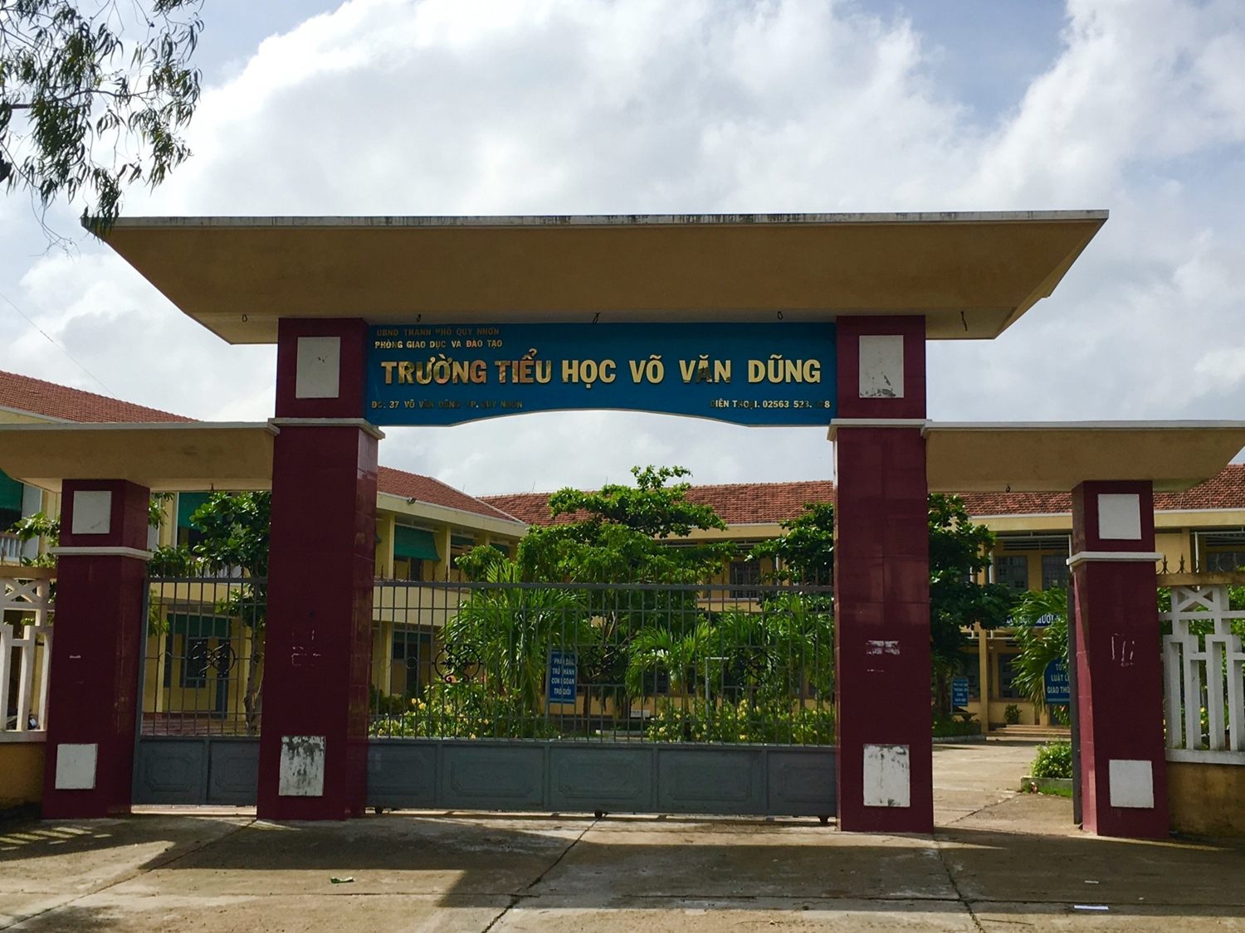
CHÀO MỪNG QUÝ THẦY CÔ ĐẾN DỰ GIỜ LỚP 3B
nhiÖt liÖt chµo mõng
Quý thầy cô đến dự lớp 3D
Giáo viên:Huỳnh Thi Lý
Ngô Mây: 3/2024

Slide 2
WARM UP

Slide 5
VOCABULARY

Slide 7
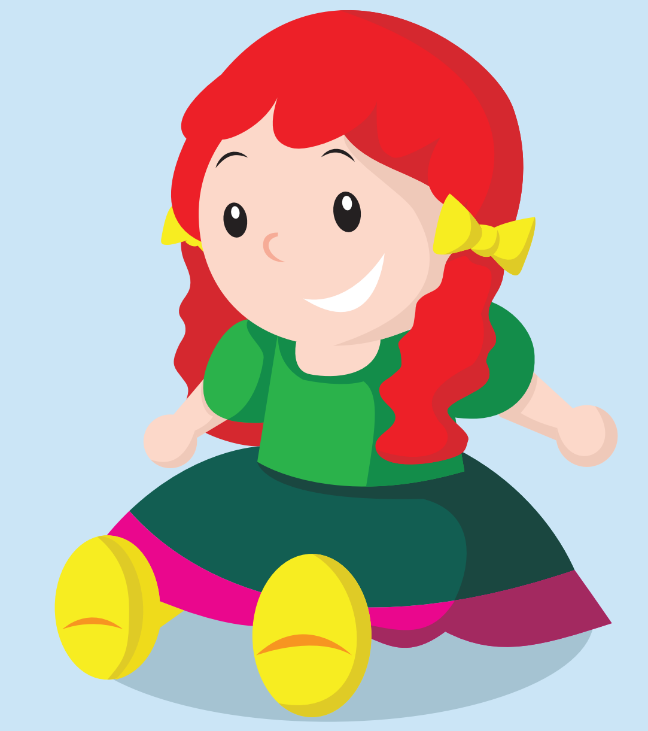

Slide 8
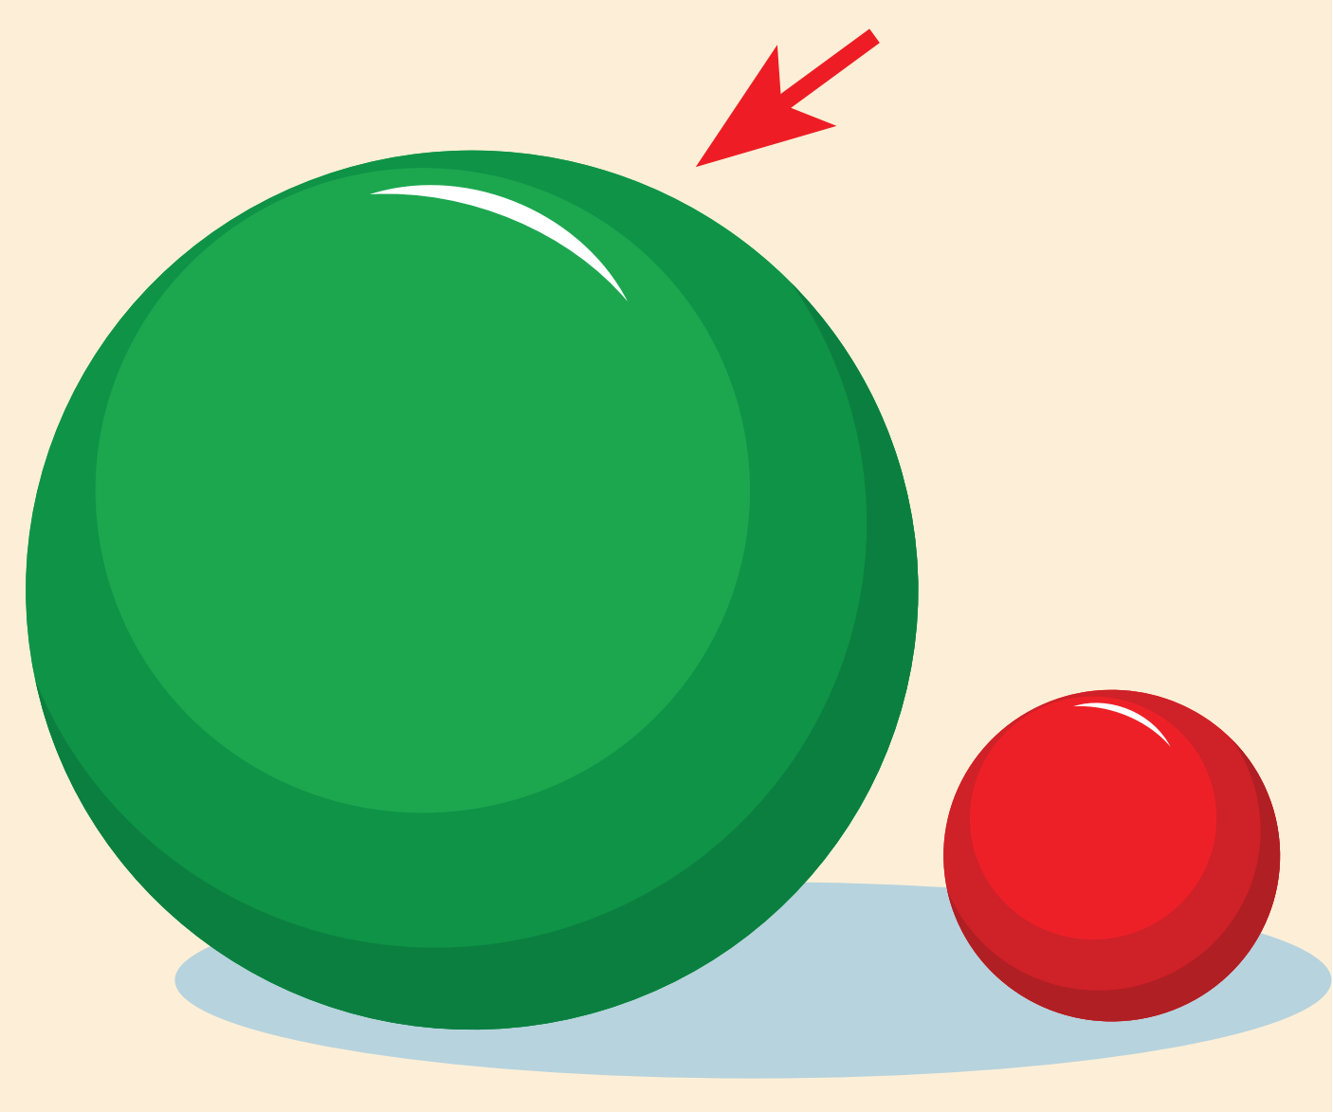

Slide 9
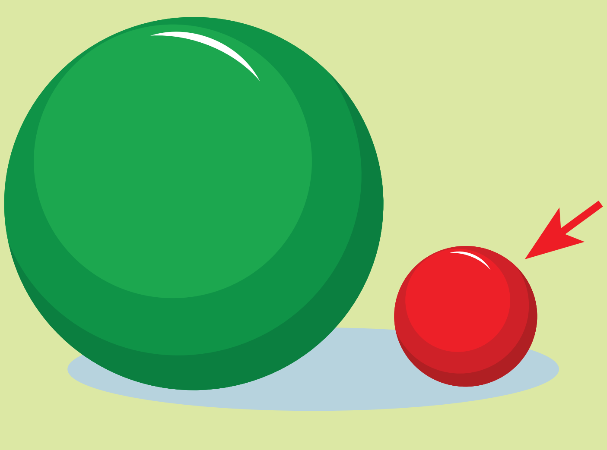

Slide 11
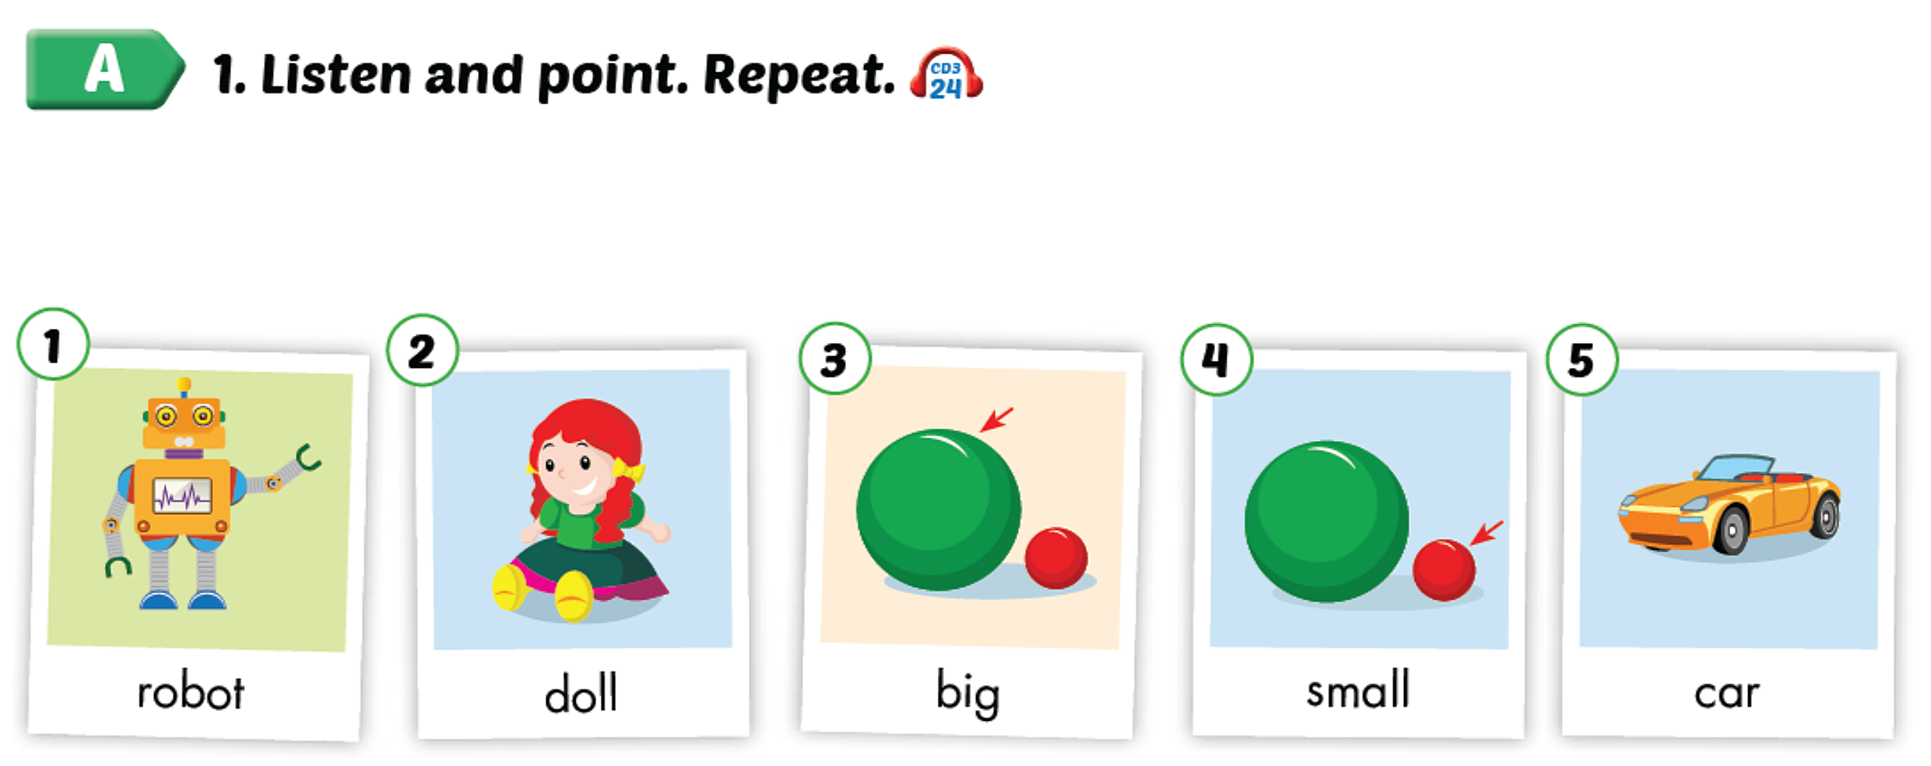

Slide 12
REVIEW

Slide 13
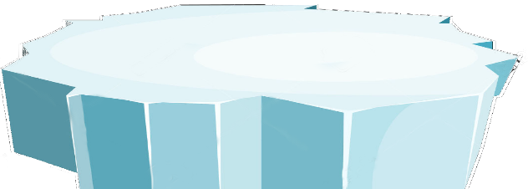
The little penguins
PLAY

Slide 14
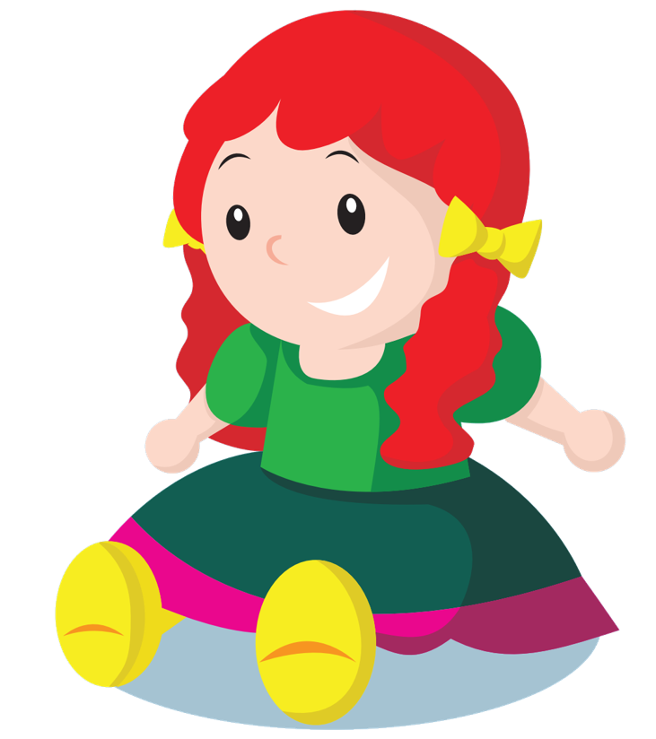
What word is it ?
SURFING
NEXT
STOP
doll

Slide 15
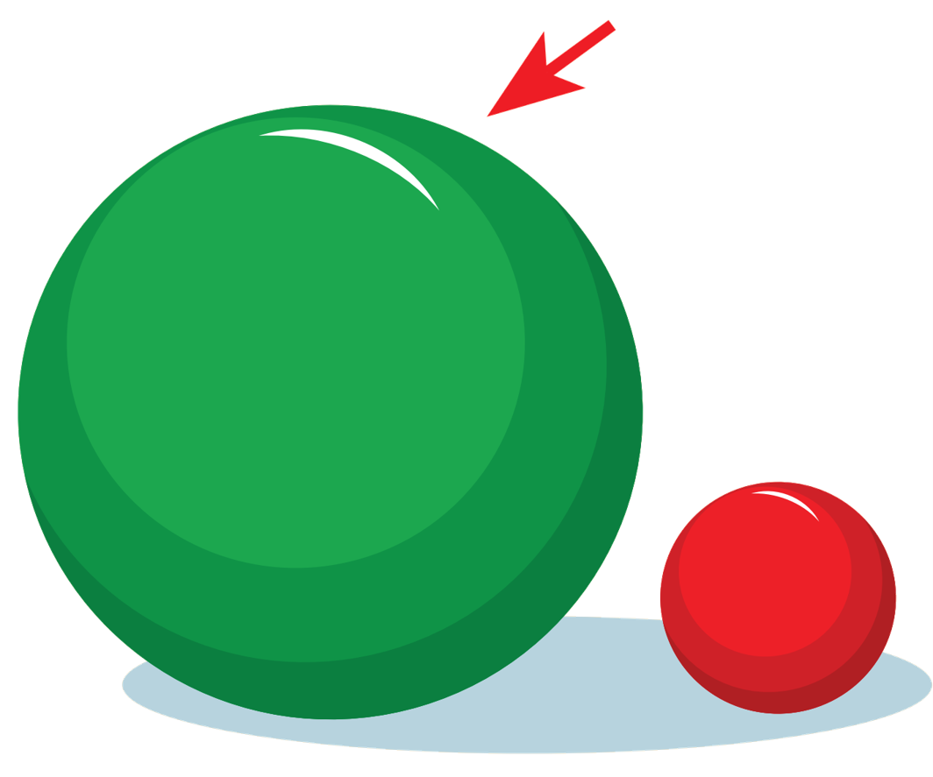
What word is it ?
SURFING
NEXT
STOP
big

Slide 16
What word is it ?
SURFING
NEXT
STOP
robot

Slide 17
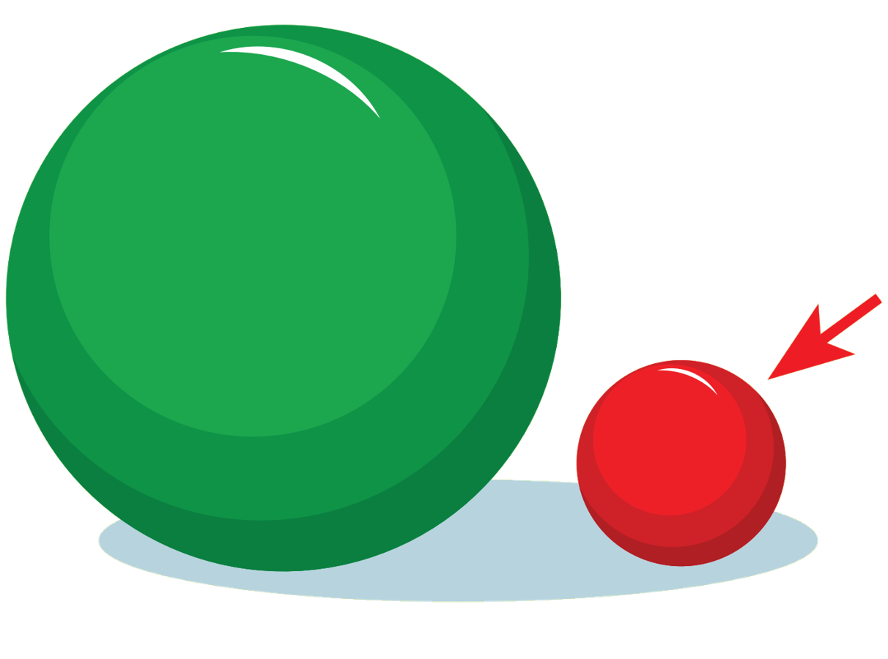
What word is it ?
SURFING
NEXT
STOP
small

Slide 18
What word is it ?
SURFING
NEXT
STOP
car.

Slide 19
Game over!
EXIT

Slide 20
2. SENTENCES

Slide 21
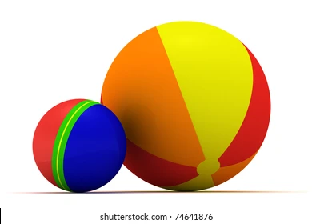
I can see a big ball.
What can you see ?
I can see a small ball.

Slide 22
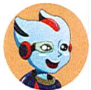
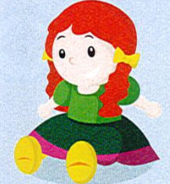
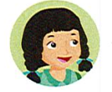
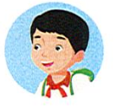
B1. Listen and practice
What can you see?
I can see a big doll.
What can you see?
I can see a big ball.
I can see a small robot.

Slide 23
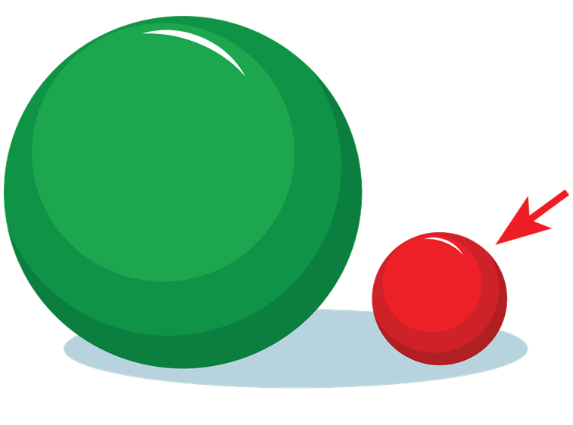
What can you see?
I can see ………..

Slide 24
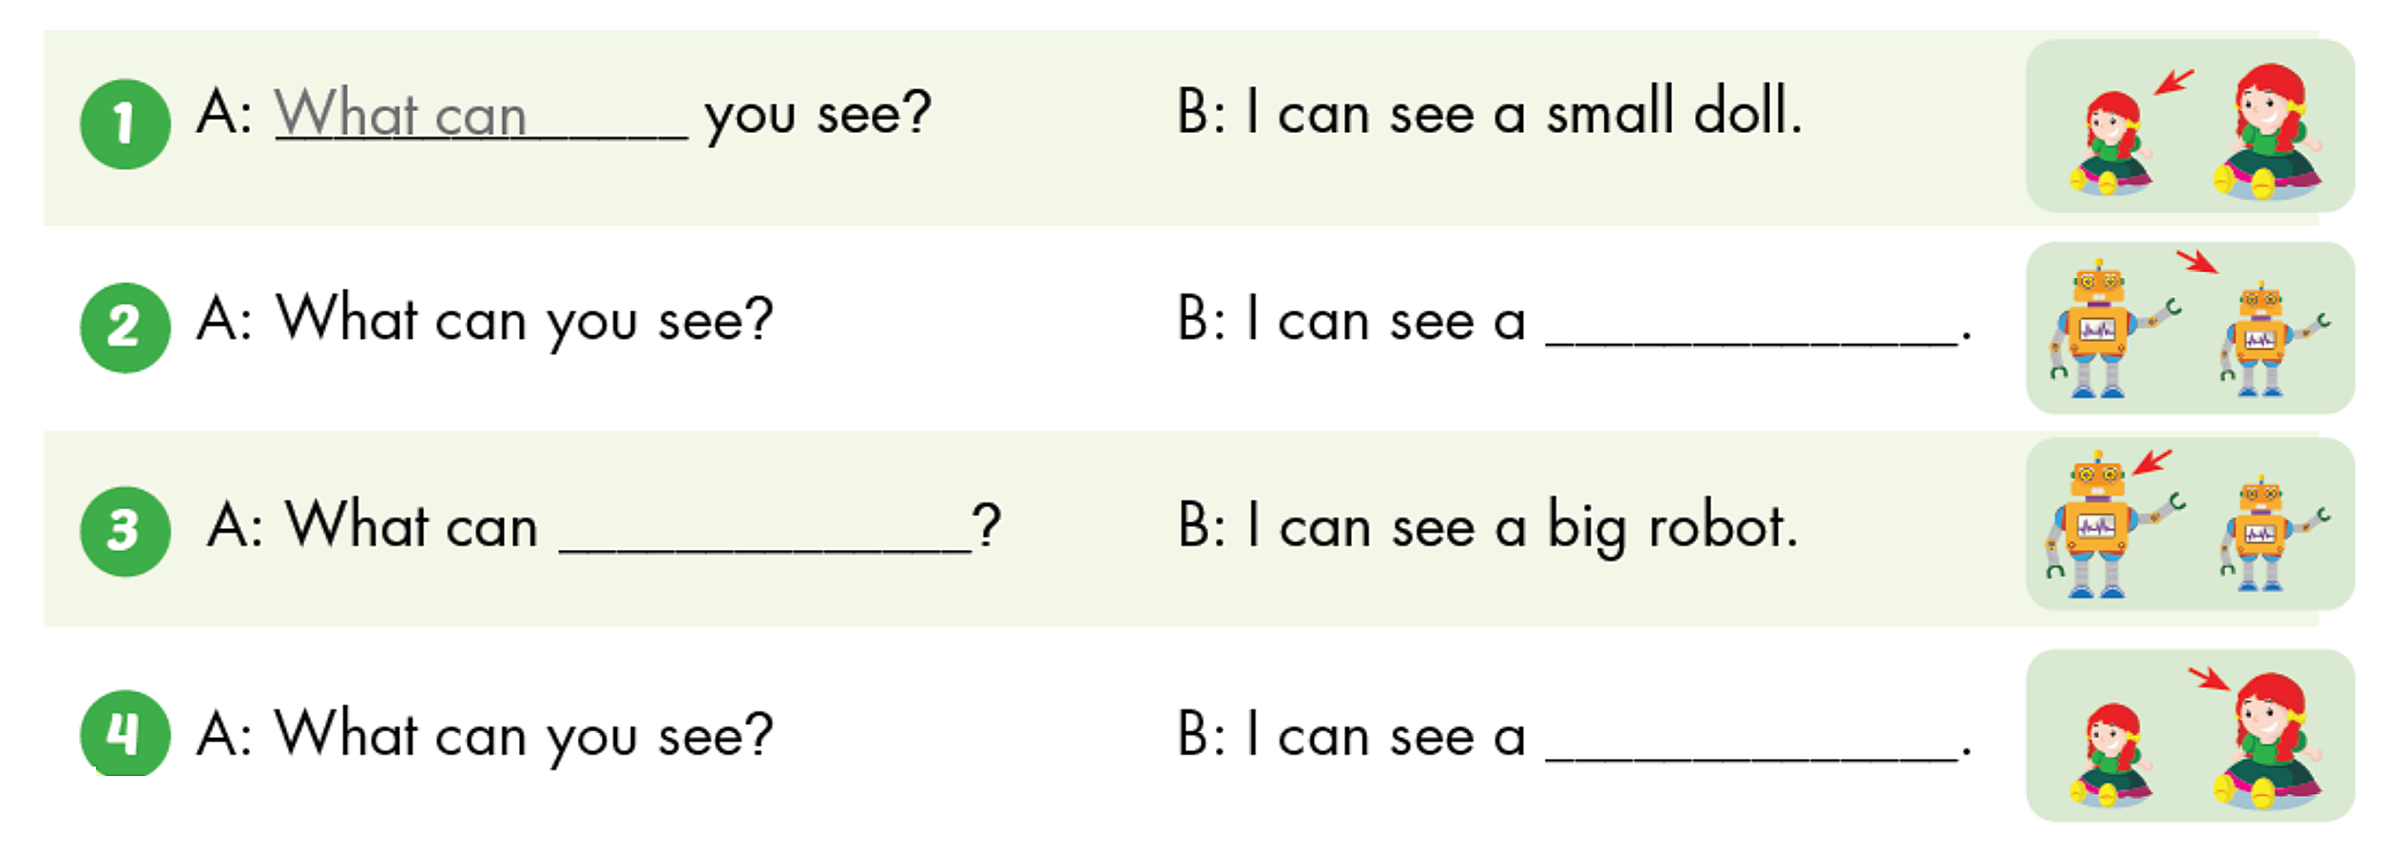
small robot
you see
big doll

Slide 25
REVIEW

Slide 26
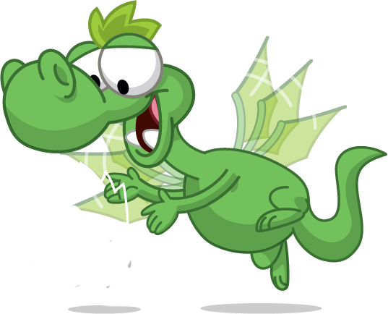
REVIEW
Play a game:Pass The Bomb
Notes:
Play a game to revise vocab

Slide 27
REVIEW
What can you see ?
I can see………..
A big doll
A small doll
A big doll
Click on Waldo to reveal the answer

Slide 28
REVIEW
What can you see ?
I can see………..
A big
robot
A small robot
A small robot
Click on Waldo to reveal the answer

Slide 29
REVIEW
What can you see ?
I can see a………..car.
big
car
small
tall
big
Click on Waldo to reveal the answer

Slide 30
What can you see ?
I like small bag.
It’s a bag.
It’s a big bag.
I can see a small bag.
I can see a small bag.
Click on Waldo to reveal the answer

Slide 31
REVIEW
see-can- I –pen-a-big
I can see big pen a.
I can see big a pen.
I can see a big pen.
I see can a big pen.
I can see a big pen.
Click on Waldo to reveal the answer

Slide 32
REVIEW
Extra Practice
WorkBook, Page. 68

Slide 33
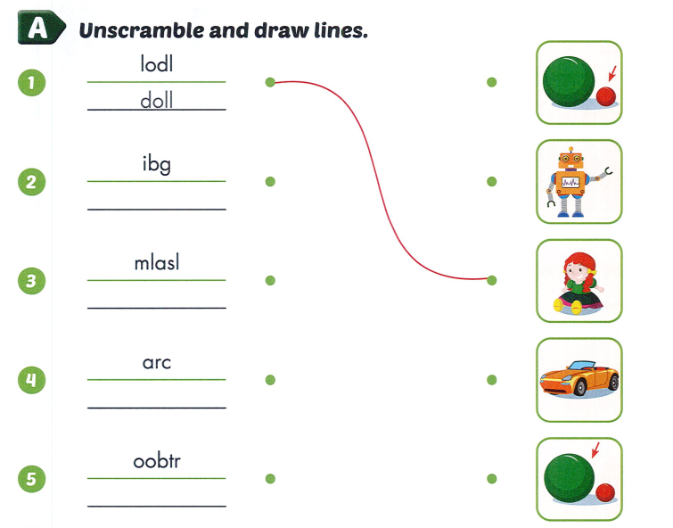

Slide 34
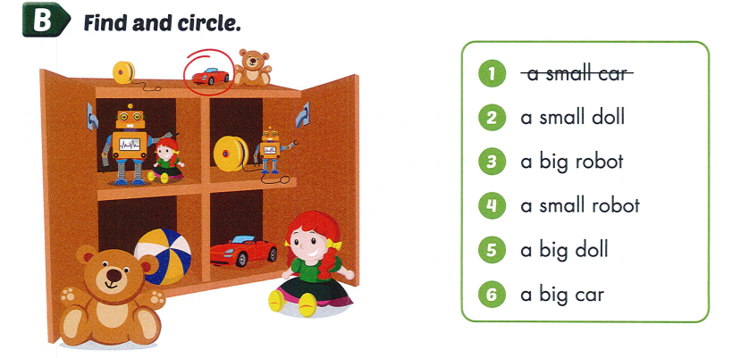

Slide 36
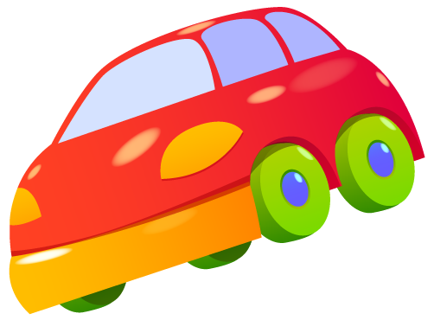
SPEAKING

Slide 37
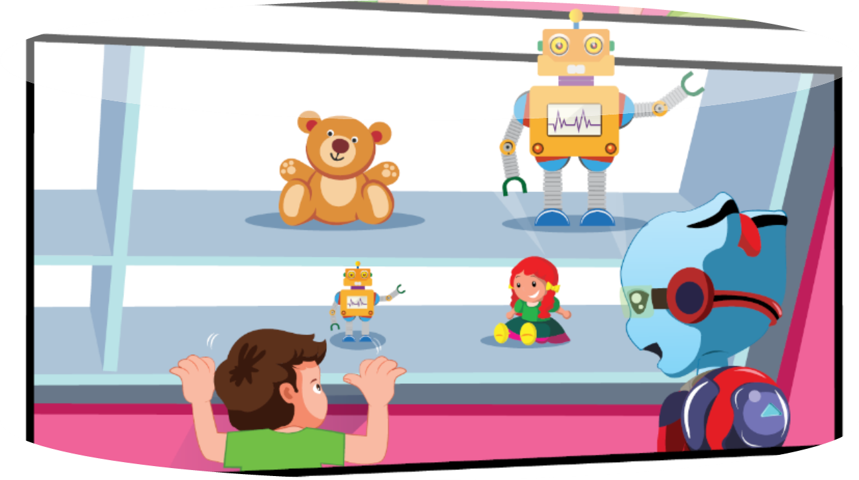

Slide 38
Thursday, March 14th, 2024

