Slide 1
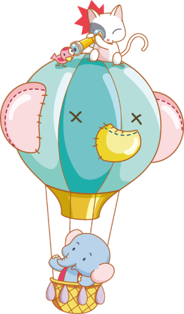
WARM- UP
&
REVIEW
Notes:
Thanh Yến Trần 0967 255 149 zalo/ FB https://www.facebook.com/thanhyentrananhngutaymy/

Slide 3
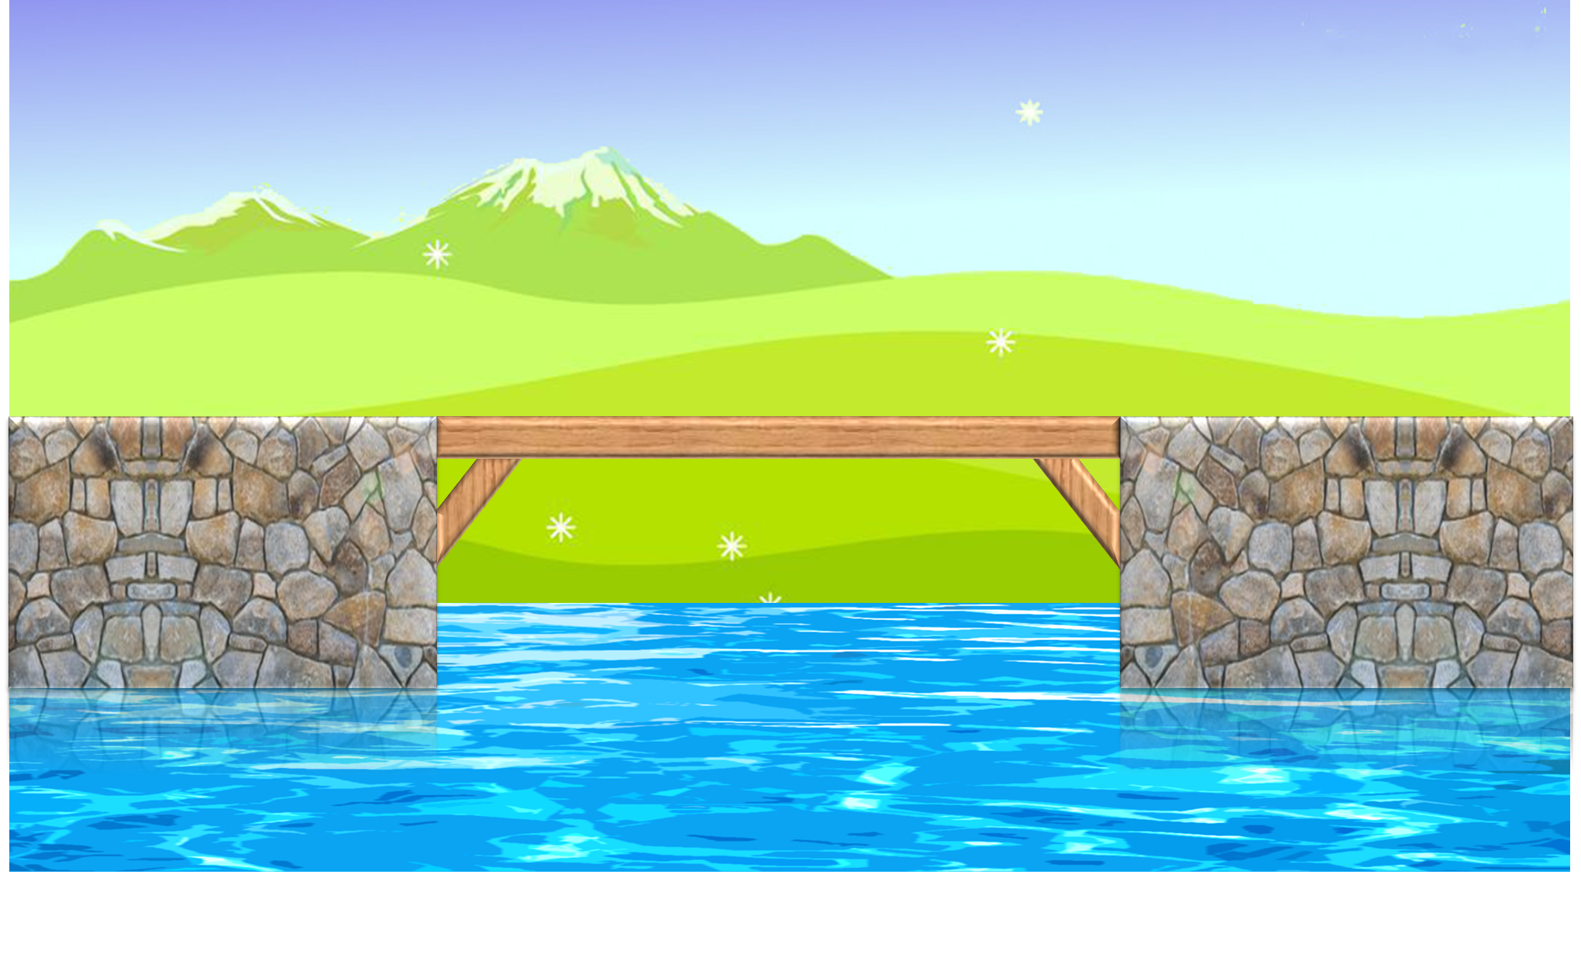
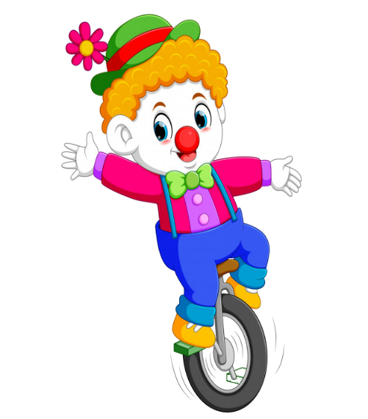
PLAY
Notes:
Yên Trần 0967 255 149 zalo/ FB https://www.facebook.com/thanhyentrananhngutaymy/

Slide 4
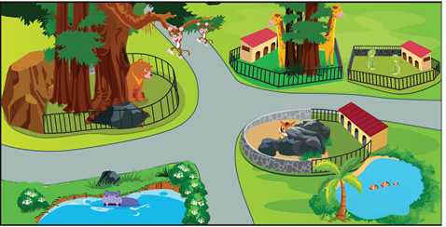
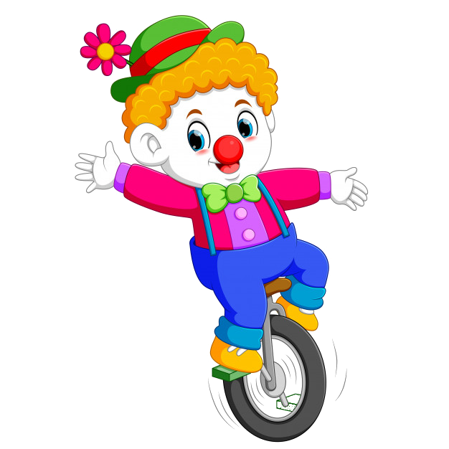
Is there a tiger in the zoo ?
a. Yes, there is
b. Yes, it is
c. No, there isn’t
d. No, it isn’t

Slide 5
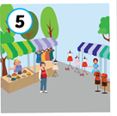
Would you like to go to the ………………?
a. beach
b. park
c. swimming pool
d. flea market

Slide 6
: tìm
Lucy’s_____ the phone.
a. in
b. to
c. on
d. with

Slide 7
: tìm
speak / I / please / to / can / Tony / , / ?
a. Can speak I to Tony , please ?
b. I can speak to Tony , please ?
c. Can I speak to Tony , please ?
d. Can I to speak Tony , please ?

Slide 8
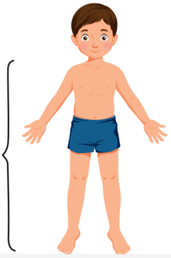
Listen and choose:
a. clean my room
b. clean my house
c. do my homework
d. do my chorus
Notes:
Yên Trần 0967 255 149 zalo/ FB https://www.facebook.com/thanhyentrananhngutaymy/

Slide 9
: tìm
What’s this ? It’s a………..
a. mobile phone
b. battery
c. phone charger
d. phone chager

Slide 10
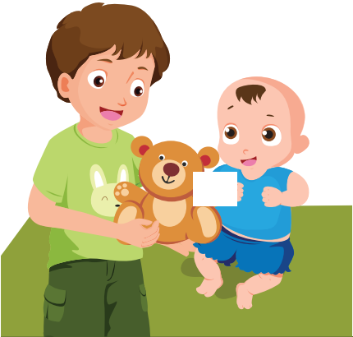
Find the missing picture
A
B
C
D

Slide 11
Do you want to go___________?
a. shopping
b. shop
c. shoping
d. to shop

Slide 12
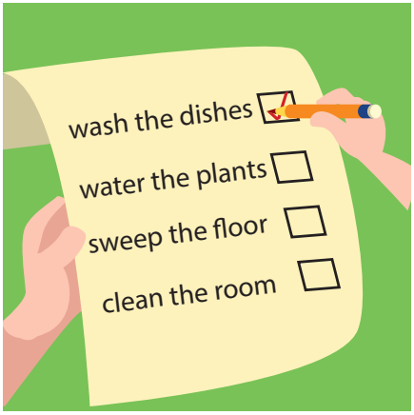
.
a. babysit
b. do my chores
c. do my homework
d. clean my room

Slide 13
Do you want to go to the park ?
A. Sorry , I do.
B. That sounds great !
C. Sorry , I can’t . I have to clean my room .
a. B and C
b. A and C
c. A and B
d. A, B and C

Slide 14
EXIT

Slide 15
Grade 5
A SHOPPING TRIP
LESSON 2
Notes:
Thanh Yến Trần 0967 255 149 zalo/ FB https://www.facebook.com/thanhyentrananhngutaymy/

Slide 16
Vocabulary

Slide 17
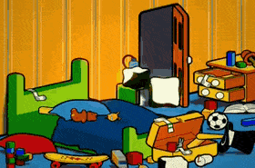
Clean
my room
Notes:
Thanh Yến Trần 0967 255 149 zalo/ FB https://www.facebook.com/thanhyentrananhngutaymy/

Slide 18
do
my homework

Slide 19
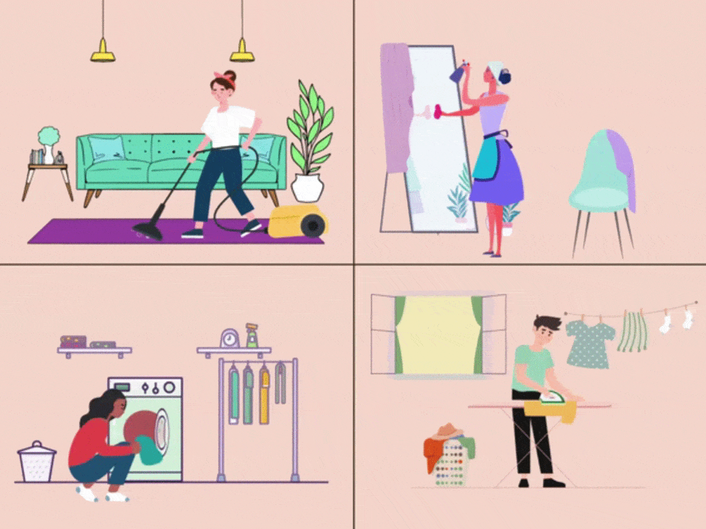
do
my chores

Slide 20
go shopping

Slide 21
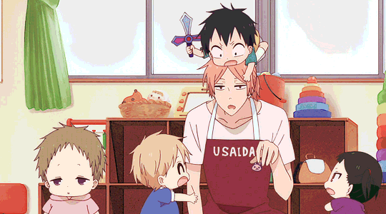
babysit

Slide 22
Clean
my room
do
my homework
go
shopping
do
my chores
babysit
Notes:
Click on each picture to hear the word

Slide 23
Listen and read

Slide 24
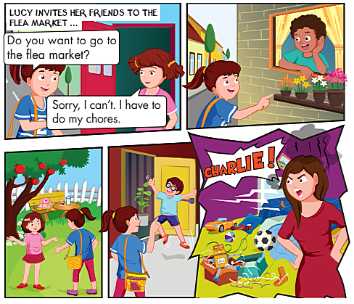
Answer the question:
Who are they?
What does Lucy want to do ?
How does Jane answer ?

Slide 25
LISTEN AND (✓) or(✗)

Slide 26
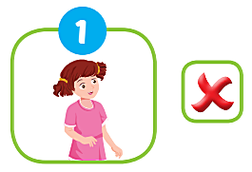
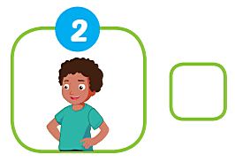
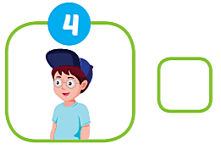
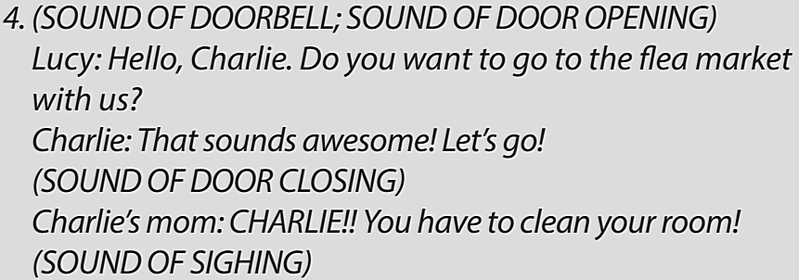
✓
✗
✓

Slide 27
Structure
Do you want to go to the flea market?
Sorry, I can’t. I have to do my chores.
That sounds awesome!

Slide 28
Practice the Structure
Do you want to go to the zoo?
That sounds awesome !

Slide 29
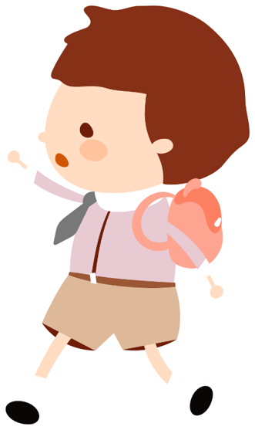
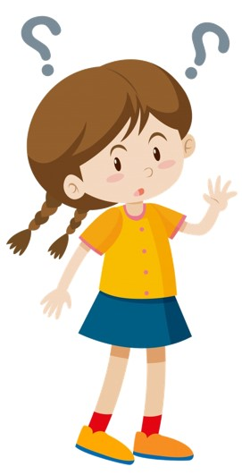
Practice the Structure
Sorry, I can’t.
I have to go
to school.
Do you want
to go to the
swimming pool?

Slide 30
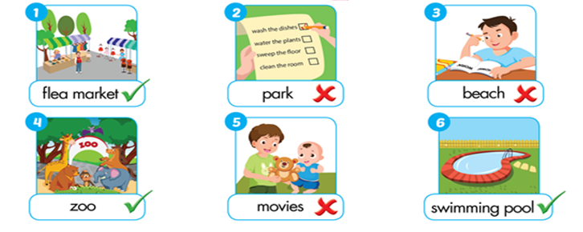
Practice the Structure

Slide 31
1. Vocabulary :
- clean my room : dọn dẹp phòng
- do my homework : làm bài tập về nhà
- do my chores : làm việc nhà
- go shopping : đi mua sắm
- babysit : trông trẻ
2. Structure:
Do you want to go to the flea market ?
- That’s sound great / awesome !
- Sorry, I can’t . I have to do my homework .
Friday November 10th 2023
Theme 3: A SHOPPING TRIP
Lesson 2 (A,B)

Slide 32
Thank you very much for attending this lesson.
The End
Goodbye. See you again

