Slide 1
9
Colours
LESSON 1
Period 2

Slide 2
What colour is it?
blue

Slide 3
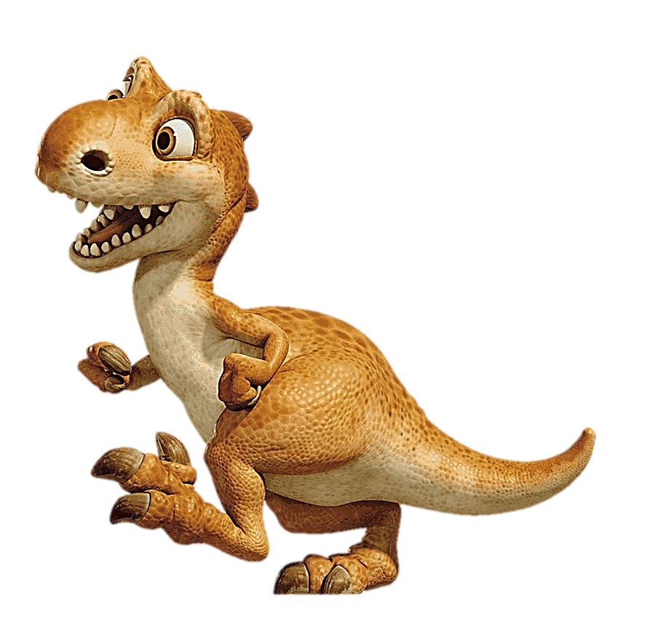
What colour is it?
brown

Slide 4
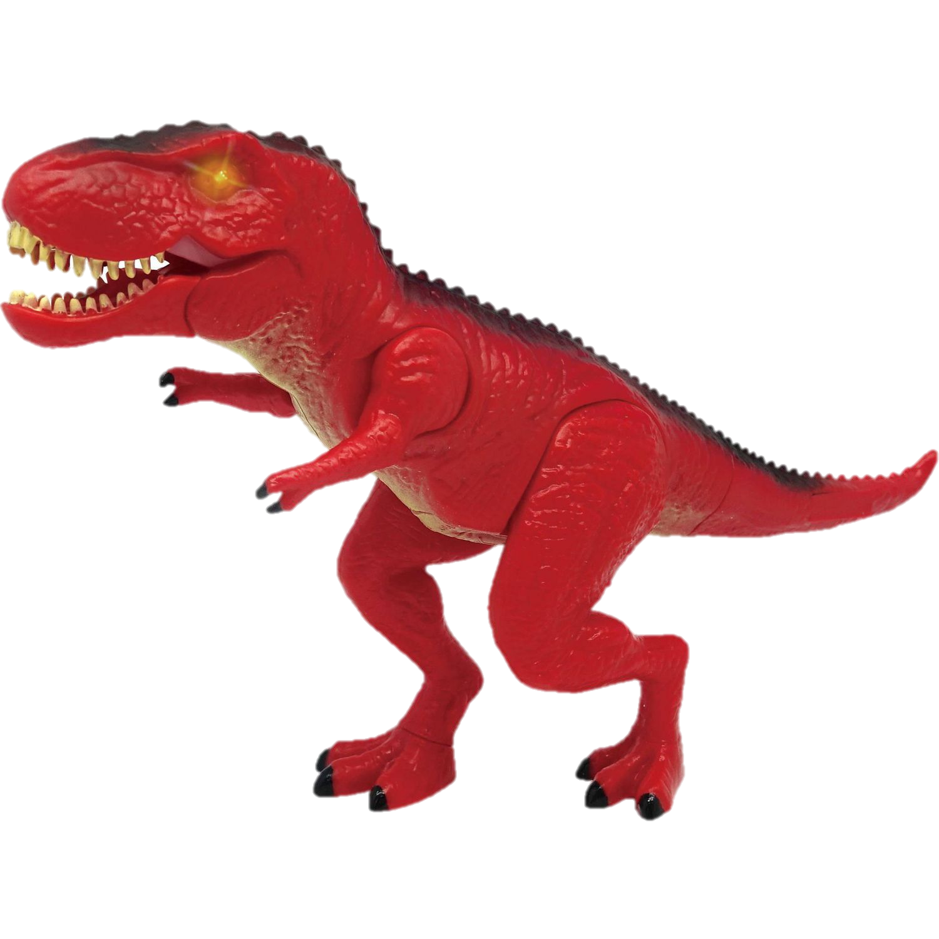
What colour is it ?
red

Slide 5
What colour is it?
yellow

Slide 6
What colour is it ?
red

Slide 7
What colour is it ?
yellow

Slide 8
What colour is it ?
blue

Slide 9
What colour is it ?
brown

Slide 12
Listen and tick.



Slide 13
Spin and choose a school thing
1 point
5 points
SPIN
3 points
2 points
10 points
End game
tekhnologic
Notes:
- Divide the class into groups of 2 (boys and girls). Each team takes turn to choose a school thing. They need to read the sentence and say the missing word(s) with the picture to get points.
- The group with more points at the end of the game will be the winner.

Slide 14
Read and complete.
What colour is ________?
it
It’s blue.

Slide 15
Read and complete.
colour
What ________ is it?
It’s red.

Slide 16
Read and complete.
What colour is it?
___________brown.
It’s

Slide 17
Read and complete.
What colour is it?
yellow
It’s _________.

Slide 18
Read and complete.
What _______ is it?
colour
It’s blue.

Slide 19
Read and complete.
What colour is it?
brown
It’s ________.

Slide 20
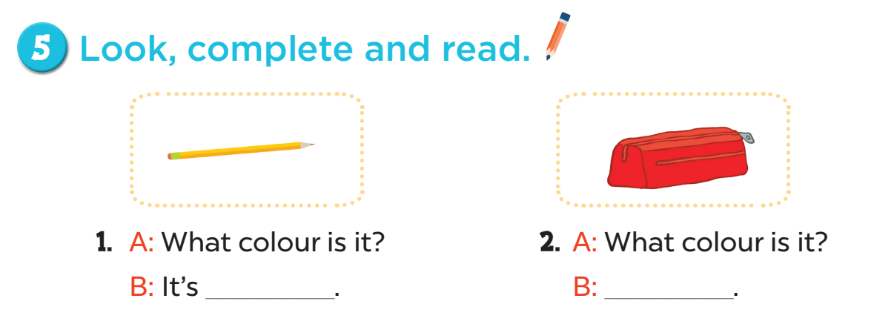
yellow
It’s red
63

Slide 21
3. A: _______colour is it?
B: It’s __________.
4. A: ______________is it?
B: It’s __________.
What
What colour
brown
blue

Slide 22
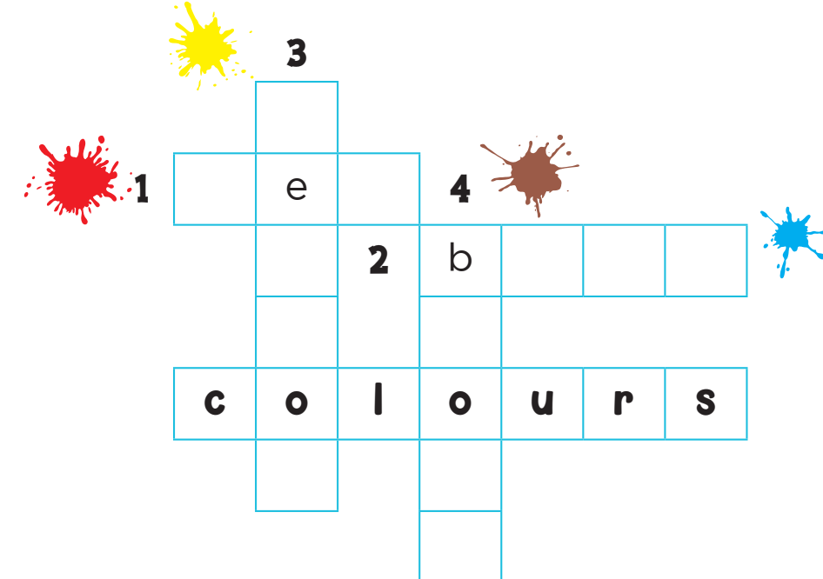
y
l
l
w
r d
l u e
r
w
n

