Slide 1







9
Colours
LESSON 3
Period 5

Slide 2
01
Warm-up and review

Slide 3
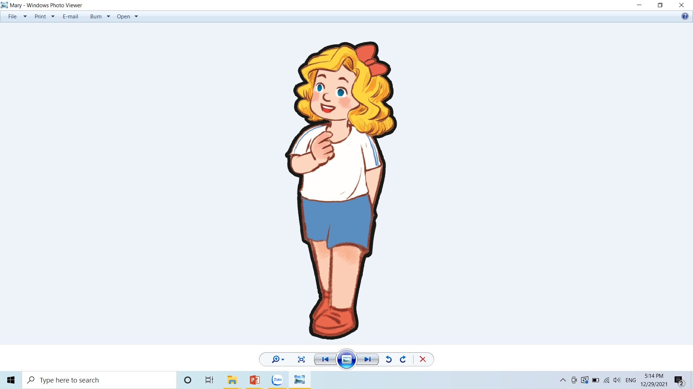

That door could be really fun. Let’s play a game to find out. Are you ready?
Hello, everyone, this is me Mary. Do you like my Anywhere Door?

Slide 4









TEAM 1
0
TEAM 2
0
Notes:
Divide the class into 2 teams.
Each team takes turns choosing from door 1 to 8. Then answer the questions.
Then students can choose to keep or give the points they get to the other team. (Students cannot choose to keep or give twice in a row)

Slide 5
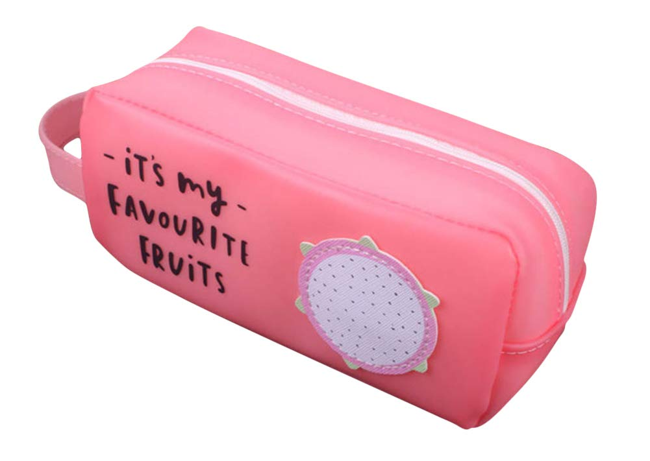
What is it?
What colour is it?
It’s a pencil case.
It’s pink.

Slide 6

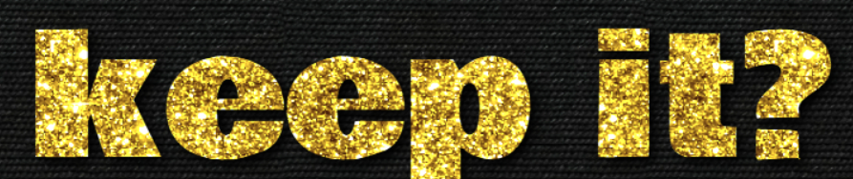
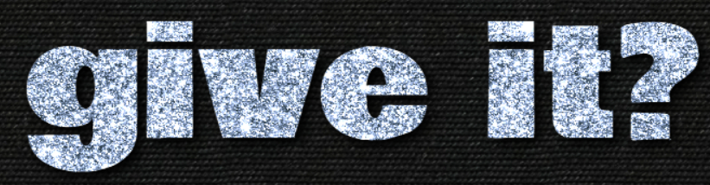
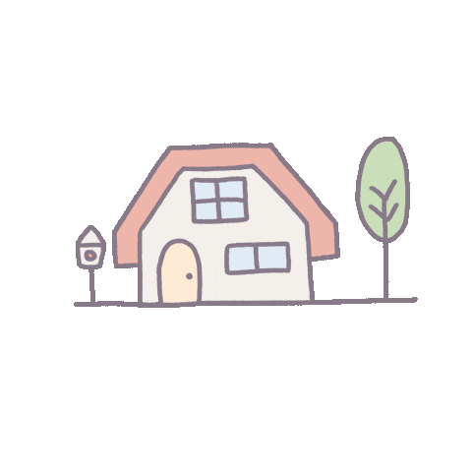
4 points
or
Notes:
Click the home to go back.

Slide 7

What colour are they?
What are they?
They’re notebooks.
They’re orange.

Slide 8
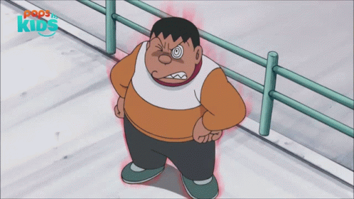

1 point
or
Notes:
Click the home to go back.

Slide 9
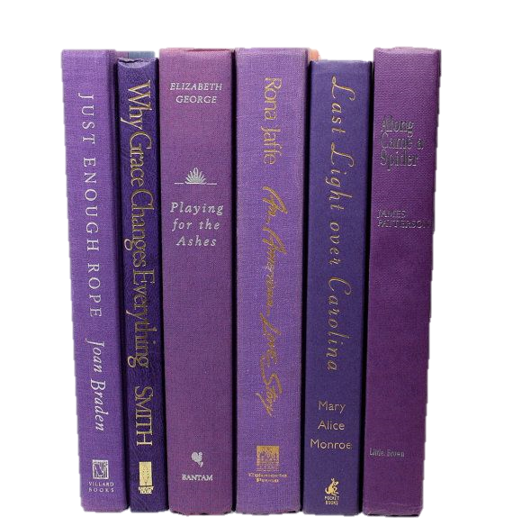
What are they?
What colour are they?
They’re books.
They’re purple.

Slide 10
3 points
or
Notes:
Click the home to go back.

Slide 11
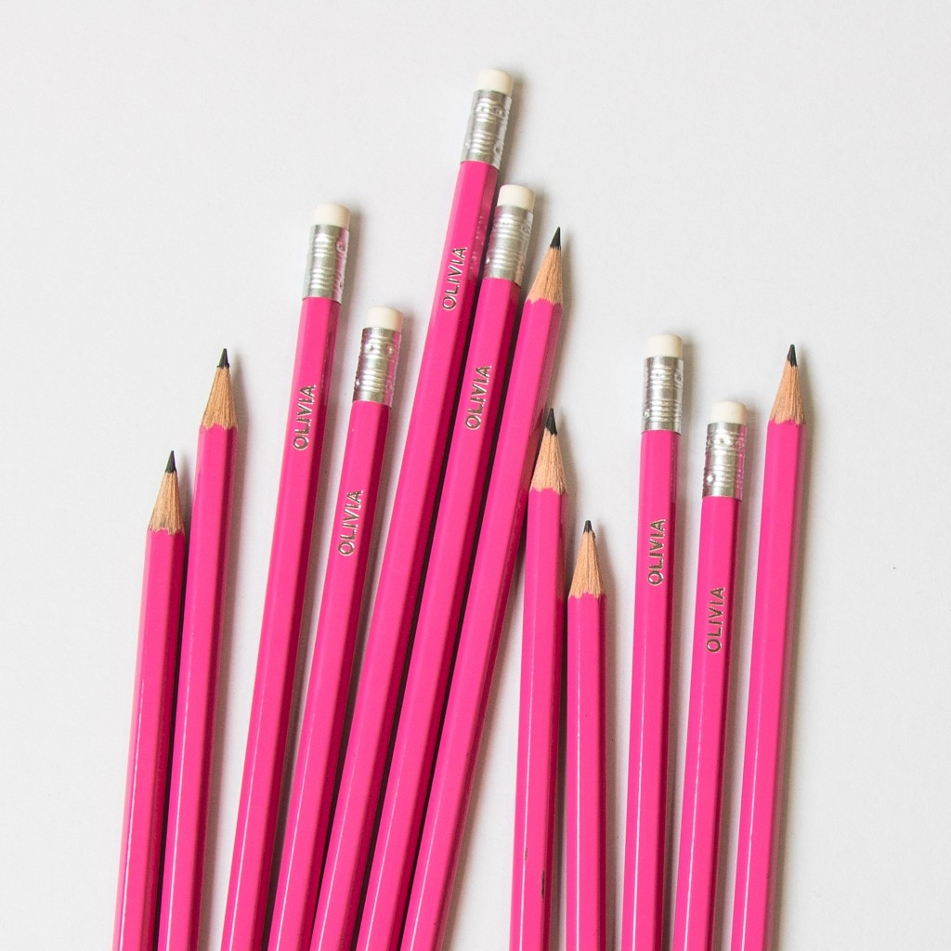
What are they?
What colour are they?
They’re pink.
They’re pencils.

Slide 12
2 points
or
Notes:
Click the home to go back.

Slide 13
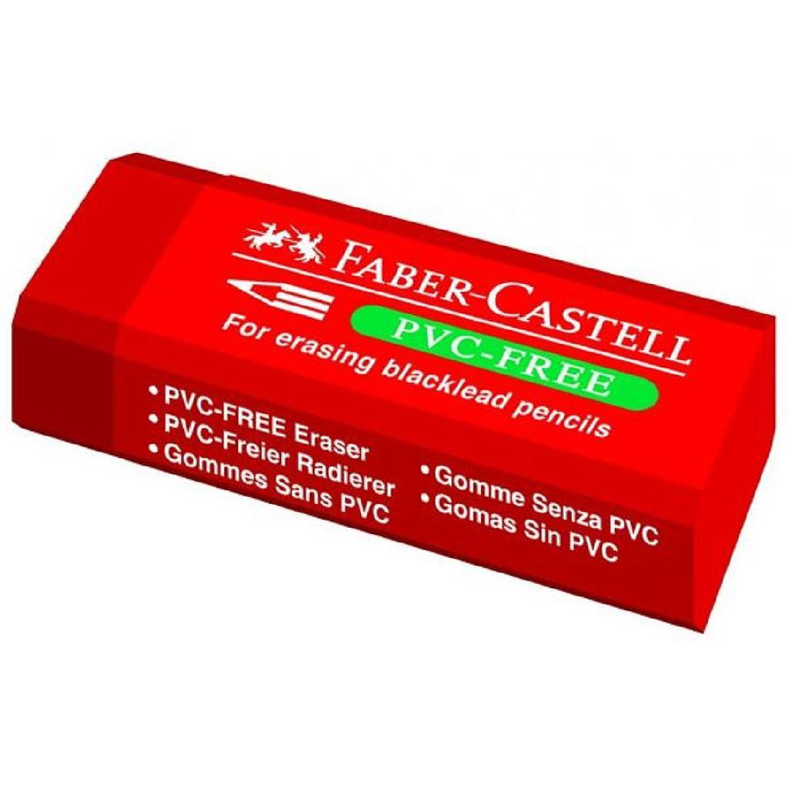
What colour is it?
What is it?
It’s an eraser.
It’s red.

Slide 14
2 points
or
Notes:
Click the home to go back.

Slide 15
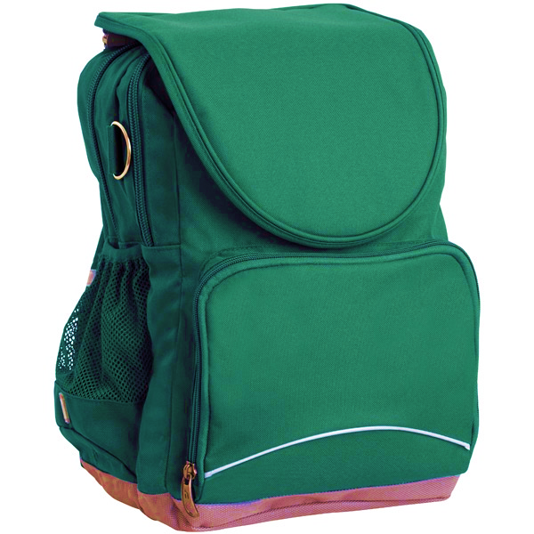
What colour is it?
What is it?
It’s a school bag.
It’s green.

Slide 16
3 points
or
Notes:
Click the home to go back.

Slide 17
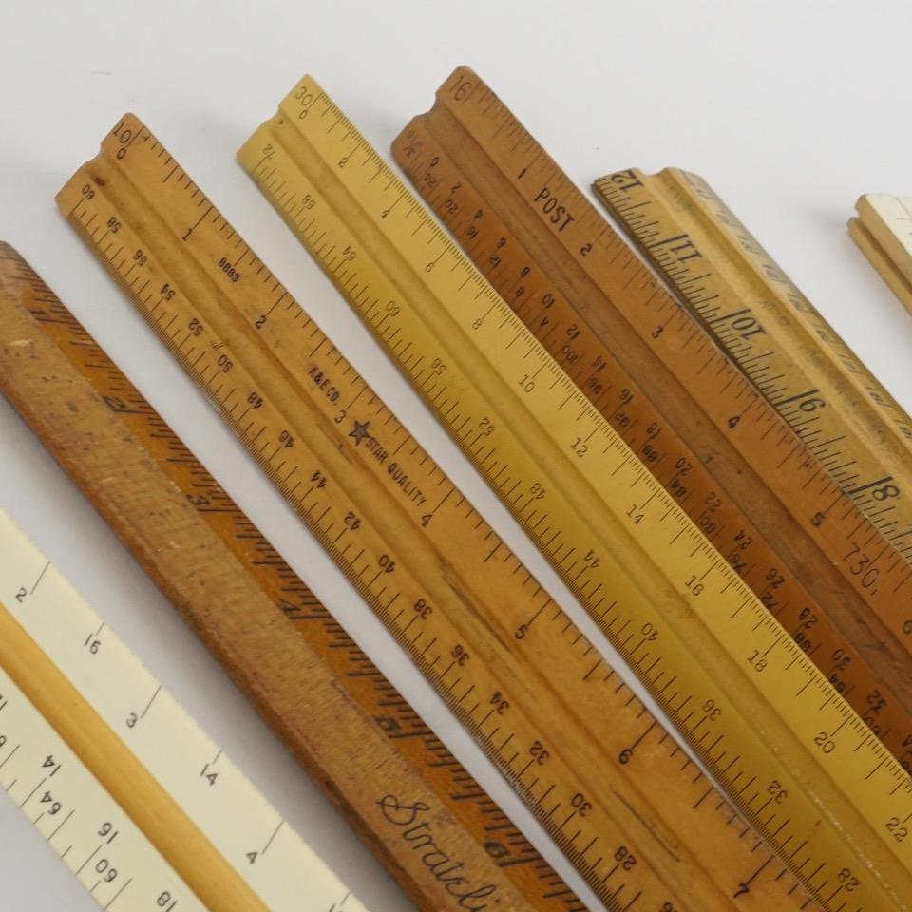
What colour are they?
What are they?
They’re rulers.
They’re brown.

Slide 18
0 point
or
Notes:
Click the home to go back.

Slide 19

What colour are they?
What are they?
They’re yellow.
They’re pens.

Slide 20
6 points
or
Notes:
Click the home to go back.

Slide 21

Listen and repeat.

Slide 22
Well done, boys and girls. Now let’s learn some sounds. Listen and repeat.

Slide 23

bl
ack

Slide 24
bl
ue

Slide 25
br
own

Slide 26
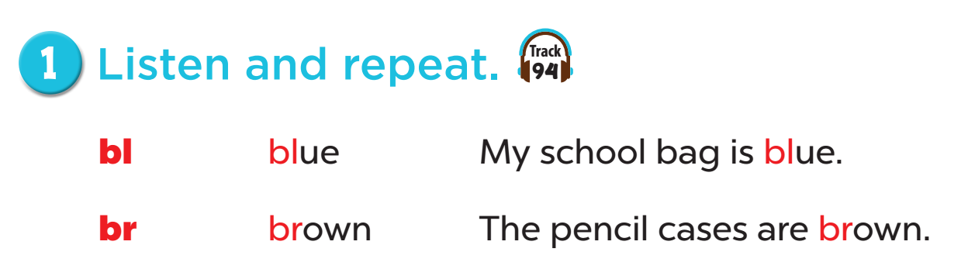

Slide 27

Listen and circle.

Slide 28


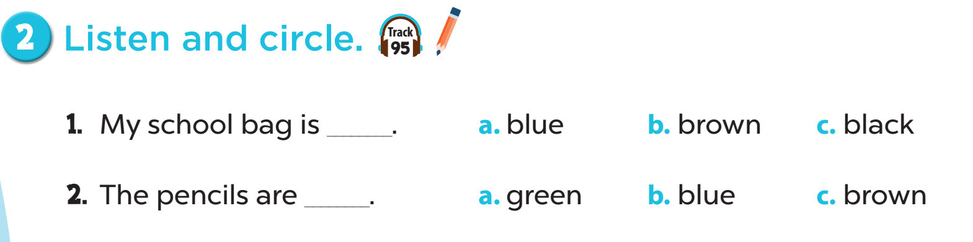


Slide 29

Let’s chant.

Slide 30
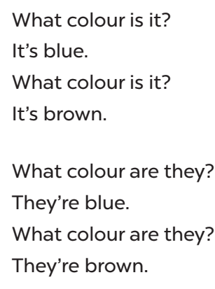
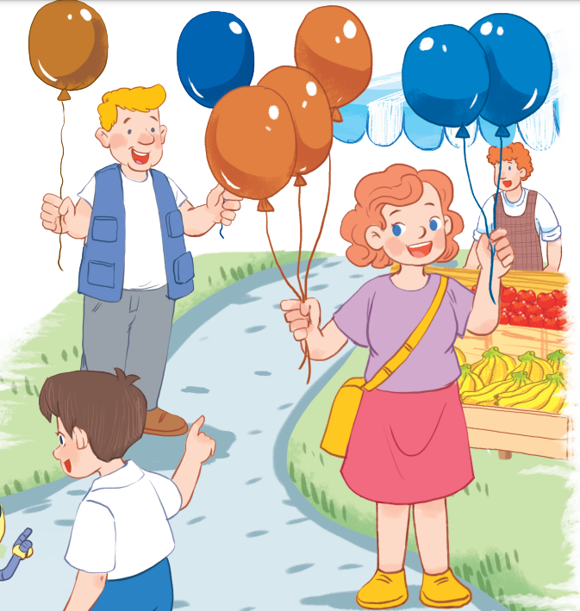
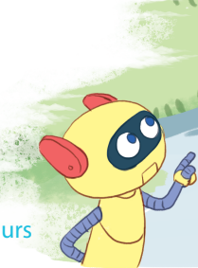

Slide 31
Now it’s your turn.
Let’s chant in pairs!

Slide 33
Let’s chant in groups.
Are you ready? Let’s go!

Slide 35

Fun corner and wrap-up

Slide 36
bl
ack
Notes:
Slap the board game. (choose the sounds and phonics words)
- Divide the class into groups or play individually.
- Teacher writes some words on the board then plays the sounds.

Slide 37
bl
ue

Slide 38
br
own

Slide 39

Website: sachmem.vn
Fanpage: www.facebook.com/sachmem.vn

