Slide 1
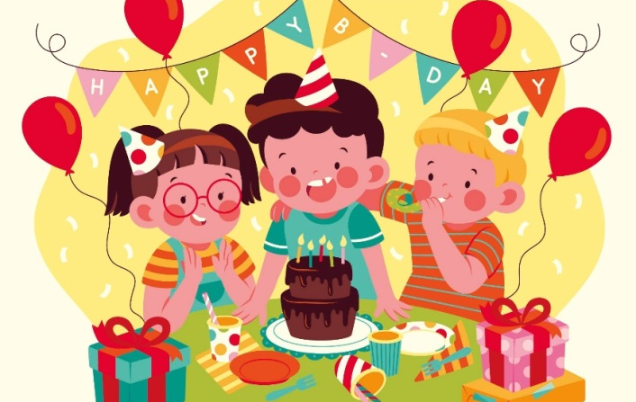
Wednesday, October 13th 2023
My birthday party
Unit
4
Lesson 2 (4+5+6)

Slide 2
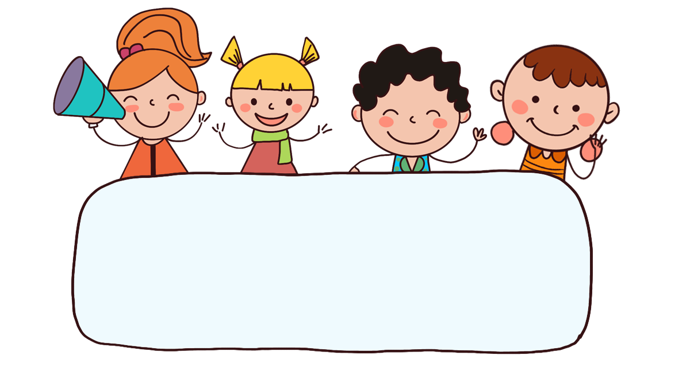
Warm-up

Slide 3
FEEDING GOLDFISH
Mỗi câu trả lời đúng là
CÂU THẦN CHÚ giúp cá Vàng
ngoi lên mặt nước nhận thức ăn.
Nào chúng mình cùng giúp
bạn nhỏ cho cá Vàng ăn nhé!
START

Slide 4
Next
gr___s
A. ape
B. ate
C. epa
Notes:
Facebook : Bùi Liễu
Mobile phone: 0968142780

Slide 5
lemo____
Next
A. neda
B. nake
C. nade

Slide 6
___ce
Next
A. gui
B. jui
C. juz
Notes:
Facebook : Bùi Liễu
Mobile phone: 0968142780

Slide 7
Next
__ips
A. tr
B. ch
C. cr
Notes:
Facebook : Bùi Liễu
Mobile phone: 0968142780

Slide 8
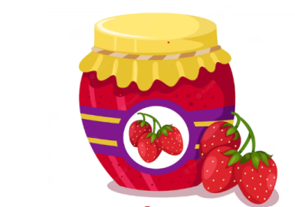
What do you want to eat?
Next
A. I want some jam.
B. I want some juice.
C. I want some chips.
Notes:
Facebook : Bùi Liễu
Mobile phone: 0968142780

Slide 9
What do you want to drink?
Next
A. I want some juice.
B. I want some lemonade.
C. I want some jam.
Notes:
Facebook : Bùi Liễu
Mobile phone: 0968142780

Slide 10
What do you want to eat?
Next
A. I want some grapes.
B. I want some chips.

Slide 11
_____ do you want to eat?
I want some water.
Next
A. When
B. What
C. Why
Notes:
Facebook : Bùi Liễu
Mobile phone: 0968142780

Slide 12
A: What do you want to ______?
B: I want some lemonade.
Next
A. like
B. eat
C. drink

Slide 13
A: What do you want to ______?
B: I want some grapes.
Next
A. eat
B. drink
C. like
Notes:
Facebook : Bùi Liễu
Mobile phone: 0968142780

Slide 14
THANK YOU!
Next
Notes:
Facebook : Bùi Liễu
Mobile phone: 0968142780

Slide 15
Contents
4
5
6
Listen and tick.
Look, complete and read.
Let’s play.

Slide 16
4. Listen and tick.
1.
2.
a
b
a
b

Slide 17
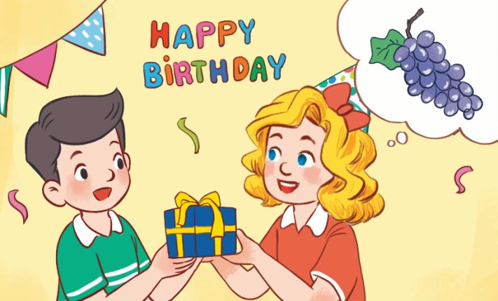
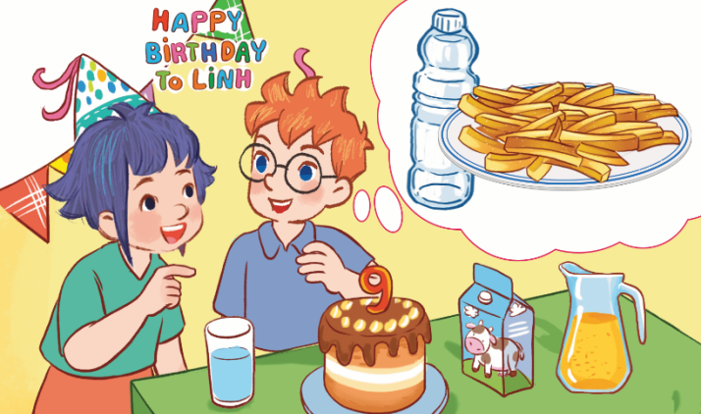
5. Look, complete and read.
1.
A: Happy birthday, Nam!
B: Thank you. _________ do you want to eat, Mary?
A: I want some __________.
What
grapes
2.
drink
A: What do you want to ______, Ben?
B: I want some water.
A: What do you want to eat?
B: I want some ________.
chips

Slide 18
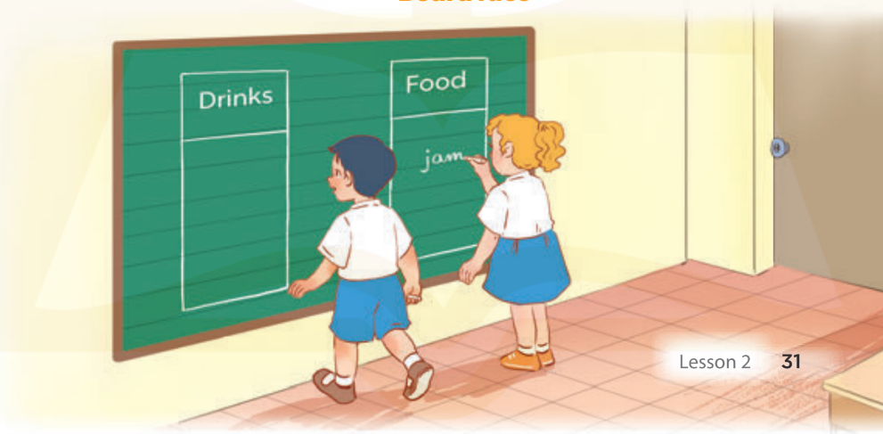
6. Let’s play.
Board race

Slide 19
Wrap up

Slide 20
Unit 4 Lesson 2
What do you want to eat / drink?
I want ________.
Bùi Liễu 0968142780

Slide 21
Homework
Learn by heart all the new words.
Read again the dialogue in part 1.

Slide 22
Thank you!

