Slide 1
Welcome to our class

Slide 2
Find the following words in the word search
N
N | E | I | G | H | B | O | U | R | H | O | O | D | S | L | X
S | E | N | S | E | O | F | C | O | M | M | U | N | I | T | Y
H | D | U | S | M | A | R | T | C | I | T | Y | W | H | E | O
U | E | F | N | E | C | O | F | R | I | E | N | D | L | Y | U
R | V | O | V | B | I | E | N | C | D | W | E | L | L | E | R
K | I | P | R | I | V | A | C | Y | J | C | A | M | E | R | A
Y | C | B | L | U | S | E | N | S | O | R | L | N | O | U | S
B | E | T | I | N | T | E | R | A | C | T | V | E | C | I | T
S
D
S
E
D
P
C
S
I

Slide 3
UNIT 3: CITIES OF THE FUTURE
Lesson 5: Listening
Living in a smart city

Slide 4
PRE-LISTENING
Match the words and phrase with their meanings.
interact
privacy
sense of community
neighbourhood
an area of a town
the feeling of belonging to a group
to talk or do things with other people
the state of being alone and not watched or interrupted by other people

Slide 5







FISHING GAME
GO

Slide 6


c. to talk or do things with other people.
1. interact
a. an area of a town
b. the feeling of belonging to a group
c. to talk or do things with other people
d. the state of being alone and not watched or interrupted by other people

Slide 7
d. the state of being alone and not watched or interrupted by other people.
2. privacy
c. to talk or do things with other people.
a. an area of a town
d. the state of being alone and not watched or interrupted by other people.
b. the feeling of belonging to a group

Slide 8
b. the feeling of belonging to a group.
3. sense of community
b. the feeling of
belonging to a group
a. an area of a town
d. the state of being alone and not watched or interrupted by other people
c. to talk or do things with other people

Slide 9
a. an area of a town.
4. neighbourhood
a. an area of a town
b. the feeling of belonging to a group
d. the state of being alone and not watched orinterrupted by other people
c. to talk or do things with other people

Slide 10
PRE-LISTENING
Match the words and phrase with their meanings.
interact
privacy
sense of community
neighbourhood
an area of a town
the feeling of belonging to a group
to talk or do things with other people
the state of being alone and not watched or interrupted by other people

Slide 11
Read the following statements and put them in the right column:
Modern technologies are used to support people better.
2. Eco – friendy infrastructure will reduce greenhouse gas emissions.
3. People don’t have sense of community .
4. Smart devices help cities operate more efficiently .
5. People have limited privacy due to the cameras installed everywhere in the city.
6. People will use public transport instead of their own vehicles.
7. Some city dwellers can’t use smart devices.
8. Cities will include a lot of green space.
Advantages | Disadvantages
1- 2- 4- 6- 8
3- 5- 7

Slide 12

2. Listen to an interview and choose the correct answers A, B, or C.
What is the interview mainly about?
A. Advantages of living in a smart city.
B. Problems of living in a smart city.
C. Attractions of urban lifestyles.
2. How are cameras and sensors used in a smart city?
To collect information about city dwellers and their activities.
B. To collect information about the government and some companies.
C. To improve city dwellers' safety and security.
3. Why does Ms Stevens feel lonely?
Because she doesn't interact with many people.
Because she can't use the smart devices.
Because she doesn't like her neighbourhood.

Slide 13


Listen to the interview again and complete the table. Use no more than THREE words for each answer.
Situations | Problems
There are cameras and sensors everywhere. | City dwellers may lose their (1) _______________ in public areas.
People use (2) ________________ to help them with household chores. | it is not easy for some people to get familiar with and use the smart devices.
Some city dwellers (3) ____________ with each other face to face less. | There is no (4) ______________ in the neighbourhood.
right to privacy
smart technologies
sense of community
interact

Slide 14
Work in groups. Discuss the following questions.
Which of the disadvantages she mentions do you think is the most serious? Why?
Do you agree with Ms Stevens?

Slide 15
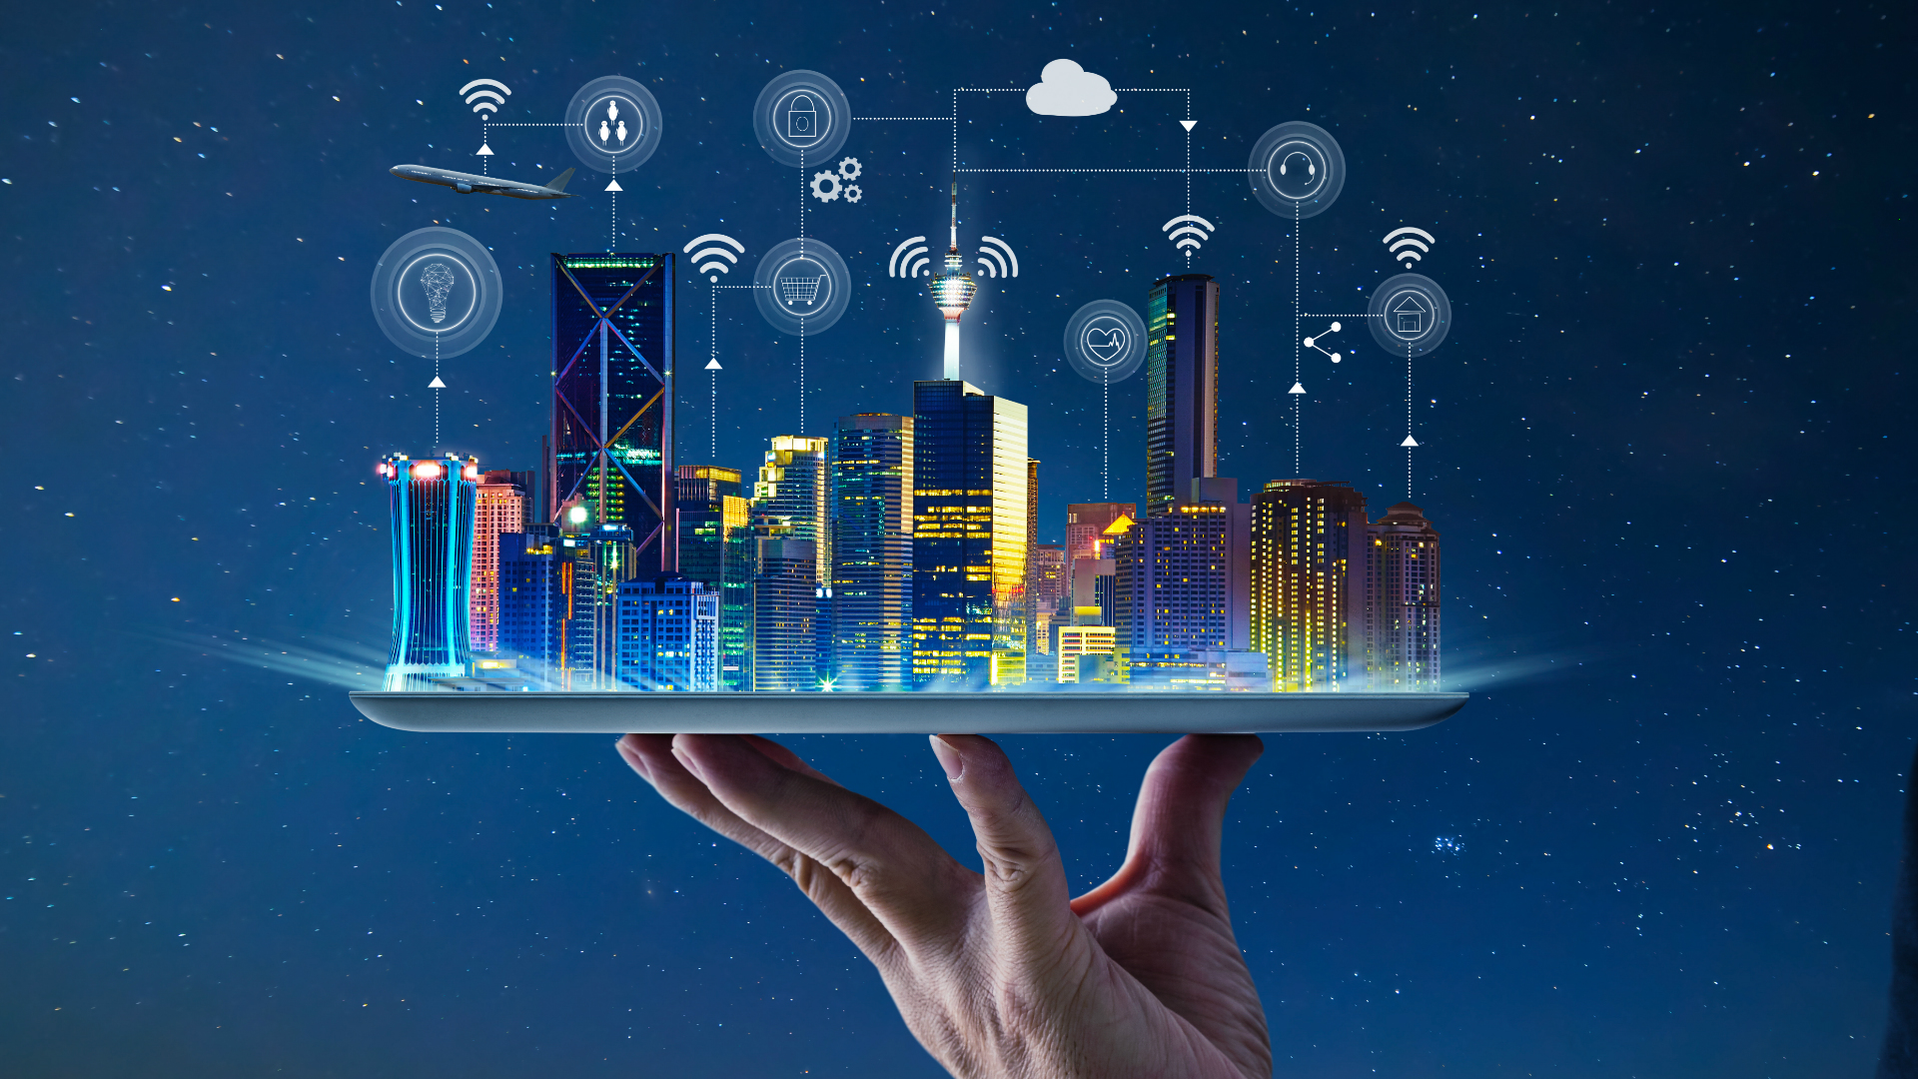

HOMEWORK
Do exercises in the workbook.
Prepare for Lesson 6 - Unit 3.

Slide 16
THANK YOU FOR YOUR LISTENING

