Slide 1


4 WORDS
1 ANSWER
Notes:
✅ "Good morning everyone! So today, we welcome Mrs. Nga to our class. Okay, clap your hands to welcome her!"
How are you all today? Are you happy, sleepy, or tired? I would like to show you a small activity to help you wake up. Do you want to play a game?

Slide 2

I will show you 4 words.

Slide 3
Guess the secret word from the 4 words and answer.

Slide 4

animal
brown
Ex
jump
Australia
Notes:
I have four words here. I will show them **one by one**, and you will guess the hidden word. 😊

Slide 5


kangaroo

Slide 6
If you want to guess, raise your hand.

Slide 7
LET’S PLAY!

Slide 8

students
teachers
1
class
study
Notes:
This is a place where you can learn everyday.

Slide 9

SCHOOL

Slide 10

clean
cook
2
wash
home
Notes:
You can do it everyday at home. do you have the answer yet?

Slide 11

HOUSEHOLD CHORE

Slide 12

alone
strong
3
free
no help

Slide 13

INDEPENDENCE
Notes:
This is one vocabulary you just learned before.

Slide 14

balance
time
4
schedule
skill
Notes:
This is a skill related to time.

Slide 15

TIME MANAGEMENT

Slide 16
knowledge
alone
5
learn
no teacher

Slide 17
SELF - STUDY
Notes:
We just played a game about many skills in your life, right?

Slide 18




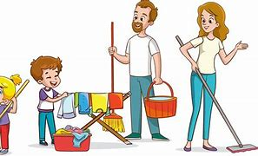
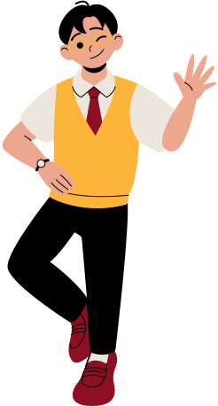
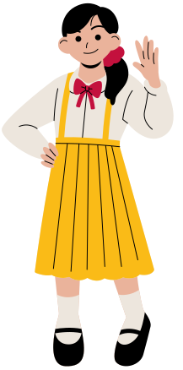
Basic life skills
Notes:
all of them are basic life skills, so today we will explore how to learn basic life skills. I belive that it play a vital role in you life.

Slide 19
UNIT 8: BECOMING INDEPENDENT
Lesson 4: SPEAKING
Learning basic life skills
Notes:
before we learn the lesson, I would like to show you some vocabulary

Slide 20


load (v)
/ləʊd/
đưa vào
To put things into a machine, vehicle, or container.
She is loading clothes into the washing machine.
Notes:
"When you want to wash clothes, the first step is to load them into the washing machine."

Slide 21
washing powder (n)
/ˈwɑːʃɪŋ paʊdər/
bột giặt
soap or detergent in the form of powder for washing clothes
Notes:
after loading the clothes, you need to add washing powder to the washing machine.

Slide 22
lấy ra, dời đi
remove (v)
/rɪˈmuːv/
to take somebody/something away from a place
Notes:
"After the washing machine has finished, what should you do next?"
"You should remove the clothes from the washing machine."

Slide 23
hang (v)
/hæŋ/
treo, phơi
To attach or suspend something from a higher position so that it does not touch the ground.
She is hanging the clothes.
Notes:
When the clothes have been removes from the washing machine, you should hang them under the sunlight to dry.
When your mother finishes washing the clothes, you should help her hang them. It is a good way to share housework in your family.

Slide 24
phân loại
sort (v)
/ˌsɔːrt/
to put a number of things in an order or to separate them into groups
She is sorting the clothes.
Notes:
When the clothes have dried, you need to sort them and put them into a clothing box.
We have just learned some vocabulary about how to wash clothes. Now, I want to show you some tips to help you describe the steps for washing clothes.

Slide 25

Tips
To give instructions, you should use:
the imperative form of the verb. Example: Don’t .../ Avoid .../ Make sure ...
Don’t open the lid while cooking.
modal verbs.
Example: You could .../ You should .../ You mustn’t ...
You should measure the water carefully.
linking words or phrases.
Example: First,/ To begin with,/ First of all,... Second,/ Secondly, ...
Then,/After that,/In addtion, ...
Last but not least,/Finally, ...
To begin with, measure the rice and water in the correct ratio.
Notes:
When you want to teach someone anything, you should teach them carefully and clearly so they can understand it. Here are some tips to help you give instructions clearly.
After modal verbs, you should use the bare infinitive form of the verb
"We have just learned some structures. I think they will be very helpful for you. Now, let's explore the next part to see them in a particular context. Task 1."

Slide 26
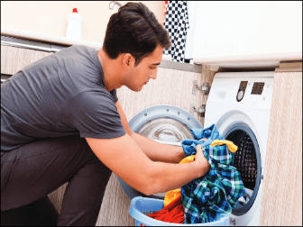
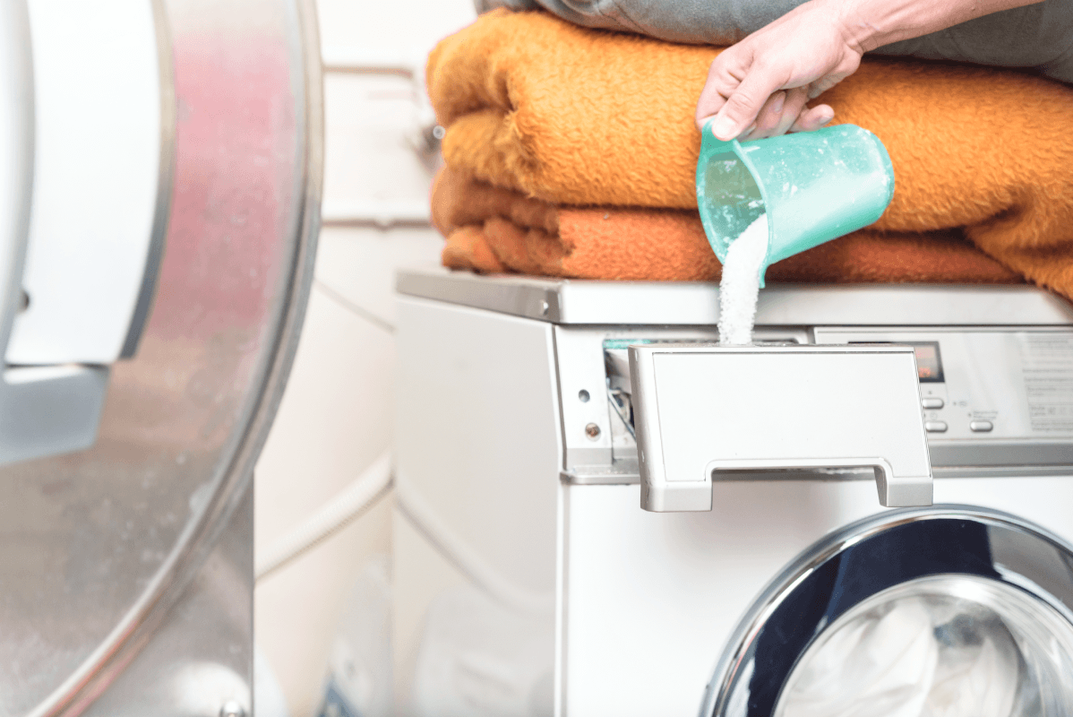

What is the man doing?
Notes:
✅ "Look at these pictures. What can you see in these pictures?"
✅ "A man, a washing machine, ..."
✅ "OK, so can you tell me what the man is doing?"

Slide 27

Task 1:
Work in pairs . Discuss these questions.
a. Have you ever done your laundry? If yes, how did you do it?
Notes:
✅ "So, have you ever done your laundry?
✅ You have 2 minutes to discuss this question. Work in pairs."
✅ "OK. All of you have different ways to wash clothes, right?"
✅ "Now, we will explore the basic way of washing clothes in the next question. Student A: I’ve never done the laundry so I don't know how to do it. How about you? Student B: I do the laundry sometimes. It's actually quite easy. You just need to put the clothes into the washing machine along with the detergent. Then, remember to turn it on and hang the clothes to dry once the machine is done.

Slide 28
Task 1:
Work in pairs. Discuss these questions.
b. Below are some steps to do laundry. Put them in the correct order.
B
D
E
C
A
1. _____
2. _____
3. _____
4. _____
5. _____
A. Hang or fold, and store your own clothes
B. Sort the clothes by colour
C. Remove the wet clothes from the washing machine and dry them
D. Add the washing powder or liquid
E. Load the washing machine and turn it on
Notes:
We have just talked about some simple ways to wash clothes. Here is a diagram that shows the full process of washing clothes.
How many steps are there to do laundry, everyone? There are 5 steps.
So, I would like you to arrange these 5 steps in the correct order.
Great job, everyone! You did very well.
Now that we have learned the process of washing clothes, let's move on to Task 2 to learn how to describe the process in detail.

Slide 29

Task 2:
Read the following instructions on how to do laundry. Circle the correct answers.
There are several simple steps in doing laundry. First of all, (1) sort / don’t sort your clothes by colour. You should separate them into whites and colours and wash them separately. (2) Secondly / Finally, add the washing powder or liquid. Read the instructions on the packet to make sure you use the right amount. Then, (3) load / you load the washing machine and turn it on. Make sure you place the items one at a time. Don’t put too many items as they need room to move about in the water. When the washing machine stops, (4) remove / you will remove the wet clothes. You can hang the items to dry, or put them in the dryer. Remember that air-drying clothes saves energy and money. (5) Finally / Afterwards, don’t forget to hang or fold each item. You could also iron your clothes before storing them in the wardrobe or drawer.
Notes:
here is a model process, but we need to choose the correct answer for five options here.
So I think it very easy for you. you can look at the tips again to chooose the best answer, ok
Ok, everyone lets do it.

Slide 30
Task 2:
Read the following instructions on how to do laundry. Circle the correct answers.
There are several simple steps in doing laundry. First of all, (1) sort your clothes by colour. You should separate them into whites and colours and wash them separately. (2) Secondly / Finally, add the washing powder or liquid. Read the instructions on the packet to make sure you use the right amount. Then, (3) load / you load the washing machine and turn it on. Make sure you place the items one at a time. Don’t put too many items as they need room to move about in the water. When the washing machine stops, (4) remove / you will remove the wet clothes. You can hang the items to dry, or put them in the dryer. Remember that air-drying clothes saves energy and money. (5) Finally / Afterwards, don’t forget to hang or fold each item. You could also iron your clothes before storing them in the wardrobe or drawer.
Notes:
You should sort your clothes by color to avoid discoloration

Slide 31
Task 2:
Read the following instructions on how to do laundry. Circle the correct answers.
There are several simple steps in doing laundry. First of all, (1) sort your clothes by colour. You should separate them into whites and colours and wash them separately. (2) Secondly, add the washing powder or liquid. Read the instructions on the packet to make sure you use the right amount. Then, (3) load / you load the washing machine and turn it on. Make sure you place the items one at a time. Don’t put too many items as they need room to move about in the water. When the washing machine stops, (4) remove / you will remove the wet clothes. You can hang the items to dry, or put them in the dryer. Remember that air-drying clothes saves energy and money. (5) Finally / Afterwards, don’t forget to hang or fold each item. You could also iron your clothes before storing them in the wardrobe or drawer.
Notes:
So, you can see the first step here. What is the next step?
Yes, of course! It can't be "finally", it should be "secondly."

Slide 32
Task 2:
Read the following instructions on how to do laundry. Circle the correct answers.
There are several simple steps in doing laundry. First of all, (1) sort your clothes by colour. You should separate them into whites and colours and wash them separately. (2) Secondly, add the washing powder or liquid. Read the instructions on the packet to make sure you use the right amount. Then, (3) load the washing machine and turn it on. Make sure you place the items one at a time. Don’t put too many items as they need room to move about in the water. When the washing machine stops,
(4) remove / you will remove the wet clothes. You can hang the items to dry, or put them in the dryer. Remember that air-drying clothes saves energy and money. (5) Finally / Afterwards, don’t forget to hang or fold each item. You could also iron your clothes before storing them in the wardrobe or drawer.
Notes:
So, what does it mean in this sentence?
Could you translate it into Vietnamese?

Slide 33
Task 2:
Read the following instructions on how to do laundry. Circle the correct answers.
There are several simple steps in doing laundry. First of all, (1) sort your clothes by colour. You should separate them into whites and colours and wash them separately. (2) Secondly, add the washing powder or liquid. Read the instructions on the packet to make sure you use the right amount. Then, (3) load the washing machine and turn it on. Make sure you place the items one at a time. Don’t put too many items as they need room to move about in the water. When the washing machine stops,
(4) remove the wet clothes. You can hang the items to dry, or put them in the dryer. Remember that air-drying clothes saves energy and money.
(5) Finally / Afterwards, don’t forget to hang or fold each item. You could also iron your clothes before storing them in the wardrobe or drawer.

Slide 34
Task 2:
Read the following instructions on how to do laundry. Circle the correct answers.
There are several simple steps in doing laundry. First of all, (1) sort your clothes by colour. You should separate them into whites and colours and wash them separately. (2) Secondly, add the washing powder or liquid. Read the instructions on the packet to make sure you use the right amount. Then, (3) load the washing machine and turn it on. Make sure you place the items one at a time. Don’t put too many items as they need room to move about in the water. When the washing machine stops,
(4) remove the wet clothes. You can hang the items to dry, or put them in the dryer. Remember that air-drying clothes saves energy and money.
(5) Finally, don’t forget to hang or fold each item. You could also iron your clothes before storing them in the wardrobe or drawer.
Notes:
All of you did very well on this task about how to do laundry. Now, we will explore another household chore: cooking rice.

Slide 35
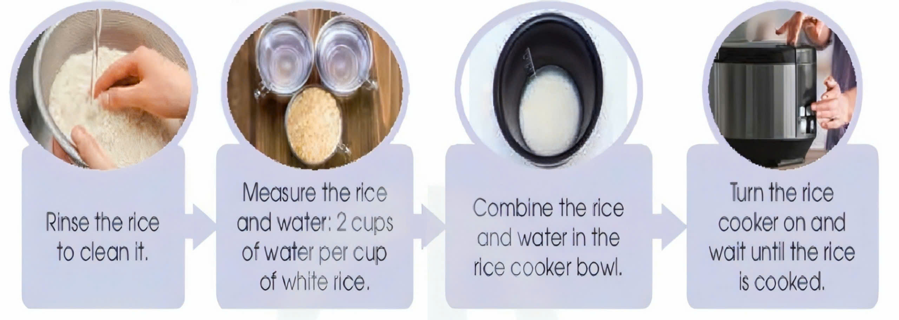
Task 3:Work in pairs. Read the steps in cooking rice in a rice cooker. Use the model in 2 and the tips above to give instructions.
Notes:
"Ok, we have seen a model of the correct laundry process. Now, I would like to show you a diagram that describes how to cook rice properly. You can base it on the model passage in Task 2."
You have 4 mins to do this task! let’s do it!

Slide 36
Tips
To give instructions, you should use:
the imperative form of the verb. Example: Don’t .../ Avoid .../ Make sure ...
Don’t open the lid while cooking.
modal verbs.
Example: You could .../ You should .../ You mustn’t ...
You should measure the water carefully.
linking words or phrases.
Example: First,/ To begin with,/ First of all,... Second,/ Secondly, ...
Then,/After that,/In addtion, ...
Last but not least,/Finally, ...
To begin with, measure the rice and water in the correct ratio.
Notes:
You can use the tips we learned before.

Slide 37
Task 3:Work in pairs. Read the steps in cooking rice in a rice cooker. Use the model in 2 and the tips above to give instructions.
Notes:
"Ok, we have seen a model of the correct laundry process. Now, I would like to show you a diagram that describes how to cook rice properly. You can base it on the model passage in Task 2."
You have 4 mins to do this task! let’s do it!

Slide 38
Task 4: Work in groups. Add more steps or tips, and report to the whole class. Vote for the best recipe for cooking rice in a rice cooker.
Notes:
You can add more ideas anywhere you like, depending on your own way of cooking rice.
I would love to see new rice recipes from all of you
! 😊 I will divide the class into groups to discuss and add more ideas to your recipes.
You will discuss for 5 minutes. After that, I will call on some groups to present their ideas.
The most exciting part is that we will vote for the most creative group by raising our hands.

Slide 39








Wrap-up
What have we learned in the lesson today?
How to learn basic life skills
Notes:
"You are in grade 11, right? So, you should learn basic life skills such as cooking rice, doing laundry, or simply sweeping the floor by yourself because you have only one year left before going to university and living far away from your family. I think these skills play a vital role, an important role in your life. Let's try it!"

Slide 40

HOMEWORK
Learn by heart the vocabulary
Do exercises in the workbook
Prepare for the next lesson 5
- Listening
Notes:
"You are in grade 11, right? So, you should learn basic life skills such as cooking rice, doing laundry, or simply sweeping the floor by yourself because you have only one year left before going to university and living far away from your family. I think these skills play a vital role, an important role in your life. Let's try it!"

