Slide 1


Notes:
This template is for educational, non-commercial purposes only. For more free game templates like this one, visit https://www.taysteachingtoolkit.com

Slide 2

CHOOSE A NUMBER &
ANSWER A QUESTION

Slide 3


IF IT’S RIGHT, YOU CAN
PLAY A CARD GAME
+4 POINTS
+4 POINTS

Slide 4
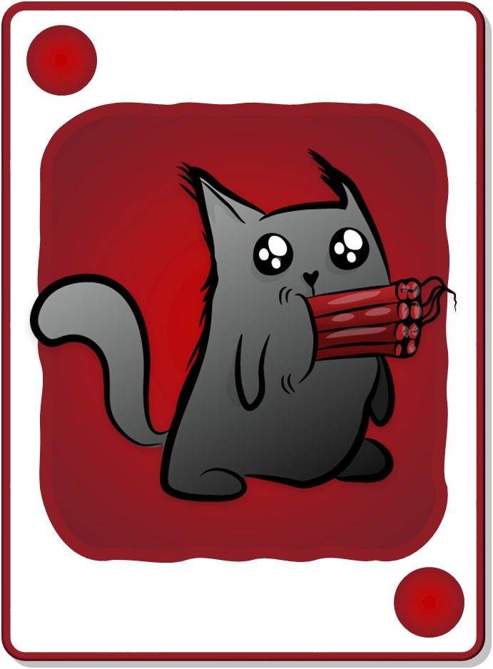

KEEP THE POINTS
OR
DRAW AGAIN FOR MORE!
+2 POINTS
+4 POINTS
Take 6 points
Take 4 points
Draw again
+4 POINTS
+2 POINTS

Slide 5
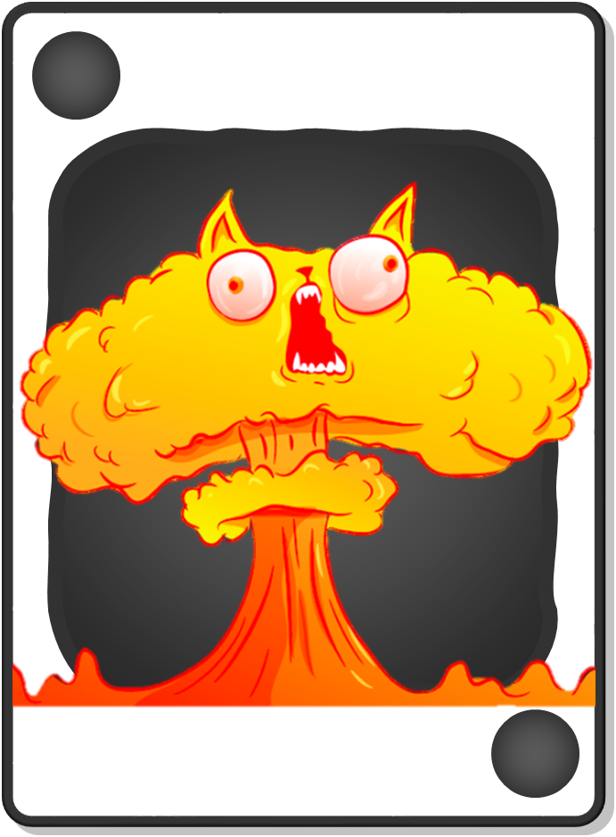
BEWARE!
IF YOU FIND A BOMB,
YOU GET 0 POINTS.
+2 POINTS
BOMB!
Take 6 points
Draw again
+2 POINTS
BOMB!
Notes:
game over = their turn is over and they get no points for their turn

Slide 6

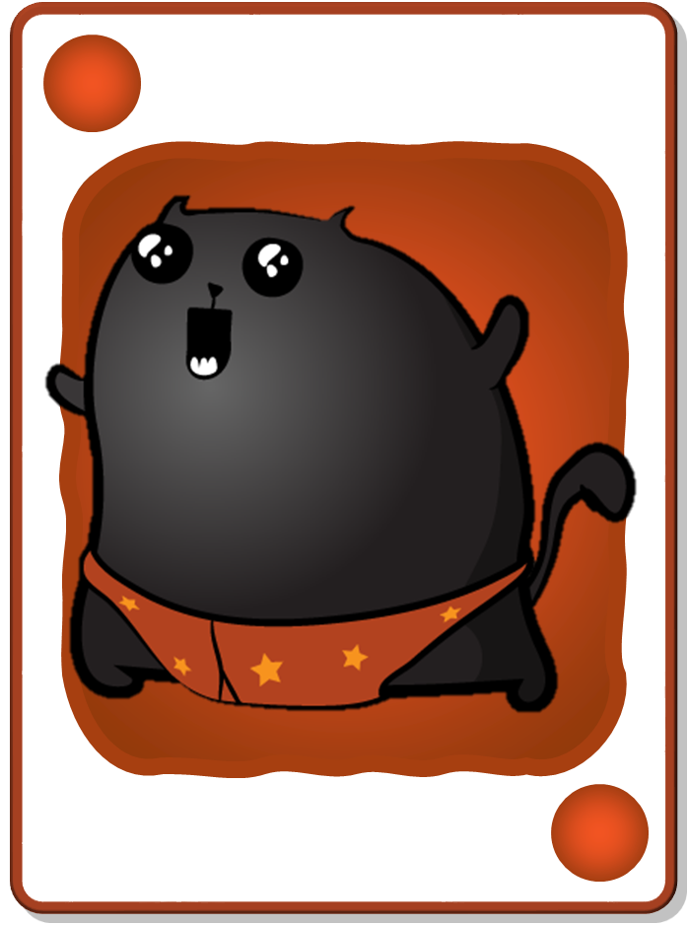
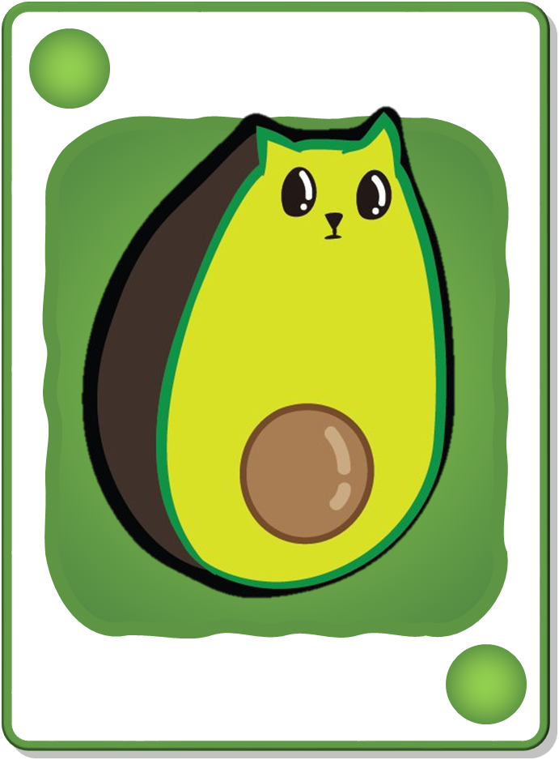
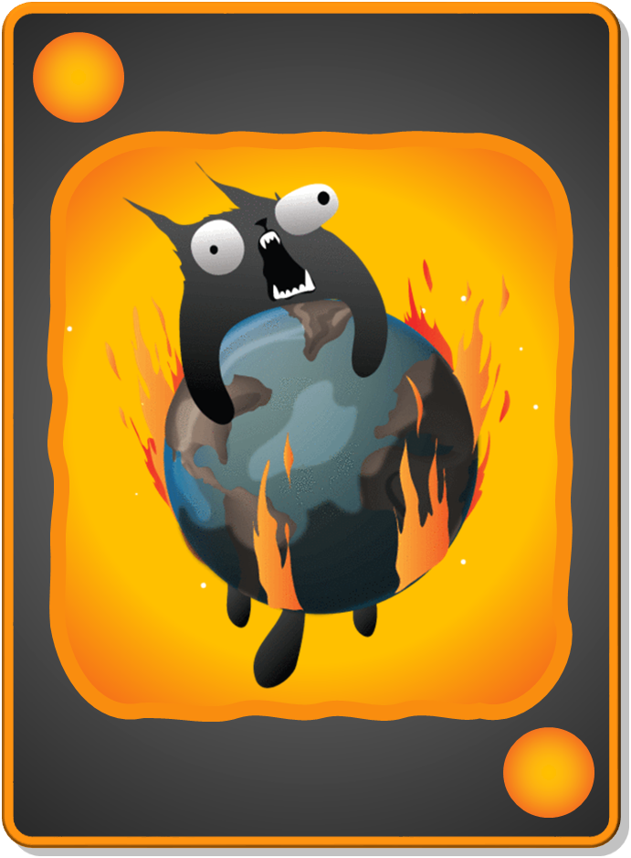
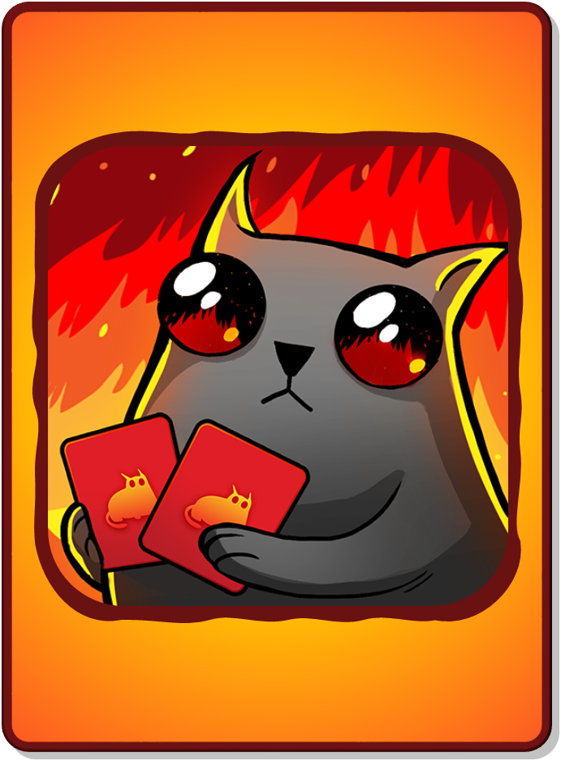
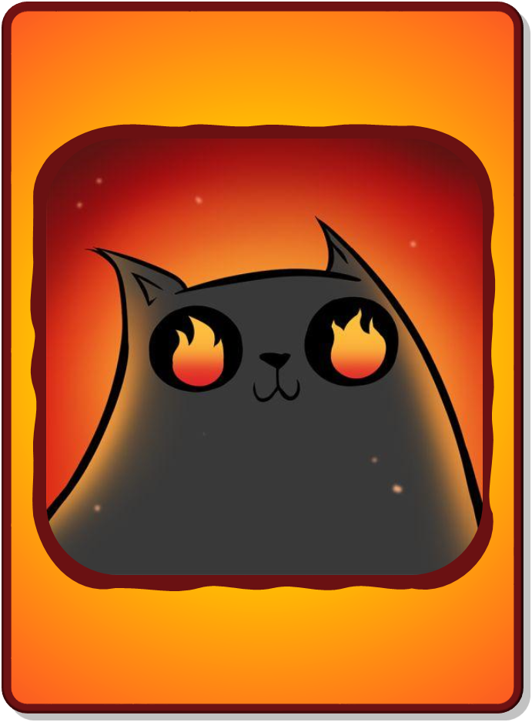
DECK CARDS
+1 POINT
+2 POINTS
+3 POINTS
+4 POINTS
+5 POINTS
BOMB!
NUCLEAR!
+1 POINT
+2 POINTS
+3 POINTS
+4 POINTS
+5 POINTS
BOMB!
NUCLEAR!
All teams lose
all points!
LOSE ALL POINTS!
CHANGE POINTS!
RARE CARDS
Only your team
loses all points!
LSOE ALL POINTS!
CHANGE POINTS!
Notes:
“Rare cards” cannot be found in the decks where students accumulate points. They’re a separate reward event (see reward slides for details).

Slide 7

1
2
CHOOSE A NUMBER
3
4
5
6
Notes:
A student/team chooses a letter.
Click the letter they choose to go to the corresponding question slide.

Slide 8





CHOOSE THE CORRECT ANSWER:
What is it called when people live without a stable home
or shelter?
A. homelessness
B. unemployment
C. pollution
A. Homelessness
Notes:
Click the spacebar to make the ANSWER appear.
The blank space in the middle is for any extra text/images you need.
Click the green button to go to the reward slide.
Click the red button to go back to the question-choosing slide.
Background wood texture by vector.satrian on https://www.vecteezy.com

Slide 9
CHOOSE THE CORRECT ANSWER:
What is the unfair treatment of people based on race, gender
or religion called?
A. education
B. pollution
C. discrimination
C. discrimination
Notes:
Click the spacebar to make the ANSWER appear.
The blank space in the middle is for any extra text/images you need.
Click the green button to go to the reward slide.
Click the red button to go back to the question-choosing slide.
Background wood texture by vector.satrian on https://www.vecteezy.com

Slide 10
CHOOSE THE CORRECT ANSWER:
What do we call the lack of jobs in a society?
A. overpopulation
B. poverty
C. unemployment
C. unemployment
Notes:
Click the spacebar to make the ANSWER appear.
The blank space in the middle is for any extra text/images you need.
Click the green button to go to the reward slide.
Click the red button to go back to the question-choosing slide.
Background wood texture by vector.satrian on https://www.vecteezy.com

Slide 11
CHOOSE THE CORRECT ANSWER:
What social issue occurs when people do not have enough money to meet basic needs?
A. wealth
B. poverty
C. tourism
B. poverty
Notes:
Click the spacebar to make the ANSWER appear.
The blank space in the middle is for any extra text/images you need.
Click the green button to go to the reward slide.
Click the red button to go back to the question-choosing slide.
Background wood texture by vector.satrian on https://www.vecteezy.com

Slide 12

+4 POINTS
BOMB!
+3 POINTS
+3 POINTS
Total Points:
0
3
7
10
+3 POINTS
+3 POINTS
+4 POINTS
BOMB!
Notes:
Press the spacebar to reveal the first card.
Ask the student/team if they want to take the total points they have so far or draw again to possibly add more points.
I usually have my students say “keep going” (draw again) or “stop” (take the points they’ve accumulated).
Repeat this process until they either decide to take their accumulated points or reach a Bomb or Nuclear card.
Click the ABC Cat icon in the right-hand corner to go back the question-choosing slide.
Background wood texture by vector.satrian on https://www.vecteezy.com

Slide 13


CHANGE POINTS!
YOU FOUND A RARE CARD!
Reveal it
or get 5 points?
CHANGE POINTS!
Notes:
The student/team has a choice: They can either get 5 points or take a chance and reveal the rare card, from which they will either lose all their points or get to change points with another team.
Press the spacebar to reveal the card, if they choose that option.
Click the ABC Cat icon in the right-hand corner to go back the question-choosing slide.
Background wood texture by vector.satrian on https://www.vecteezy.com

Slide 14
NUCLEAR!
+4 POINTS
+2 POINTS
+2 POINTS
+1 POINT
+3 POINTS
+3 POINTS
Total Points:
0
2
6
7
9
15
12
+3 POINTS
+3 POINTS
+1 POINT
+4 POINTS
NUCLEAR!
+2 POINTS
+2 POINTS
Notes:
Press the spacebar to reveal the first card.
Ask the student/team if they want to take the total points they have so far or draw again to possibly add more points.
I usually have my students say “keep going” (draw again) or “stop” (take the points they’ve accumulated).
Repeat this process until they either decide to take their accumulated points or reach a Bomb or Nuclear card.
Click the ABC Cat icon in the right-hand corner to go back the question-choosing slide.
Background wood texture by vector.satrian on https://www.vecteezy.com

Slide 15
+1 POINT
+1 POINT
+1 POINT
BOMB!
Total Points:
0
1
2
3
+1 POINT
+1 POINT
+1 POINT
BOMB!
Notes:
Press the spacebar to reveal the first card.
Ask the student/team if they want to take the total points they have so far or draw again to possibly add more points.
I usually have my students say “keep going” (draw again) or “stop” (take the points they’ve accumulated).
Repeat this process until they either decide to take their accumulated points or reach a Bomb or Nuclear card.
Click the ABC Cat icon in the right-hand corner to go back the question-choosing slide.
Background wood texture by vector.satrian on https://www.vecteezy.com

Slide 16
+4 POINTS
+2 POINTS
+2 POINTS
+1 POINT
+1 POINT
+1 POINT
+1 POINT
+5 POINTS
BOMB!
+3 POINTS
Total Points:
0
3
5
7
20
13
18
11
12
19
+5 POINTS
+3 POINTS
+1 POINT
+1 POINT
+1 POINT
+1 POINT
+4 POINTS
+2 POINTS
+2 POINTS
BOMB!
Notes:
Press the spacebar to reveal the first card.
Ask the student/team if they want to take the total points they have so far or draw again to possibly add more points.
I usually have my students say “keep going” (draw again) or “stop” (take the points they’ve accumulated).
Repeat this process until they either decide to take their accumulated points or reach a Bomb or Nuclear card.
Click the ABC Cat icon in the right-hand corner to go back the question-choosing slide.
Background wood texture by vector.satrian on https://www.vecteezy.com

Slide 17
LOSE ALL POINTS!
YOU FOUND A RARE CARD!
Reveal it
or get 5 points?
LSOE ALL POINTS!
Notes:
The student/team has a choice: They can either get 5 points or take a chance and reveal the rare card, from which they will either lose all their points or get to change points with another team.
Press the spacebar to reveal the card, if they choose that option.
Click the ABC Cat icon in the right-hand corner to go back the question-choosing slide.
Background wood texture by vector.satrian on https://www.vecteezy.com

Slide 18


UNIT 9: SOCIAL ISSUES
Lesson 1: Getting Started
A social awareness club meeting

Slide 19
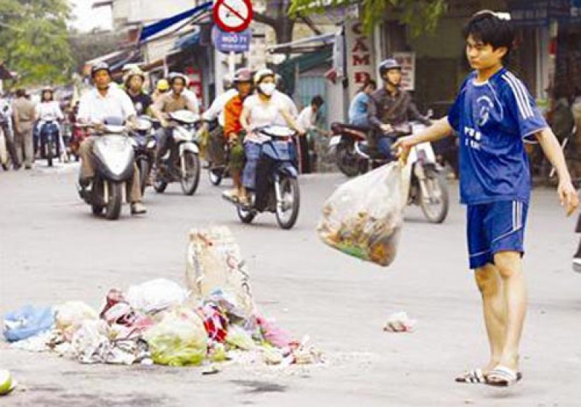
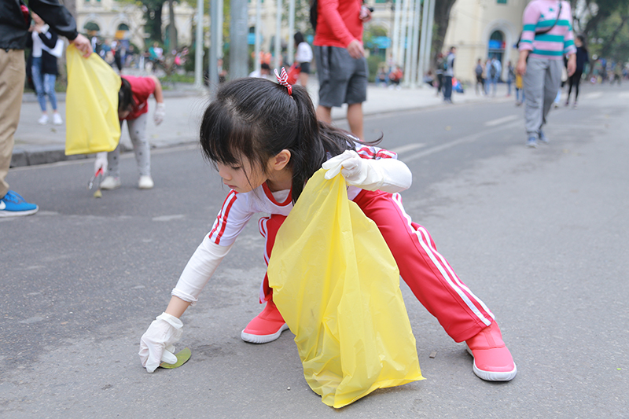
A
awareness (n)
/əˈweə.nəs/
Definition: Knowledge or understanding of a particular subject or issue.
A
B

Slide 20
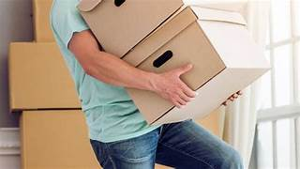
struggle with (phrasal verb)
/ˈstrʌɡ.əl wɪð/
'Struggle with' means to have difficulty handling or dealing with something

Slide 21
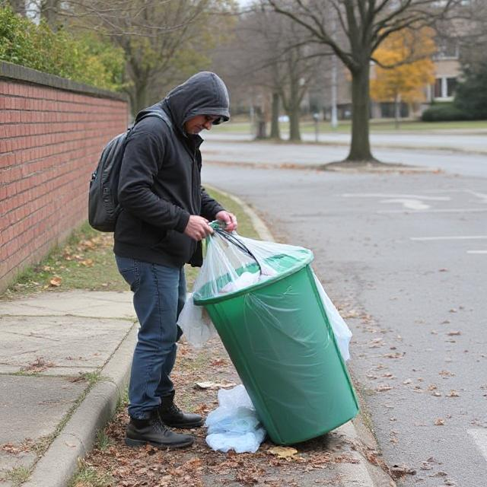
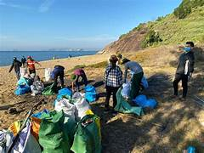
campaign (n)
/kæmˈpeɪn/
A
B

Slide 22

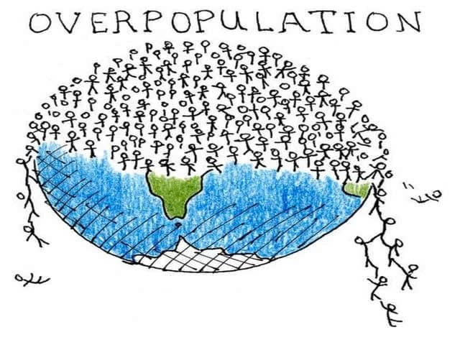
4
overpopulation (n)
/ˌəʊvərˌpɑːpjuˈleɪʃn/
2003
2025

Slide 23
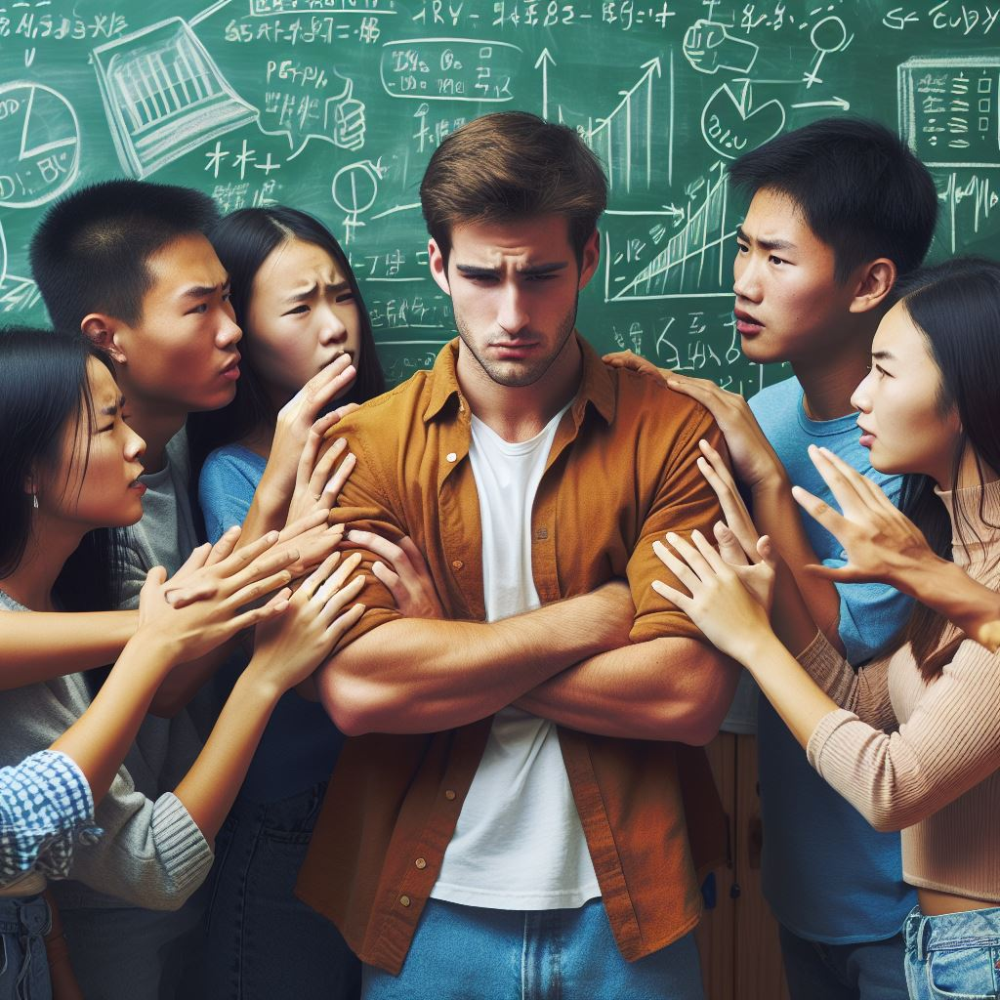
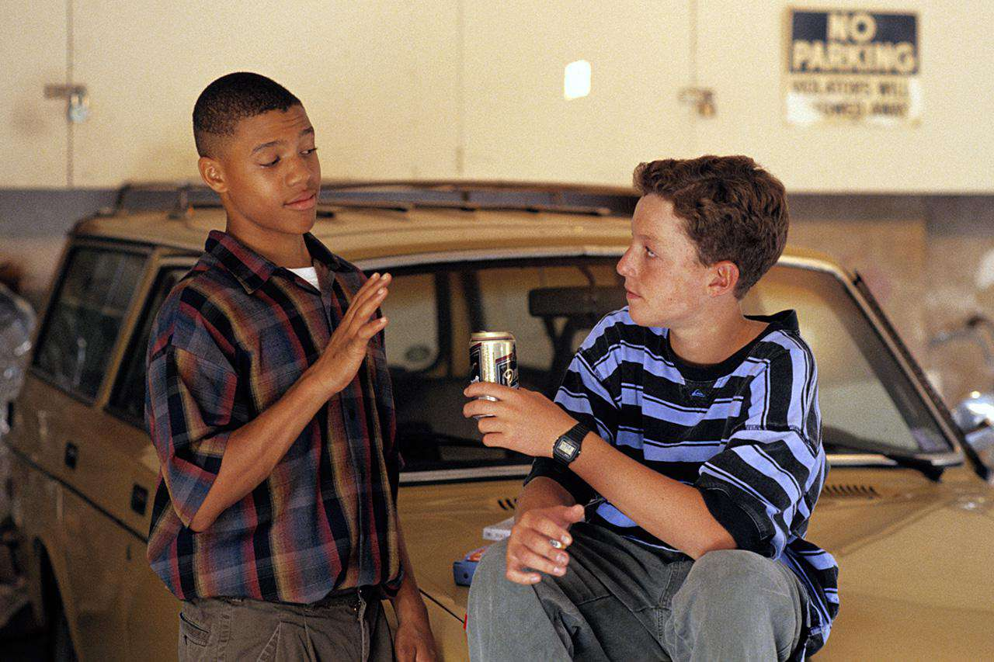
peer pressure (n)
/ˈpɪr ˌpreʃ.ɚ/
Definition : When friends or people of the same age influence you to do something,
good or bad.

Slide 24
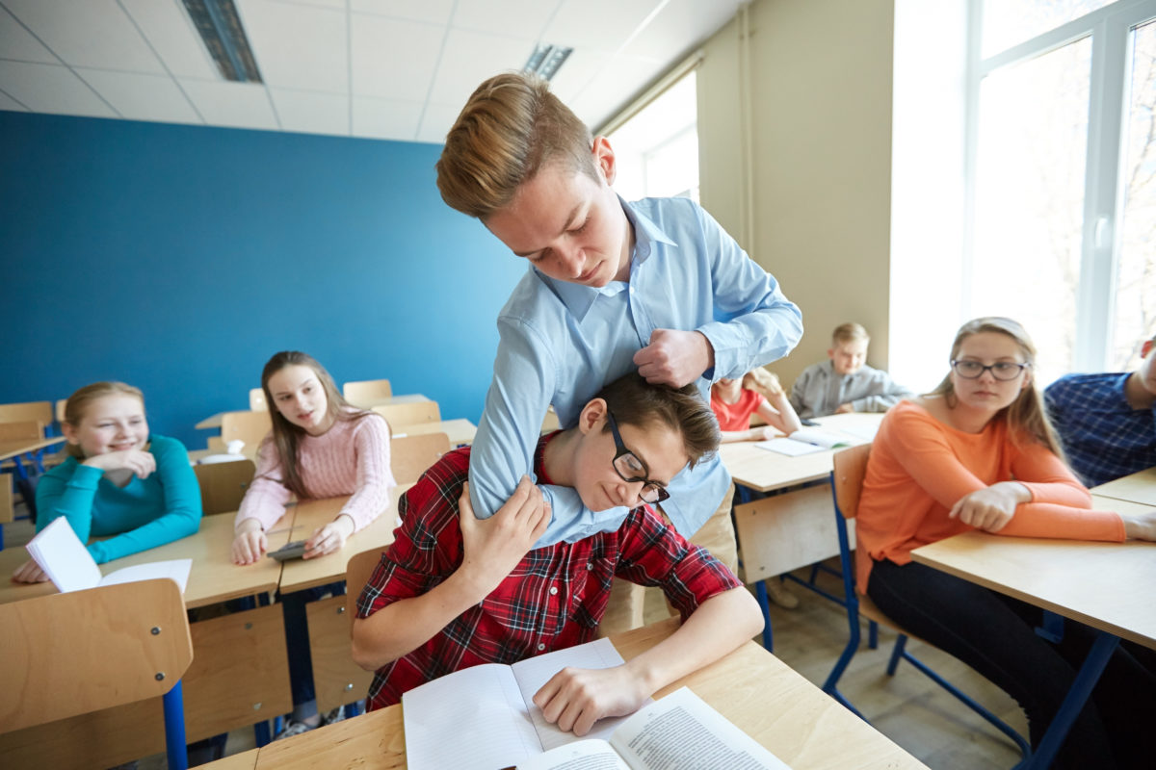
bully (v)
/ˈbʊli/

Slide 25
Fill in the gaps by using the following words
peer pressure
struggle with
campaign
overpopulation
bully
awareness
1.The government started a new ________ to encourage people to recycle.
2.Many students ________ math because they find it difficult.
3.Due to ___________, cities are becoming overcrowded and polluted.
4.She refused to smoke, even though she felt strong ___________ from her friends.
5.The teacher taught us about the importance of ________ when using social media safely.
6.We should never ________ others because it can hurt them emotionally and physically.

Slide 26
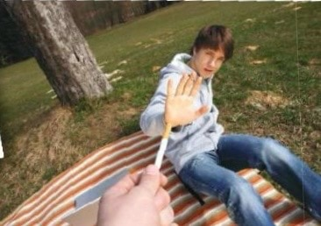
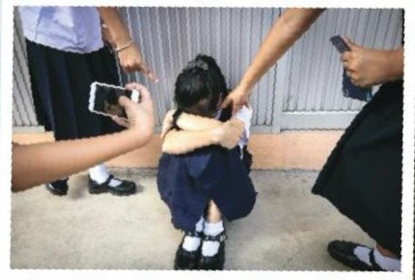
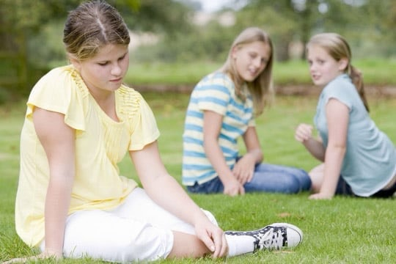

Slide 27
Task 1: Listen and read

Slide 28
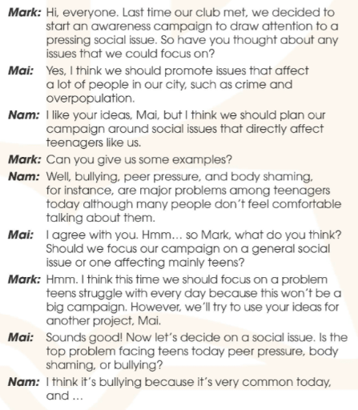

Slide 29
Task 2: Who suggests the following ideas ? Tick (✓) the correct box.

Slide 30
 | Mark | Mai | Nam
1. Issues that have an effect on many people in the city
2. Problems that have a direct impact on teens
3. An issue that teens face in their everyday life

Slide 31
 | Mark | Mai | Nam
1. Issues that have an effect on many people in the city
2. Problems that have a direct impact on teens
3. An issue that teens face in their everyday life

Slide 32
 
 | Mark | Mai | Nam
1. Issues that have an effect on many people in the city |   |  
Yes, I think we should promote issues that affect a lot of people in our city, such as crime and overpopulation.

Slide 33
 
 | Mark | Mai | Nam
2. Problems that have a direct impact on teens |   |  
I like your ideas, Mai, but I think we should plan our campaign around social issues that directly affect teenagers like us.

Slide 34
 
 | Mark | Mai | Nam
3. An issue that teens face in their everyday life |   |  
Hmm. I think this time we should focus on a problem teens struggle with every day because this won't be a big campaign.

Slide 35
Task 3: Guess five social issues in task 1 based on the pictures below.

Slide 36

1. overpopulation

Slide 37
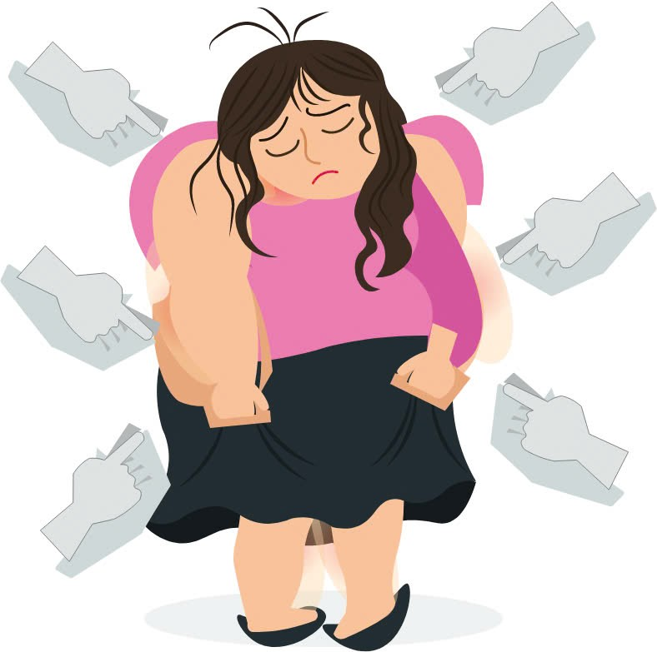
2. body shaming

Slide 38
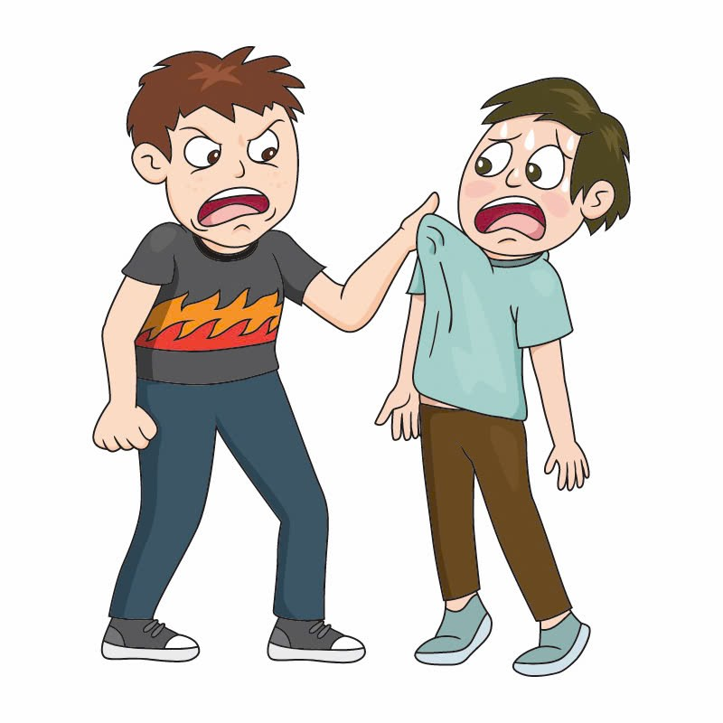
3. bully

Slide 39
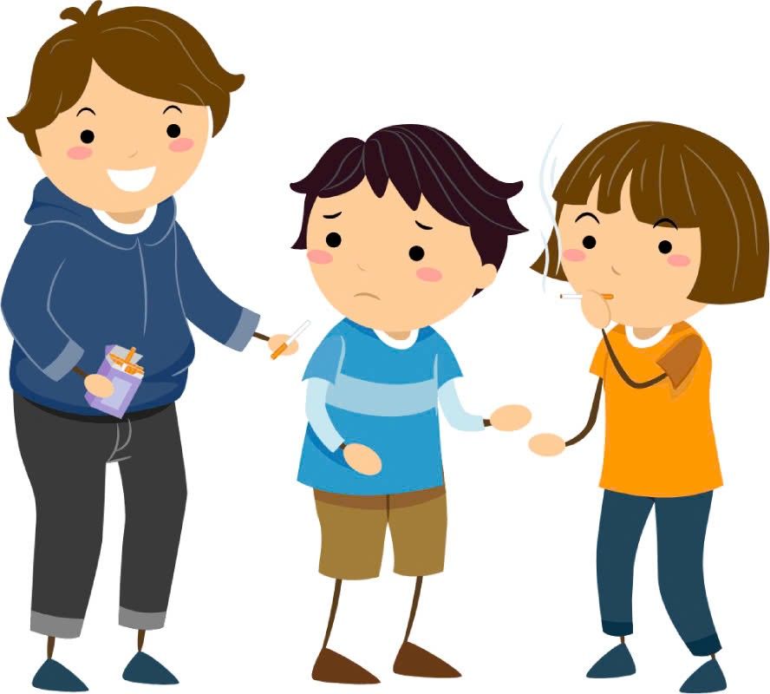
4. peer pressure

Slide 40
Task 4: Complete the summary with words from 1.

Slide 41
Nam believes that there are major teen problems today (1)_______ many people don't feel comfortable talking about them. Mai agrees with him. Mark thinks they should focus on a problem teens struggle with every day. (2)______, they'll try to use Mai's ideas for another project. Finally, Nam suggests focusing their campaign on bullying (3)______ this issue is very common among teenagers these days.
although
However
because

Slide 42
Task 5: Can you think of other issues that exist in your school ? What can we do to stop them or help the victims?

Slide 43
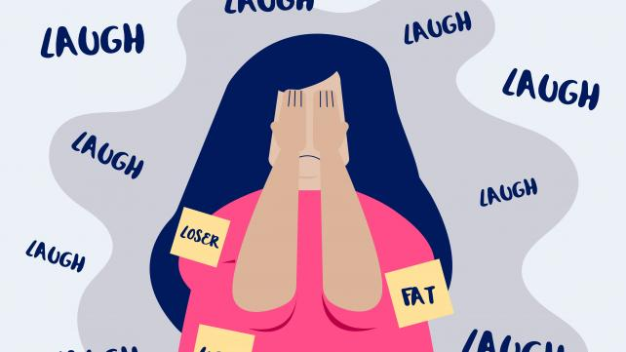
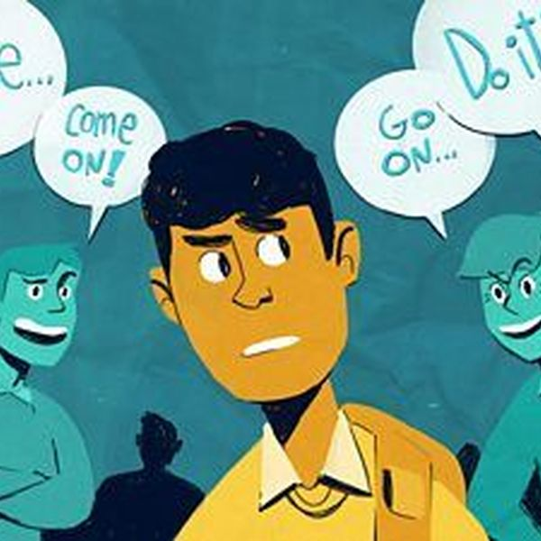
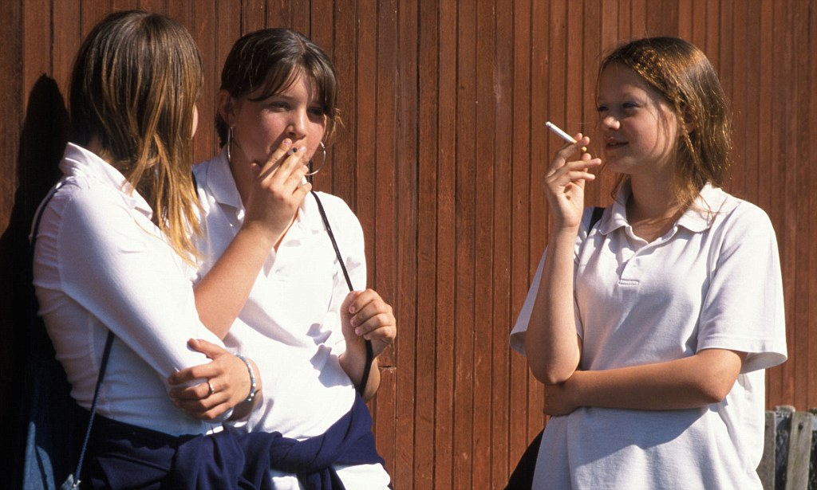
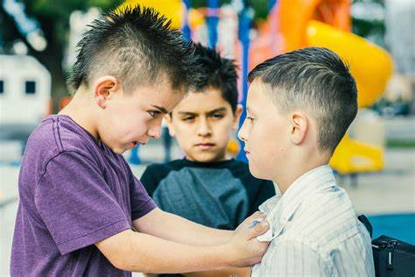

Slide 44

HOMEWORK
Learn new words by heart.
Prepare for the next lesson.

