Slide 1
WELCOME TO MY LESSON
CLASS: 11A2

Slide 2

WARM-UP
GAME:Jumble words
- Each word will be shown in a non-alphabetical order.
- Each team has 10 seconds to guess the word.
- If a team cannot answer within 10 seconds, the other team has the right to answer by raising their hand
- Each correct answer earns one point.
- The team with the most points is the winner.

Slide 3

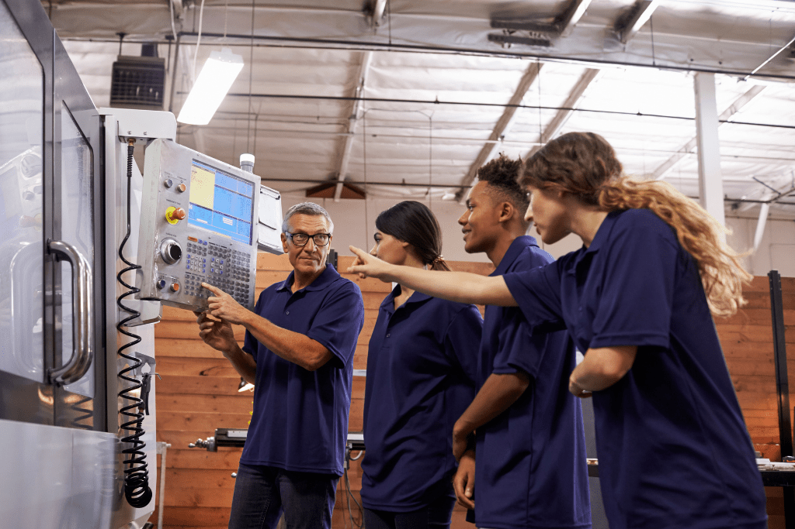

_ _ _ _ _ _ _ _ _ _ _ _ _
P R E I T C E S H I P A P
APPRENTICESHIP

Slide 4

T O R A C T O D E
_ _ _ _ _ _ _ _ _ _
DOCTORATE

Slide 5
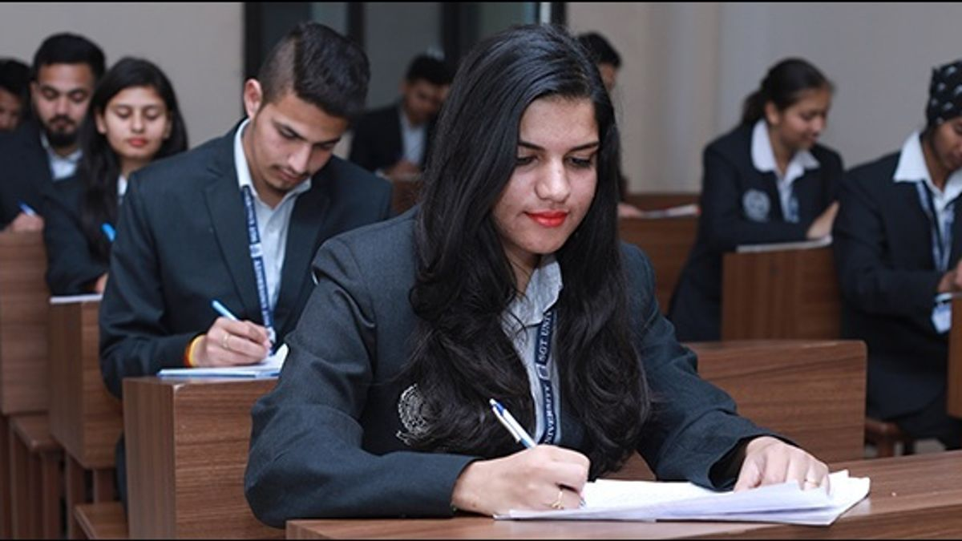
M A L F O R
_ _ _ _ _ _
FORMAL

Slide 6

D U A T I O N G R A
_ _ _ _ _ _ _ _ _ _ _
GRADUATION

Slide 7
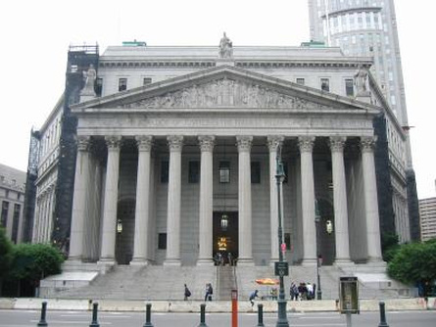
_ _ _ _ _ _ _ _ _ _
S T I T U N I O N I
INSTITUTION

Slide 8

V O C A S C H O O L T I O N A L
_ _ _ _ _ _ _ _ _ _ _ _ _ _ _ _ _
VOCATIONAL SCHOOL

Slide 9

B R O C H U E R
_ _ _ _ _ _ _ _ _
BROCHURE

Slide 10
Unit 7: Education options for school-leavers
Lesson 8: Looking Back & Project

Slide 11

Listen and mark the intonation in these questions, using (rising intonation) or (falling intonation).
LOOKING BACK
Pronunciation
1. Are you interested in studying at university?
2. How much is the fee for this cooking course?
3. Did you attend the education fair?
4. Who would like to train to become a tour guide?

Slide 12
Complete the text. Use the correct form of the words and phrase in the box.
LOOKING BACK
Vocabulary
school-leaver apprenticeship higher education graduation institution
Nowadays, there are educational opportunities available to all (1) ___________. If they want to earn an academic degree, they can continue their studies at (2) __________________ institutions. But if they want to gain practical and job-specific skills then vocational education is the perfect choice for them. At vocational schools, they can also do (3) _________________ and learn from skilled people on the job. Having qualifications from good educational (4) _____________helps young people find jobs immediately after (5) _______________.

Slide 13
Complete the text. Use the correct form of the words and phrase in the box.
LOOKING BACK
Vocabulary
apprenticeship higher education graduation institution
Nowadays, there are educational opportunities available to all (1) ___________. If they want to earn an academic degree, they can continue their studies at (2) __________________ institutions. But if they want to gain practical and job-specific skills then vocational education is the perfect choice for them. At vocational schools, they can also do (3) _________________ and learn from skilled people on the job. Having qualifications from good educational (4) _____________helps young people find jobs immediately after (5) _______________.
school-leaver

Slide 14
Complete the text. Use the correct form of the words and phrase in the box.
LOOKING BACK
Vocabulary
apprenticeship graduation institution
Nowadays, there are educational opportunities available to all (1) ___________. If they want to earn an academic degree, they can continue their studies at (2) __________________ institutions. But if they want to gain practical and job-specific skills then vocational education is the perfect choice for them. At vocational schools, they can also do (3) _________________ and learn from skilled people on the job. Having qualifications from good educational (4) _____________helps young people find jobs immediately after (5) _______________.
school-leaver
higher education

Slide 15
Complete the text. Use the correct form of the words and phrase in the box.
LOOKING BACK
Vocabulary
graduation institution
Nowadays, there are educational opportunities available to all (1) ___________. If they want to earn an academic degree, they can continue their studies at (2) __________________ institutions. But if they want to gain practical and job-specific skills then vocational education is the perfect choice for them. At vocational schools, they can also do (3) _________________ and learn from skilled people on the job. Having qualifications from good educational (4) _____________helps young people find jobs immediately after (5) _______________.
school-leaver
higher education
apprenticeship

Slide 16
Complete the text. Use the correct form of the words and phrase in the box.
LOOKING BACK
Vocabulary
graduation
Nowadays, there are educational opportunities available to all (1) ___________. If they want to earn an academic degree, they can continue their studies at (2) __________________ institutions. But if they want to gain practical and job-specific skills then vocational education is the perfect choice for them. At vocational schools, they can also do (3) _________________ and learn from skilled people on the job. Having qualifications from good educational (4) _____________helps young people find jobs immediately after (5) _______________.
school-leaver
higher education
apprenticeship
institution

Slide 17
Complete the text. Use the correct form of the words and phrase in the box.
LOOKING BACK
Vocabulary
Nowadays, there are educational opportunities available to all (1) ___________. If they want to earn an academic degree, they can continue their studies at (2) __________________ institutions. But if they want to gain practical and job-specific skills then vocational education is the perfect choice for them. At vocational schools, they can also do (3) _________________ and learn from skilled people on the job. Having qualifications from good educational (4) _____________helps young people find jobs immediately after (5) _______________.
school-leaver
higher education
apprenticeship
institution
graduation

Slide 18
LOOKING BACK
Grammar
Rewrite these sentences using perfect participle clauses or perfect gerunds.
1. After he finished school, my brother took a year off and travelled around the world.
-> _________________________________took a year off and travelled around the world.
2. He did not remember that he had discussed his study options with his parents.
-> _________________________________ his study options with his parents.
3. My cousin didn't ask anyone for advice, so she made the wrong decision about her education.
-> _________________________________ made the wrong decision about her education.
4. Lan won the first prize in the competition. This is something she's very proud of.
-> _______________________________________is something Lan is very proud of.
Having finished school, my brother
He did not remember having discussed
Not having asked anyone for advice,
Having won the first prize in the competition

Slide 19
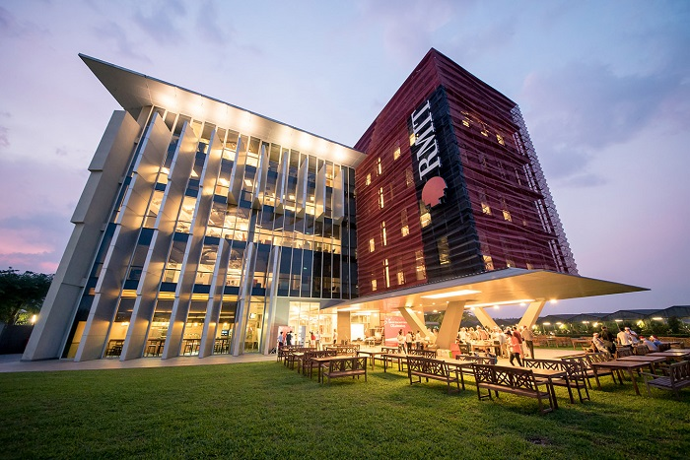

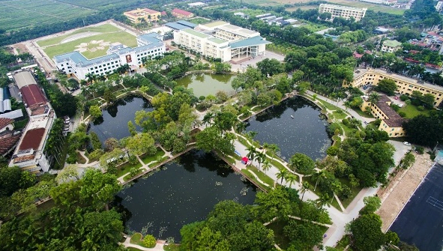

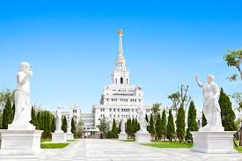
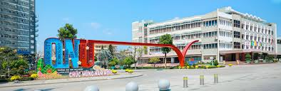
PROJECT
CHOOSING THE PERFECT EDUCATIONAL INSTITUTION
RMIT UNIVERSITY
FPT UNIVERSITY IN HA NOI
VIETNAM NATIONAL UNIVERSITY OF AGRICULTURE
VIETNAM NATIONAL UNIVERSITY HCM CITY
VINUNIVERSITY
QUY NHƠN UNIVERSITY

Slide 20
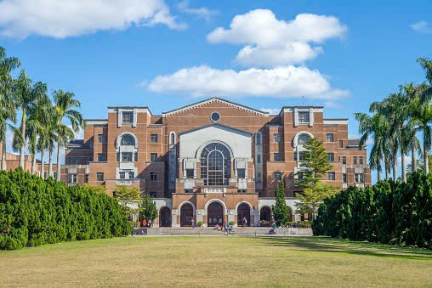
Work in groups. Do some research on educational institutions for school-leavers (e.g. colleges, universities, vocational schools) in Viet Nam. Choose one that you think has the best programme for a particular subject, trade, or job, and present your findings to the class,
PROJECT
CHOOSING THE PERFECT EDUCATIONAL INSTITUTION
• What type of educational institution is it? Where is it? How big is it?
• What programme or training for that particular subject, trade, or job does it offer? How much is the fee?
• What facilities does it have? Are there any student activities or clubs?
• What job opportunities are there for its students after graduation?
1. Type, Location, and Size of the Institution.
2. Programme, Subject, Trade or Job and Fee.
3. Facilities, Student activities, and Clubs.
4. Job opportunities after graduation.

Slide 21
Evaluation Criteria
Criteria | Excellent | Good | Average | Needs improvement
Content (clear, well-structured, enough content)
Organization (clear introduction, body, and conclusion.)
Pronunciation (natural intonation,…)
Interaction (eye contact,…)

Slide 22
Homework
- Do exercises in the workbook.
- Prepare for Unit 8: Becoming independent - Getting started.

