Slide 2
WARM-UP
CATCH THE FISH!

Slide 3
WARM-UP
Students work in 2 groups.
There are several pictures and you need to choose the correct fish that the picture represents.
Go to the board and write down the correct answer in order.

Slide 4
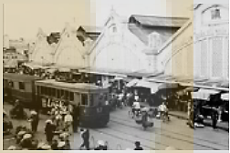
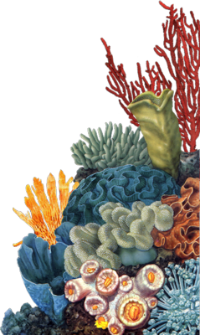
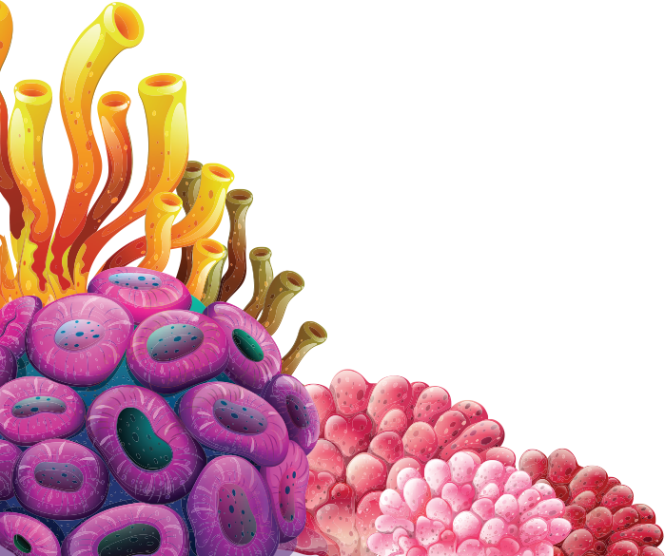
WARM-UP
low-rise building
low-rise building
high-rise building
unemployment
rush hour

Slide 5
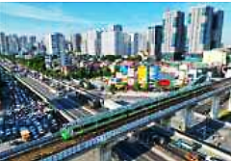
WARM-UP
high-rise building
rush hour
unemployment
high-rise building
low-rise building

Slide 6
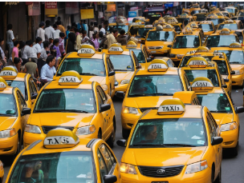
WARM-UP
rush hour
rush hour
unemployment
high-rise building
low-rise building

Slide 7
WARM-UP
unemployment
low-rise building
rush hour
high-rise building
unemployment

Slide 8
Unit 4
urbaniSation
What is the song about?

Slide 9
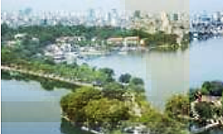
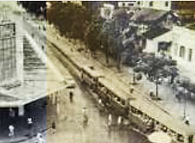
PRE- READING: Work in groups. Look at the pictures and discuss the following question.
What do the pictures tell you about Ha Noi and people’s life in the city ?

Slide 10
VOCABULARY

Slide 11
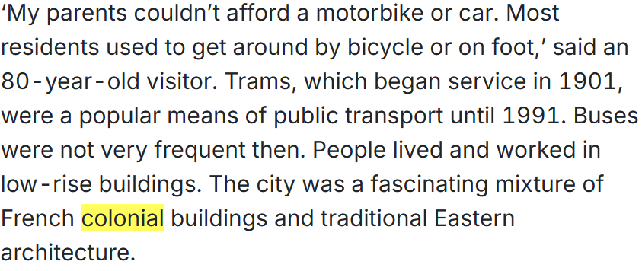
VOCABULARY

Slide 12
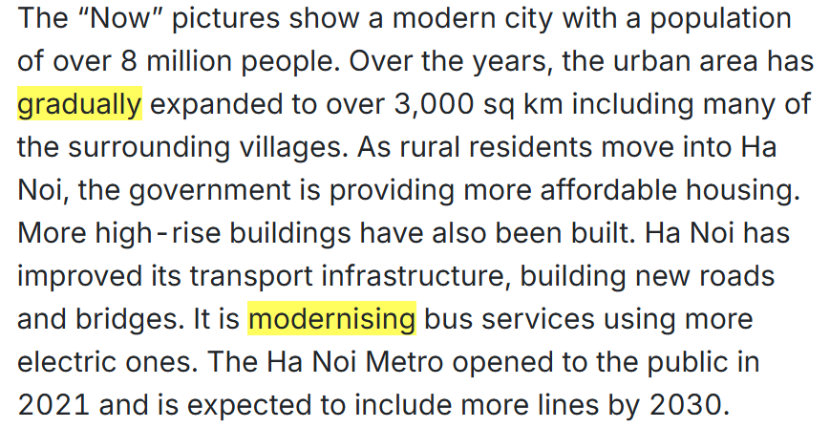
VOCABULARY

Slide 13
VOCABULARY

Slide 14
Choose the correct meanings of the following words
1. residents
A. people who live in a particular place
B. buildings in a particular place

Slide 15
Choose the correct meanings of the following words
2. colonial
A. connected with the native country
B. connected with a country that controls another country

Slide 16
Choose the correct meanings of the following words
3. gradually
A. slowly, over a period of time
B. quickly, over a short time

Slide 17
PRACTICE
2
Choose the correct meanings of the highlighted words
4. modernising
A. making something attractive
B. making use of the latest technology, design, etc.

Slide 18
PRACTICE
2
Choose the correct meanings of the highlighted words
5. concern
A. a feeling of satisfaction
B. a feeling of worry about something important

Slide 19
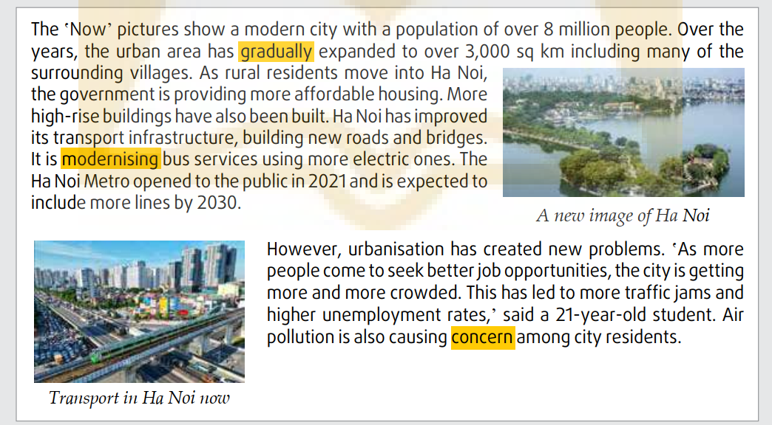
PRACTICE
1
Read the article . Put the main ideas in the order they appear in the article.
3____
1____
4____
2____

Slide 20
PRACTICE
1
Read the article . Put the main ideas in the order they appear in the article.
C

Slide 21
PRACTICE
1
Read the article . Put the main ideas in the order they appear in the article.
D

Slide 22
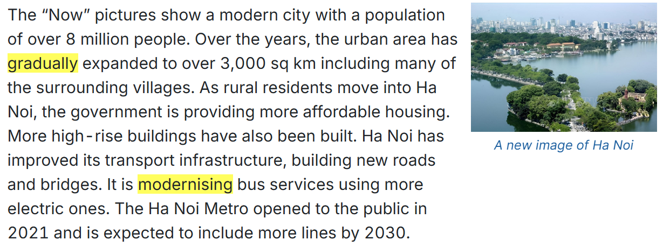
PRACTICE
1
Read the article . Put the main ideas in the order they appear in the article.
A

Slide 23
PRACTICE
1
Read the article . Put the main ideas in the order they appear in the article.
B

Slide 24
PRACTICE
2
Read the article again and complete the table using no more than THREE words and/or a number for each gap.
152
8 million
trams
metro/
trains
low-rise buildings

Slide 25
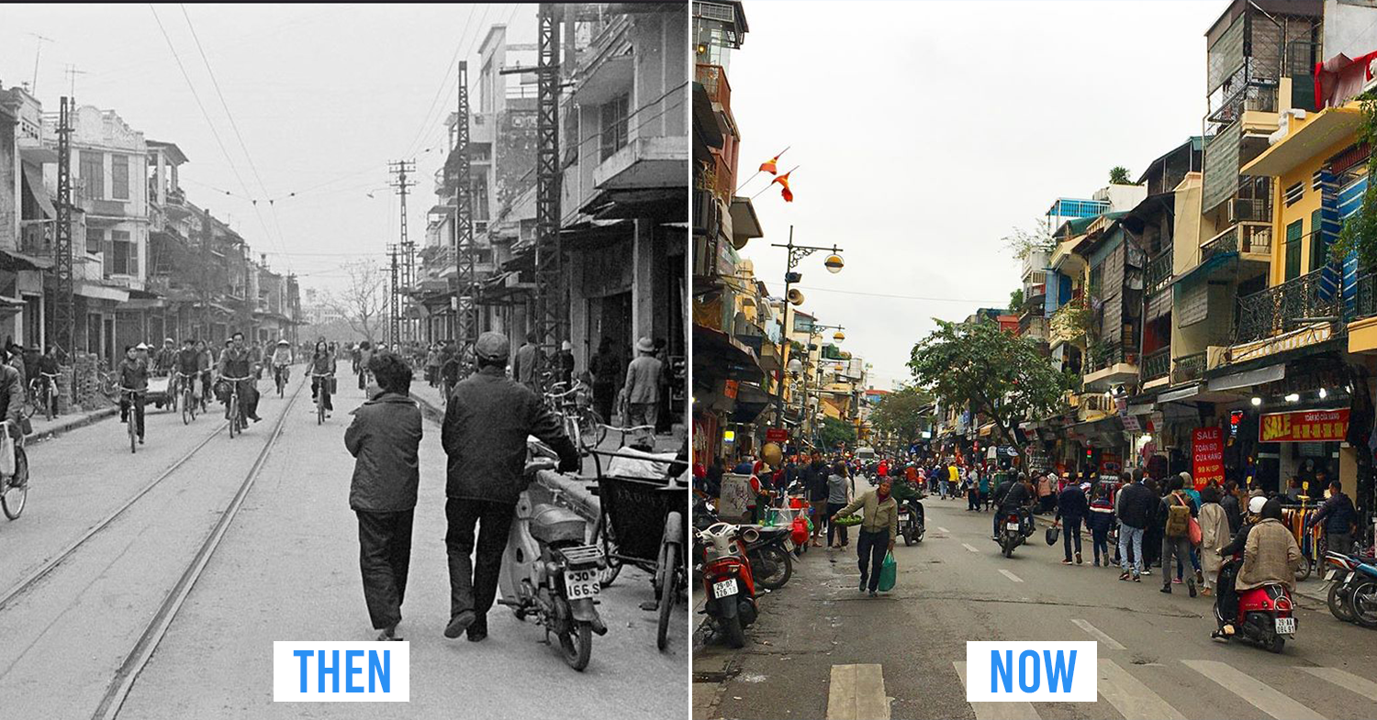
PRODUCTION
3
Work in pairs. discuss the following questions.

Slide 26
PRODUCTION
I prefer to live in Ha Noi at present because …………………………………………………………………
I prefer to live in Ha Noi in the past because………………………………………………………

Slide 27
CONSOLIDATION
1
Wrap-up
What have you learnt today?
Read for main ideas and specific information in news items about the Urbanisation of Ha Noi
New vocabulary words

Slide 28
CONSOLIDATION
2
Homework
Do exercises in the workbook.
Prepare for Lesson 4 - Unit 4.

Slide 29
Website: hoclieu.vn
Fanpage: facebook.com/www.tienganhglobalsuccess.vn

