Slide 1
WELCOME TO OUR CLASS
10a8

Slide 2
Online learning

Slide 3
UNIT 8: NEW WAYS TO LEARN LESSON IV: SPEAKING
ONLINE LEARNING

Slide 11
Online learning

Slide 12
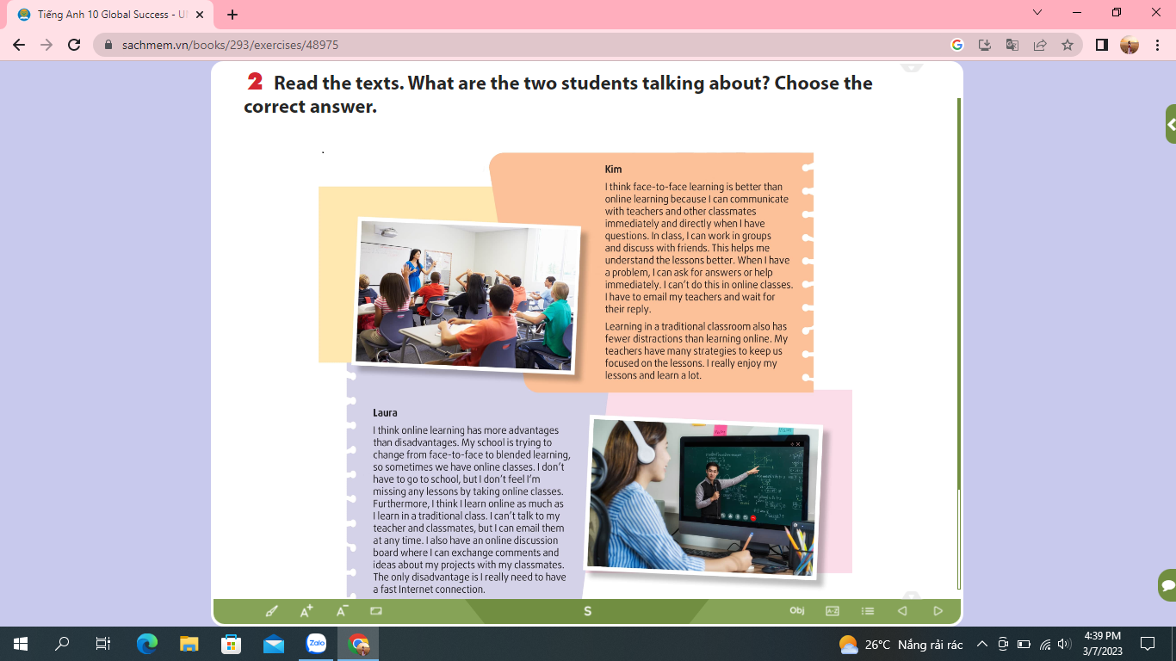

Slide 13
Advantages of online learning
1. Cost-saving
2. Easy logistics (save the time from traffic jams, commuting,…)
3. Easy progress tracking
4. Comfortable learning from your home
5. Flexible ways to assess children
6. Promote life-long learning
7. Teach you to be self-disciplined

Slide 14
Disadvantages of online learning
Create a sense of isolation
Require you to be an active learner
Require good time management skills
Unable to focus on screens for a long time
Lack quality assurance

Slide 15
Work in groups
Two groups will be For and two groups will be Against
Discuss and provide explanations to support your side.

Slide 16
Useful expressions
A: I think online learning has more advantages than disadvantages. First,………………………………………
B: I don’t agree with you. Online learning has more disadvantages than advantages. …………………….

Slide 17
- Write a paragraph about the advantages and disadvantages of online learning and provide solutions to overcome disadvantages.
- Prepare for the next lesson: Listening

Slide 18
Thank you!

