Slide 2
UNIT 1: LIFE STORIES
LESSON 1: GETTING STARTED

Slide 3
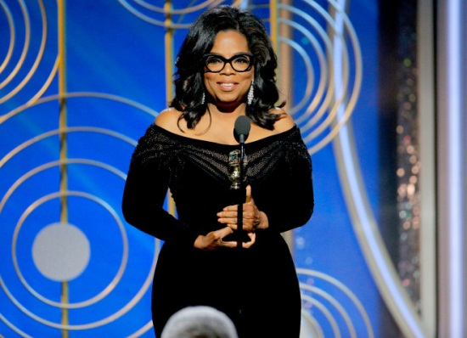
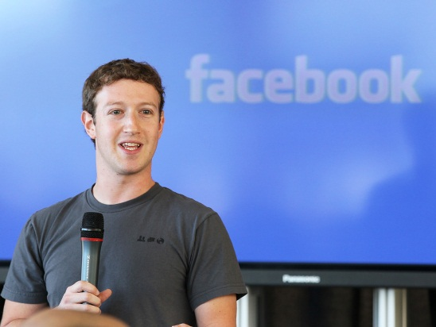
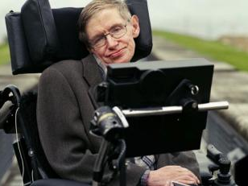
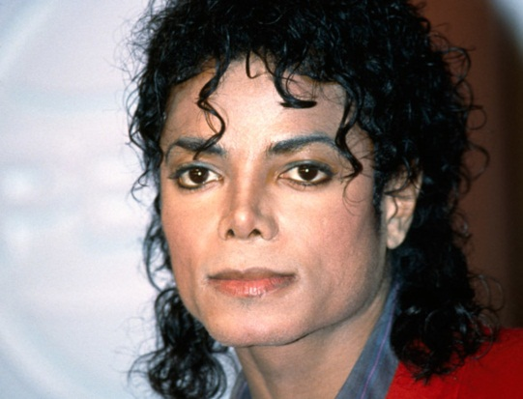
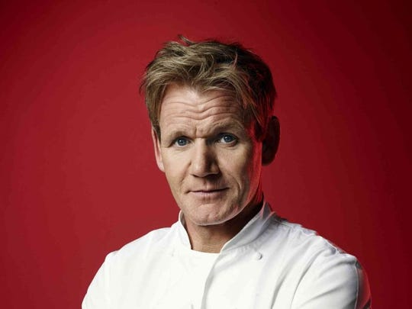
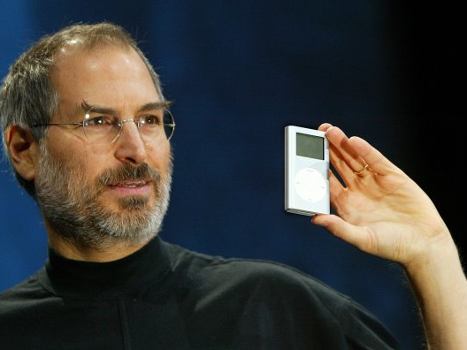
Guess the famous people

Slide 4
Oprah Winfrey
Oprah Gail Winfrey (born Orpah Gail Winfrey; January 29, 1954) is an American talk show host, television producer, actress, author, and philanthropist.

Slide 5
Mark Elliot Zuckerberg is an American media magnate, internet entrepreneur, and philanthropist. He is known for co-founding Facebook, Inc.
Mark Zuckerberg

Slide 6
Michael Joseph Jackson (August 29, 1958 – June 25, 2009) was an American singer, songwriter, and dancer. Dubbed the "King of Pop
Michael Jackson

Slide 7
Gordon James Ramsay OBE is a British chef, restaurateur, television personality and writer. He was born in Johnstone, Scotland
Gordon Ramsay

Slide 8
He was the chairman, chief executive officer (CEO), and co-founder of Apple Inc.; the chairman and majority shareholder of Pixar; a member of The Walt Disney
Steve Jobs

Slide 9
Stephen William Hawking (8 January 1942 – 14 March 2018) was an English theoretical physicist, cosmologist, ..
Stephen Hawking

Slide 10
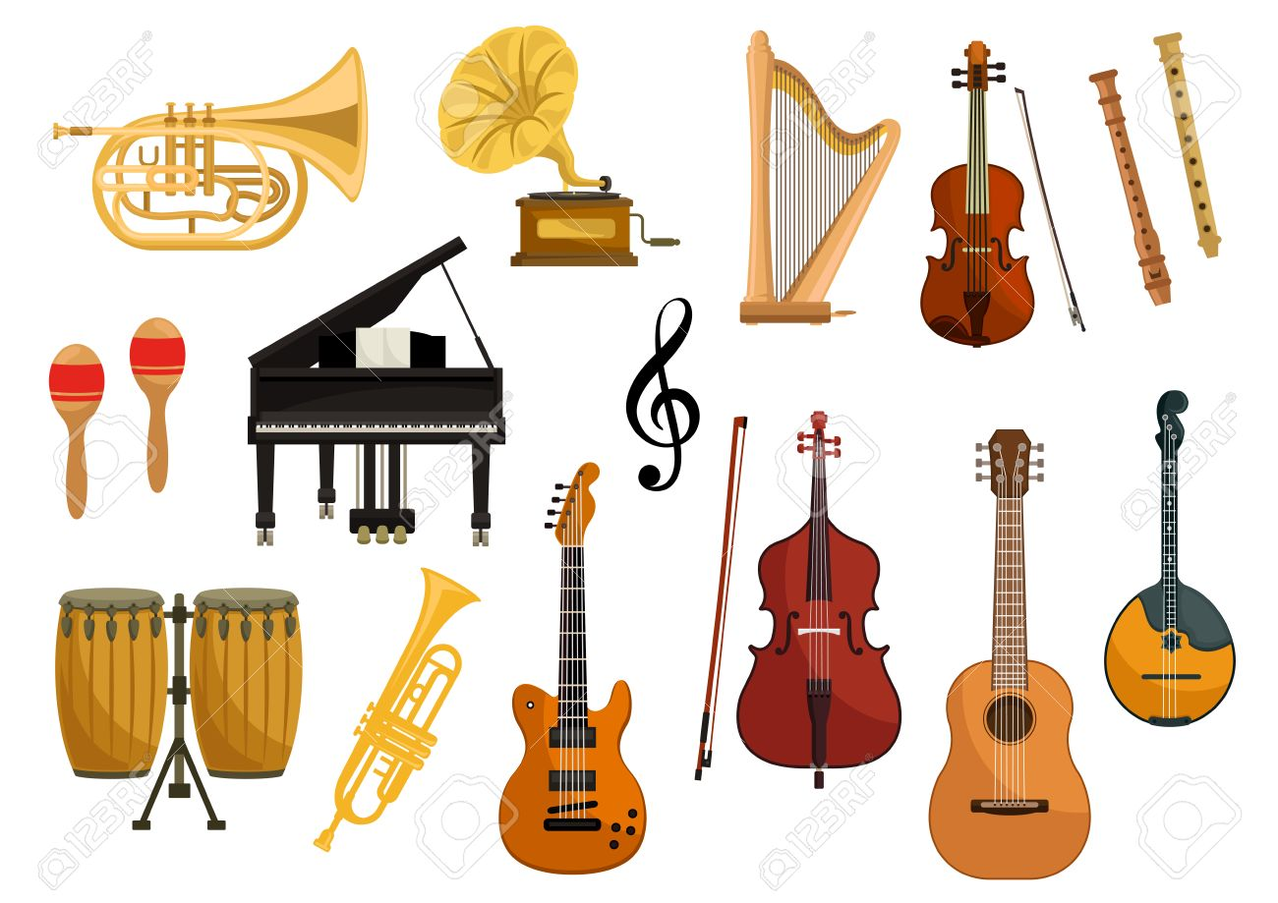
 musical instrument

Slide 11
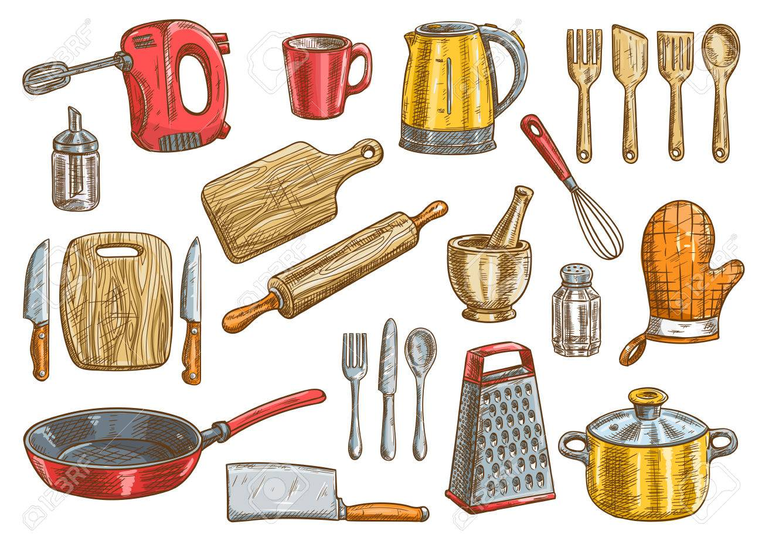
kitchen tools

Slide 12
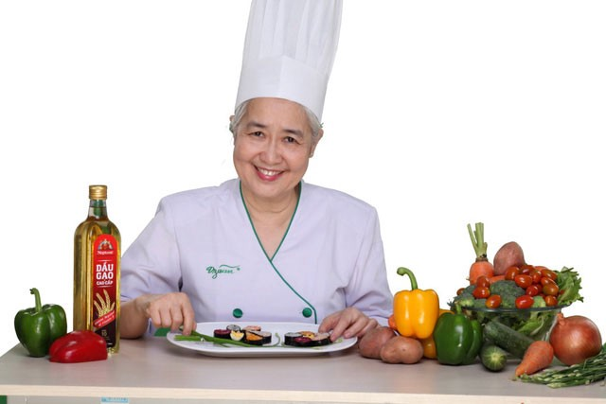
Famous chef

Slide 13
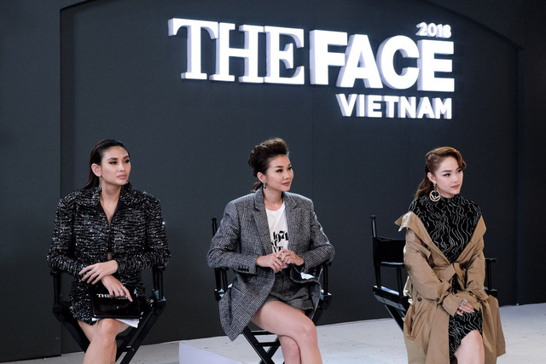
Judge

Slide 14
Vocabulary
1. inspire (v) /ɪnˈspaɪə/
truyền cảm hứng
2. waver (v) /ˈweɪ.və(r)/
phân vân
3. stimulate (v) /ˈstɪm.jə.leɪt/
khuyến khích, kích thích
4. creativity (n) /kriː.eɪˈtɪv.ə.ti/
sự sáng tạo
5. innovation (n) /ˌɪn.əˈveɪ.ʃ^{ə}n/
sự đổi mới, sự cách tân
6. talented (adj) /ˈtæl.^{ə}n.t̬ɪd/
có tài năng, có năng khiếu
7. influential (adj) /ˌɪn.fluˈen.ʃ^{ə}l/
có sức ảnh hưởng
8. Good luck with your ........
chúc may mắn với…..

Slide 15
Activity 1. Hung and Quang are talking about famous people. Listen and read.
The person I admire
Hung: The topic for tomorrow’s presentation is really interesting. Have you decided who to talk about, Quang?
Quang: Not yet. I’m still wavering between two famous people, Steve Jobs and Michael Jackson. I admire them both.
Hung: But who’s had a greater impact on you?
Quang: I’m not sure … Steve Jobs’s work stimulates my creativity and innovation, while Michael Jackson’s music inspired me to learn to play a musical instrument. What do you think?

Slide 16
Hung: Well, both of them were very talented and inﬂuential, but I prefer Steve Jobs. I think Michael Jackson was a great dancer, but not an excellent singer. In his later years, his singing voice became weak and thin and wasn’t as good as before. Quang: I see. What about you? Who are you going to talk about?
Hung: Christine Ha.
Quang: You mean … the lady who won the US MasterChef trophy in 2012?
Hung: That’s right.
Quang: I know your dream is to become a famous chef. Is that why you want to talk about her?

Slide 17
Hung: Yes. What’s more, Christine is a blind chef and a gifted writer. She’s very talented and determined. It was absolutely amazing to watch her use all the kitchen tools and prepare the dishes.
Quang: I agree. I remember how excited I felt when Christine was creating those great-looking dishes … and even anxious when the judges were tasting them. By the way, do you know where she was born? In Viet Nam or the US? Hung: In California, but she was inspired by memories of her mum’s cooking.
Quang: It seems you know quite a lot about her. Good luck with your presentation tomorrow!
Hung: The same to you!

Slide 18
Activity 2. Decide whether the following statements aretrue (T), false (F), or not given (NG). Tick the correct box.
 |  | T | F | NG
1 | Quang can’t decide who he is going to talk about tomorrow.
2 | Quang wants to become as famous as Steve Jobs and Michael Jackson.
3 | Hung likes Michael Jackson’s singing.
4 | Hung learnt to play a musical instrument because he was inspired by Michael Jackson’s songs.
5 | Both Quang and Hung admire Christine Ha.






Slide 19
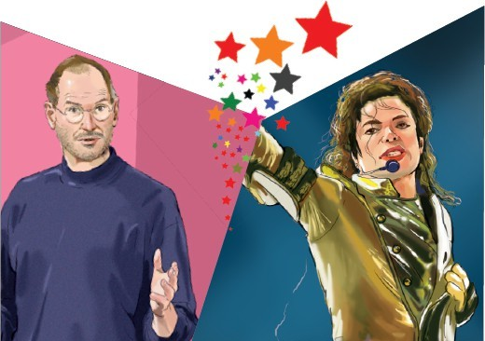
Activity 3. Discuss with a partner.
If you were Quang, who would you choose to talk about, Steve Jobs or Michael Jackson? Why?
Steve Jobs: a pioneer of the microcomputer revolution, a creative entrepreneur;
Michael Jackson: a good dancer with complex dance techniques, an inﬂuential singer and songwriter

Slide 20
Activity 4. Find the words in the conversation that have the same sounds as the following.
1. too _______________
2. eye _______________
3. sea _______________
4. one _______________
5. no ________________
/tuː/
two
I
/aɪ/
/siː/
see
=>Homophones
/wʌn/
won
A homophone is a word that is pronounced the same as another word but differs in meaning
/nəʊ/
know

Slide 21
Activity 5. Read the conversation again and write the correct tenses of the verbs in brackets.
I remember how excited I (feel) ________________ when Christine (create) ________________ those great-looking dishes.
felt
was creating

Slide 22
Pls watch the short clip !
What can you learn from this ?

Slide 23
Homework
Learn vocabulary by heart.
Do the exercises ( part 5 )
Prepare the next lesson: Language

