Slide 1


Slide 2

Unit
3
1
Unit
FAMILY LIFE
MUSIC
LESSON 4
SPEAKING
Talking about a TV music show

Slide 3
LESSON 4
SPEAKING
Unit
GETTING STARTED
WARM-UP
Video watching

Slide 4
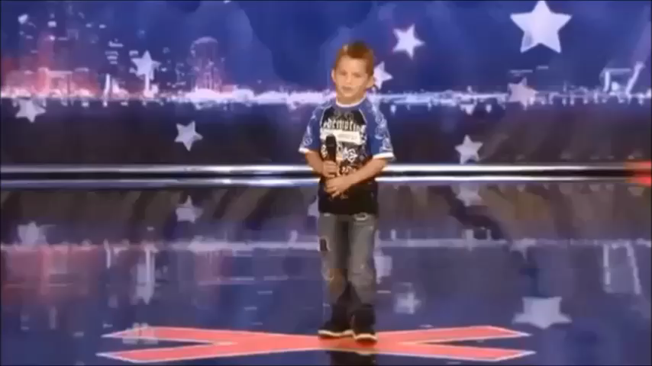
WARM-UP
Video watching
Watch the video and write down the names of the music shows.

Slide 5
WARM-UP
Video watching
America’s Got Talent
Pop Idol
Vietnam’s Got Talent
Perfect Edition (Cover Star)
X Factor

Slide 6
* Vocabulary:
1. dress up /drɛs ʌp/ (phr.v): hóa trang
2. remain /rɪˈmeɪn/ (v): giữ lại
3. runners-up /ˈrʌnəz-ʌp/ (n): á quân
4. cash prize /kæʃ praɪz/ (n.phr): giải thưởng tiền mặt
5. participant /pɑːˈtɪs.ɪ.pənt/(n): người tham gia; participate (v)
6. guest /ɡest/ (n): khách mời
7. score /skɔːr/ (n): điểm số
8. Come up with (v) nghĩ ra
9. Winner /ˈwɪn.ər/ (n) người chiến thắng
10. Performance /pəˈfɔː.məns/ (n) màn biểu diễn

Slide 7
PRESENTATION
1
Read about a TV music show and complete the notes below.
Name: I know your face
People who give their scores: _________________________
Number of participants: ________
What participants have to do: ________________________________
How participants win the show: _____________________
6. Prize(s): ________
two main judges and a guest artist
six
dress up and perform as famous international
or local artists in a live show every week
- 3 participants with the highest scores after
5 weeks go to the final night.
- TV audiences vote and decide on the winner and two runners-up.
cash

Slide 8
PRESENTATION
Extension: Brainstorm some popular TV shows or competitions.
TV shows or competitions
The Voice Kids

Slide 9

PRESENTATION
1
Extension: Ask your friends Yes/No questions to guess the TV show or competition they have chosen.

Slide 10


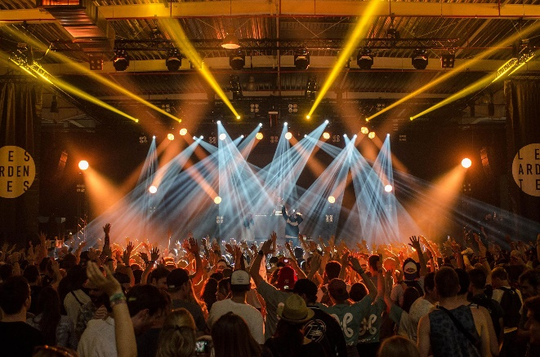
CONTROLLED PRACTICE
2
Work in groups. Make up a new music show. Use the points in 1 to organise your ideas
Name: ________
People who give their scores: ________
Number of participants: ________
What participants have to do: ________
How participants win the show: ________
6. Prize(s): ________

Slide 11
LESSON 1
GETTING STARTED
Unit
GETTING STARTED
WARM-UP
Video watching
PRESENTATION
Vocabulary
Task 1: Read about a TV music show and complete the notes below.
Task 2: Work in groups. Make up a new music show. Use the points in 1 to organise your ideas.
CONTROLLED PRACTICE
Task 3: Present your show to the whole class. Use your ideas in 2 and the expressions below. Vote for the best show.
FREE PRACTICE

Slide 12
FREE PRACTICE
PRACTICE
3
Present your show to the whole class. Use your ideas in 2 and the expressions below. Vote for the best show.
Useful expressions:
We came up with an idea about a TV music show which is …
Let us give you an example …
In our show, there will be …
The participants have to …
The winner will receive …

Slide 13
LESSON 1
GETTING STARTED
Unit
GETTING STARTED
WARM-UP
Video watching
PRESENTATION
Vocabulary
Task 1: Read about a TV music show and complete the notes below.
Task 2: Work in groups. Make up a new music show. Use the points in 1 to organise your ideas.
CONTROLLED PRACTICE
Task 3: Present your show to the whole class. Use your ideas in 2 and the expressions below. Vote for the best show.
FREE PRACTICE
Wrap-up
Home work
CONSOLIDATION

Slide 14
CONSOLIDATION
1
Wrap-up
Talk about music shows

Slide 15
CONSOLIDATION
2
Homework
Do exercises in the workbook
Search the Internet for some information about music festivals

Slide 16

Website: sachmem.vn
Fanpage: facebook.com/sachmem.vn/

