Slide 2
Unit
3
1
Unit
FAMILY LIFE
MUSIC
LESSON 1
GETTING STARTED
A talented artist

Slide 3
LESSON 1
GETTING STARTED
Unit
GETTING STARTED
Guess the name of the songs
WARM-UP

Slide 4
WARM-UP
Guess the name of the songs
SONG 1
Ước gì
SONG 2
Tóc nâu môi trầm
SONG 3
Tình lỡ cách xa
SONG 4
Mong manh tình về

Slide 5
WARM-UP
Guess the name of the songs
Who sings these songs?
My Tam.
Is she a talented singer?
Yes, she is considered the Queen of V- Pop.
Ước gì
Tóc nâu môi trầm
Tình lỡ cách xa
Mong manh tình về

Slide 6
* Vocabulary:
1. famous /ˈfeɪməs/ (adj): nổi tiếng
2. traditional music /trəˈdɪʃənl ˈmjuːzɪk/ (n.phr): âm nhạc truyền thống
3. talented /ˈtæləntɪd/ (adj): tài năng
4. pop singer /pɒp ˈsɪŋə/ (n.phr): ca sĩ nhạc pop
5. fan /fæn/ (n): fan hâm mộ
6. award /əˈwɔːrd/ (n): giải thưởng
7. trumpet /ˈtrʌmpɪt/ (n): kèn
8. musical instrument / ˈmjuː.zɪ.kəl ˈɪn.strə.mənt/ (n.phr): nhạc cụ
9. perform /pəˈfɔːm/ (v): biểu diễn
10. reach /riːtʃ/ (v): đạt mốc

Slide 7
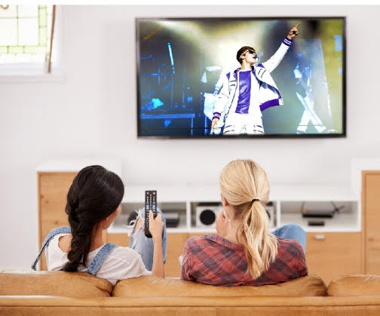
PRACTICE
1
Listen and read.
A talented artist

Slide 8
1. Listen and read
A talented artist
Mai: That pop singer looks great, Ann!
Ann: Yeah. He’s a popular teen idol around the world now.
Mai: Really? You must be a fan of his!
Ann: Yep, I really love his music. He’s a talented artist who can write music and play many musical instruments. He has received several awards such as the Grammy, Billboard Music and Teen Choice Awards.
Mai: Wow! Did he go to a music school?
Ann: No, he didn’t, but he learnt to play the piano, drums, guitar, and trumpet by himself. When he was a teenager, he performed at the local theatre in his home town during the tourist season.
Mai: How did he become famous?
Ann: Well, when he was 12, his mother started to upload his cover song videos on social media, and the videos made him an online star within a couple of months.
Mai: Sounds amazing!
Ann: And his videos have reached more than two billion total views. Many fans say that his beautiful songs have helped bring more love into their lives.

Slide 9
PRACTICE
PRACTICE
2
Read the conversation again and answer the following questions.
1. Who are Ann and Mai talking about?
2. What is he good at?
3. What made him popular?
They are talking about a young pop singer.
(Mai 1: That pop singer looks great.)
He is good at writing music and playing many
musical instruments.
(Ann 2: He’s a talented artist who can write music and play many musical instruments.
His cover song videos made him popular.
(Ann 4: Well, when he was 12, his mother started to upload his cover song videos on social
media, and the videos made him an online star within a couple of months.)

Slide 10
PRACTICE
3
Find words or phrases in the conversation which refer to:
a type of music
music awards
musical instruments
ways of sharing information and videos
pop
Grammy, Billboard Music and Teen Choice Awards
piano, drums, guitar, and trumpet
social media

Slide 11
PRACTICE
4
Match the two parts to make complete sentences.
1. This artist didn’t go to a music school,
a. and he has received several awards.
2. His beautiful songs have helped
b. to upload his cover song videos on social media.
3. His mother started
c. bring more love to people’s lives.
4. He is a talented artist,
d. but he learnt to play musical instruments by himself.

Slide 12
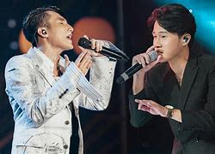
PRODUCTION
5
Talk about your favourite singer or musical band. You should mention who she/he is, what she/he is good at, what makes her/ him famous.

Slide 13
CONSOLIDATION
1
Wrap-up
Gain an overview about the topic Music
Memorise vocabulary to talk about music idols

Slide 14
CONSOLIDATION
2
Homework
Do exercises in the workbook
Project preparation

Slide 15
CONSOLIDATION
2
Homework
Project preparation
+ do research on a form of traditional music in Viet Nam or another country
+ include information related to the points stated on the Project page or prepare a poster (drawing, pictures) presenting the research results.
+ give an oral presentation of the research results in the last lesson of the unit.
(You can search for ideas on the Internet, in the newspaper, etc. or talk to experts for reference and you should use photos/pictures to illustrate your ideas.)

Slide 16
Website: sachmem.vn
Fanpage: facebook.com/sachmem.vn/

